Slide 1
Mathematical Statistics
Lecture 06
Prof. Dr. M. Junaid Mughal

Slide 2
Last Class
Events
Operation with events
  Intersection of events
  Union of events
Venn Diagram
Problems

Slide 3
Today’s Agenda
Introduction to Probability (continued)
Counting Problems
Multiplication Theorem

Slide 4
Probability
If there are n equally likely possibilities of which one must occur and s are regarded as favorable or success, then the probability of success is given by s/n; Classical approach
If n repetitions of an experiment (n very large), an event is observed to occur in h of these, then probability of the event is then h/n. This also called Empirical Probability; Frequency Approach.

Slide 5
Counting Problems
In order to evaluate probability, we must know how many elements are there in sample space.
  Finite and Infinite Sample Space
  Continuous and Discrete Sample Space

Slide 6
Example
An experiment consists of flipping a coin and then flipping it a second time if a head occurs. If a tail occurs on the first, flip, then a die is tossed once. T D

Slide 7
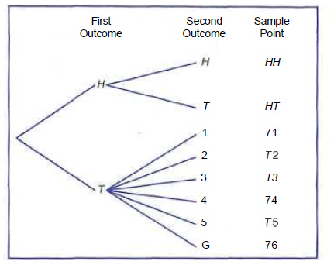
Example
An experiment consists of flipping a coin and then flipping it a second time if a head occurs. If a tail occurs on the first, flip, then a die is tossed once.

Slide 8
Example
An experiment consists of flipping a coin and then flipping it a second time if a head occurs. If a tail occurs on the first, flip, then a die is tossed once
The sample space can be written from the tree diagram as
S= {HH, HT, T1, T2, T3, T4, T5, T6}.

Slide 9
Example 2
Suppose that three items are selected at random from a manufacturing process. Each item is inspected and classified defective, D, or non-defective, N. To list the elements of the sample space providing the most information, we construct the tree diagram. TD

Slide 10
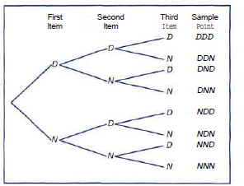
Example 2
Suppose that three items are selected at random from a manufacturing process. Each item is inspected and classified defective, D, or non-defective, N. To list the elements of the sample space providing the most information, we construct the tree diagram

Slide 11
Sample Space- Tree Diagram
Suppose that three items are selected at random from a manufacturing process. Each item is inspected and classified defective, D, or non-defective, N. To list the elements of the sample space providing the most information, we construct the tree diagram
The sample space can be written from the tree diagram as
S = {DDD, DDN, DND, DNN, NDD, NDN, NND, NNN}.

Slide 12
Counting Sample Points
In the experiment when two dies are rolled and we are only interested in the sum of the dies which is equal to 7. Writing down all the elements in the sample space will be cumbersome in such an experiment. However if we only know how many all possible elements are in the sample space, that may be enough to solve the problem

Slide 13
Counting Sample Points
In many cases we shall be able to solve a probability problem by counting the number of points in the sample space without actually listing each element. The fundamental principle of counting, is often referred to as the multiplication rule

Slide 14
Counting Problem (Multiplication Theorem)
Theorem:
If an operation can be performed in n₁ ways, and if for each of these ways a second operation can be performed in n₂ way, then the two operations can be performed together in n₁n₂ ways

Slide 15
Counting Problem (Multiplication Theorem)
Theorem:
If sets A and B contain respectively m and n elements, there are m*n ways of choosing an element from A then an element from B.

Slide 16
Example
How many sample points are: there: in the sample: space when a pair of dice is thrown once? TD

Slide 17
Example
How many sample points are: there: in the sample: space when a pair of dice is thrown once?

Slide 18
Example
A developer of a new subdivision offers prospective home buyers a choice of Tudor, rustic:, colonial, and traditional exterior styling in ranch, two-story, and split-level floor plans. In how many different ways can a buyer order one of these homes? TD

Slide 19
Example
A developer of a new subdivision offers prospective home buyers a choice of Tudor, rustic:, colonial, and traditional exterior styling in ranch, two-story, and split-level floor plans. In how many different ways can a buyer order one of these homes?

Slide 20
Counting Problem (Multiplication Theorem)
Theorem:
If an operation can be performed in n₁ ways, and if for each of these a second operation can be performed in n₂ ways, and for each of the first two a third operation can be performed in n_{k} ways, and so forth, then the sequence of k operations can be performed in n₁n₂n₃…n_{k} ways.

Slide 21
Example
Sam is going to assemble a computer by himself. He: has the choice of ordering chips from two brands, a hard drive from four, memory from three, and an accessory bundle from five local stores. How many different, ways can Sam order the parts? TD

Slide 22
Example
Sam is going to assemble a computer by himself. He: has the choice of ordering chips from two brands, a hard drive from four, memory from three, and an accessory bundle from five local stores. How many different, ways can Sam order the parts?

Slide 23
Exercise
2.21 Registrants at a large convention are offered 6
sightseeing tours on each of 3 days. In how many ways can a person arrange to go on a sight seeing tour planned by this convention? TREE DIAGRAM

Slide 24
Exercise
2.21 Registrants at a large convention are offered 6
sightseeing tours on each of 3 days. In how many ways can a person arrange to go on a sight seeing tour planned by this convention?

Slide 25
Exercise
2.22 In a medical study patients are classified in 8 ways according to whether they have blood type AB+, AB~, A+, A~, B+, B~, 0+, or 0~, and also according to whether their blood pressure is low, normal, or high. Find the number of ways in which a patient can be classified.

Slide 26
Exercise
2.23 If an experiment consists of throwing a die and then drawing a letter at random from the English alphabet, how many points are there in the sample space?

Slide 27
Exercise
2.24 Students at a private liberal arts college are classified as being freshmen, sophomores, juniors, or seniors, and also according to whether they are male or female. Find the total number of possible classifications for the students of that college.

Slide 28
Exercise
2.25 A certain shoe comes in 5 different styles with each style available in 4 distinct colors. If the store wishes to display pairs of these shoes showing all of its various styles and colors, how many different pairs would the store have on display?

Slide 29
Summary
Introduction to Probability
Counting Sample Points
Multiplication Theorem

Slide 30
References
Probability and Statistics for Engineers and Scientists by Walpole

