Slide 1
Mathematical Statistics
Lecture 04
Prof. Dr. M. Junaid Mughal

Slide 2
Last Class
Mean
Variance
Standard Deviation
Introduction to Probability

Slide 3
Mean, Average or Expected Value
Mean = (Σ X_{j})/n
example
89 84 87 81 89 86 91 90 78 89 87 99 83 89
Σ X_{j} = 1222
Mean = 1222/14 = 87.3

Slide 4
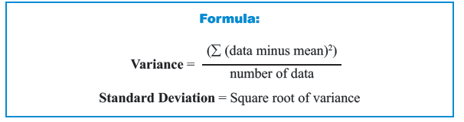
Variance and Standard Deviation
Variance is defined as mean of the squared deviations from the mean.
Standard Deviation measures variation of the scores about the mean. Mathematically, it is calculated by taking square root of the variance.

Slide 5
Variance
To calculate Variance, we need to
Step 1. Calculate the mean.
Step 2. From each data subtract the mean and then square.
Step 3. Add all these values.
Step 4. Divide this sum by number of data in the set.
Step 5. Standard deviation is obtained by taking the square root of the variance.

Slide 6
Examples
Calculate Variance and Standard Deviation of marks of students from Group A of a Primary School.

Slide 7
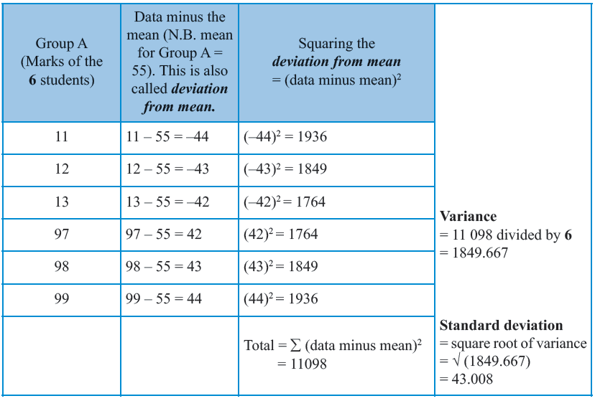

Slide 8


Slide 12
Sample Variance and Sample Standard Deviation
In the example we considered all the students from Group A.
That’s why in the formula used to calculate variance, we divided by the number of data.
Suppose that the students of Group A can be taken to be a sample that represents the entire population of students who would take the same examination.
How can we use the Variance of marks for Group A to estimate the Variance of marks for the entire population of students?

Slide 13
Sample Variance and Sample Standard Deviation
Remember that a population refers to every member of a group,
While a sample is a small subset of the population which is intended to produce a smaller group with the same (or similar) characteristics as the population.
Samples (because of the cost-effectiveness) can then be used to know more about the entire population.
Observing every single member of the population can be very costly and time consuming!

Slide 14
Sample Variance and Sample Standard Deviation
Therefore, calculating the exact value of population mean or variance is practically impossible when we have a large population.
That’s why we collect data from the sample and calculate the sample parameter (mean, mode, variance,.... are referred to as parameters).
Then we use the sample parameter to estimate the population parameter.
The estimated population variance also often referred to as sample variance is obtained by changing the denominator to number of data minus one.

Slide 15
Sample Variance and Sample Standard Deviation
Note
  when we calculated the variance of marks for Group A we referred to it as variance only
  but
  when we will use Group A to calculate an estimate for the population variance, the estimated variance will be referred to as the sample variance.

Slide 16
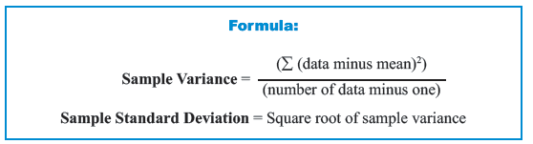
Sample Variance and Sample Standard Deviation
Dividing by n−1 satisfies this property of being “unbiased”, but dividing by n does not.

Slide 17
Example : Sample Variance and Sample Standard Deviation
Calculate Sample Variance and Sample Standard Deviation using marks of students from Group A of Primary School

Slide 18
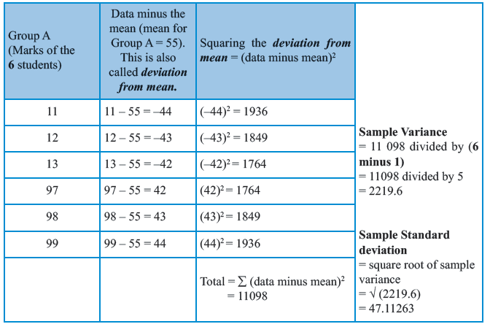
Example : Sample Variance and Sample Standard Deviation

Slide 19
Example : Sample Variance and Sample Standard Deviation

Slide 20
Example : Sample Variance and Sample Standard Deviation

Slide 21
Example : Sample Variance and Sample Standard Deviation

Slide 22
Sample Space
The set of all possible outcomes of a statistical experiment is called the sample space and is represented by the symbol S.

Slide 23
Sample Space
Each outcome in a sample space is called an element or a member of the sample space, or simply a sample point.
If the sample space has a finite number of elements, we may list the members separated by commas and enclosed in braces.
Thus the sample space S, of possible outcomes when a coin is tossed, may be written
  S={H,T),
  where H and T correspond to "heads" and "tails," respectively.

Slide 24
Sample Space
Consider the experiment of tossing a die. If we are interested in the number that shows on the top face, the sample space would be
S1 = {1,2,3,4,5,6}.
But
If we are interested only in whether the number is even or odd, the sample space is simply
S2 = {even, odd}.
Note: more than one sample space can be used to describe the outcomes of an experiment.

Slide 25
Sample Space
Consider the experiment of tossing a die. If we are interested in the number that shows on the top face, the sample space would be
S1 = {1,2,3,4,5,6}.
But
If we are interested only in whether the number is even or odd, the sample space is simply
S2 = {even, odd}.
Which representation is better ?

Slide 26
Sample Space
Which representation is better ?
In this case S₁ provides more information than S₂.
If we know which element in S₁ occurs, we can tell which outcome in S₂ occurs;
However, a knowledge of what happens in S₂ is of little help in determining which element in S₁ occurs.
In general, it is desirable to use a sample space that gives the most information concerning the outcomes of the experiment.

Slide 27
Sample Space- Tree Diagram
In some experiments it is helpful to list the elements of the sample space systematically by means of a tree diagram.
Example
An experiment consists of flipping a coin and then flipping it a second time if a head occurs. If a tail occurs on the first, flip, then a die is tossed once. To list the elements of the sample space providing the most information, we construct the tree diagram

Slide 28
Sample Space- Tree Diagram
To understand the problem we break it as
An experiment consists of flipping a coin
and then flipping it a second time if a head occurs.
If a tail occurs on the first, flip, then a die is tossed once.

Slide 29
Sample Space- Tree Diagram
An experiment consists of flipping a coin and then flipping it a second time if a head occurs. If a tail occurs on the first, flip, then a die is tossed once.

Slide 30
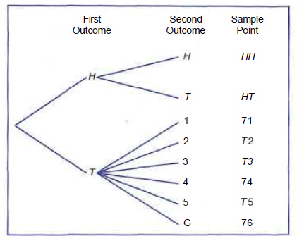
Sample Space- Tree Diagram

Slide 31
Sample Space- Tree Diagram
An experiment consists of flipping a coin and then flipping it a second time if a head occurs. If a tail occurs on the first, flip, then a die is tossed once
The sample space can be written from the tree diagram as
S= {HH, HT, T1, T2, T3, T4, T5, T6}.

Slide 32
Sample Space- Tree Diagram
Example 2
Suppose that three items are selected at random from a manufacturing process. Each item is inspected and classified defective, D, or non-defective, N. To list the elements of the sample space providing the most information, we construct the tree diagram

Slide 33
Sample Space- Tree Diagram
Suppose that three items are selected at random from a manufacturing process. Each item is inspected and classified defective, D, or non-defective, N. To list the elements of the sample space providing the most information, we construct the tree diagram

Slide 34
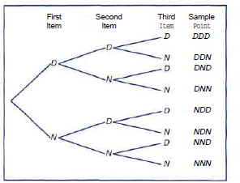
Sample Space- Tree Diagram

Slide 35
Sample Space- Tree Diagram
Suppose that three items are selected at random from a manufacturing process. Each item is inspected and classified defective, D, or non-defective, N. To list the elements of the sample space providing the most information, we construct the tree diagram
The sample space can be written from the tree diagram as
S = {DDD, DDN, DND, DNN, NDD, NDN, NND, NNN}.

Slide 36
Event
An event is a subset of a sample space.
For any given experiment we may be interested in the occurrence of certain events rather than in the outcome of a specific element in the sample space.
Example : For instance, we may be interested in the event A that the outcome when a die is tossed is divisible by 3.
The sample space for tossing a dice will have all possible outcome,
S₁ = {1,2,3,4,5,6}.
In this sample space we find those elements which are divisible by 3. which are,
A = {3,6}

Slide 37
Event
Example : we may be interested in the event B that the number of defective parts is greater than 1:
In example 2, The sample space was written from the tree diagram as
S = {DDD, DDN, DND, DNN, NDD, NDN, NND, NNN}.
We note down all the elements which have more than 1 defective parts, that is there are two or more D’s in the elements, we get
B = {DDN, DND,NDD,DDD}

Slide 38
Event
Example:
Given the sample space
  S = {t | t > 0},
  where t is the life in years of a certain electronic component, then the event A that the component fails before the end of the fifth year is the subset
  A = {t | 0 < t < 5}.

Slide 39
Event
It is conceivable that an event may be a subset that includes the entire sample space S,
or a subset of S called the null set and denoted by the symbol φ, Which contains no elements at all.

Slide 40
Complement of event
Definition : The complement of an event A with respect to S is the subset of all elements of S that are not in A.
We denote the complement, of A by the symbol A'.
Example
Consider the sample space
S = {book, catalyst, cigarette:, precipitate, engineer, rivet}.
Let A = {catalyst, rivet, book, cigarette}.
Then the complement of A is
A' = {precipitate, engineer}.

Slide 41
Complement of event
Example
Let R be the event that a red card is selected from an ordinary deck of 52 playing cards, and let S be the entire deck.
Then R' is the event that the card selected
from the deck is not a red but a black card.

Slide 42
Example

Slide 43
References
1: Advanced Engineering Mathematics by E Kreyszig 8th edition
2: Probability and Statistics for Engineers and Scientists by Walpole

