Slide 1
Mathematical Statistics
Lecture 32
Prof. Dr. M. Junaid Mughal

Slide 2
Last Class
Revision (1st half)

Slide 3
Today’s Agenda (Revision)
Probability Distributions
Cumulative and Marginal Distribution
Mean and Variance of Distributions
Statistical Independence
Mean of a joint distribution
Covariance and Correlation
Discrete Uniform Distribution
Bournoulli’s Process & Binomial Distribution
Poisson’s Process and Poisson’s Distribution
Continuous Uniform Distribution
Normal Distribution
Gamma and Exponential Distribution
Estimation of Parameters
Maximum Likelihood Method
Confidence Interval
Regression and Correlation Analysis

Slide 4
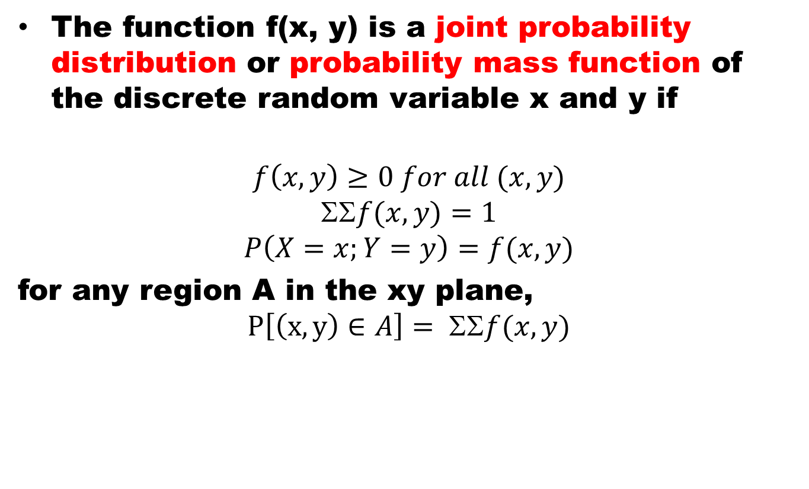
Joint Probability Distribution
The function f(x, y) is a joint probability distribution or probability mass function of the discrete random variable x and y if
$$f\left(x, y\right)≥0 for all (x, y)$$
$$f(x, y)=1$$
$$P\left(X=x;Y=y\right)=f(x, y)$$
for any region A in the xy plane,
$$P\left[\left(x, y\right)∈A\right]= ΣΣf(x, y)$$

Slide 5
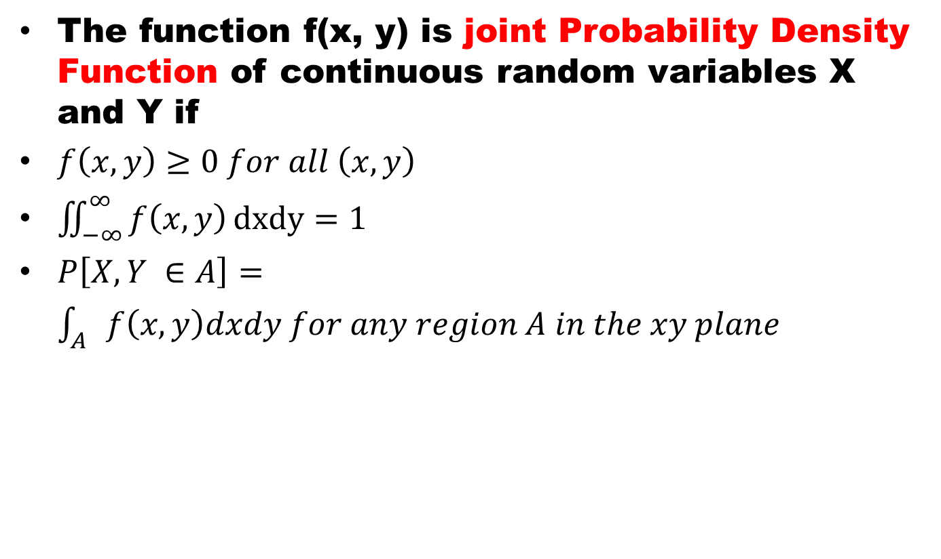
Continuous Joint PDF
The function f(x, y) is joint Probability Density Function of continuous random variables X and Y if
$f\left(x, y\right)≥0 for all \left(x, y\right)$
$\iint_{−∞}^{∞}{f\left(x, y\right)}dxdy=1$
$P\left[X, Y ∈A\right]=\int_{A}{f\left(x,y\right)dxdy for any region A in the xy plane}$

Slide 6
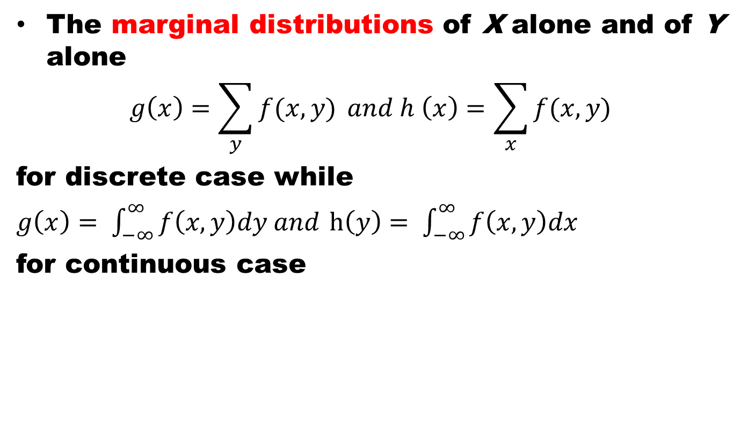
Marginal Distribution
The marginal distributions of X alone and of Y alone
$$g\left(x\right)=\sum_{y}{f(x,y)} and h \left(x\right)=\sum_{x}{f(x,y)}$$
for discrete case while
$g\left(x\right)= \int_{−∞}^{∞}{f\left(x,y\right)dy and}$ $h\left(y\right)= \int_{−∞}^{∞}{f\left(x,y\right)dx}$
for continuous case

Slide 7
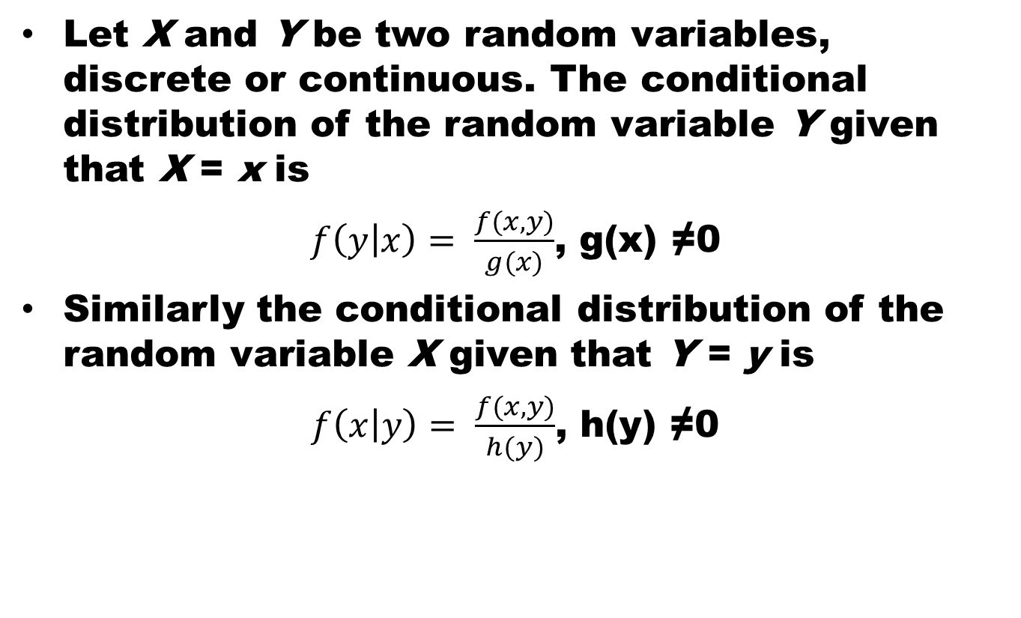
Conditional Distribution
Let X and Y be two random variables, discrete or continuous. The conditional distribution of the random variable Y given that X = x is
$f\left(y | x\right)= \frac{f(x,y)}{g(x)}$, g(x) ≠0
Similarly the conditional distribution of the random variable X given that Y = y is
$f\left(x | y\right)= \frac{f(x,y)}{h(y)}$, h(y) ≠0

Slide 8
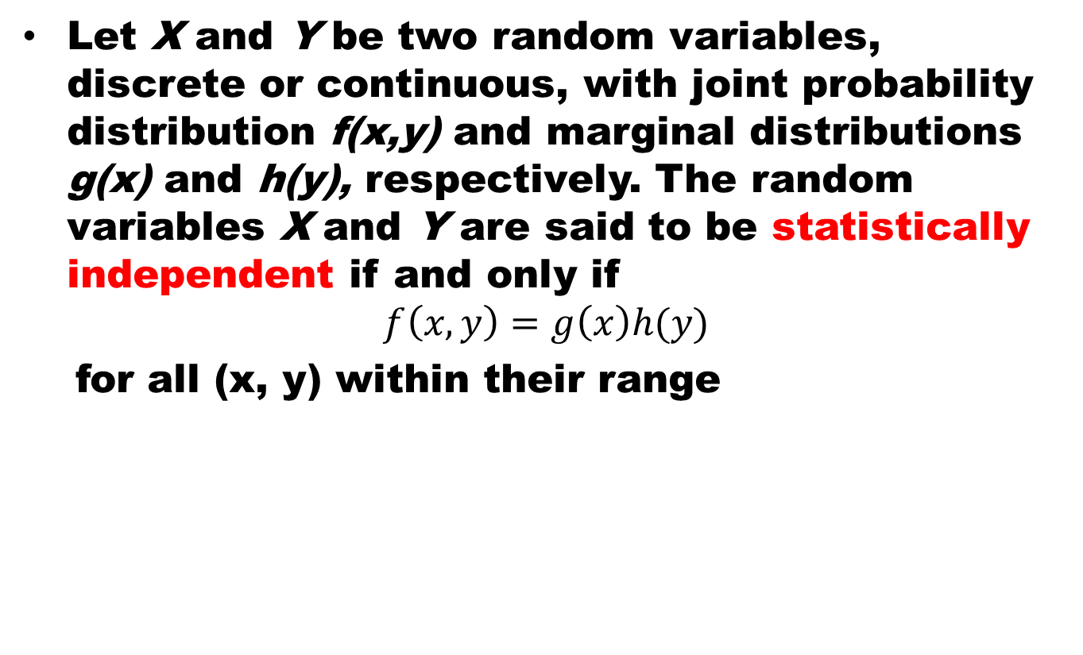
Statistical Independence
Let X and Y be two random variables, discrete or continuous, with joint probability distribution f(x,y) and marginal distributions g(x) and h(y), respectively. The random variables X and Y are said to be statistically independent if and only if
$$f\left(x,y\right)=g\left(x\right)h(y)$$
for all (x, y) within their range

Slide 9
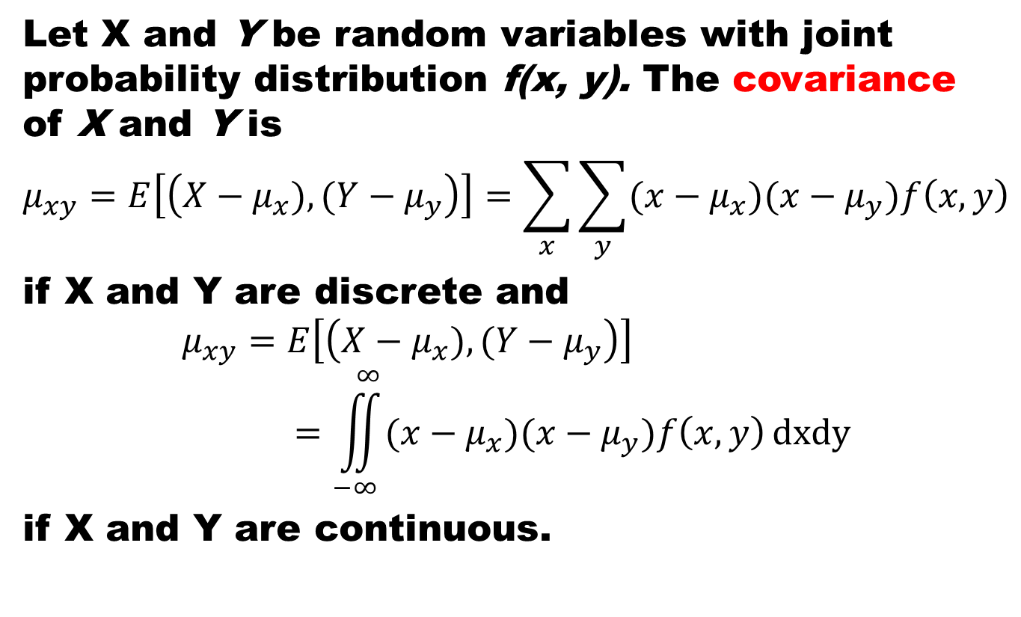
Covariance
Let X and Y be random variables with joint probability distribution f(x, y). The covariance of X and Y is
$$μ_{xy}=E\left[\left(X−μ_{x}), (Y−μ_{y}\right)\right]=\sum_{x}{\sum_{y}{(x−μ_{x})(x−μ_{y})f\left(x,y\right)}}$$
if X and Y are discrete and
$$μ_{xy}=E\left[\left(X−μ_{x}), (Y−μ_{y}\right)\right]=\iint_{−∞}^{∞}{(x−μ_{x})(x−μ_{y})f\left(x,y\right)}dxdy$$
if X and Y are continuous.

Slide 10
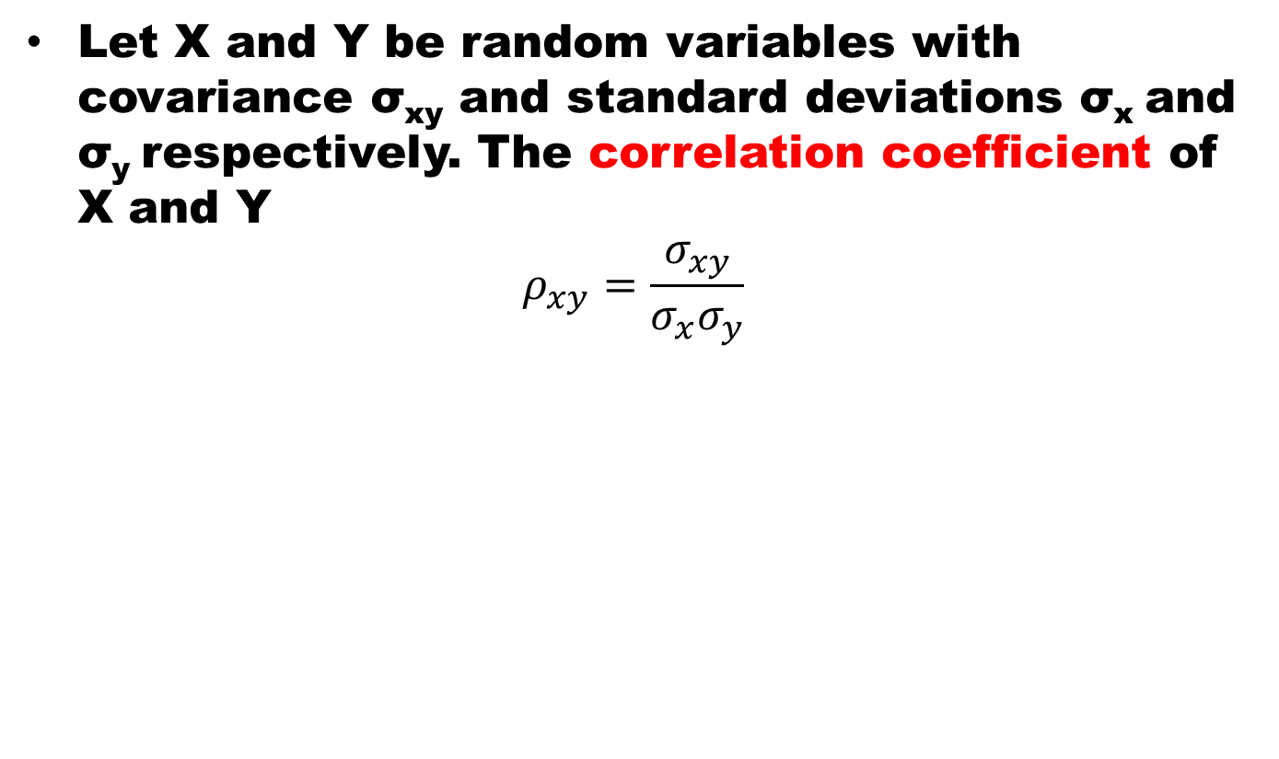
Correlation
Let X and Y be random variables with covariance σ_{xy} and standard deviations σ_{x} and σ_{y} respectively. The correlation coefficient of X and Y
$$ρ_{xy}=\frac{σ_{xy}}{σ_{x}σ_{y}}$$

Slide 11
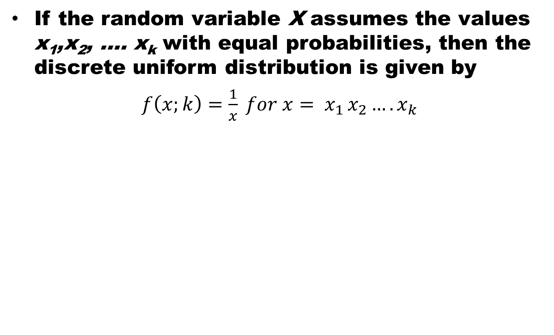
Discrete Uniform Distribution
If the random variable X assumes the values x₁,x₂, …. x_{k} with equal probabilities, then the discrete uniform distribution is given by
$f\left(x;k\right)=\frac{1}{x} for x= x_{1 }x_{2}….x_{k}$

Slide 12
Bournoulli’s Process / Trail
The Bournoulli’s process possesses following properties
  The experiments consists of repeated trails
  The probability of success is same in each trail
  There are n trails and n is constant
  The n – trails are independent.

Slide 13
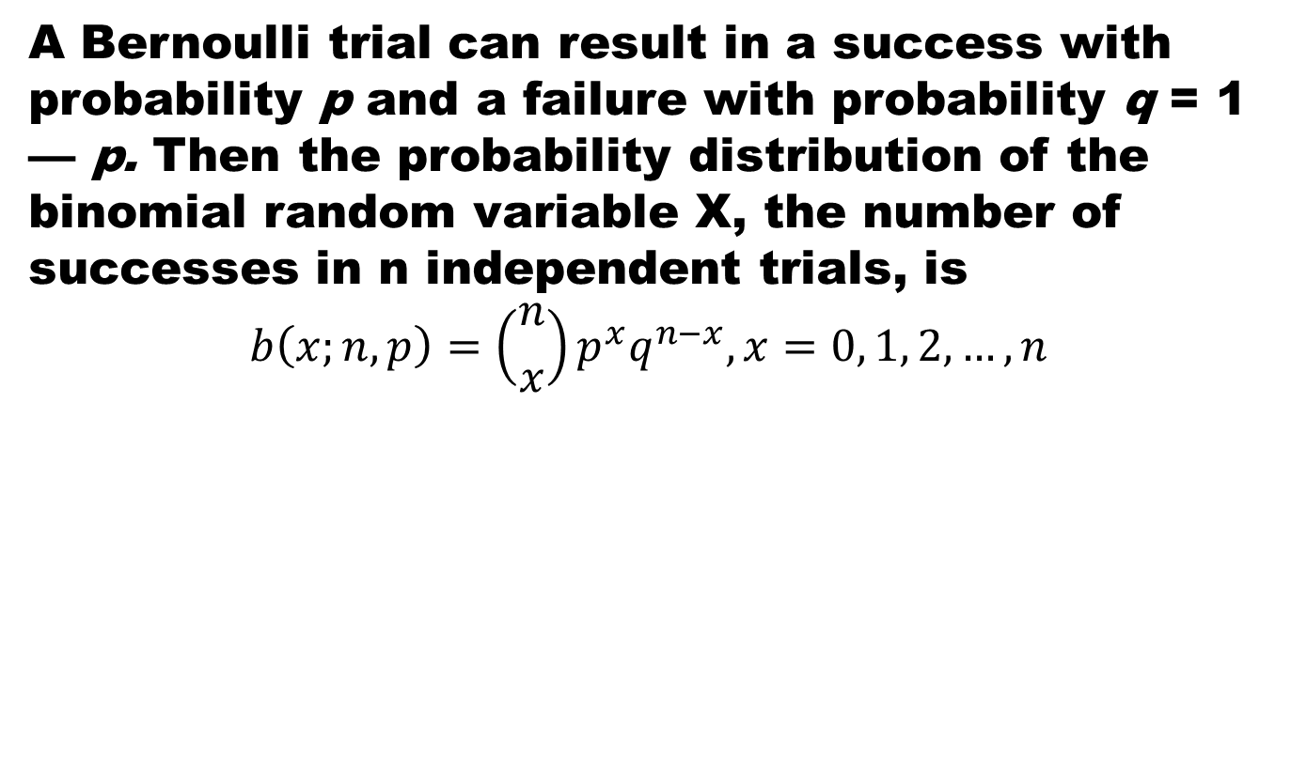
Binomial Distribution
A Bernoulli trial can result in a success with probability p and a failure with probability q = 1 — p. Then the probability distribution of the binomial random variable X, the number of successes in n independent trials, is
$$b\left(x;n,p\right)=\left({n \atop x}\right)p^{x}q^{n−x}, x=0, 1, 2,…, n$$

Slide 14
Poisson’s Experiment and Process
Experiments yielding numerical values of a random variable X, the number of outcomes occurring during a given time interval or in a specified region, are called Poisson experiments.
Poisson Experiment is derived from the Poisson’s Process.

Slide 15
Poisson’s Process
A process is called a Poisson Process if
  the process has no memory
  The probability that a single outcome will occur during a very short time interval or in a small region is proportional to the length of the time interval or the size of the region and does not depend on the number of outcomes occurring outside this time interval or region.
  The probability that more than one outcome will occur in such a short time interval or fall in such a small region is negligible.
The number X of outcomes occurring during a Poisson experiment is called a Poisson random variable, and its probability distribution is called the Poisson distribution.

Slide 16
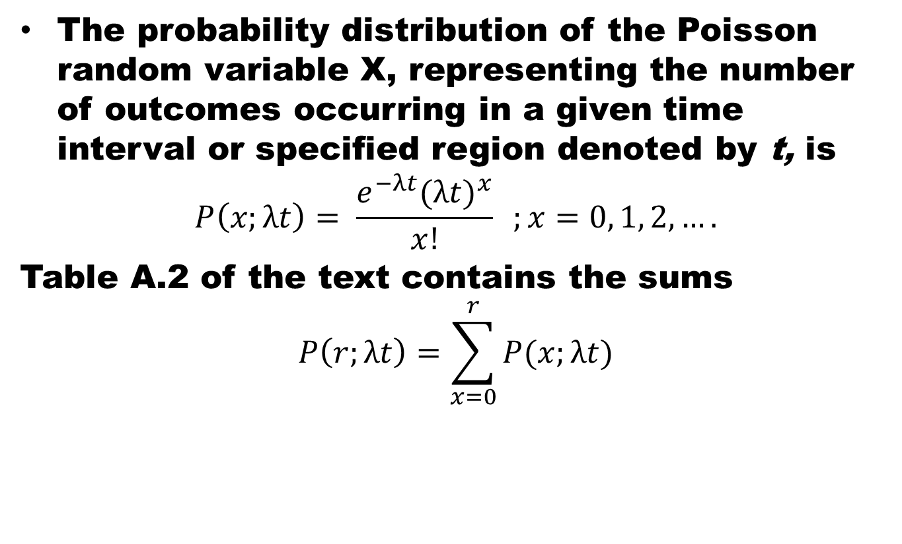
Poisson Distribution
The probability distribution of the Poisson random variable X, representing the number of outcomes occurring in a given time interval or specified region denoted by t, is
$$P\left(x;λt\right)= \frac{e^{−λt}{(λt)}^{x}}{x!} ;x=0, 1, 2, ….$$
Table A.2 of the text contains the sums
$$P\left(r;λt\right)=\sum_{x=0}^{r}{P(x;λt)}$$
where λ is the average number of outcomes per unit time, distance, area, or volume, and e = 2.71828 • • •.

Slide 17
Poisson Dist. as Limiting case of Binom. Dist.
It should be evident from the three principles of the Poisson process that the Poisson distribution relates to the binomial distribution.
Although the Poisson usually finds applications in space and time problems but it can be viewed as a limiting form of the binomial distribution.
In the case of the binomial, if n is quite large and p is small, the conditions begin to simulate the continuous space or time region implications of the Poisson process.
The independence among Bernoulli trials in the binomial case is consistent with property 2 of the Poisson process.

Slide 18
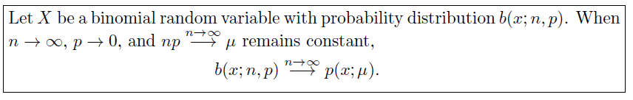
Poisson Dist. as Limiting case of Binom. Dist.

Slide 19
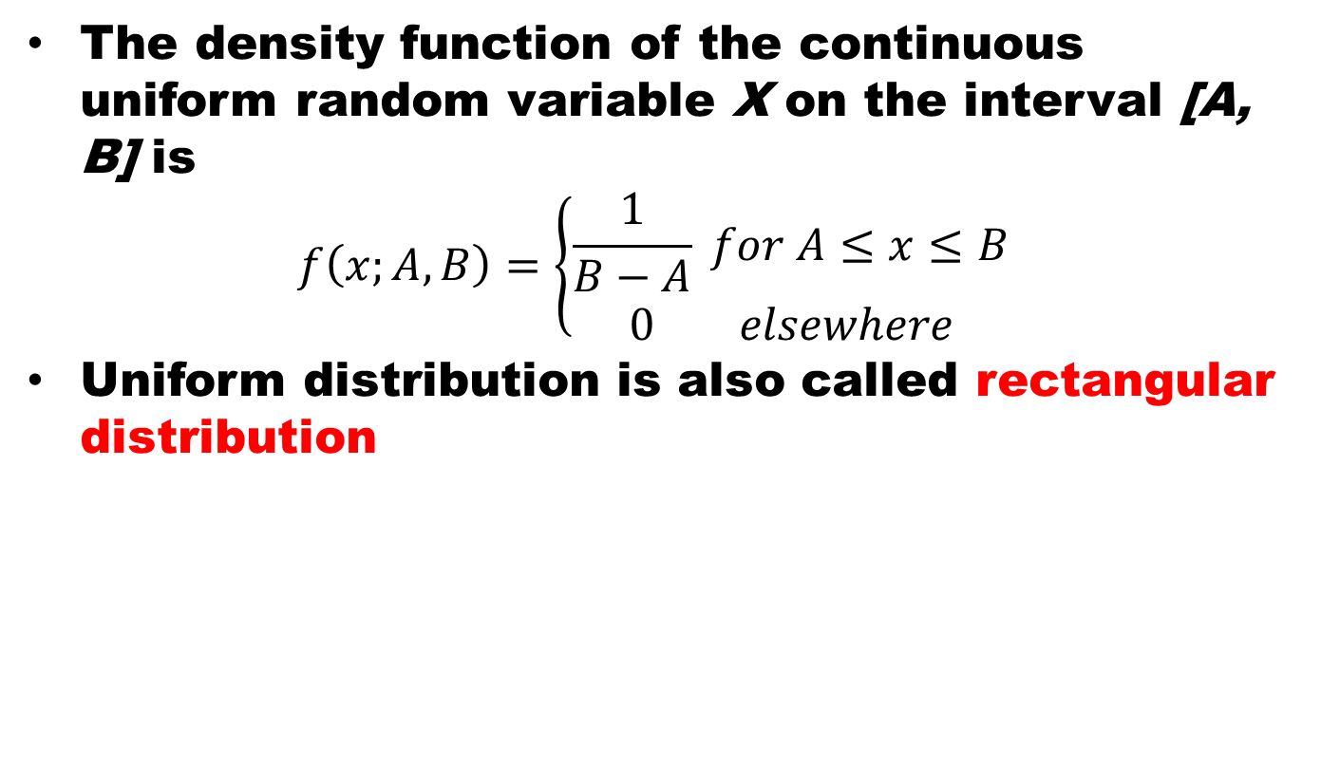
Uniform Distribution
The density function of the continuous uniform random variable X on the interval [A, B] is
$$f\left(x;A,B\right)=\left\{\begin{aligned}\frac{1}{B−A} for A≤x≤B \\ 0 elsewhere\end{aligned}\right.$$
Uniform distribution is also called rectangular distribution

Slide 20
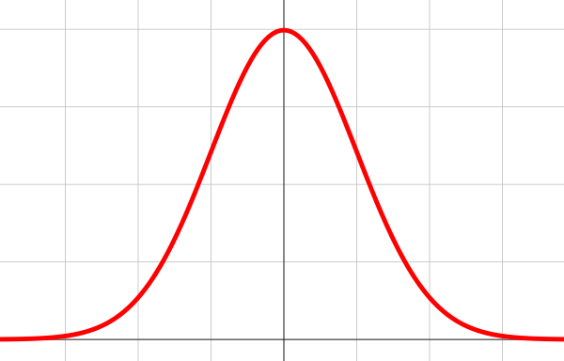

Normal Distribution
The most important, continuous probability distribution in the entire field of statistics is the normal distribution. Its graph, called the normal curve, is the bell shaped curve.

Slide 21
Normal Distribution
Normal distribution describes approximately many phenomena that occur in
  nature,
  industry,
  and research
Physical measurements in areas such as
  meteorological experiments,
  rainfall studies,
  measurements of manufactured parts
  errors in scientific measurements
are often more than adequately explained with a normal distribution.

Slide 22
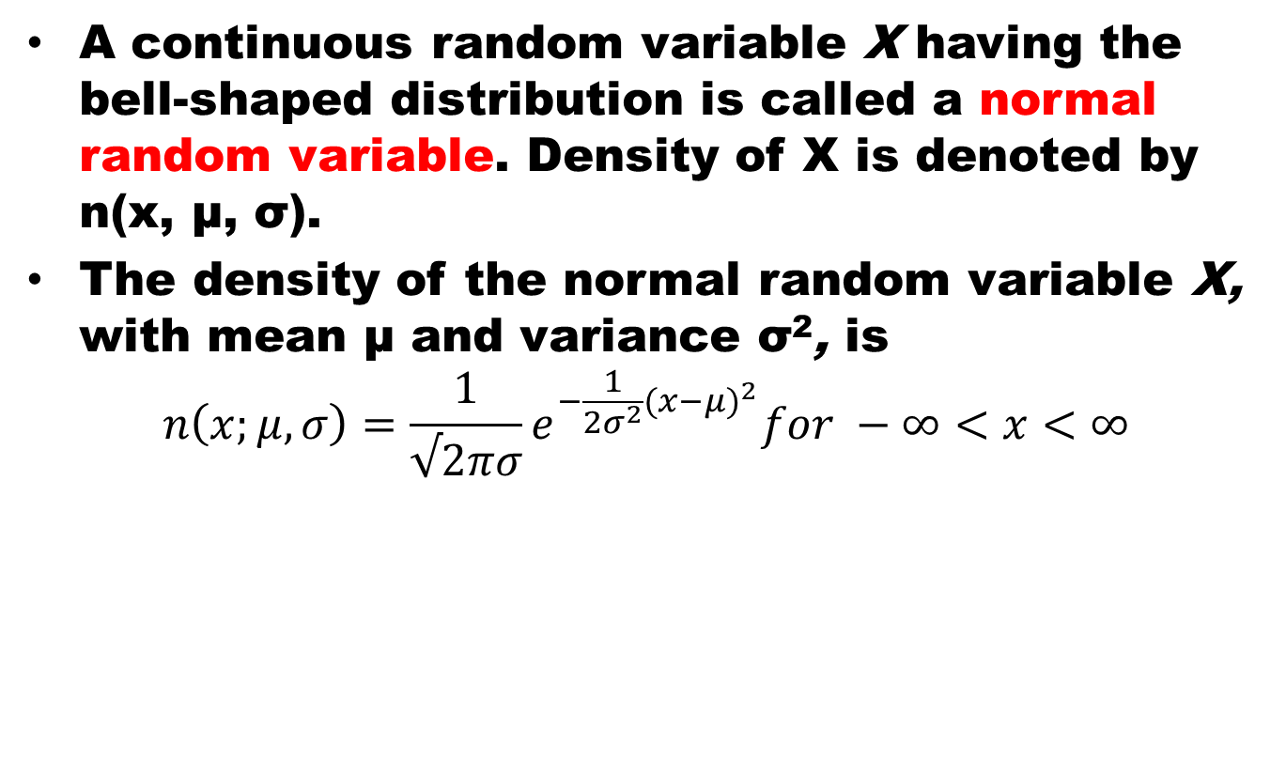
Normal Distribution
A continuous random variable X having the bell-shaped distribution is called a normal random variable. Density of X is denoted by n(x, μ, σ).
The density of the normal random variable X, with mean μ and variance σ², is
$$n\left(x;μ,σ\right)=\frac{1}{√2πσ}e^{−\frac{1}{{2σ}^{2}}{(x−μ)}^{2}}for −∞<x<∞$$

Slide 23
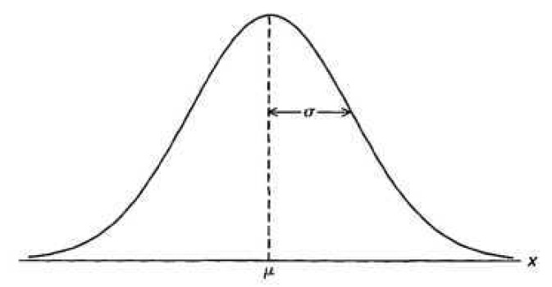
Properties of Normal Distribution
The mode, which is the point on the horizontal axis where the curve is a maximum, occurs at x = μ
The curve is symmetric about a vertical axis through the mean μ .
The curve has its points of inflection at x = p ± σ, is concave downward if p — σ < X < p + σ, and is concave upward otherwise.

Slide 24
Properties of Normal Distribution
The normal curve approaches the horizontal axis asymptotically as we proceed in either direction away from the mean.
The total area under the curve and above the horizontal axis is equal to 1.

Slide 25
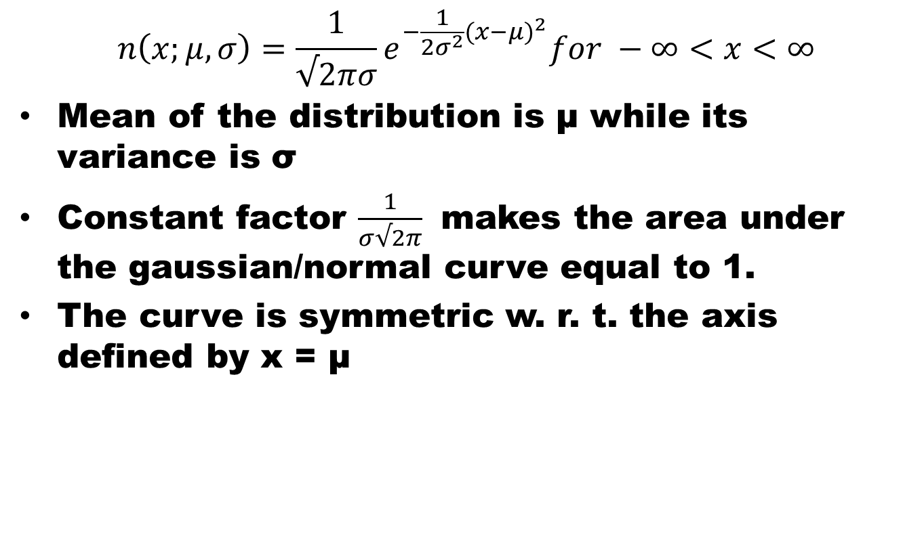
Normal Distribution
$$n\left(x;μ,σ\right)=\frac{1}{√2πσ}e^{−\frac{1}{{2σ}^{2}}{(x−μ)}^{2}}for −∞<x<∞$$
Mean of the distribution is μ while its variance is σ
Constant factor $\frac{1}{σ√2π}$ makes the area under the gaussian/normal curve equal to 1.
The curve is symmetric w. r. t. the axis defined by x = μ

Slide 26
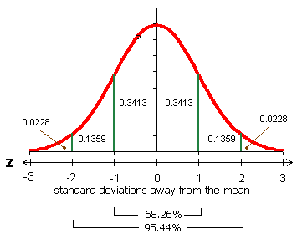
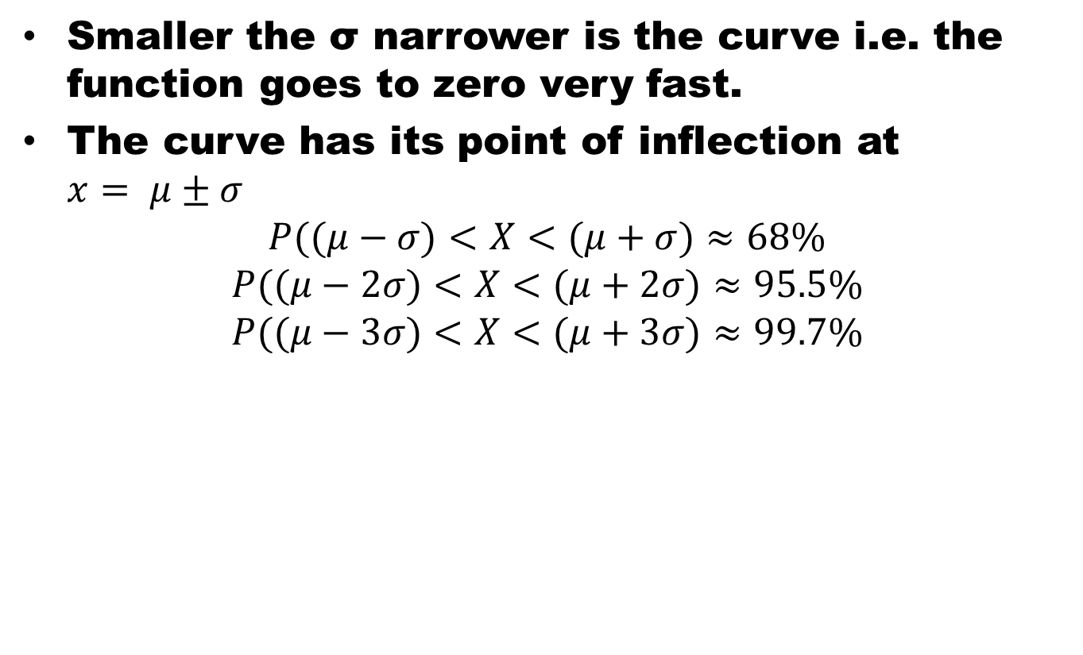
Normal Distribution
Smaller the σ narrower is the curve i.e. the function goes to zero very fast.
The curve has its point of inflection at $x= μ±σ$
$$P((μ−σ)<X<(μ+σ)≈68\%$$
$$P((μ−2σ)<X<(μ+2σ)≈95.5\%$$
$$P((μ−3σ)<X<(μ+3σ)≈99.7\%$$

Slide 27
Beauty of Normal Distribution
No matter what μ and σ are, the area between μ-σ and μ+σ is about 68%; the area between μ-2σ and μ+2σ is about 95%; and the area between μ-3σ and μ+3σ is about 99.7%. Almost all values fall within 3 standard deviations.

Slide 28
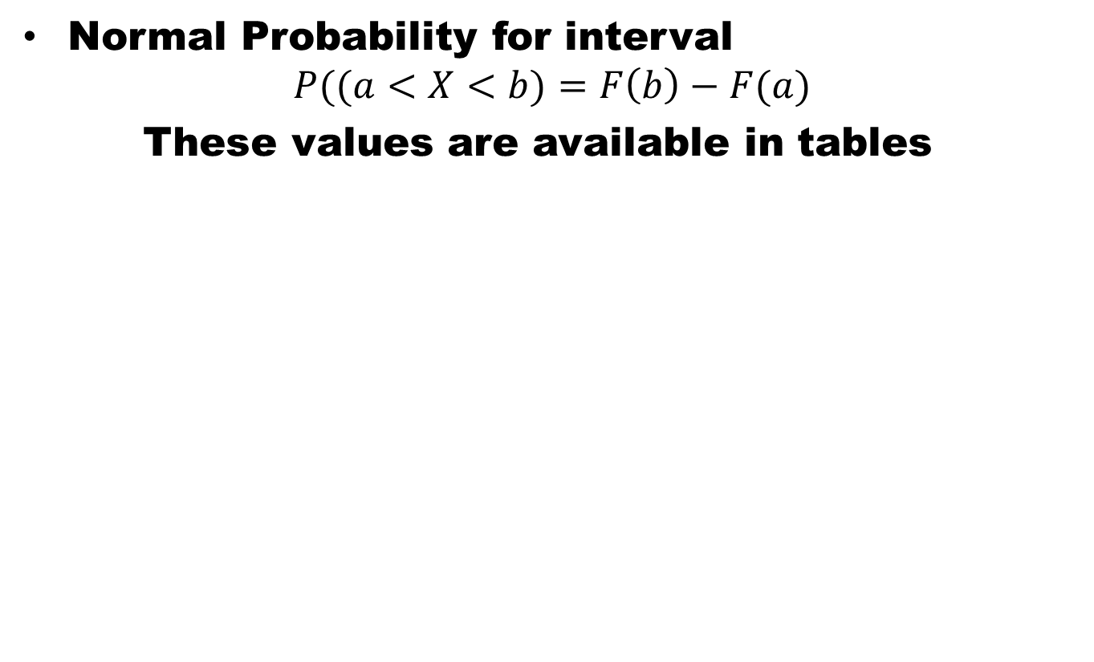
Normal Distribution
Normal Probability for interval
$$P((a<X<b)=F\left(b\right)−F(a)$$
These values are available in tables

Slide 29
Standard Normal Distribution
The distribution of a normal random variable with mean 0 and variance 1 is called a standard normal distribution.

Slide 30
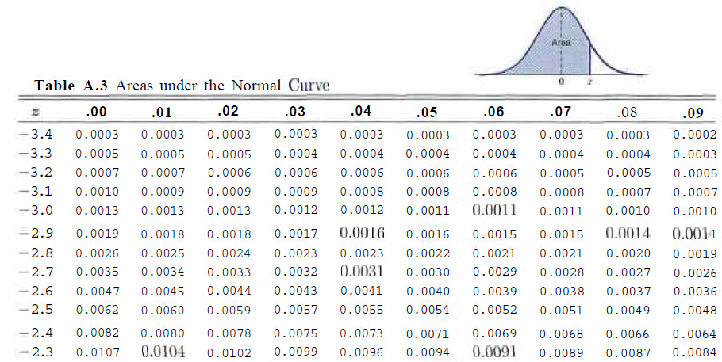
Area under the Normal Curve

Slide 31
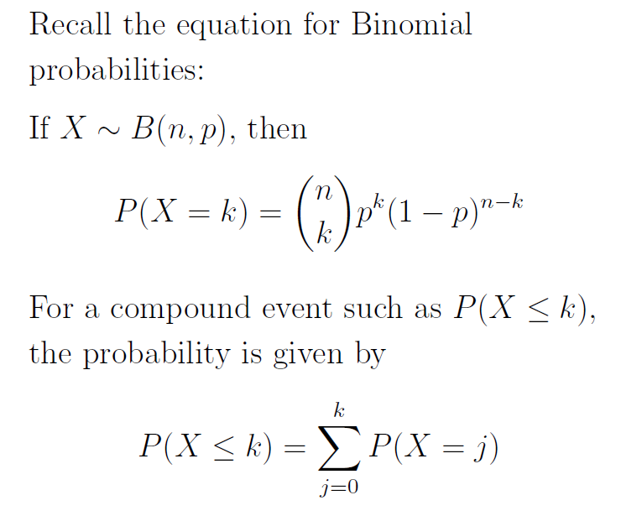
Recall the Binomial Distribution
Probability for a Binomial Random variable X
For a compound event such as P(X ≤ k) the probability is given by

Slide 32
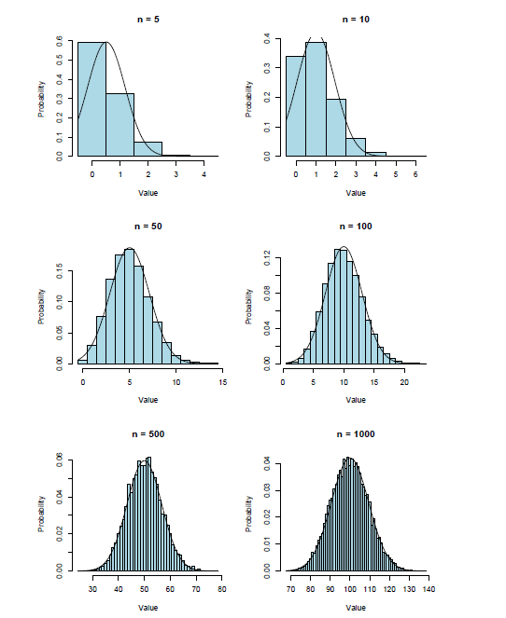
Binomial Distribution

Slide 33
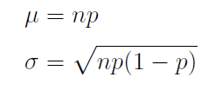
Parameters of the Approximating Distribution
The approximating Normal distribution has the same mean and standard deviation as the underlying Binomial distribution.
Thus, if X ~ B(n; p), having mean E[X] = np and standard deviation SD(X) = √np(1 - p) = sqrt(npq),
It can be approximated by Normal distribution with

Slide 34
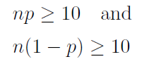
When is the approximation appropriate?
The farther p is from 0.5 , the larger n needs to be for the approximation to work.
Thus, as a rule of thumb, only use the approximation if

Slide 35
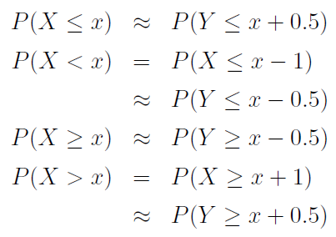
Calculations with the Normal Approximation
The addition of 0.5 in the previous slide is an example of the continuity correction which is intended to refine the approximation by accounting for the fact that the Binomial distribution is discrete while the Normal distribution is continuous.
In general, we make the following adjustments:

Slide 36
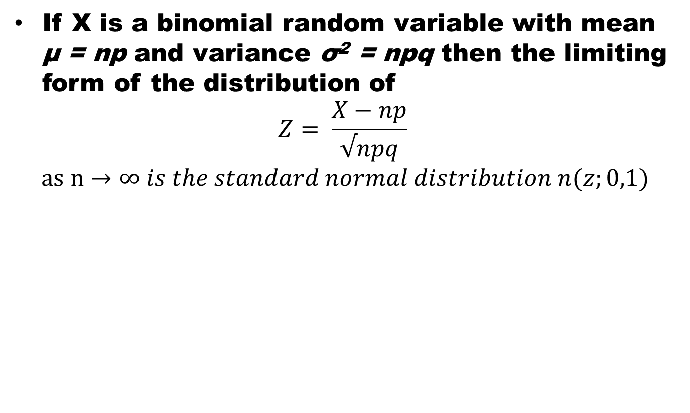
Normal Approximation to the Binomial
If X is a binomial random variable with mean μ = np and variance σ² = npq then the limiting form of the distribution of
$$Z= \frac{X−np}{√npq}$$
$$as n→∞ is the standard normal distribution n(z;0,1)$$

Slide 37
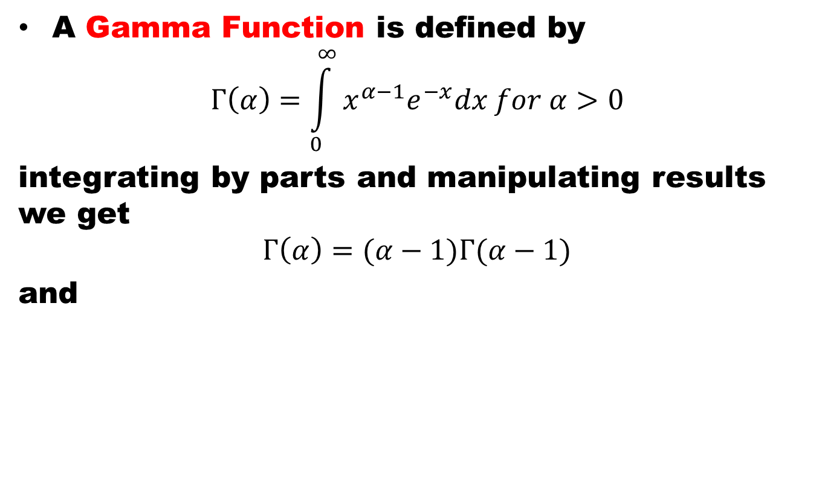
Gamma Function
A Gamma Function is defined by
$$Γ\left(α\right)=\int_{0}^{∞}{x^{α−1}e^{−x}dx for α>0}$$
integrating by parts and manipulating results we get
$$Γ\left(α\right)=(α−1)Γ(α−1)$$
and

Slide 38
Properties of Gamma Function

Slide 39
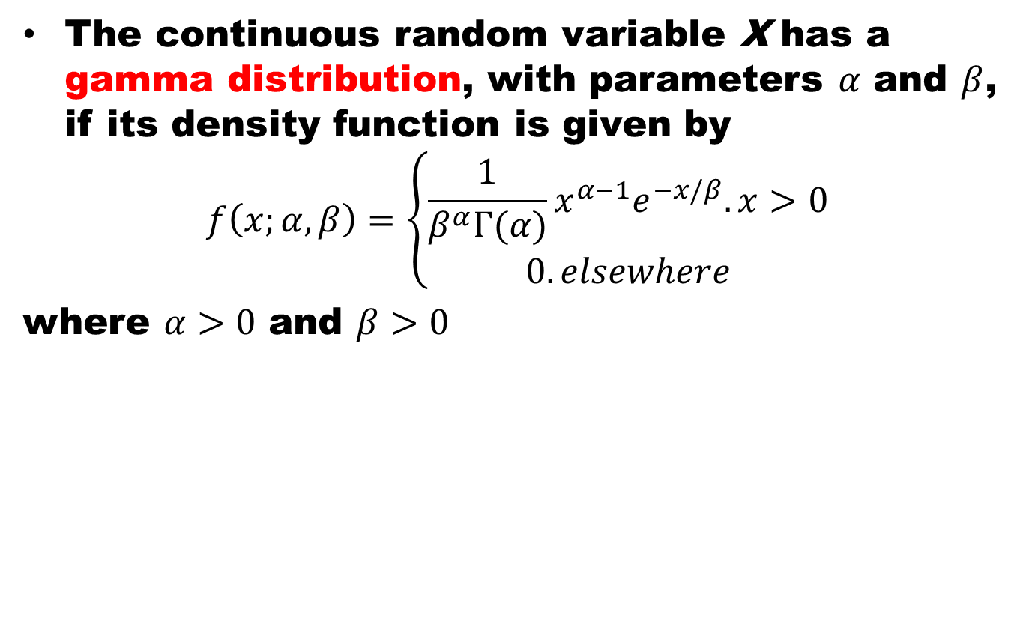
Gamma Distribution
The continuous random variable X has a gamma distribution, with parameters $α$ and $β$, if its density function is given by
$$f\left(x;α,β\right)=\left\{\begin{aligned}\frac{1}{β^{α}Γ(α)}x^{α−1}e^{−x/β}. x>0 \\ 0. elsewhere\end{aligned}\right.$$
where $α>0$ and $β>0$
The mean and variance of Gamma distribution are

Slide 40
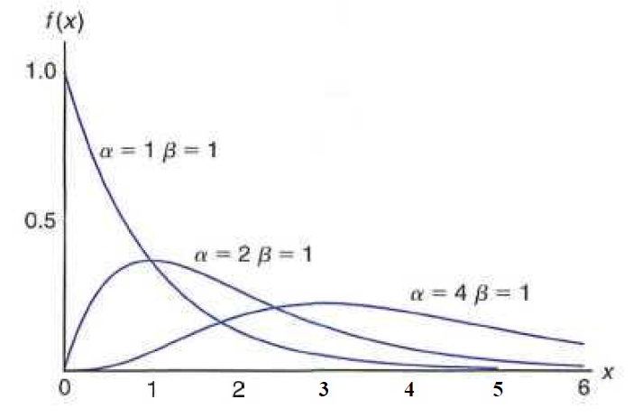
Gamma Distribution

Slide 41
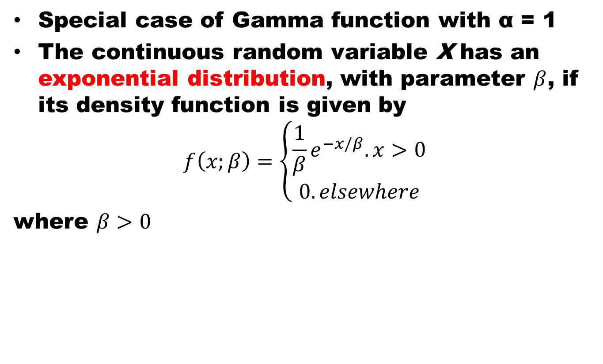
Exponential Distribution
Special case of Gamma function with α = 1
The continuous random variable X has an exponential distribution, with parameter $β$, if its density function is given by
$$f\left(x;β\right)=\left\{\begin{aligned}\frac{1}{β}e^{−x/β}. x>0 \\ 0. elsewhere\end{aligned}\right.$$
where $β>0$
The mean and variance of Exponential distribution are

Slide 42
Relationship of Exponential Distribution to the Poisson Process
The relationship between the exponential distribution (often called the negative exponential) and the Poisson process is quite simple.
Poisson distribution was developed as a single-parameter distribution with parameter λ, where λ may be interpreted as the mean number of events per unit "time."
Consider now the random variable described by the time required for the first event to occur. Using the Poisson distribution, we find that the probability of no events occurring in the span up to time t is given by

Slide 43
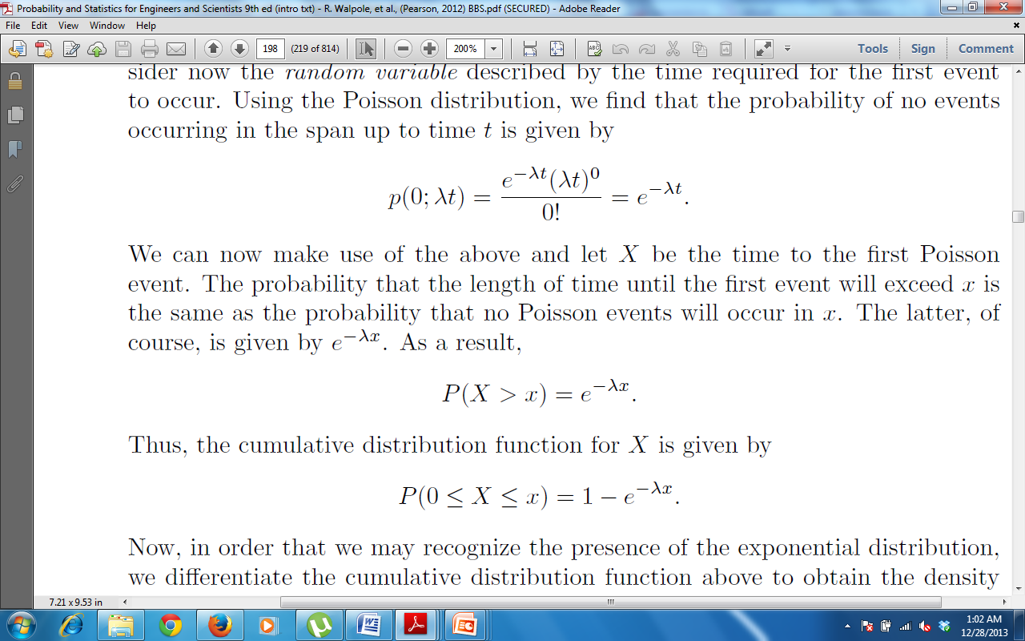
Relationship of Exponential Distribution to the Poisson Process
Consider now the random variable described by the time required for the first event to occur. Using the Poisson distribution, we find that the probability of no events occurring in the span up to time t is given by
We can now make use of the above and let X be the time to the first Poisson event. The probability that the length of time until the first event will exceed x is the same as the probability that no Poisson events will occur in x.

Slide 44
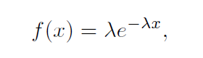
Relationship of Exponential Distribution to the Poisson Process
Thus the cumulative distribution function for X is given by
Now, in order that we recognize the presence of the exponential distribution, we may differentiate the cumulative distribution function above to obtain the density function
which is the density function of the exponential distribution with λ = 1/β.

Slide 45
Estimation of Parameters
Population and Sample
A point estimate of a parameter is a number (point on the real line), which is computed from a given sample and serves as an approximation of the unknown exact value of the parameter of the population.
An interval estimate is an interval (“confidence interval”) obtained from a sample.

Slide 46

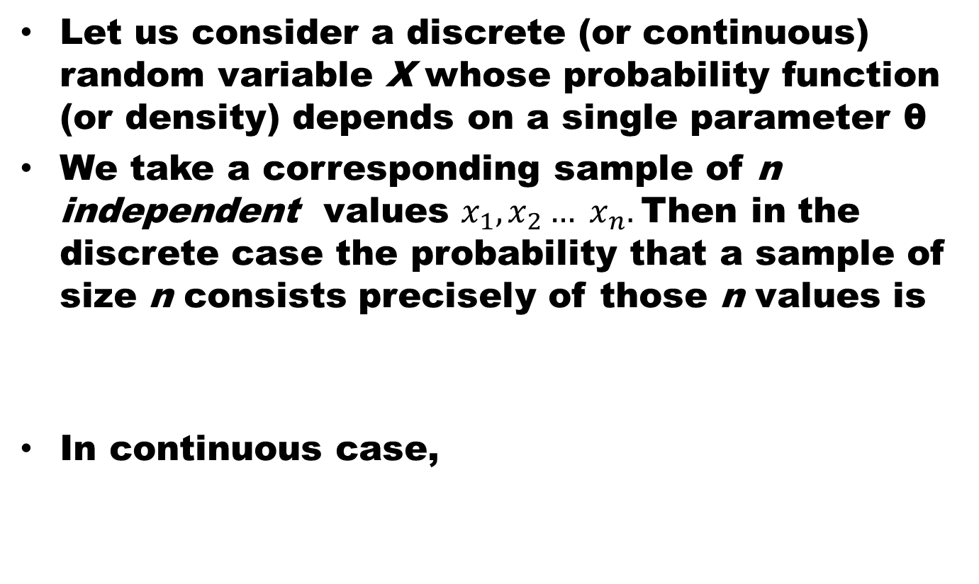
Maximum Likelihood Method
Let us consider a discrete (or continuous) random variable X whose probability function (or density) depends on a single parameter θ
We take a corresponding sample of n independent values $x_{1},x_{2}… x_{n}.$Then in the discrete case the probability that a sample of size n consists precisely of those n values is
In continuous case,

Slide 47
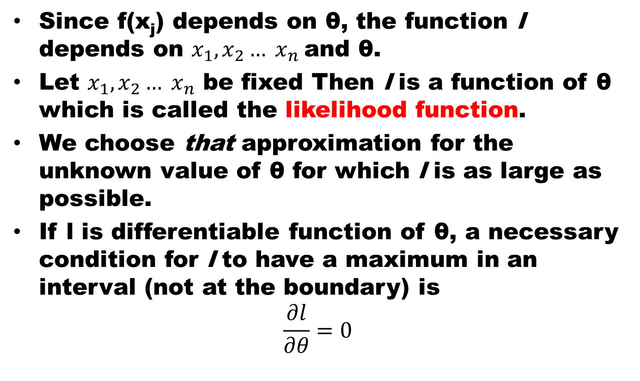
Maximum Likelihood Method
Since f(x_{j}) depends on θ, the function l depends on $x_{1},x_{2}… x_{n}$and θ.
Let $x_{1},x_{2}… x_{n}$ be fixed Then l is a function of θ which is called the likelihood function.
We choose that approximation for the unknown value of θ for which l is as large as possible.
If l is differentiable function of θ, a necessary condition for l to have a maximum in an interval (not at the boundary) is
$$\frac{∂l}{∂θ}=0$$

Slide 48
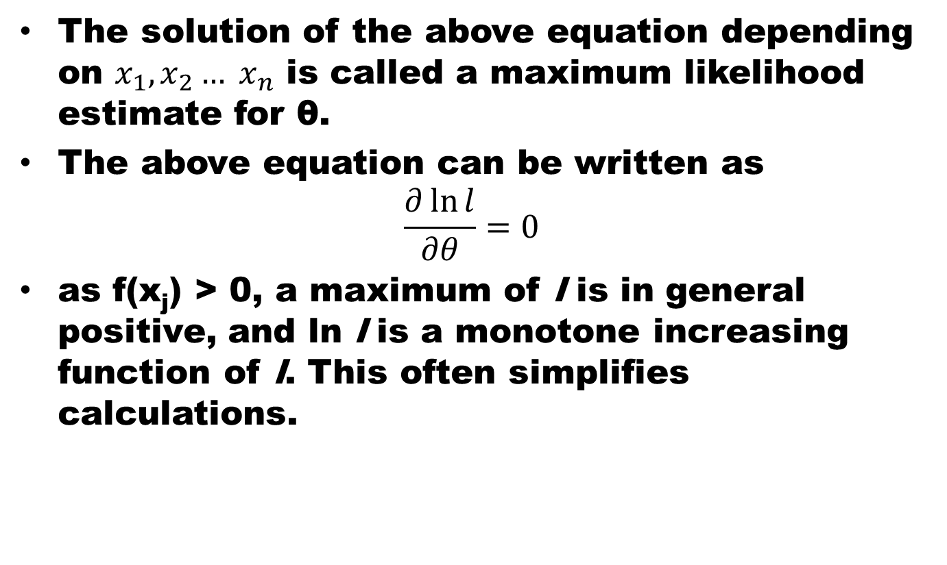
Maximum Likelihood Method
The solution of the above equation depending on $x_{1},x_{2}… x_{n}$ is called a maximum likelihood estimate for θ.
The above equation can be written as
$$\frac{∂\ln{l}}{∂θ}=0$$
as f(x_{j}) > 0, a maximum of l is in general positive, and ln l is a monotone increasing function of l. This often simplifies calculations.

Slide 49
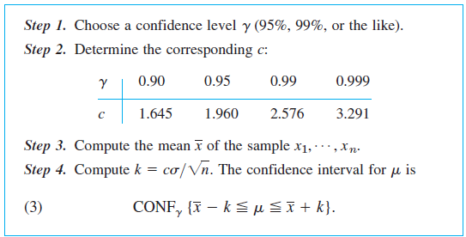
Confidence Interval for Mean of ND
It’s assumed that variance is known

Slide 50
Regression Analysis
In regression analysis one of the two variables, call it x, can be regarded as an ordinary variable because we can measure it without substantial error or we can even give it values we want. x is called the independent variable, or sometimes the controlled variable because we can control it.
The other variable, Y, is a random variable, and we are interested in the dependence ofY on x.

Slide 51
Least Squares Principle
The straight line should be fitted through the given points so that the sum of the squares of the distances of those points from the straight line is minimum, where the distance is measured in the vertical direction.

Slide 52
Correlation Analysis
Correlation Coefficient for a Discrete Data set is defined as
r = S_{xy}/(S_{xx}S_{yy})^{1/2}
The Correlation Coefficient r describes strength of linear relation and sign its direction
If r = 1 all (x,y) lie on st line with +ve slope and vice versa
If r > 0, the pattern in scatter diagram runs from bottom left to top right and vice versa
Magnitude of r is closer to 1 means strong linear relation and closer to 0 signifies weak relation.

Slide 53
Summary
Revision of 2nd half of the course

Slide 54
References
Probability and Statistics for Engineers and Scientists by Walpole
Schaum Outline Series on Probability and Statistics.
Advanced Engineering Mathematics by E Kreyszig.

