Slide 1
Mathematical Statistics
Lecture 31
Prof. Dr. M. Junaid Mughal

Slide 2
Today’s Agenda (Revision)
Data Representation
Stem and Leaf Plot
Bar Chart and Histogram
Center and Spread of Data
Quartiles
Median of Grouped Data
Box and Whisker Plot (Outliers)
Mode
Mean and Weighted Mean
Variance and Standard Deviation
Experiments, Outcomes and Events
Union, Intersection, Complement of Events

Slide 3
Today’s Agenda (Revision)
Probability
Counting Problems
  Tree Diagrams
  Permutations and Combinations
Axioms of Probability
Additive and Multiplicative Rules
Conditional Probability
Independent Events
Theorem of total Probability
Bayes Rule
Random Variables
Probability Distributions
Cumulative and Marginal Distribution
Mean and Variance of Distributions

Slide 4
Data Representation (Summary)
Data can be represented
  Numerically
    Numbers
    Grouped Data
    Tables
  Graphically
    Curves
    Pie Chart
    Stem and Leaf plot
    Bar Chart / Histogram

Slide 5
Data Representation
Data can be represented
  Numerically
    Grouped Data
      A raw dataset can be organized by constructing a table showing the frequency distribution of the variable
      As in the above example we can represent the data
      {20, 21, 20, 22, 23, 19, 23, 19, 20, 22}
Age years | Number of students
19 | 2
20 | 3
21 | 1
22 | 2
23 | 2

Slide 6
Data Representation
Data can be represented
  Numerically
    Tables
      A table is a means of arranging data in rows and columns
      e.g. age of people
Name | Age (years)
Faisal | 25
Amir | 29
Waqar | 39
Waseem | 40
Kamran | 28

Slide 7
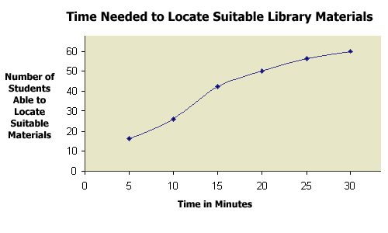
Data Representation
  Graphically
    Curves

Slide 8
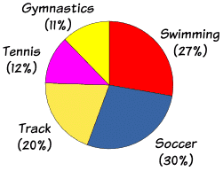
Data Representation
  Graphically
    Pie Chart
      A pie chart (or a circle graph) is a circular chart divided into sectors, illustrating numerical proportion.
      E.g., a survey of all the sportsmen in a certain country show

Slide 9
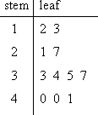
Data Representation
  Graphically
  Stem and Leaf plot
    Stem-and-leaf plots are a method for showing the frequency with which certain classes of values occur.
    For instance, suppose you have the following list of values:
      12, 13, 21, 27, 33, 34, 35, 37, 40, 40, 41.
      We can represent it as
The "stem" is the left-hand column which contains the tens digits. The "leaves" are the lists in the right-hand column, showing all the ones digits for each of the tens, twenties, thirties, and forties

Slide 10
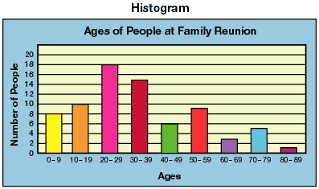
Data Representation
  Graphically
    Bar Chart / Histogram
      A bar chart or bar graph is a chart with rectangular bars with lengths proportional to the values that they represent. The bars can be plotted vertically or horizontally. A vertical bar chart is sometimes called a column bar chart.

Slide 11
Center and Spread of Data
As a center of location the location of data values we can take a median.
78 81 83 84 86 87 87 89 89 89 89 90 91 99
87 and 89 are middle values (7th and 8th) so median will be 88.
Median may not be present in the data.
Spread of data can be measured by the range
Spread is also called variability.
  In this case spread is 99 – 78 = 21.

Slide 12
Quartiles
With Quartiles data is divided in 4 groups in the same manner as we do for median.
There are three quartiles in data called
  Lower Quartile q_{l} (median of the lower half of the data)
  Middle Quartile q_{m}(median of the data)
  Upper Quartile q_{u} (median of the upper half of the data)
Interquartile Range IQR can be found by
IQR = q_{u} - q_{l}

Slide 13
Box and Whisker Plot
Also called Box Plot
Box plot is obtained by 5 values of data.
  Minimum value of the data
  Three quartiles
  Maximum value of the data

Slide 14
Outliers
An Outlier is a value that appears to be uniquely different from rest of the data set.
  This might indicate that something has gone wrong with data collection process
  One way of finding outlier is using IQR
  Outlier is conventionally defined as a value more than a distance of 1.5 * IQR from either end of box
In the example of last class

Slide 15
Mean, Average or Expected Value
Mean = (Σ X_{j})/n
example
89 84 87 81 89 86 91 90 78 89 87 99 83 89
Σ X_{j} = 1222
Mean = 1222/14 = 87.3

Slide 16
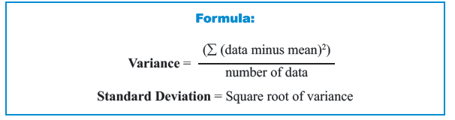
Variance
Spread and variability of the data values can be measure in a more refined way by standard deviation and variance.
Variance is defined as mean of the squared deviations from the mean.

Slide 17
Standard Deviation
Standard Deviation measures variation of the scores about the mean. Mathematically, it is calculated by taking square root of the variance.

Slide 18
Experiments, Outcomes and Events
Experiment is a process of measurement or observation in a lab, factory, on the street, in nature or wherever.
  Experiment is used in a rather general strength
  An experiment to be random must yield at least two possible outcomes
A trial is a single performance of the experiment.
Result of a trail is called outcome or sample point
  n trials then give a sample of size n consisting n – samples
A sample space S of an experiment is the set of all possible outcomes.
Subsets of S are called events and outcomes Simple events

Slide 19
Union, Intersection, Complement of Events
The Union AUB consists of all points in A or B or both.
The intersection A ∩ B consists of all points that are in both A and B.
  If A and B have nothing in common then A ∩ B = Φ where Φ is called empty set.
If A ∩ B = Φ then the events A and B are called Mutually Excusive or Disjoint
A Complement of set A denoted by A^{c} or A’ consists of all points of S not in A. Thus A ∩ A’ = Φ and A U A’ = S

Slide 20
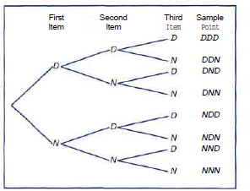
Sample Space- Tree Diagram
Suppose that three items are selected at random from a manufacturing process. Each item is inspected and classified defective, D, or non-defective, N. To list the elements of the sample space providing the most information, we construct the tree diagram

Slide 21
Counting Problem (Multiplication Theorem)
Theorem:
If an operation can be performed in n₁ ways, and if for each of these a second operation can be performed in n₂ ways, and for each of the first two a third operation can be performed in n_{k} ways, and so forth, then the sequence of k operations can be performed in n₁n₂n₃…n_{k} ways.

Slide 22
Permutation
Definition:
A permutation is an arrangement of all or part of a set of objects.

Slide 23
Permutation
In general, n distinct objects can be arranged in
  n(n - l)(n - 2) • • • (3)(2)(1) ways.
We represent this product by the symbol n! which is read as "n factorial."
Three objects can be arranged in
3! = (3)(2)(1) = 6 ways.
By definition,
      1! = 1
      0! = 1

Slide 24
Permutations
A permutation is an arrangement of all or part of a set of objects.
Theorem:
The number of permutations of n objects is n!.

Slide 25
Permutations
In general, n distinct objects taken r at a time can be arranged in
n(n- l ) ( n - 2 ) - - - ( n - r + 1)
ways.
We represent this product by the symbol

Slide 26
Combinations
Definition: When we have n different objects, and we want to have combinations containing r objects, then we will have _{n}C_{r} such combinations. (where, r is less than n).

Slide 27
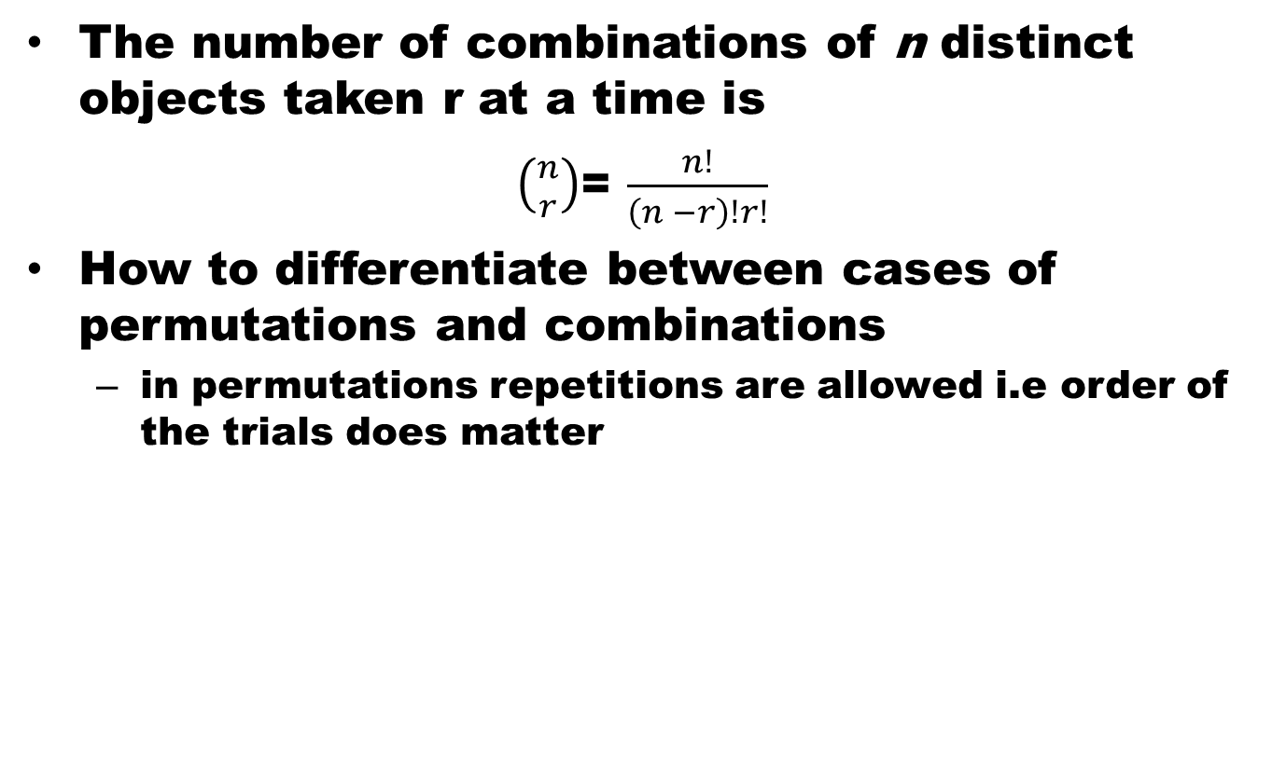
Combinations
The number of combinations of n distinct objects taken r at a time is
$\left({n \atop r}\right)$= $\frac{n!}{\left(n −r\right)!r!}$
How to differentiate between cases of permutations and combinations
  in permutations repetitions are allowed i.e order of the trials does matter

Slide 28
Probability
If there are n equally likely possibilities of which one must occur and s are regarded as favorable or success, then the probability of success is given by s/n
  If an event can occur in h different possible ways, all of which are equally likely, the probability of the event is h/n: Classical Approach
  If n repetitions of an experiment, n is very large, an event is observed to occur in h of these, the probability of the event is h/n: Frequency Approach or Empirical Probability.

Slide 29
Axioms of Probability
To each event A in the class C of events, we associate a real number P(A). The P is called the probability function, and P(A) the probability of event A if the following axioms are satisfied
  For every event A in the class C: P(A) ≥ 0
  For the certain event S in the class C: P(S) = 1
  For any number of mutually exclusive events A₁, A₂ …. A_{n} in the class C:
  P(A₁UA₂U…..UA_{n}) = P(A₁) U P(A₂) U …..U P(A_{n})
Two events A and B are mutually exclusive or disjoint if A ∩ B = Φ

Slide 30
Some Theorems
For A or B two events,
  P(A U B) = P(A) + P(B) – P(A ∩ B)
For mutually exclusive events
  P(A U B) = P(A) + P(B)
True for any number of events

Slide 31
Theorems
If A1, A2, …., An are partitions of a sample space then
P(A1 U A2 U …. U An) = P(A1) + P(A2) + … + P(An) = P(S) = 1

Slide 32
Conditional Probability
Let A and B be two events such that
P(B) > 0.
Denoted by P(A|B) the probability of A given that B has occurred is given by
P(A|B) = P(B∩A)/P(B)
P(A|B) is called the conditional probability of A given B has occurred

Slide 33
Conditional Probability
For any two events A and B:
P(A∩B) = P(A)P(B | A)
And
P(B∩A) = P(B)P(A | B)

Slide 34
Theorems on Conditional Probability
For any events A₁, A₂, …, A_{k}, we have
P(A₁∩A₂∩ … ∩A_{k})
= P(A₁)P(A₂| A₁)P(A₃|A₁∩A₂)…
P(A_{k}|A₁∩A₂∩A₃…∩A_{k-1} )
If the events A₁, A₂, . . . , A_{n}, are independent
P(A₁∩ A₂∩ … ∩A_{k})= P(A₁)P(A₂)P(A₃)…P(A_{k})

Slide 35
Theorem of Total Probability
If the events B₁, B₂,.. ,B_{k} constitute a partition of the sample space S such that P(B_{i}) ≠ 0 for i = 1,2,...,k, then for any event A of S
B₁
B₂
B₅
A
B_{k}
B₃
…
B₄

Slide 36
Bayes’ Rule
If the events B₁, B₂,.. ,B_{k} constitute a partition of the sample space S such that P(B_{i}) ≠ 0 for i = 1,2,...,k, then for any event A in S such that P(A) ≠ 0

Slide 37
Bayes’ Rule (Alternate Form)

Slide 38
Random Variables
A random variable is a function that associates a real number with each element in the sample space.
Capital letter is used to represent the random variable,
Small letter is used to represent the value
Example
  Number of people visiting an ATM
  Pressure of gas at different CNG stations
  Tossing of coin???

Slide 39
Discrete and Continuous Sample Space
If a sample space contains a finite number of possibilities or an unending sequence with as many elements as there are whole numbers, it is called a discrete sample space.
If a sample space contains an infinite number of possibilities equal to the number of points on a line segment, it is called a continuous sample space.

Slide 40
Discrete and Continuous Random Variables
A Discrete Random Variable is the one that has a countable set of outcomes.
When a random variable takes on values on continuous scale, the variable is regarded as continuous random variable.

Slide 41
Discrete Probability Distribution
The set of ordered pairs (x, f(x)) is a probability function , probability mass function or probability distribution of discrete random variable x, if for each possible outcome x
  f(x) ≥ 0
  Σf(x) = 1
  P(X = x) = f(x)

Slide 42
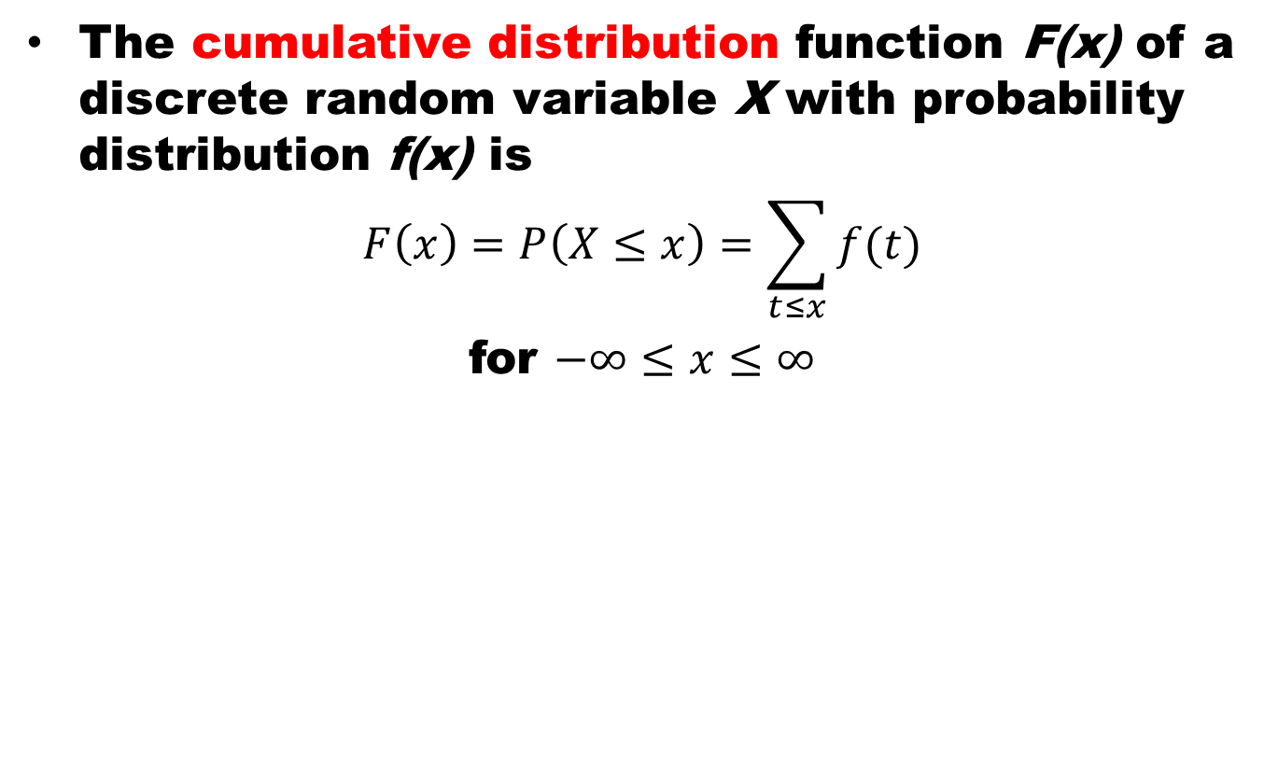
Cumulative Distribution
The cumulative distribution function F(x) of a discrete random variable X with probability distribution f(x) is
$$F\left(x\right)=P\left(X≤x\right)=\sum_{t≤x}{f(t)}$$
for $−∞≤x≤∞$

Slide 43
Continuous Probability Distribution
Continuous probability distribution cannot be written in tabular form but it can be stated as a formula. Such a formula would necessarily be a function of the numerical values of the continuous random variable X and as such will be represented by the functional notation f(x). The function f(x) usually called probability density function or density function of X.

Slide 44
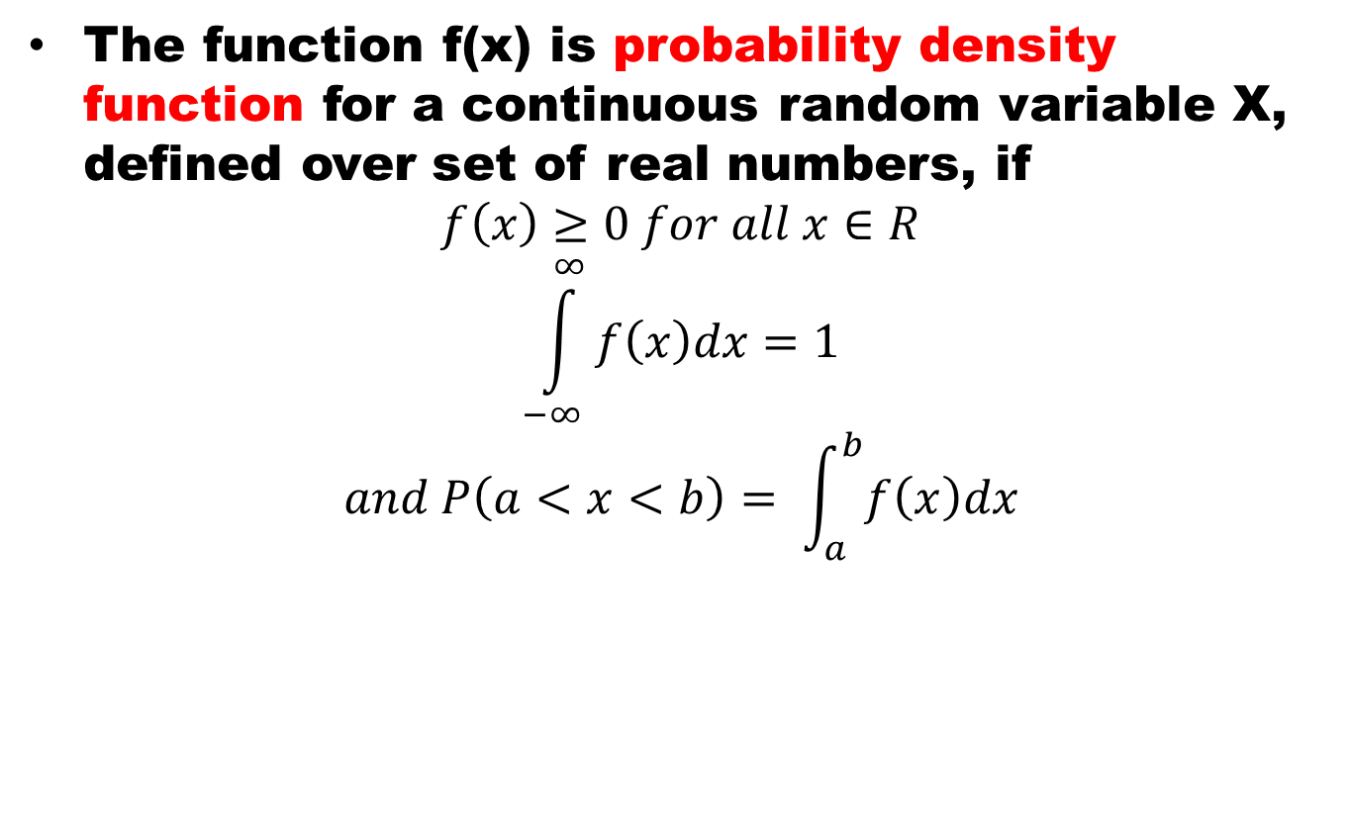
Continuous PDF
The function f(x) is probability density function for a continuous random variable X, defined over set of real numbers, if
$$f\left(x\right)≥0 for all x∈R$$
$$\int_{−∞}^{∞}{f\left(x\right)dx=1}$$
$$and P\left(a<x<b\right)= \int_{a}^{b}{f\left(x\right)dx}$$

Slide 45
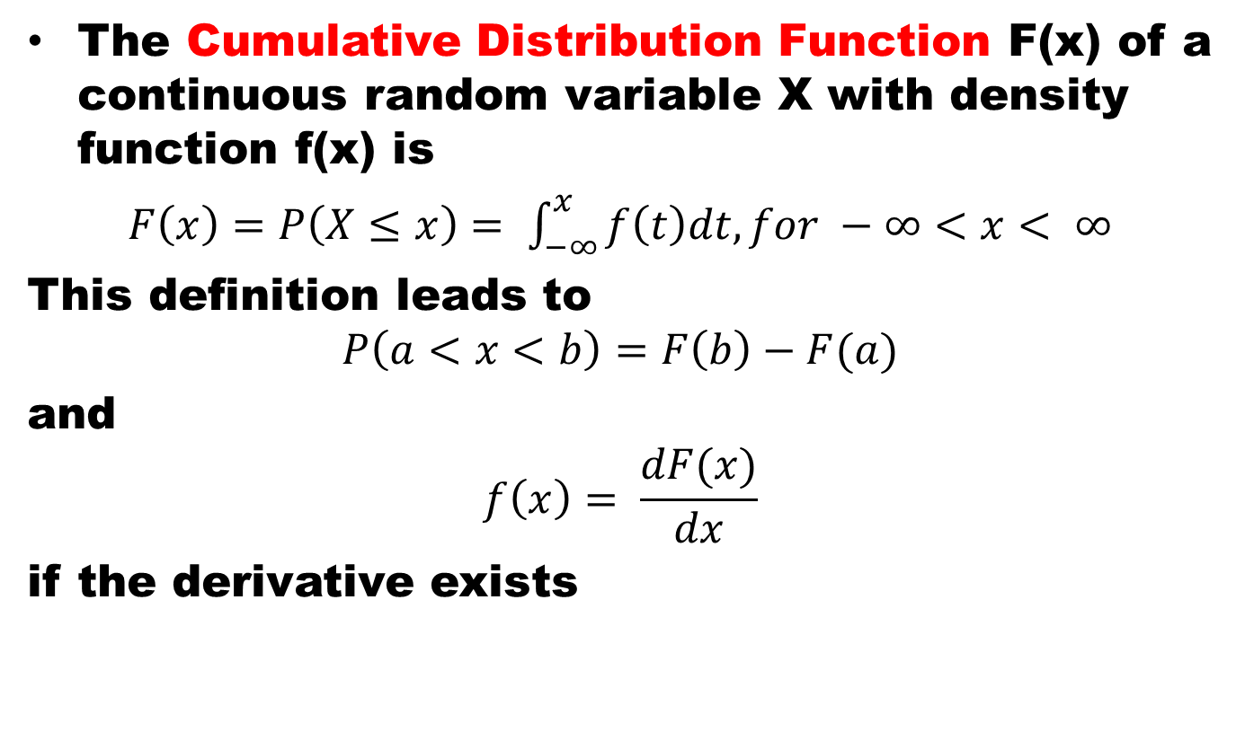
Cumulative Distribution Function
The Cumulative Distribution Function F(x) of a continuous random variable X with density function f(x) is
$F\left(x\right)=P\left(X≤x\right)= \int_{−∞}^{x}{f\left(t\right)dt, for −∞<x< ∞}$
This definition leads to
$$P\left(a<x<b\right)=F\left(b\right)−F(a)$$
and
$$f\left(x\right)= \frac{dF(x)}{dx}$$
if the derivative exists

