Slide 1
Mathematical Statistics
Lecture 30
Prof. Dr. M. Junaid Mughal

Slide 2
Last Class
Estimators

Slide 3
Today’s Class
Central Limit Theorem
Regression Analysis
Correlation

Slide 4
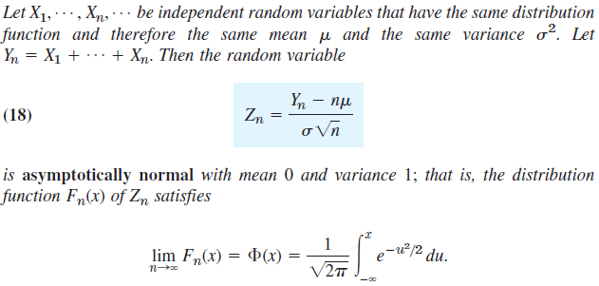
Central Limit Theorem

Slide 5
Regression Analysis
So far we were concerned with random experiments in which we observed a single quantity (random variable) and got samples whose values were single numbers.
Lets discuss experiments in which we observe or measure two quantities simultaneously, so that we get samples of pairs of values most applications involve one of two kinds of experiments, as follows.

Slide 6
Regression Analysis
In regression analysis one of the two variables, call it x, can be regarded as an ordinary variable because we can measure it without substantial error or we can even give it values we want. x is called the independent variable, or sometimes the controlled variable because we can control it (set it at values we choose). The other variable, Y, is a random variable, and we are interested in the dependence of Y on x.
Typical examples are
  the dependence of the blood pressure Y on the age x of a person or, as we shall now say, the regression of Y on x,
  the regression of the gain of weight Y of certain animals on the daily ration of food x,
  the regression of the heat conductivity Y of cork on the specific weight x of the cork, etc.

Slide 7
Regression Analysis
In correlation analysis both quantities are random variables and we are interested in relations between them.
Examples are
  the relation (one says “correlation”) between wear X and wear Y of the front tires of cars,
  between grades X and Y of students in mathematics and in physics, respectively,
  between the hardness X of steel plates in the center and the hardness Y near the edges of the plates, etc.

Slide 8
Regression Analysis
In regression analysis one of the two variables, call it x, can be regarded as an ordinary variable because we can measure it without substantial error or we can even give it values we want. x is called the independent variable, or sometimes the controlled variable because we can control it.
The other variable, Y, is a random variable, and we are interested in the dependence ofY on x.

Slide 9
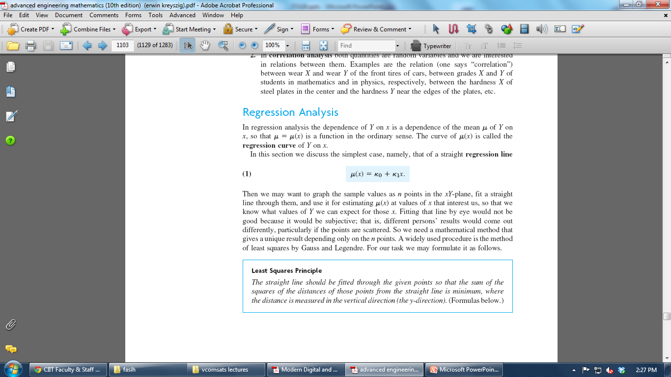
Regression Analysis

Slide 10
Regression Analysis

Slide 11
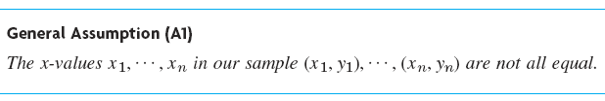
Least Squares Principle
The straight line should be fitted through the given points so that the sum of the squares of the distances of those points from the straight line is minimum, where the distance is measured in the vertical direction.

Slide 12
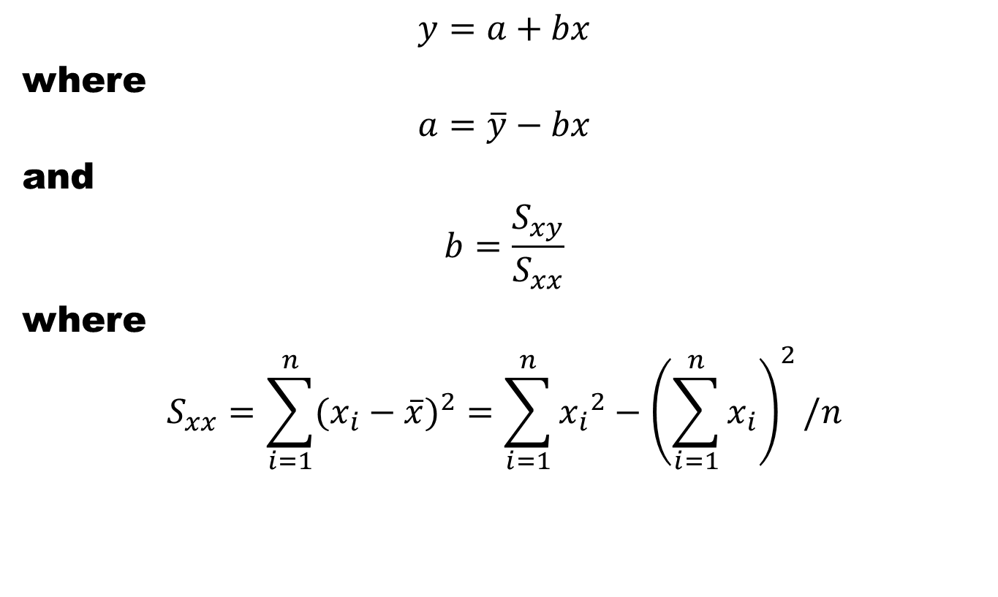
Estimators
$$y=a+bx$$
where
$$a=\overline{y}−bx$$
and
$$b=\frac{S_{xy}}{S_{xx}}$$
where
$$S_{xx}=\sum_{i=1}^{n}{{(x_{i}−\overline{x})}^{2}}=\sum_{i=1}^{n}{{x_{i}}_{}^{2}−{\left(\sum_{i=1}^{n}{x_{i}}\right)}^{2}/n}$$

Slide 13
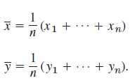

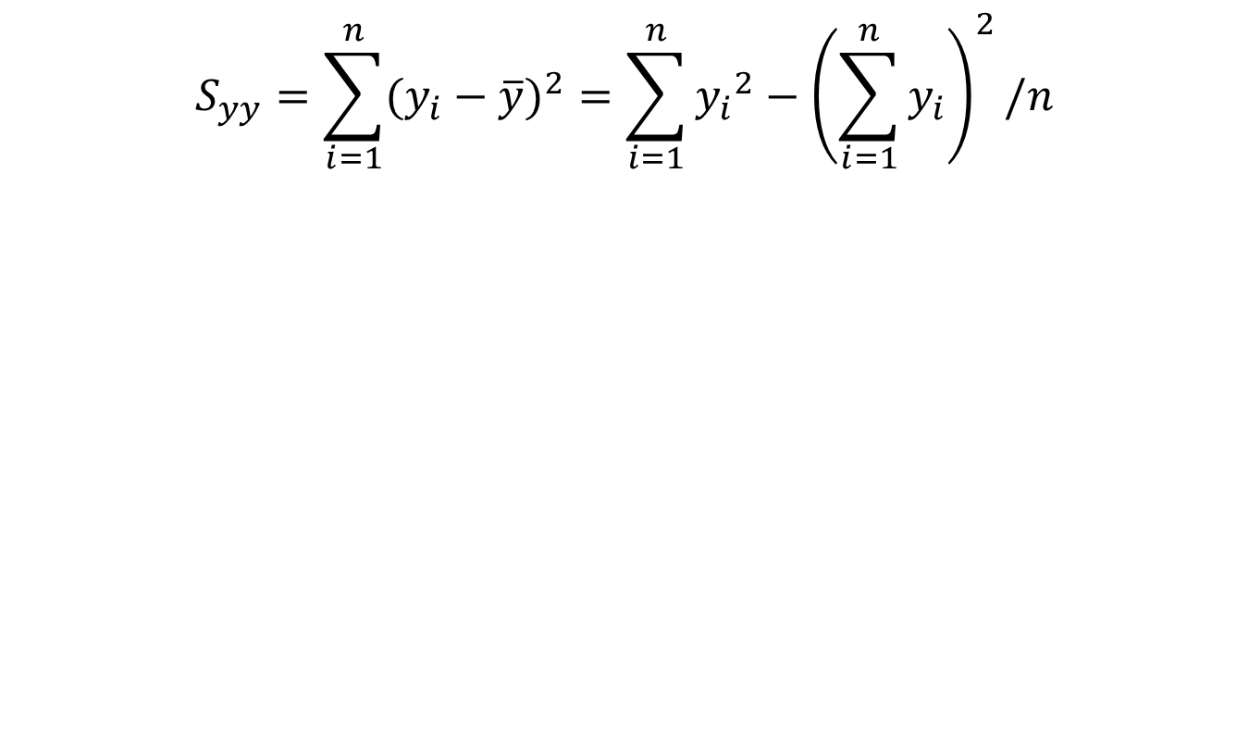
Estimators
$$S_{yy}=\sum_{i=1}^{n}{{(y_{i}−\overline{y})}^{2}}=\sum_{i=1}^{n}{{y_{i}}_{}^{2}−{\left(\sum_{i=1}^{n}{y_{i}}\right)}^{2}/n}$$

Slide 14
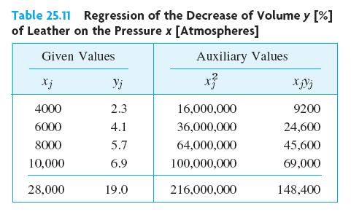
Example
The decrease of volume
of leather for certain
fixed values of high
pressure x [atmospheres]
was measured. The results
are shown in the first
two columns of Table.
Find the regression line of y on x.

Slide 15
Example
Air velocity and evaporation coefficient of burning fuel droplets in impulse engine. Fit a st. line to these data. Use this estimate to evaluate
coefficient when
v=190 cm/s
V | coeff | V | Coeff
20 | 0.18 | 60 | 0.37
100 | 0.35 | 140 | 0.78
180 | 0.56 | 220 | 0.75
260 | 1.18 | 300 | 1.36
340 | 1.17 | 380 | 1.65

Slide 16
Example
X | Y | x-mean | y-mean | xymean | xx | yy
20 | 0.18 | -180 | -0.655 | 117.9 | 32400 | 0.42903
60 | 0.37 | -140 | -0.465 | 65.1 | 19600 | 0.21623
100 | 0.35 | -100 | -0.485 | 48.5 | 10000 | 0.23523
140 | 0.78 | -60 | -0.055 | 3.3 | 3600 | 0.00302
180 | 0.56 | -20 | -0.275 | 5.5 | 400 | 0.07563
220 | 0.75 | 20 | -0.085 | -1.7 | 400 | 0.00722
260 | 1.18 | 60 | 0.345 | 20.7 | 3600 | 0.11903
300 | 1.36 | 100 | 0.525 | 52.5 | 10000 | 0.27563
340 | 1.17 | 140 | 0.335 | 46.9 | 19600 | 0.11223
380 | 1.65 | 180 | 0.815 | 146.7 | 32400 | 0.66423
2000 | 8.35 |  |  | 505.4 | 132000 | 2.13745
200 | 0.835 |  | aver | 56.15556 | 14666.67 | 0.23749

Slide 17
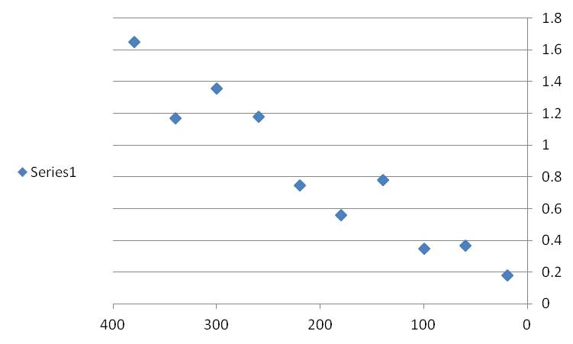
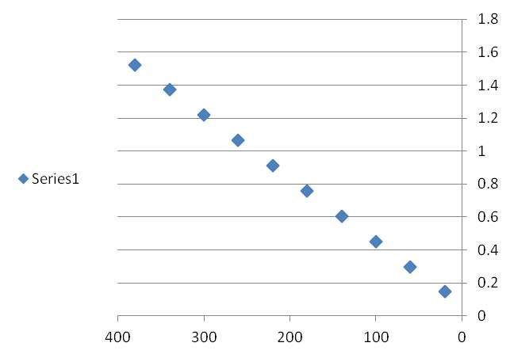
Example (Cont.)
k1= | 0.004
ko= | 0.069

Slide 18
Determination of Coefficients

Slide 19
Determination of Coefficients

Slide 20
Determination of Coefficients

Slide 21
Correlation Analysis
Correlation Coefficient for a Discrete Data set is defined as
r = S_{xy}/(S_{xx}S_{yy})^{1/2}
The Correlation Coefficient r describes strength of linear relation and sign its direction
If r = 1 all (x,y) lie on st line with +ve slope and vice versa
If r > 0, the pattern in scattergram runs from bottom left to top right and vice versa
Magnitude of r is closer to 1 means strong linear relation and closer to 0 signifies weak relation.

Slide 22
Definitions
$$y=a+bx$$
where
$$a=\overline{y}−bx$$
and
$$b=\frac{S_{xy}}{S_{xx}}$$
where
$$S_{xx}=\sum_{i=1}^{n}{{(x_{i}−\overline{x})}^{2}}=\sum_{i=1}^{n}{{x_{i}}_{}^{2}−{\left(\sum_{i=1}^{n}{x_{i}}\right)}^{2}/n}$$

Slide 23
Definitions
$$S_{yy}=\sum_{i=1}^{n}{{(y_{i}−\overline{y})}^{2}}=\sum_{i=1}^{n}{{y_{i}}_{}^{2}−{\left(\sum_{i=1}^{n}{y_{i}}\right)}^{2}/n}$$

Slide 24
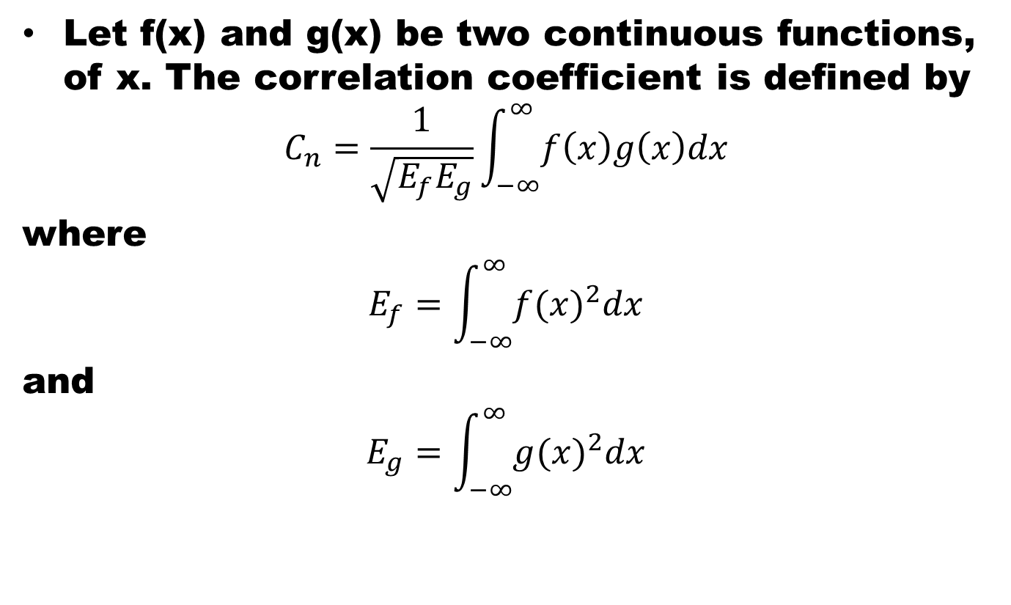
Correlation
Let f(x) and g(x) be two continuous functions, of x. The correlation coefficient is defined by
$$C_{n}=\frac{1}{\sqrt{E_{f}E_{g}}}\int_{−∞}^{∞}{f\left(x\right)g\left(x\right)dx}$$
where
$$E_{f}=\int_{−∞}^{∞}{{f(x)}^{2}dx}$$
and
$$E_{g}=\int_{−∞}^{∞}{{g(x)}^{2}dx}$$

Slide 25
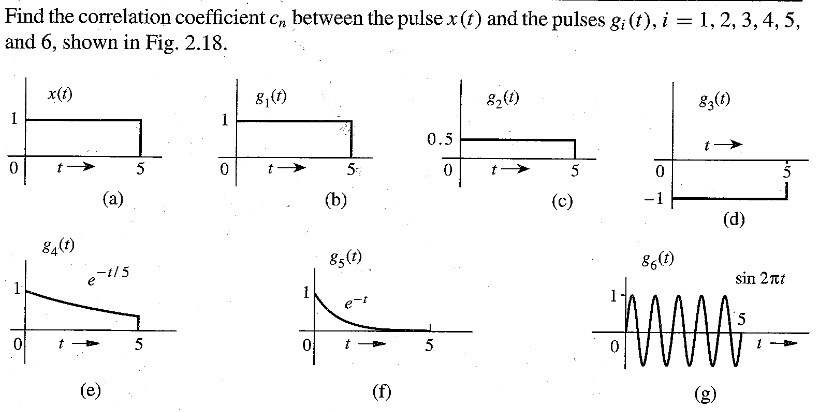
Examples

Slide 26
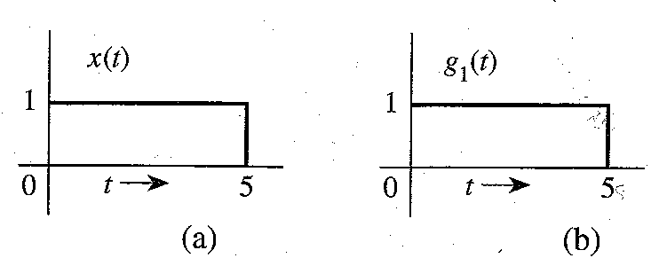
Example

Slide 27
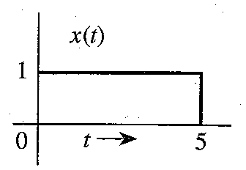
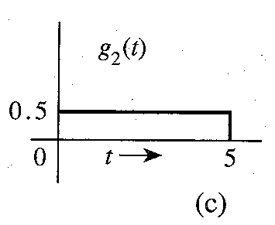
Example

Slide 28
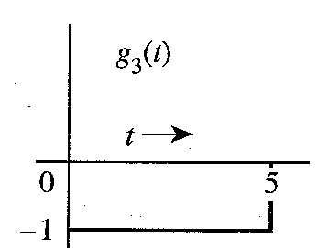
Example

Slide 29
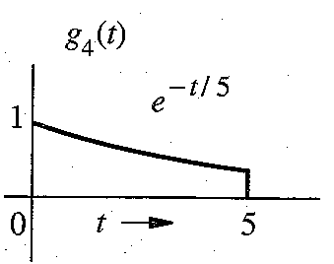
Example

Slide 30
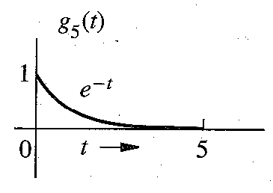
Example

Slide 31
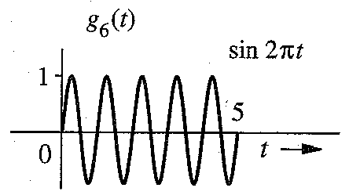
Example

Slide 32
References
Summary
Central Limit Theorem
Regression Analysis
Correlation
Probability and Statistics for Engineers and Scientists by Walpole
Advanced Engineering Mathematics by E Kreyszig.

