Slide 1
Mathematical Statistics
Lecture 29
Prof. Dr. M. Junaid Mughal

Slide 2
Last Class
Estimation of Parameters
Maximum Likelihood Estimator (MLE)

Slide 3
Today’s Agenda
Estimation of Parameters (contd)
Confidence Interval

Slide 4
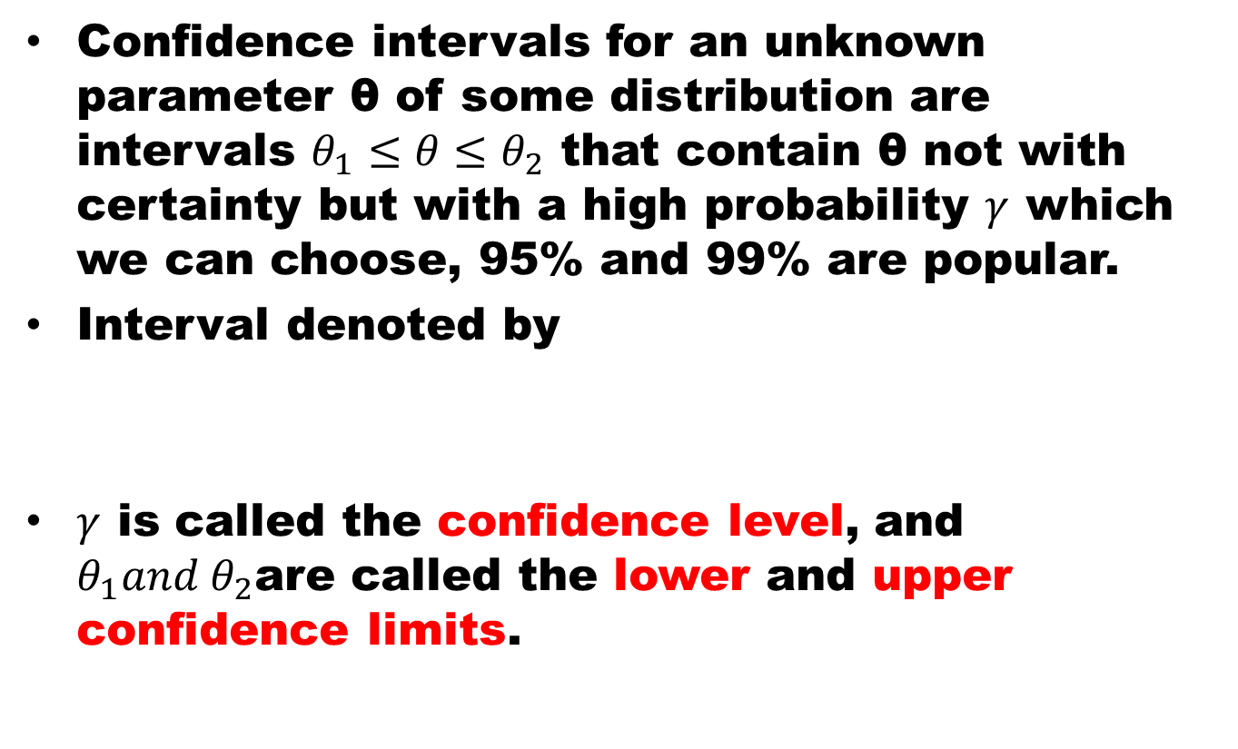
Confidence Interval
Confidence intervals for an unknown parameter θ of some distribution are intervals $θ_{1}≤θ≤θ_{2}$ that contain θ not with certainty but with a high probability $γ$ which we can choose, 95% and 99% are popular.
Interval denoted by
$γ$ is called the confidence level, and $θ_{1}and θ_{2}$are called the lower and upper confidence limits.

Slide 5
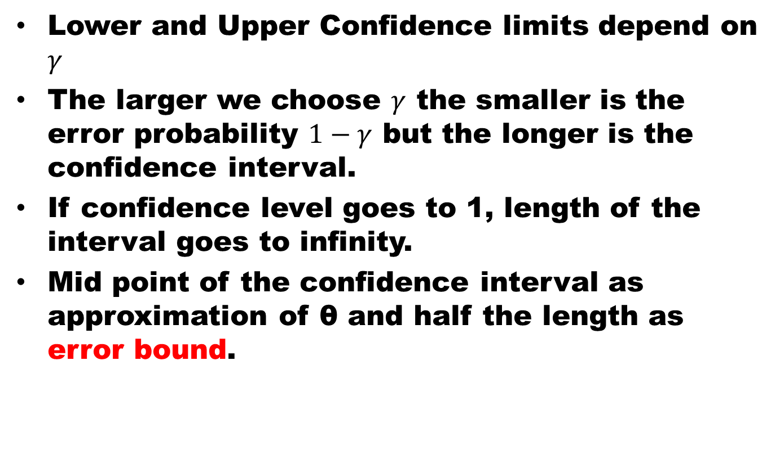
Confidence Interval
Lower and Upper Confidence limits depend on $γ$
The larger we choose $γ$ the smaller is the error probability $1−γ$ but the longer is the confidence interval.
If confidence level goes to 1, length of the interval goes to infinity.
Mid point of the confidence interval as approximation of θ and half the length as error bound.

Slide 6

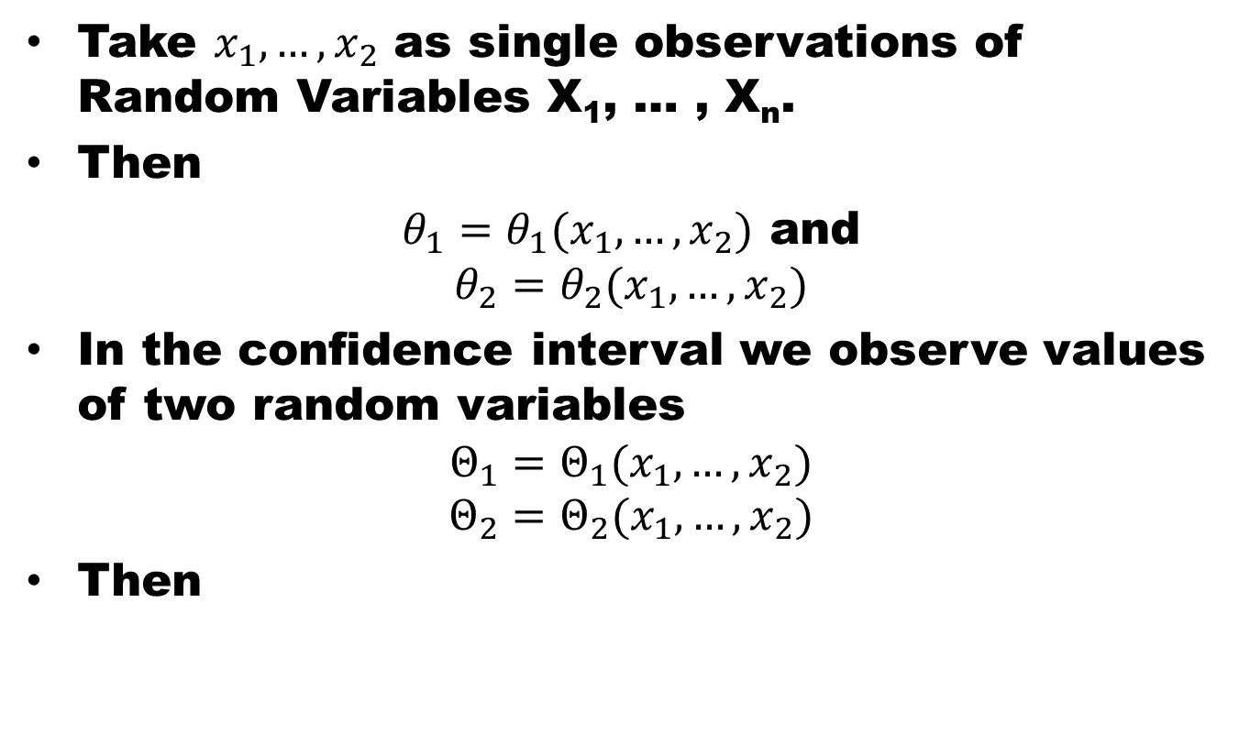
Procedure
Take $x_{1},…, x_{2}$ as single observations of Random Variables X₁, … , X_{n}.
Then
$θ_{1}=θ_{1}(x_{1},…, x_{2})$ and
$$θ_{2}=θ_{2}(x_{1},…, x_{2})$$
In the confidence interval we observe values of two random variables
$$Θ_{1}=Θ_{1}(x_{1},…, x_{2})$$
$$Θ_{2}=Θ_{2}(x_{1},…, x_{2})$$
Then

Slide 7
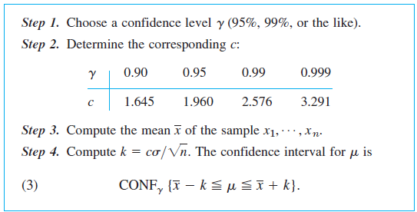
Confidence Interval for Mean of ND
It’s assumed that variance is known

Slide 8
Confidence Interval for Mean of ND
Sum of independent Normal Random Variable

Slide 9
Confidence Interval for Mean of ND
Confidence Interval

Slide 10
Example
Determine a 95% confidence interval for the mean of a normal distribution with variance 9 using a sample n = 100 values with mean 5. How large must n be for this confidence interval of length L = 0.4

Slide 11
Example
Height of 100 male students from 1456 students has estimated mean = 67.45” and variance = 2.39”. Find 95% and 99% confidence interval for estimation of the mean height.

Slide 12
Example
Mean and variance estimated from sample of 200 ball bearings are 0.824” and 0.042”. Find 95% and 99% confidence interval for this estimate.

Slide 13
Example
The average zinc concentration recovered from a sample of zinc measurements in 36 different locations is found to be 2.6 grams per milliliter. Find the 95% and 99% confidence intervals for the mean zinc concentration in the river. Assume that the population standard deviation is 0.3.

Slide 14
References
Summary
Estimation of Parameters
Confidence Interval
Central Limit Theorem
Probability and Statistics for Engineers and Scientists by Walpole
Advanced Engineering Mathematics by E Kreyszig.

