Slide 1
Mathematical Statistics
Lecture 27
Prof. Dr. M. Junaid Mughal

Slide 2
Last Class
Gamma Distribution
Exponential Distribution

Slide 3
Today’s Agenda
Exponential Distribution
Estimation of Parameters

Slide 4
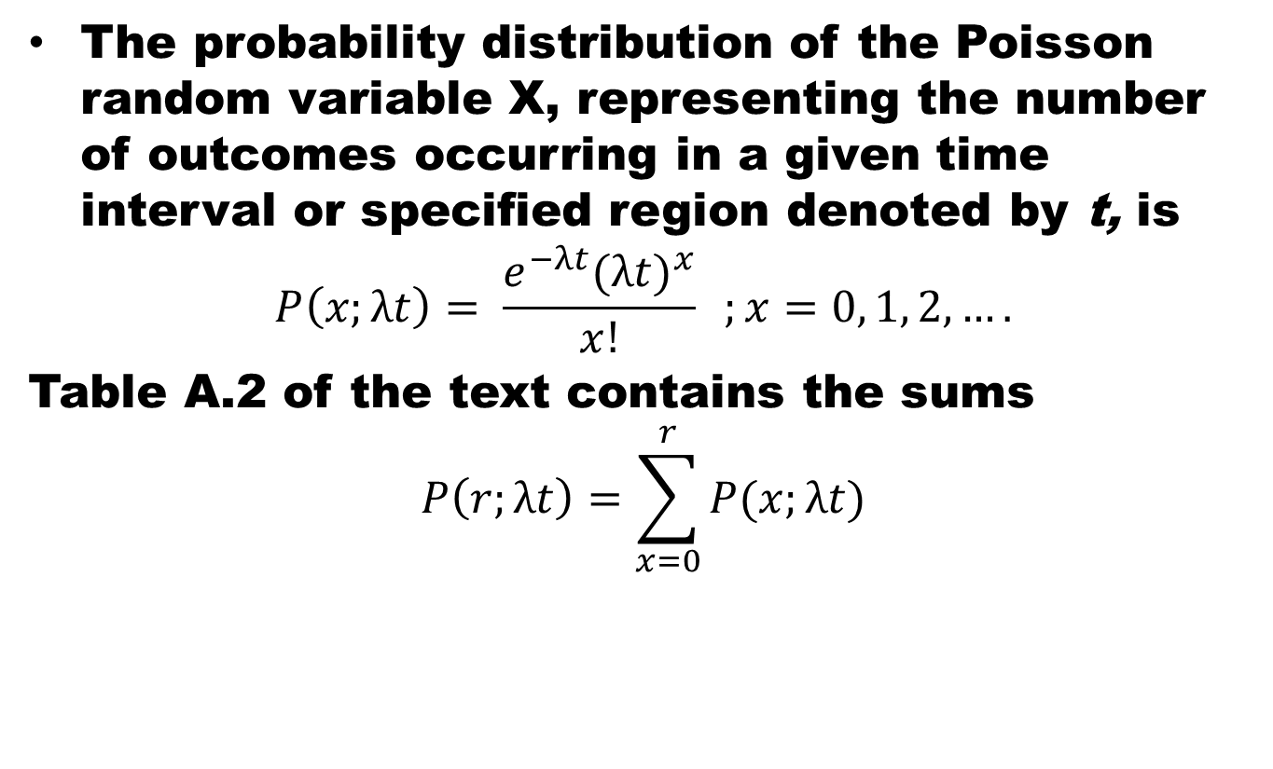
Poisson Distribution
The probability distribution of the Poisson random variable X, representing the number of outcomes occurring in a given time interval or specified region denoted by t, is
$$P\left(x;λt\right)= \frac{e^{−λt}{(λt)}^{x}}{x!} ;x=0, 1, 2, ….$$
Table A.2 of the text contains the sums
$$P\left(r;λt\right)=\sum_{x=0}^{r}{P(x;λt)}$$
where λ is the average number of outcomes per unit time, distance, area, or volume, and e = 2.71828 • • •.

Slide 5
Poisson Distribution
Theorem:
  Both the mean and variance of the Poisson distribution p(x; λt) are λt.

Slide 6
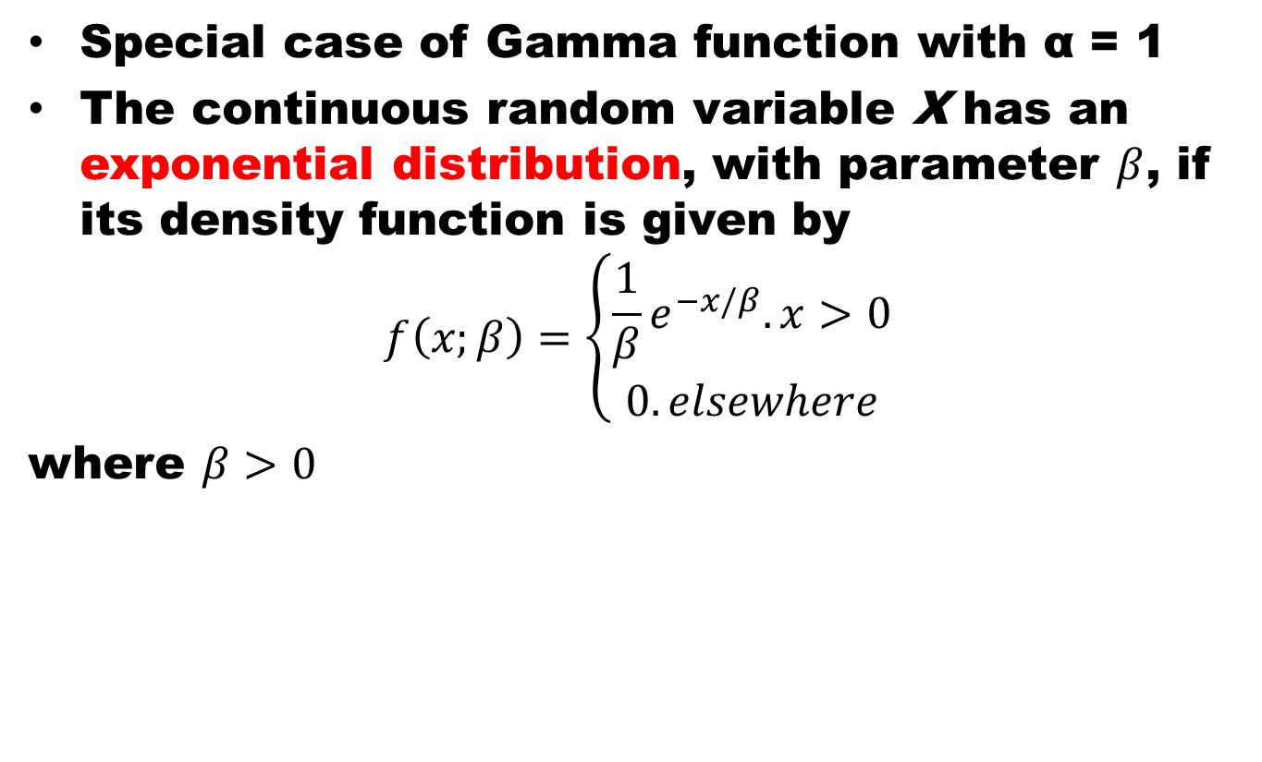
Exponential Distribution
Special case of Gamma function with α= 1
The continuous random variable X has an exponential distribution, with parameter $β$, if its density function is given by
$$f\left(x;β\right)=\left\{\begin{aligned}\frac{1}{β}e^{−x/β}. x>0 \\ 0. elsewhere\end{aligned}\right.$$
where $β>0$

Slide 7
Relationship of Exponential Distribution to the Poisson Process
The most important applications of the exponential distribution are situations where the Poisson process applies.
Recall that the Poisson process allows for the use of the discrete distribution called the Poisson distribution.
The Poisson distribution is used to compute the probability of specific numbers of "events" during a particular period of time or space.
In many applications, the time period or span of space is the random variable.
For example, an industrial engineer may be interested in modeling the time T between arrivals at a congested intersection during rush hour in a large city. An arrival represents the Poisson event.

Slide 8
Relationship of Exponential Distribution to the Poisson Process
The relationship between the exponential distribution (often called the negative exponential) and the Poisson process is quite simple.
Poisson distribution was developed as a single-parameter distribution with parameter λ, where λ may be interpreted as the mean number of events per unit "time."
Consider now the random variable described by the time required for the first event to occur. Using the Poisson distribution, we find that the probability of no events occurring in the span up to time t is given by

Slide 9
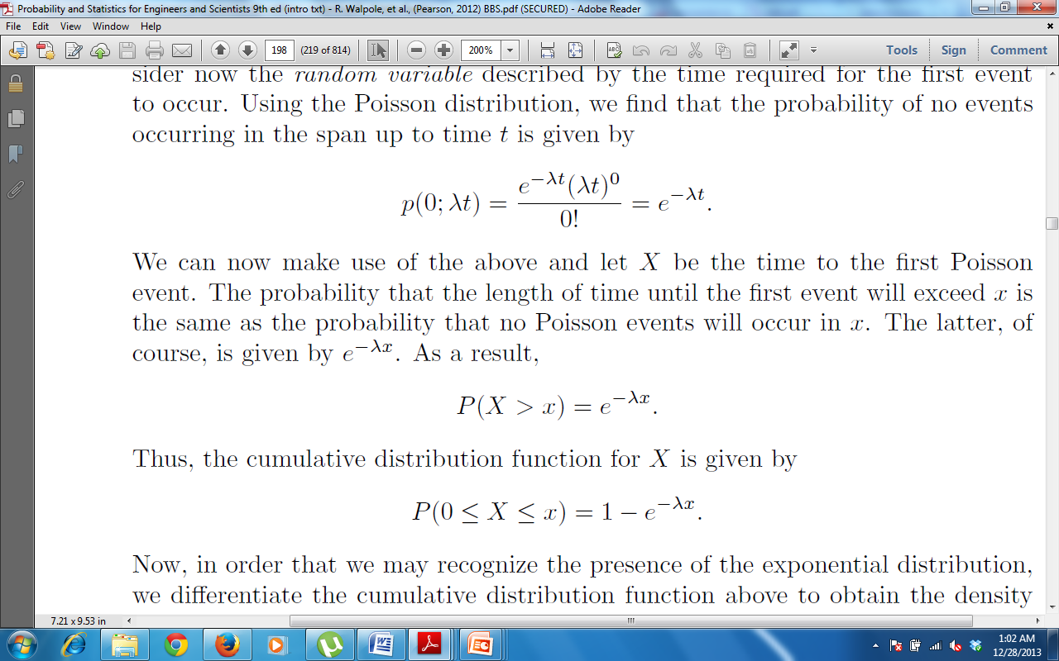
Relationship of Exponential Distribution to the Poisson Process
Consider now the random variable described by the time required for the first event to occur. Using the Poisson distribution, we find that the probability of no events occurring in the span up to time t is given by
We can now make use of the above and let X be the time to the first Poisson event. The probability that the length of time until the first event will exceed x is the same as the probability that no Poisson events will occur in x.

Slide 10
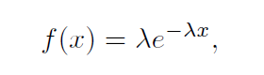
Relationship of Exponential Distribution to the Poisson Process
Thus the cumulative distribution function for X is given by
Now, in order that we recognize the presence of the exponential distribution, we may differentiate the cumulative distribution function above to obtain the density function
which is the density function of the exponential distribution with λ = 1/β.

Slide 11
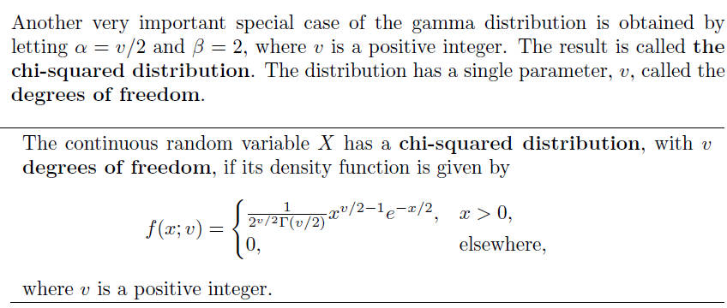
Some other continuous probability density functions
Chi-Squared Distribution

Slide 12
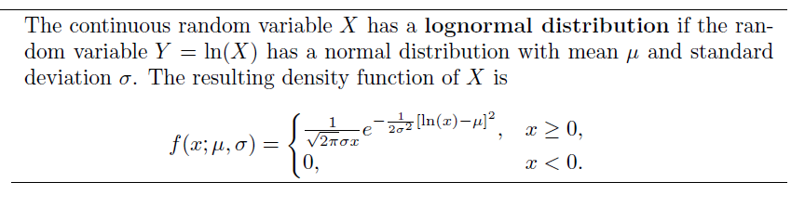
Some other continuous probability density functions
Lognormal Distribution

Slide 13
How to determine probability density functions?

Slide 14
Estimation of Parameters
Population and Sample
A point estimate of a parameter is a number (point on the real line), which is computed from a given sample and serves as an approximation of the unknown exact value of the parameter of the population.
An interval estimate is an interval (“confidence interval”) obtained from a sample.

Slide 15

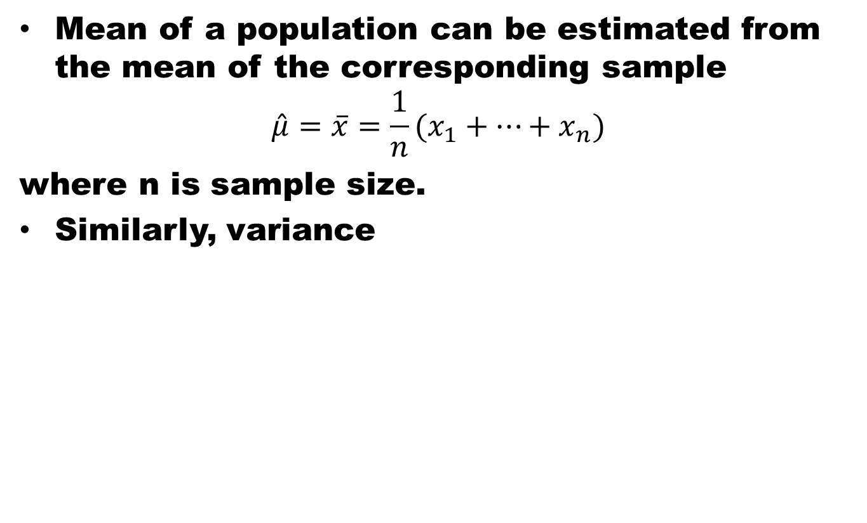
Approximation of Mean and Variance
Mean of a population can be estimated from the mean of the corresponding sample
$$\hat{μ}=\overline{x}=\frac{1}{n}(x_{1}+…+x_{n})$$
where n is sample size.
Similarly, variance

Slide 16

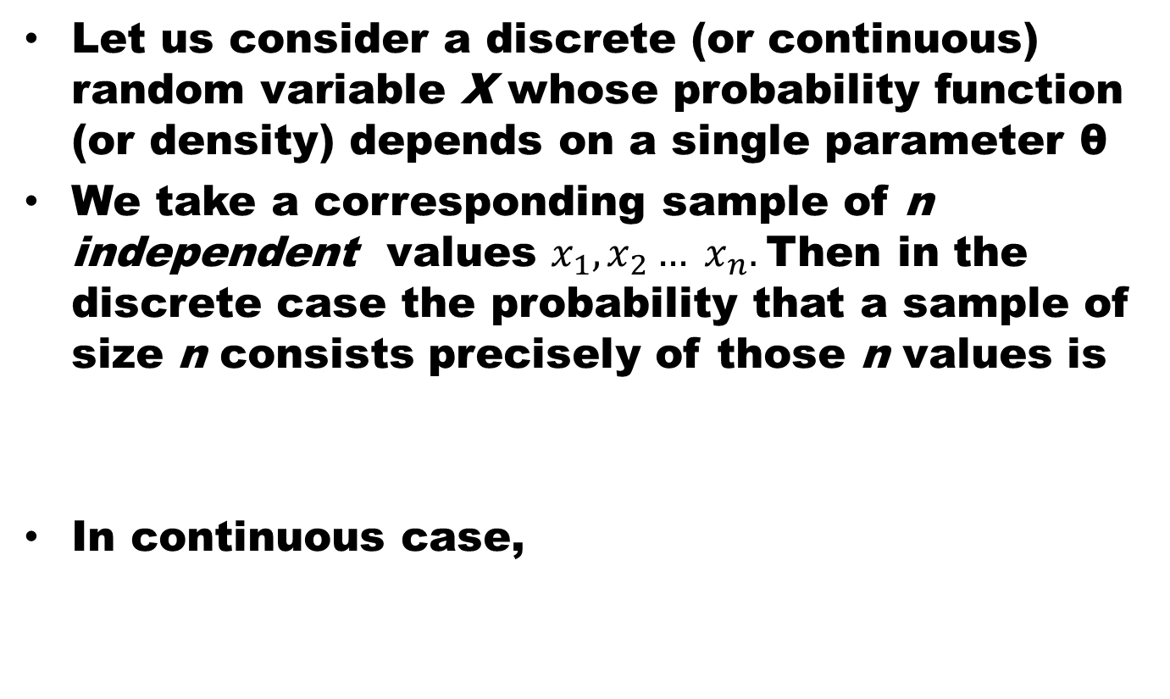
Maximum Likelihood Method
Let us consider a discrete (or continuous) random variable X whose probability function (or density) depends on a single parameter θ
We take a corresponding sample of n independent values $x_{1},x_{2}… x_{n}.$Then in the discrete case the probability that a sample of size n consists precisely of those n values is
In continuous case,

Slide 17
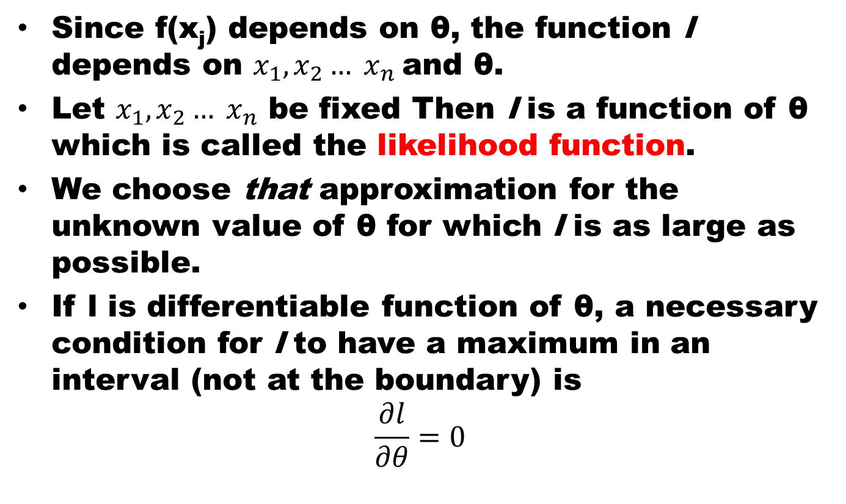
Maximum Likelihood Method
Since f(x_{j}) depends on θ,the function l depends on $x_{1},x_{2}… x_{n}$and θ.
Let $x_{1},x_{2}… x_{n}$ be fixed Then l is a function of θ which is called the likelihood function.
We choose that approximation for the unknown value of θfor which l is as large as possible.
If l is differentiable function of θ, a necessary condition for l to have a maximum in an interval (not at the boundary) is
$$\frac{∂l}{∂θ}=0$$

Slide 18
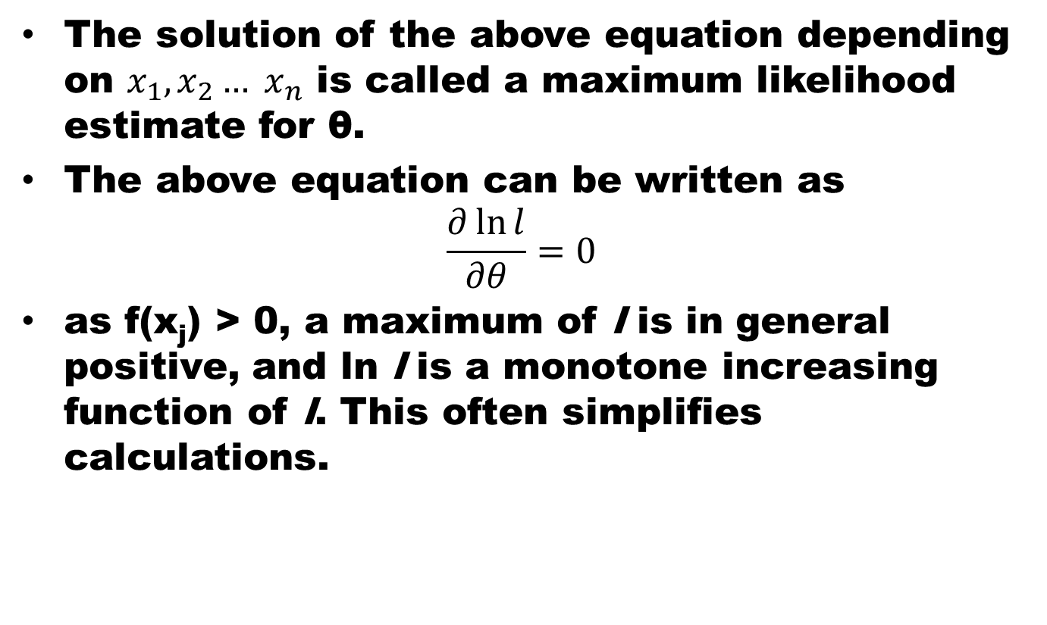
Maximum Likelihood Method
The solution of the above equation depending on $x_{1},x_{2}… x_{n}$ is called a maximum likelihood estimate for θ.
The above equation can be written as
$$\frac{∂\ln{l}}{∂θ}=0$$
as f(x_{j}) > 0, a maximum of l is in general positive, and lnl is a monotone increasing function of l. This often simplifies calculations.

Slide 19
References
Probability and Statistics for Engineers and Scientists by Walpole
Advanced Engineering Mathematics by E Kreyszig.

