Slide 1
Mathematical Statistics
Lecture 26
Prof. Dr. M. Junaid Mughal

Slide 2
Last Class
Normal Distribution
Approximation to Binomial Distribution

Slide 3
Today’s Agenda
Approximation to Binomial Distribution
Gamma Distribution
Exponential Distribution

Slide 4
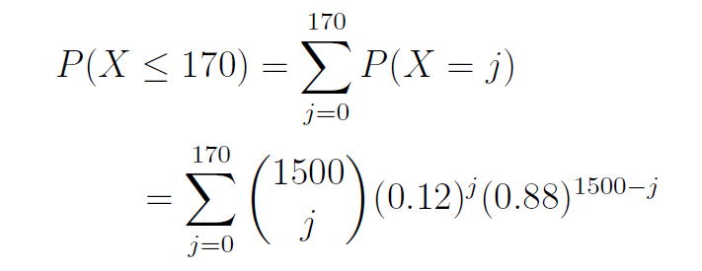
Binomial Distribution
Suppose out of a sample of 1,500 person we want to assess whether the representation of foreigners in the sample is accurate. We know that about 12% of population is foreigners. Let X be the number of foreigners in the sample, what is the probability that the sample contains 170 or fewer foreigners?

Slide 5
Binomial Distribution
It turns out that as n gets larger, the Binomial distribution looks increasingly like the Normal distribution.
Consider the following Binomial histograms, Binomial distribution with p = 0.1

Slide 6
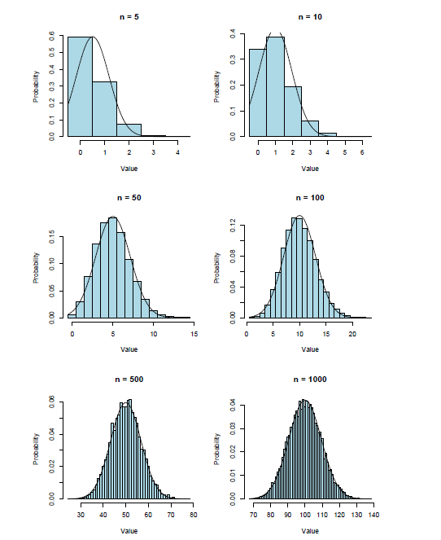
Binomial Distribution

Slide 7
Binomial Distribution

Slide 8
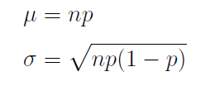
Parameters of the Approximating Distribution
The approximating Normal distribution has the same mean and standard deviation as the underlying Binomial distribution.
Thus, if X ~ B(n; p), having mean E[X] = np and standard deviation SD(X) = √np(1 - p) = sqrt(npq),
It can be approximated by Normal distribution with

Slide 9
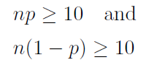
When is the approximation appropriate?
The farther p is from 0.5 , the larger n needs to be for the approximation to work.
Thus, as a rule of thumb, only use the approximation if

Slide 10
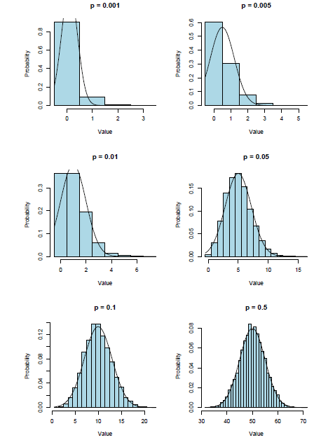
Behavior of the Approximation as a Function of p, for n = 100

Slide 11

Calculations with the Normal Approximation
Recall the problem we set out to solve:
  P(X <170); where X ~B(1500; 0.12)
How do we calculate this using the Normal approximation?
If we were to draw a histogram of the
B(1500; 0.12) distribution with bins of width one, P(X < 170) would be represented by the total area of the bins spanning

Slide 12
Calculations with the Normal Approximation
Thus, using the approximating Normal distribution Y ~ N(170; 0.12), we calculate
P(X ≤ 170) ≈ P(Y <170.5) = 0.2253
For reference, the exact Binomial probability is 0.2265, so the approximation is apparently pretty good

Slide 13
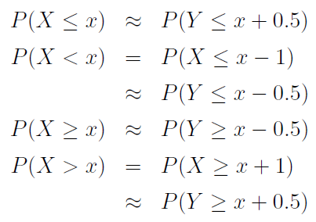
Calculations with the Normal Approximation
The addition of 0.5 in the previous slide is an example of the continuity correction which is intended to refine the approximation by accounting for the fact that the Binomial distribution is discrete while the Normal distribution is continuous.
In general, we make the following adjustments:

Slide 14
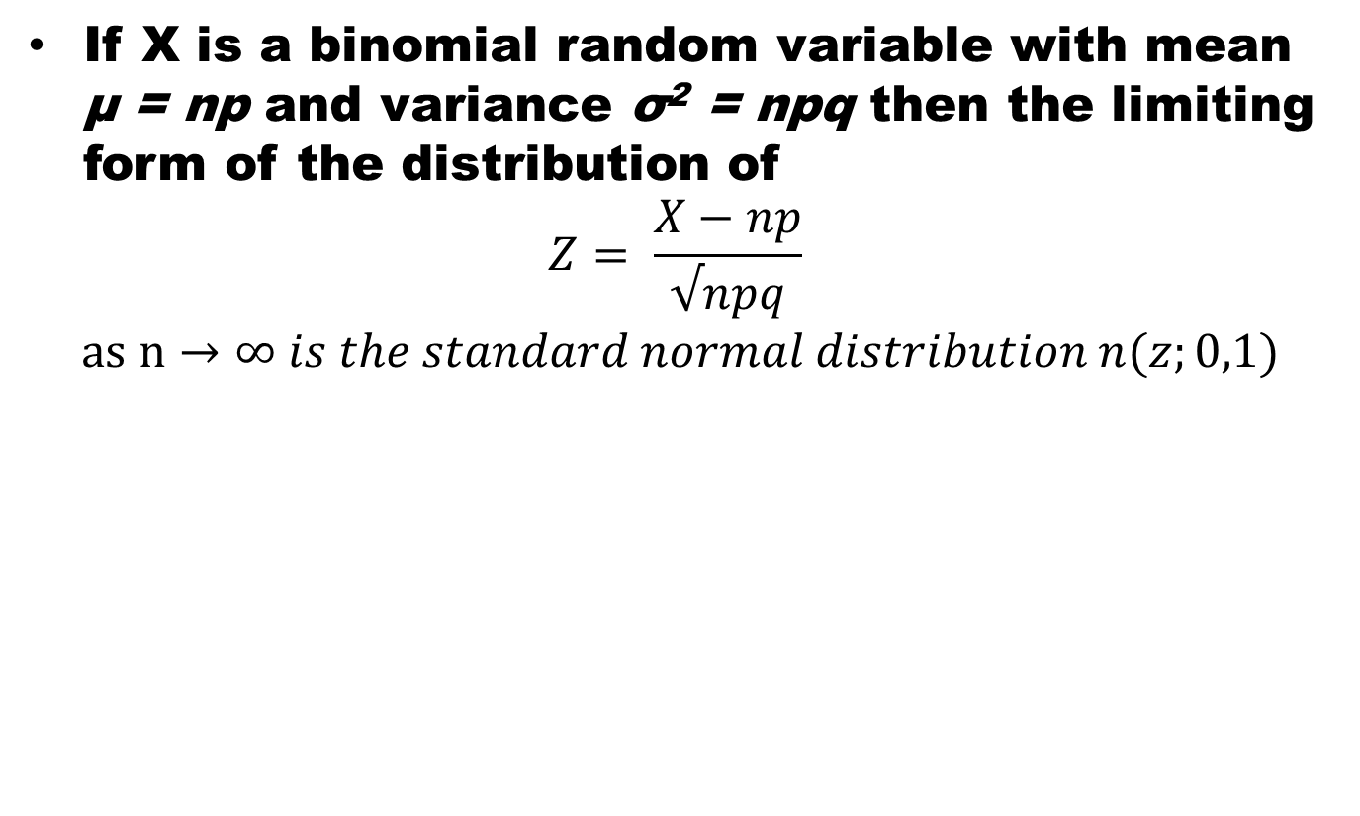
Normal Approximation to the Binomial
If Xis a binomial random variable with mean μ = npand variance σ²= npqthen the limiting form of the distribution of
$$Z= \frac{X−np}{√npq}$$
$$as n→∞ is the standard normal distribution n(z;0,1)$$

Slide 15
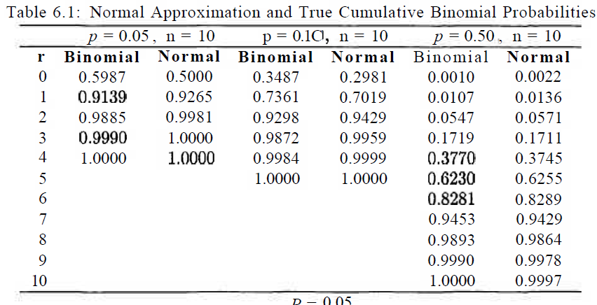
Comparison

Slide 16
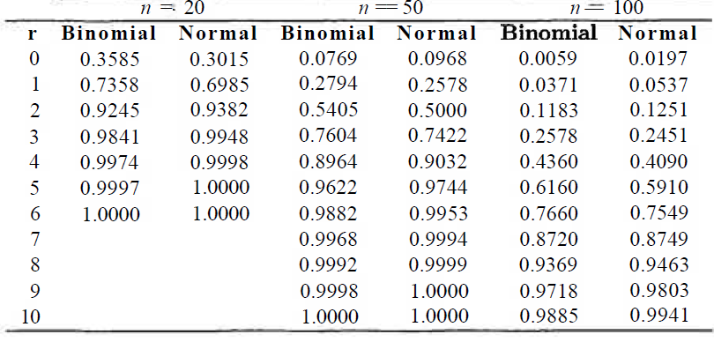
Comparison

Slide 17
Example
The probability that a patient recovers from a rare blood disease is 0.4. If 100 people are known to have contracted this disease, what is the probability that less than 30 survive?

Slide 18
Example
A multiple-choice quiz has 200 questions each with 4 possible answers of which only 1 is the correct answer. What is the probability that sheer guesswork yields from 25 to 30 correct answers for 80 of the 200 problems about which the student has no knowledge?

Slide 19
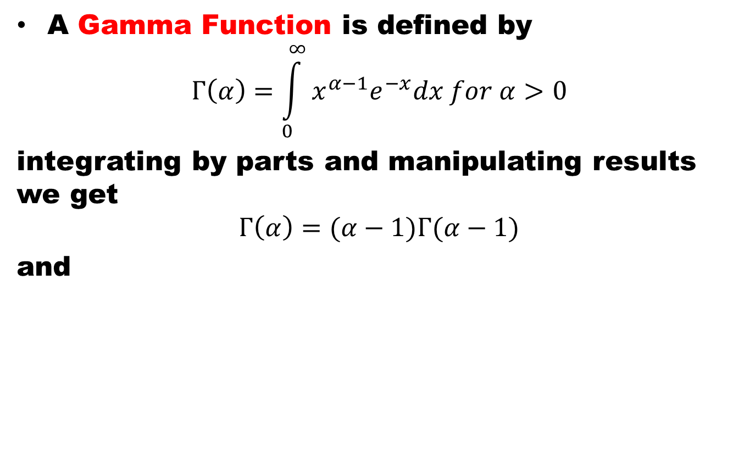
Gamma Distribution
A Gamma Function is defined by
$$Γ\left(α\right)=\int_{0}^{∞}{x^{α−1}e^{−x}dx for α>0}$$
integrating by parts and manipulating results we get
$$Γ\left(α\right)=(α−1)Γ(α−1)$$
and

Slide 20
Properties of Gamma Function

Slide 21
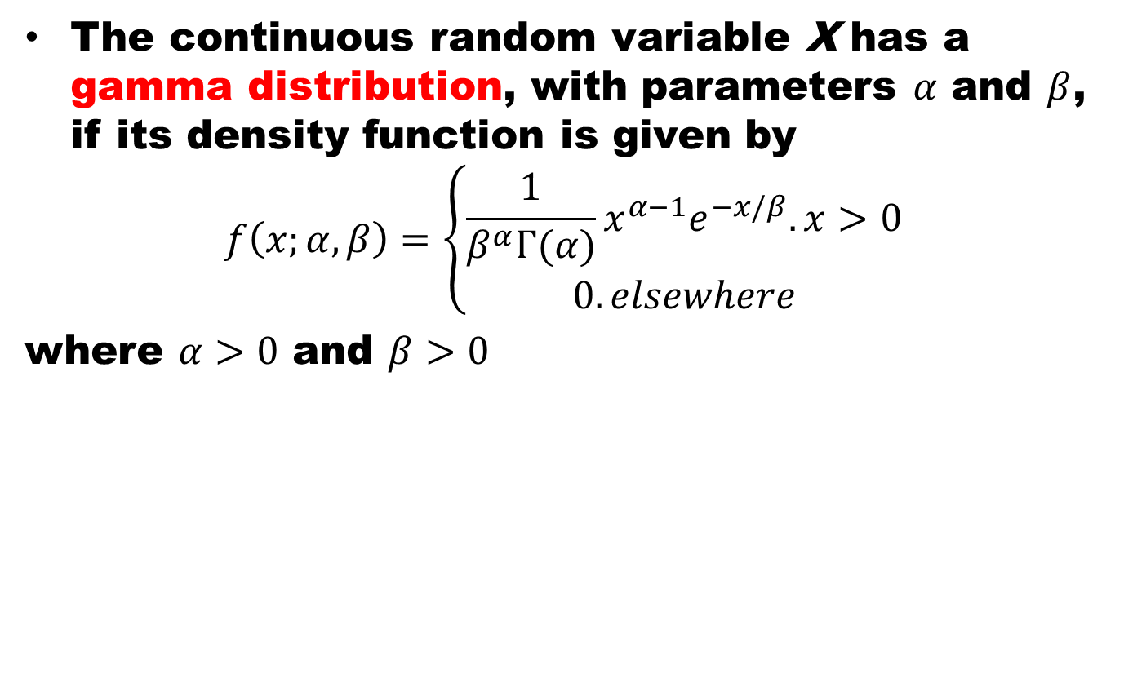
Gamma Distribution
The continuous random variable X has a gamma distribution, with parameters $α$and $β$, if its density function is given by
$$f\left(x;α,β\right)=\left\{\begin{aligned}\frac{1}{β^{α}Γ(α)}x^{α−1}e^{−x/β}. x>0 \\ 0. elsewhere\end{aligned}\right.$$
where $α>0$and $β>0$

Slide 22
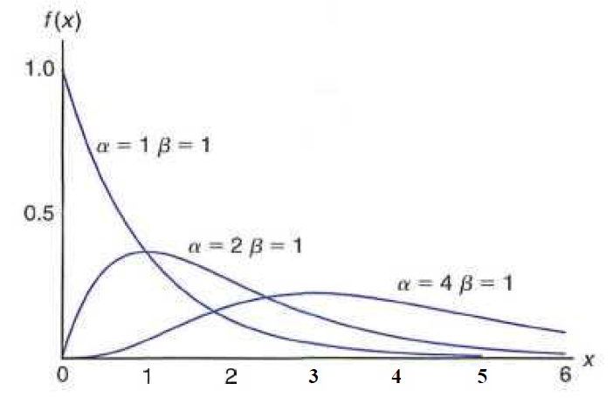
Gamma Distribution

Slide 23
Properties of Gamma Function
Proof:

Slide 24
Mean and Variance
The mean and variance of Gamma distribution are

Slide 25
Mean and Variance

Slide 26
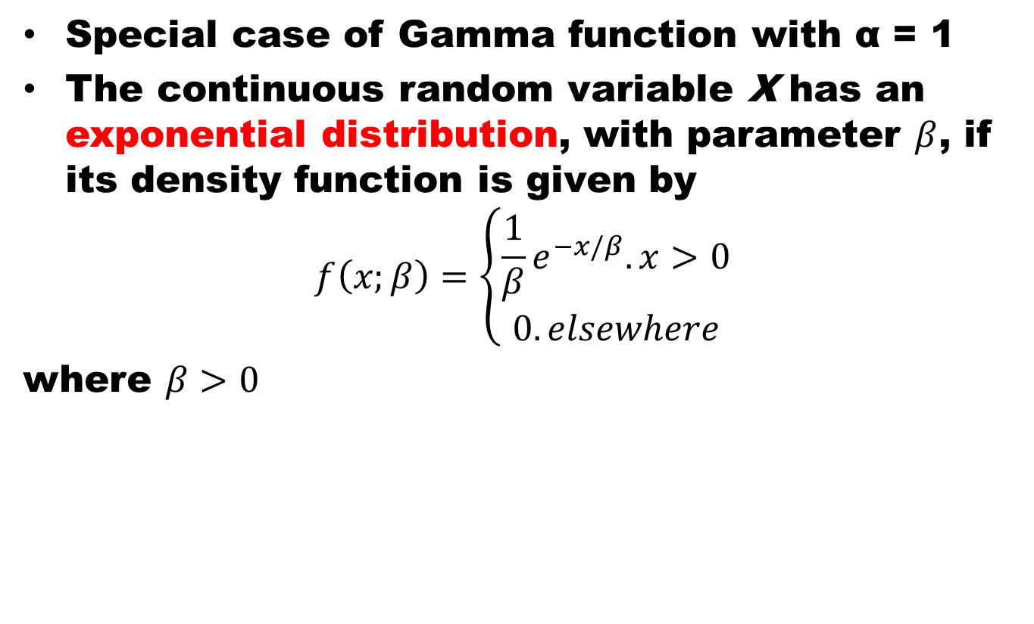
Exponential Distribution
Special case of Gamma function with α= 1
The continuous random variable X has an exponential distribution, with parameter $β$, if its density function is given by
$$f\left(x;β\right)=\left\{\begin{aligned}\frac{1}{β}e^{−x/β}. x>0 \\ 0. elsewhere\end{aligned}\right.$$
where $β>0$

Slide 27
Mean and Variance
The mean and variance of Exponential distribution are

Slide 28
References
Summary
  Gamma Distribution
  Exponential Distribution
Probability and Statistics for Engineers and Scientists by Walpole
Schaum outline series in Probability and Statistics

