Slide 1
Mathematical Statistics
Lecture 25
Prof. Dr. M. Junaid Mughal

Slide 2
Last Class
Normal Distribution

Slide 3
Today’s Agenda
Normal Distribution (cont.)
Normal Approximation to the Binomial

Slide 4
Using the Normal Curve in Reverse
All normal distributions can be converted into the standard normal curve by subtracting the mean and dividing by the standard deviation:
Then we can use the standard normal distribution table to find the probability

Slide 5
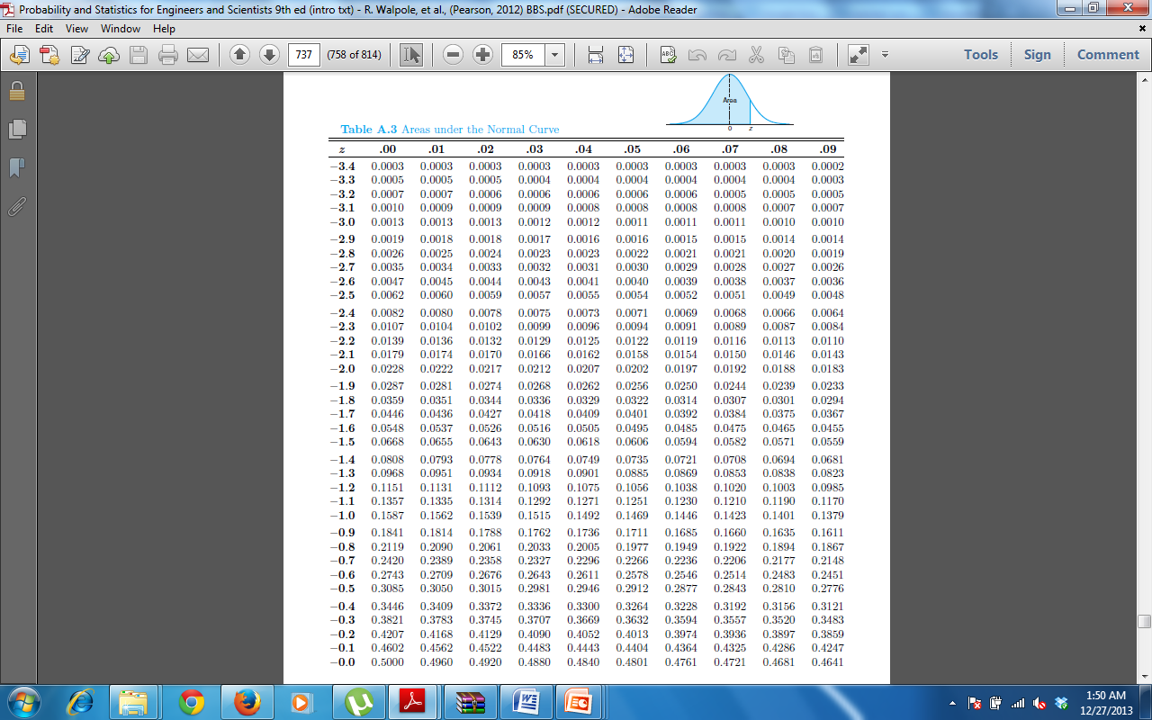
Table A.3

Slide 6
Table A.3

Slide 7
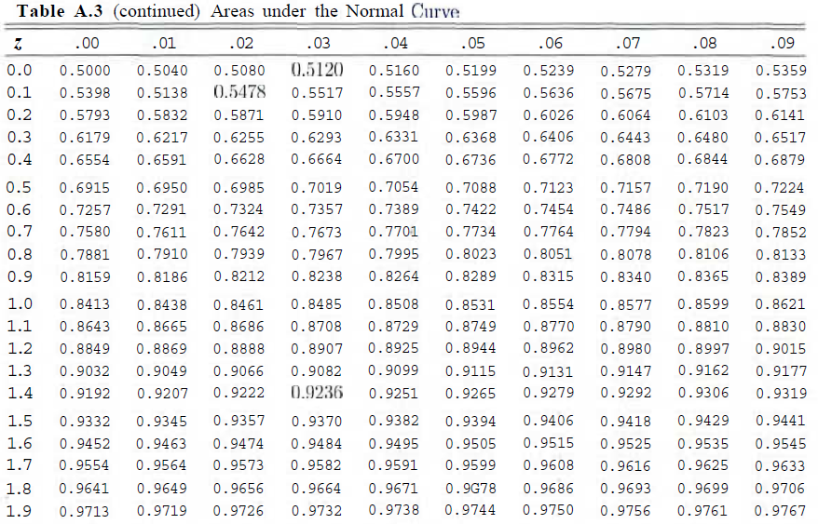
Table A.3

Slide 8
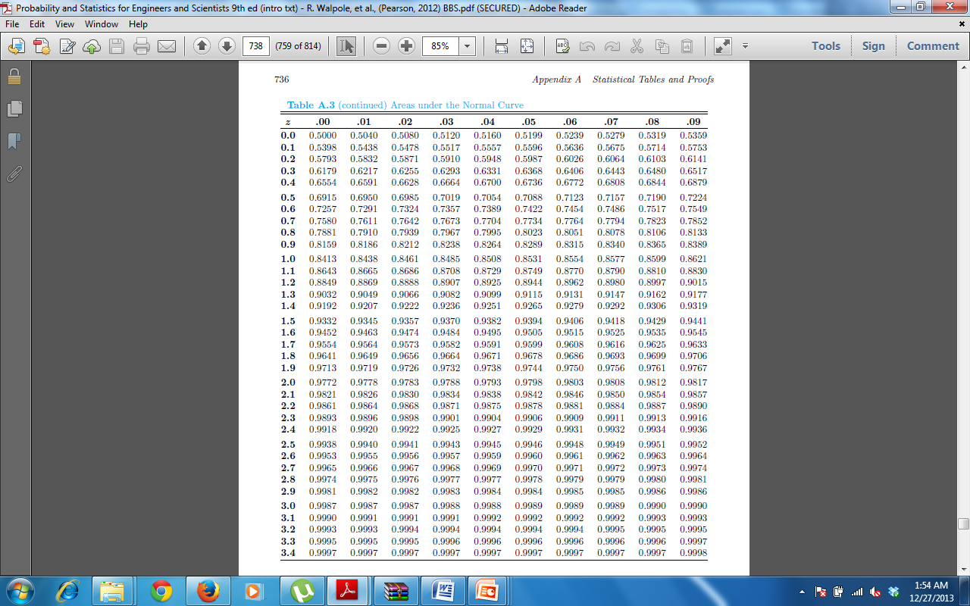
Table A.3

Slide 9
Example
The buyer of ball bearing sets specifications on the diameter to be 3.0 ± 0.01 cm. The diameter of a ball bearing has a normal distribution with mean 3.0 and standard deviation 0.005. On the average, how many manufactured ball bearings will be scrapped?

Slide 10
Example
Gauges are used to reject all components where a certain dimension is not within the specification l.50±d. This measurement is normally distributed with mean 1.50 and standard deviation 0.2. Determine the value d such that the specifications cover 95% of the measurements.

Slide 11
Example
A machine makes resistors having a mean resistance of 40 ohms and a standard deviation of 2 ohms. Assuming that the resistance follows a normal distribution and can be measured to any degree of accuracy, what percentage of resistors will have a resistance exceeding 43 ohms?

Slide 12
Example
The average grade for an exam is 74, and the standard deviation is 7. If 12% of the class is given A's, and the grades are curved to follow a normal distribution, what is the lowest possible A and the highest possible B?

Slide 13
Exercise
6.6 According to Chebyshev's theorem, the probability that any random variable assumes a value within 3 standard deviations of the mean is at least 8/9. If it is known that the probability distribution of a random variable X is normal with mean µ, and variance σ², what is the exact value of P(µ — 3σ < X < µ +3σ )?

Slide 14
Exercise
6.7 A research scientist reports that mice will live an average of 40 months when their diets are sharply restricted and then enriched with vitamins and proteins. Assuming that the lifetimes of such mice are normally distributed with a standard deviation of 6.3 months, find the probability that a given mouse will live
(a) more than 32 months;
(b) less than 28 months;
(c) between 37 and 49 months.

Slide 15
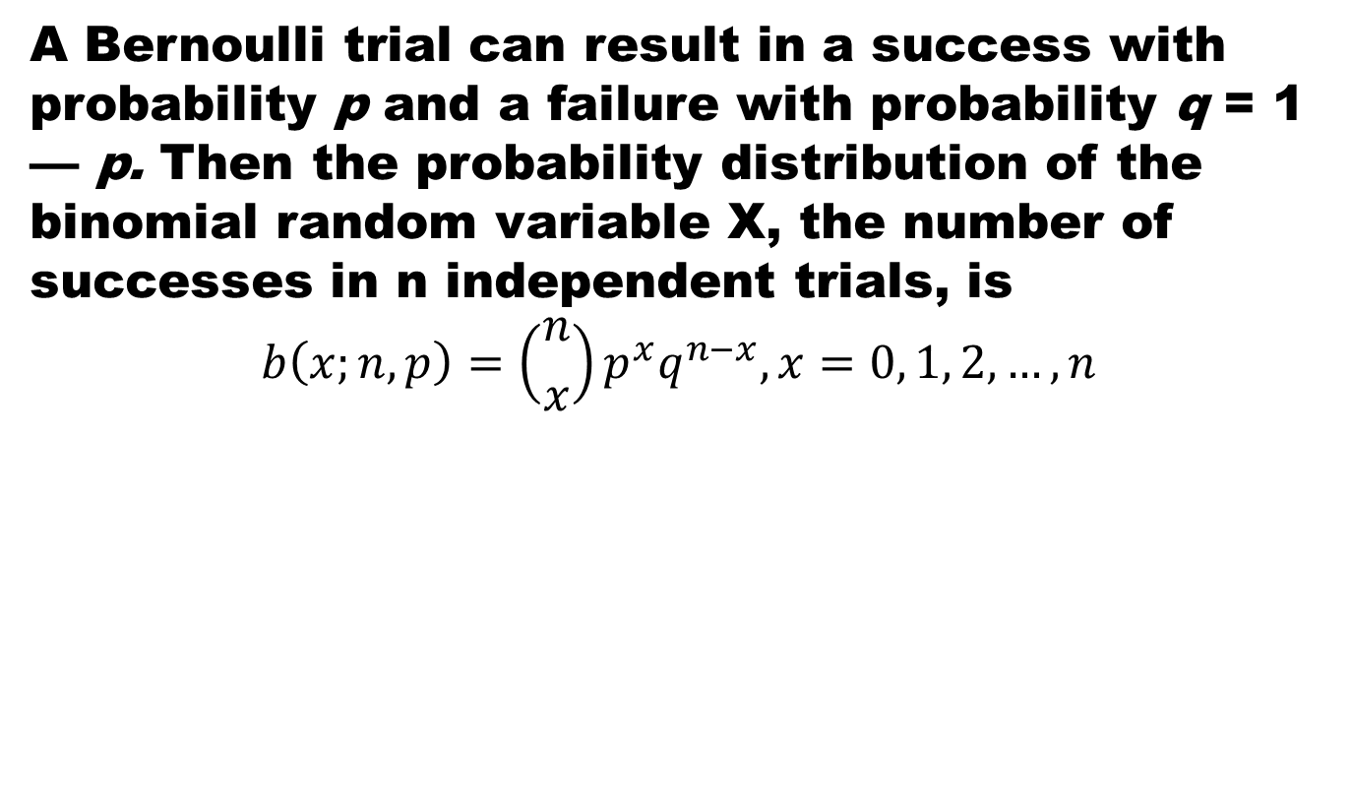
Binomial Distribution
A Bernoulli trial can result in a success with probability p and a failure with probability q = 1 — p. Then the probability distribution of the binomial random variable X, the number of successes in n independent trials, is
$$b\left(x;n,p\right)=\left({n \atop x}\right)p^{x}q^{n−x}, x=0, 1, 2,…, n$$

Slide 16
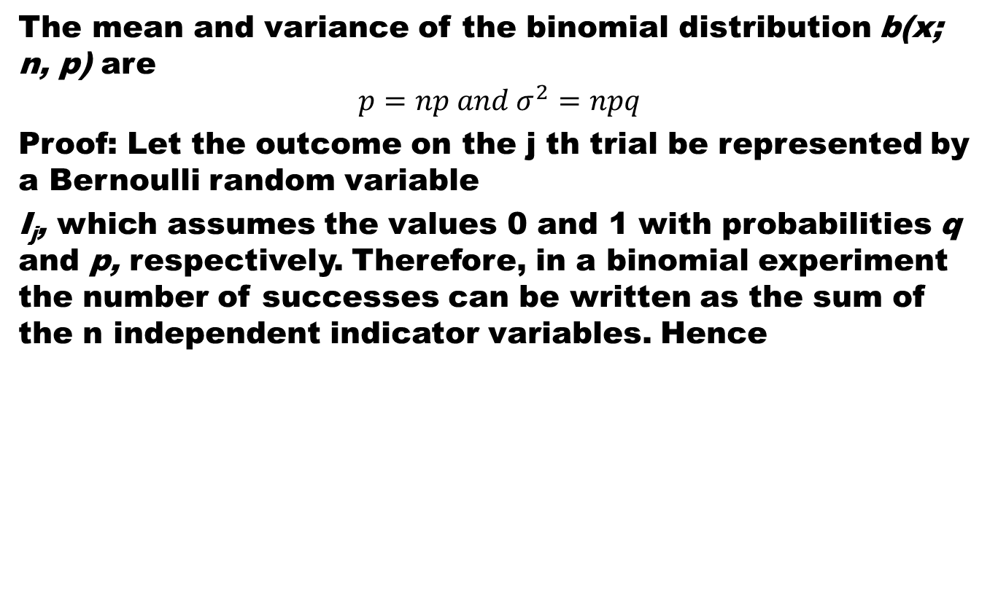
Theorem
The mean and variance of the binomial distribution b(x; n, p) are
$$p=np and σ^{2}=npq$$
Proof: Let the outcome on the j th trial be represented by a Bernoulli random variable
I_{j}, which assumes the values 0 and 1 with probabilities q and p, respectively. Therefore, in a binomial experiment the number of successes can be written as the sum of the n independent indicator variables. Hence

Slide 17
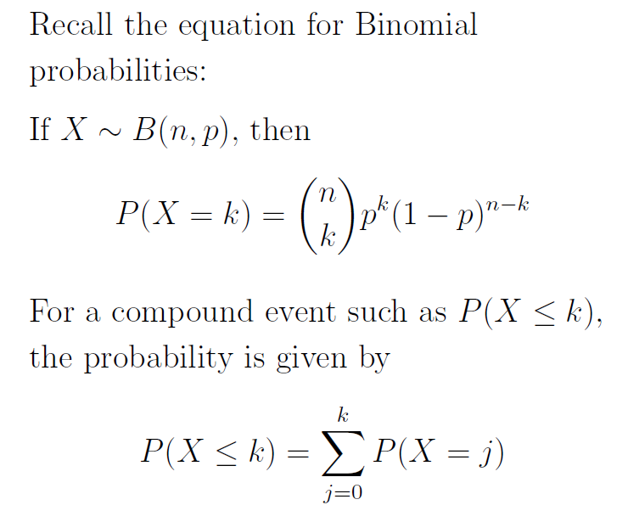
Binomial Distribution
Probability for a Binomial Random variable X
For a compound event such as P(X ≤ k) the probability is given by

Slide 18
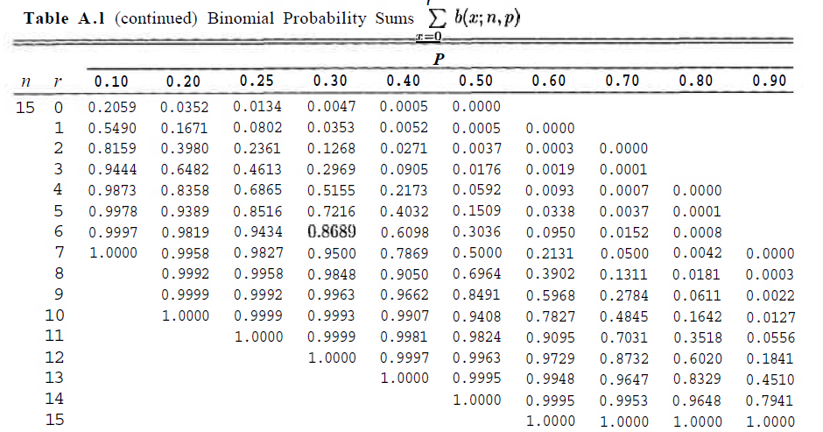
Table of Binomial Sum

Slide 19
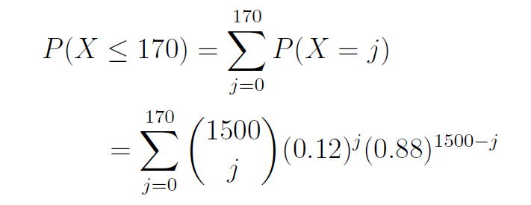
Binomial Distribution
Suppose out of a sample of 1,500 person we want to assess whether the representation of foreigners in the sample is accurate. We know that about 12% of population is foreigners. Let X be the number of foreigners in the sample, what is the probability that the sample contains 170 or fewer foreigners?

Slide 20
Binomial Distribution
It turns out that as n gets larger, the Binomial distribution looks increasingly like the Normal distribution.
Consider the following Binomial histograms, Binomial distribution with p = 0.1

Slide 21
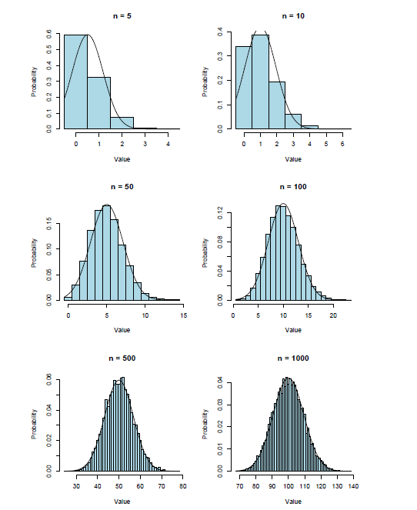
Binomial Distribution

Slide 22
Binomial Distribution

Slide 23
References
Summary
  Normal Distributions
  Normal Approximation to the Binomial distribution
Probability and Statistics for Engineers and Scientists by Walpole
Schaum outline series in Probability and Statistics

