Slide 1
Mathematical Statistics
Lecture 24
Prof. Dr. M. Junaid Mughal

Slide 2
Last Class
Normal Distribution

Slide 3
Today’s Agenda
Normal Distribution (cont.)

Slide 4
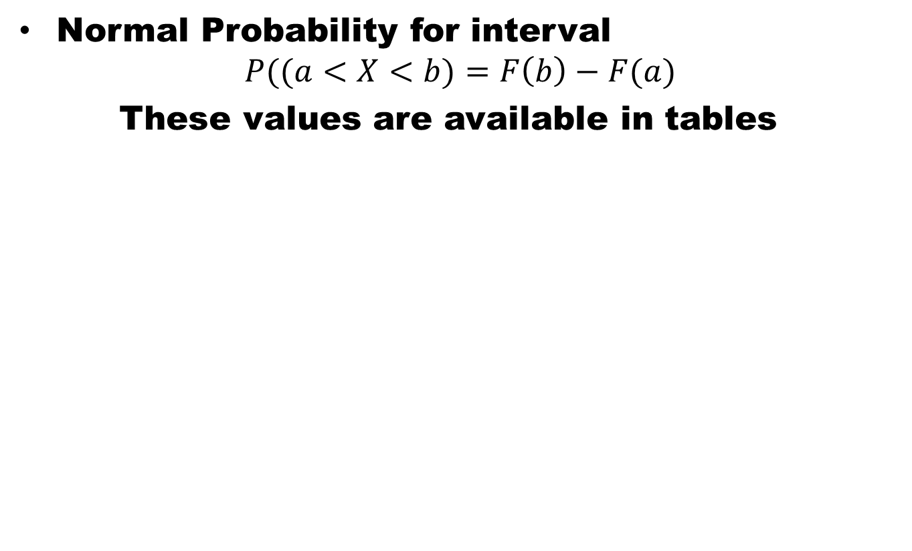
Normal Distribution
Normal Probability for interval
$$P((a<X<b)=F\left(b\right)−F(a)$$
These values are available in tables

Slide 5
Standard Normal Distribution
The distribution of a normal random variable with mean 0 and variance 1 is called a standard normal distribution.

Slide 6
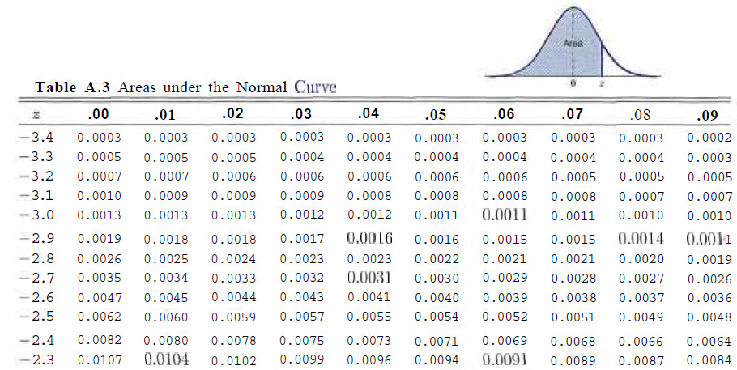
Area under the Normal Curve

Slide 7
Example
Given Standard Normal Dist. find area under the curves that lies to the right of z = 1.84 and between z = -1.97 to 0.86.

Slide 8
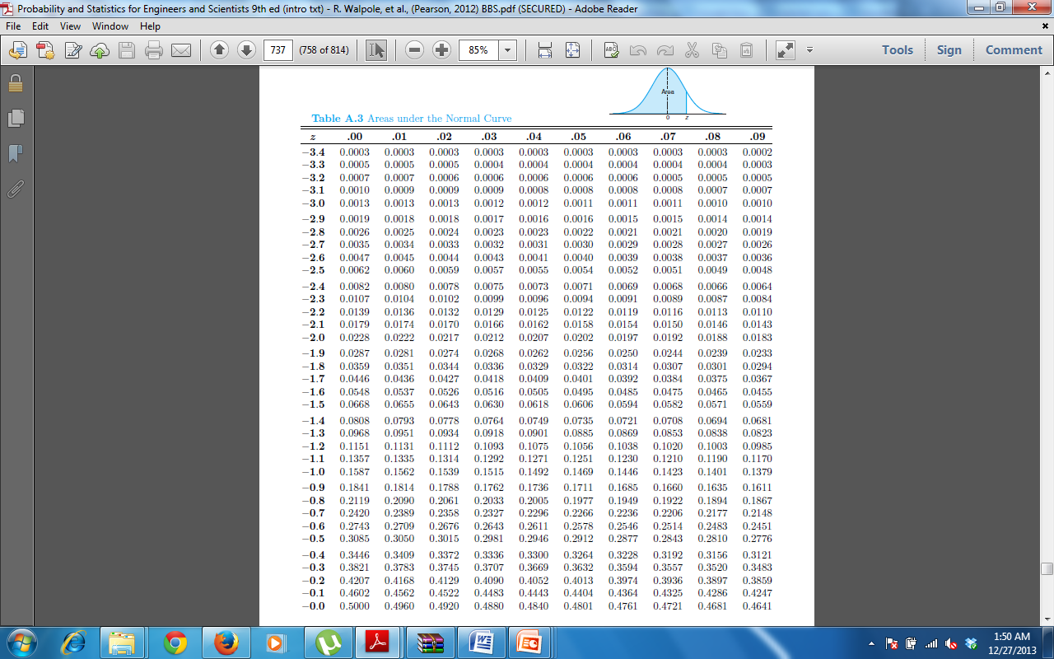
Table A.3

Slide 9
Table A.3

Slide 10
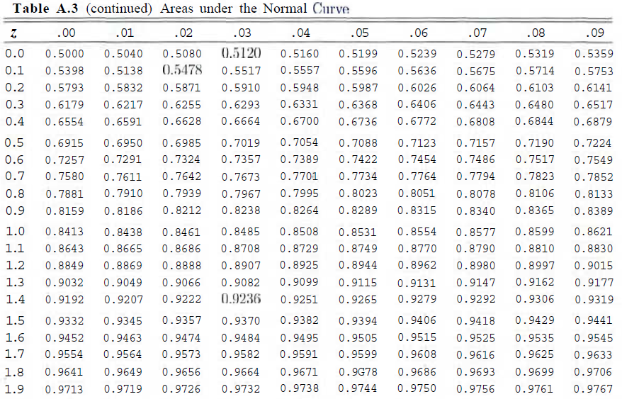
Table A.3

Slide 11
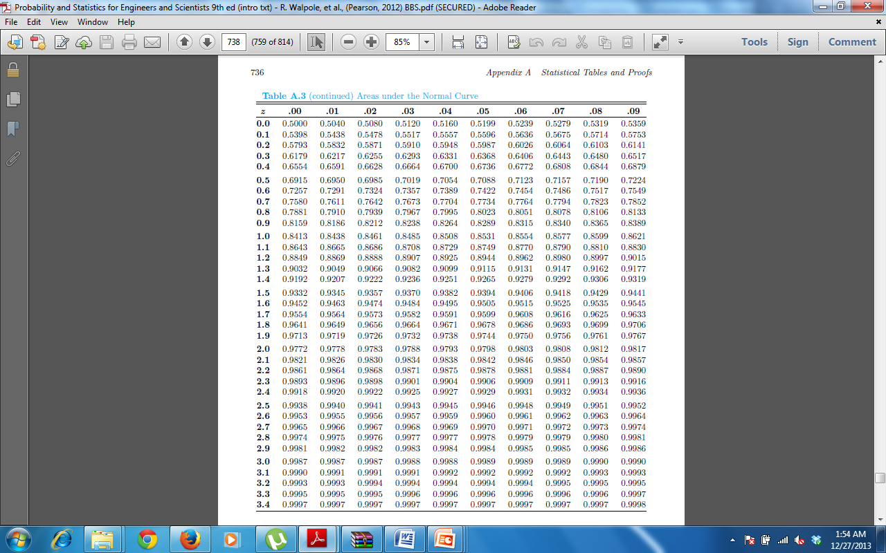
Table A.3

Slide 12
Example
Given a standard normal distribution, find the value of k such that
(a) P(Z > k) = 0.3015, and
(b) P(k < Z < -0.18) = 0.4197.

Slide 13
Using the Normal Curve in Reverse
All normal distributions can be converted into the standard normal curve by subtracting the mean and dividing by the standard deviation:
Somebody calculated all the integrals for the standard normal and put them in a table! So we never have to integrate!
Even better, computers now do all the integration.

Slide 14
Example
For example: What’s the probability of getting a math SAT score of 575 or less, μ=500 and σ=50?
i.e., A score of 575 is 1.5 standard deviations above the mean
But to look up Z= 1.5 in standard normal chart = .9332

Slide 15
Using the Normal Curve in Reverse
All normal distributions can be converted into the standard normal curve by subtracting the mean and dividing by the standard deviation:
Somebody calculated all the integrals for the standard normal and put them in a table! So we never have to integrate!
Even better, computers now do all the integration.

Slide 16
Example
For example: What’s the probability of getting a math SAT score of 575 or less, μ=500 and σ=50?
i.e., A score of 575 is 1.5 standard deviations above the mean
But to look up Z= 1.5 in standard normal chart = .9332

Slide 17
Table A.3

Slide 18
Table A.3

Slide 19
Table A.3

Slide 20
Table A.3

Slide 21
Example
Given a random variable X having a normal distribution with μ = 50 and σ = 10, find the probability that X assumes a value between 45 and 62.

Slide 22
Example
Given a normal distribution with μ = 40 and σ = 6, find the value of x that has
(a) 45% of the area to the left, and
(b) 14% of the area to the right.

Slide 23
Example
Given that X has a normal distribution with μ 300 and σ = 50, find the probability that X assumes a value greater than 362.

Slide 24
Example
A certain type of storage battery lasts, on average, 3.0 years with a standard deviation of 0.5 year. Assuming that the battery lives are normally distributed, find the probability that a given battery will last less than 2.3 years.

Slide 25
Example
An electrical firm manufactures light bulbs that have a life, before burn-out, that is normally distributed with mean equal to 800 hours and a standard deviation of 40 hours. Find the probability that a bulb burns between 778 and 834 hours.

Slide 26
References
Summary
  Normal Distributions
Probability and Statistics for Engineers and Scientists by Walpole
Schaum outline series in Probability and Statistics

