Slide 1
Mathematical Statistics
Lecture 23
Prof. Dr. M. Junaid Mughal

Slide 2
Last Class
Poisson Distribution
Continuous Distributions
  Uniform Distribution

Slide 3
Continuous Distributions

Slide 4
Today’s Agenda
Poisson Distribution (Contd)
Continuous Distributions
  Uniform Distribution (Review)
  Normal Distribution

Slide 5
Uniform Distribution
One of the simplest continuous distributions in all of statistics is the continuous uniform distribution. This distribution is characterized by a density function that is "flat," and thus the probability is uniform in a closed interval, say [A, B].

Slide 6
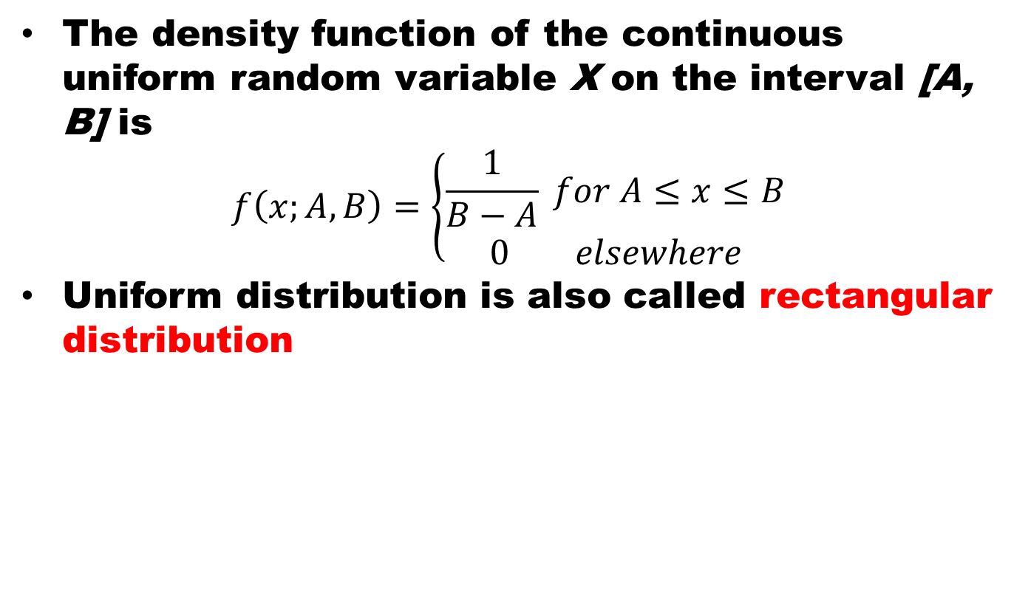
Uniform Distribution
The density function of the continuous uniform random variable X on the interval [A, B] is
$$f\left(x;A,B\right)=\left\{\begin{aligned}\frac{1}{B−A} for A≤x≤B \\ 0 elsewhere\end{aligned}\right.$$
Uniform distribution is also called rectangular distribution

Slide 7
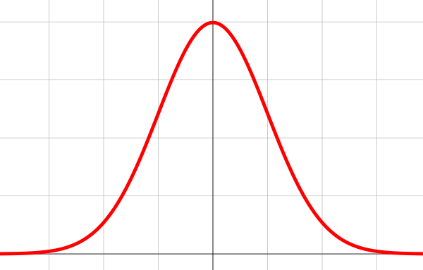

Normal Distribution
The most important, continuous probability distribution in the entire field of statistics is the normal distribution. Its graph, called the normal curve, is the bell shaped curve.

Slide 8
Normal Distribution
Number added

Slide 9
Normal Distribution
clear all
close all
a= rand(10000,10000);
b= sum(a)./10000;
figure(1)
n = hist(b,30);
hist(b,30);
meanb = mean(b);
sdb =std(b);
minb = min(b);
maxb = max(b);
x=minb:(maxb-minb)/200:maxb;
y = (1/(sqrt(2*pi)*sdb))*exp(-(((x-meanb).^2)/(2*sdb^2)));
maxy =max(y);
y = max(n)*y/maxy;
hold on
figure(1)
plot(x,y,'r','LineWidth',3);

Slide 10
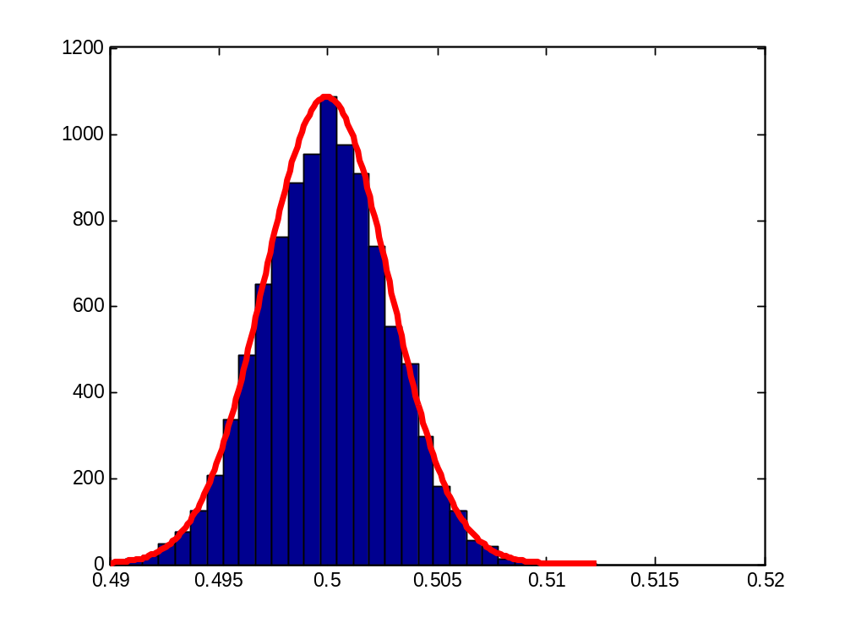
Normal Distribution

Slide 11
Normal Distribution
Normal distribution describes approximately many phenomena that occur in
  nature,
  industry,
  and research
Physical measurements in areas such as
  meteorological experiments,
  rainfall studies,
  measurements of manufactured parts
  errors in scientific measurements
are often more than adequately explained with a normal distribution.

Slide 12
Normal Distribution
In 1733, Abraham DeMoivre developed the mathematical equation of the normal curve. Which provided a basis for which much of the theory of inductive statistics is founded.
The normal distribution is often referred to as the Gaussian distribution, in honor of Karl Fricdrich Gauss (1777-1855), who also derived its equation from a study of errors in repeated measurements of the same quantity.

Slide 13
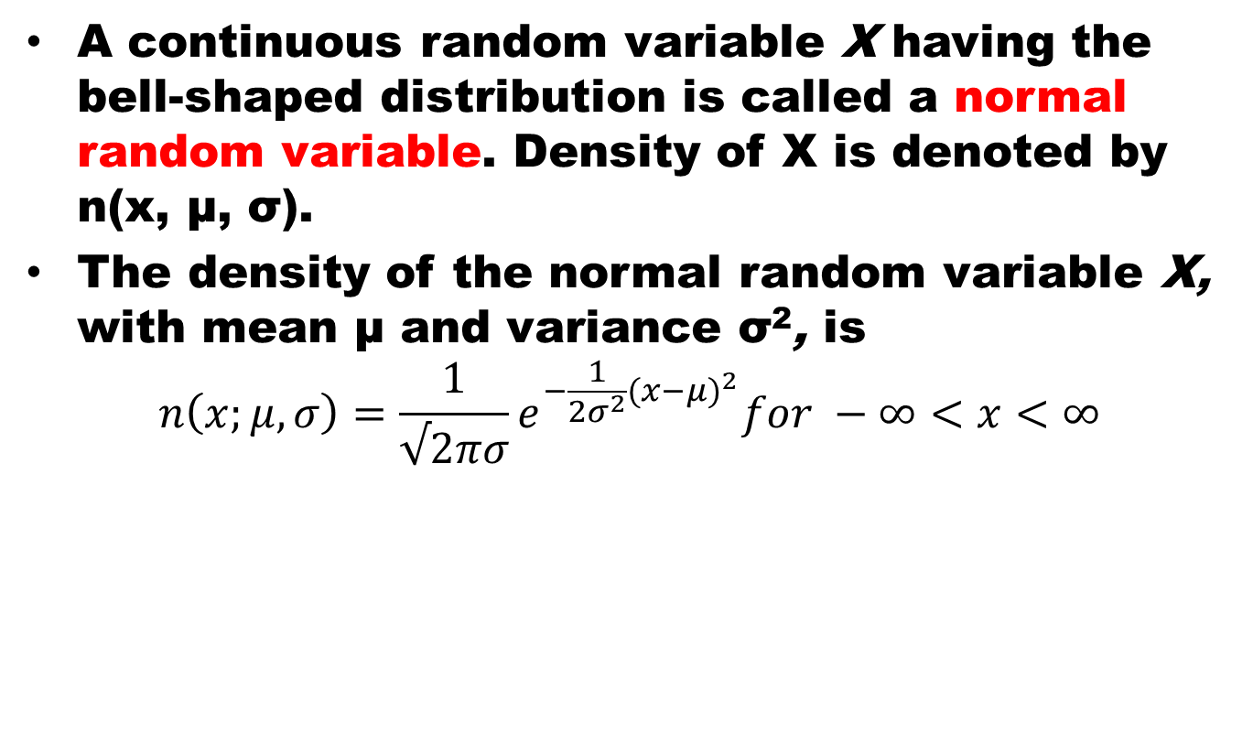
Normal Distribution
A continuous random variable X having the bell-shaped distribution is called a normal random variable. Density of X is denoted by n(x, μ, σ).
The density of the normal random variable X, with mean μand variance σ², is
$$n\left(x;μ,σ\right)=\frac{1}{√2πσ}e^{−\frac{1}{{2σ}^{2}}{(x−μ)}^{2}}for −∞<x<∞$$

Slide 14
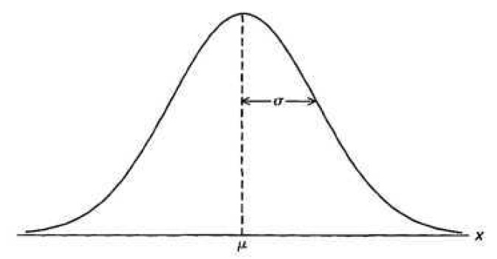
Properties of Normal Distribution
The mode, which is the point on the horizontal axis where the curve is a maximum, occurs at x = μ
The curve is symmetric about a vertical axis through the mean μ .
The curve has its points of inflection at
x = µ ± σ, is concave downward if µ — σ < X < µ + σ, and is concave upward otherwise.

Slide 15
Properties of Normal Distribution
The normal curve approaches the horizontal axis asymptotically as we proceed in either direction away from the mean.
The total area under the curve and above the horizontal axis is equal to 1.

Slide 16
Mean of Normal Distribution

Slide 17
Variance of Normal Distribution

Slide 18
Maxima of Normal Distribution

Slide 19
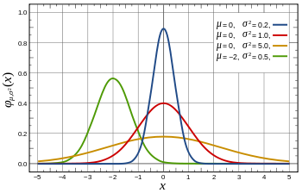
Normal Distribution

Slide 20
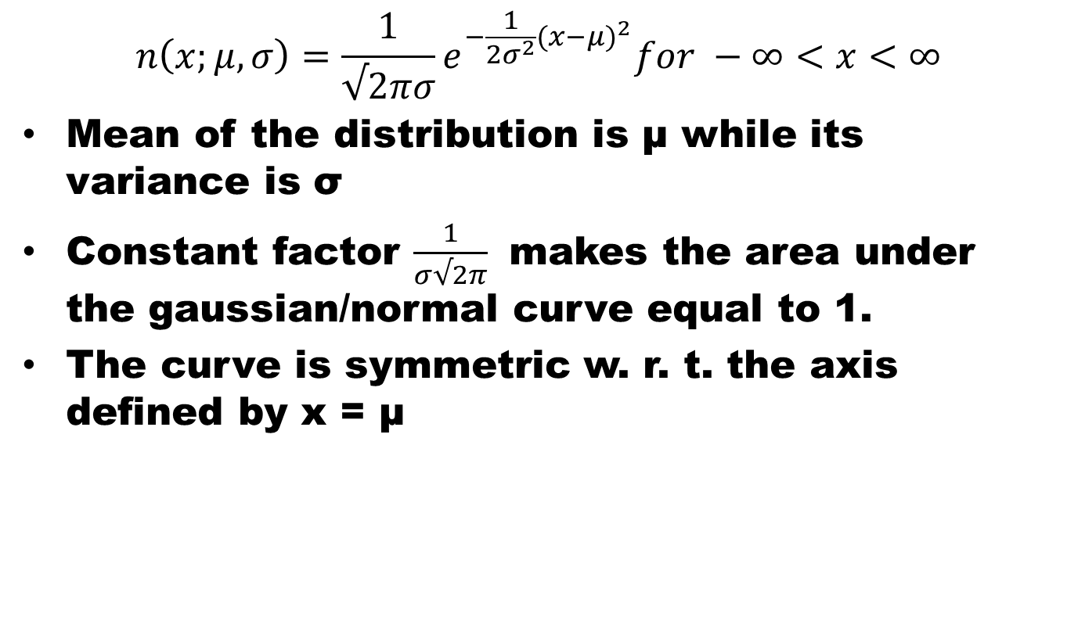
Normal Distribution
$$n\left(x;μ,σ\right)=\frac{1}{√2πσ}e^{−\frac{1}{{2σ}^{2}}{(x−μ)}^{2}}for −∞<x<∞$$
Mean of the distribution is μ while its variance is σ
Constant factor $\frac{1}{σ√2π}$ makes the area under the gaussian/normal curve equal to 1.
The curve is symmetric w. r. t. the axis defined by x = μ

Slide 21
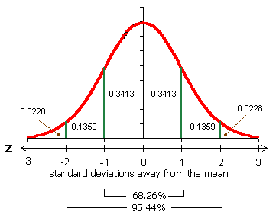
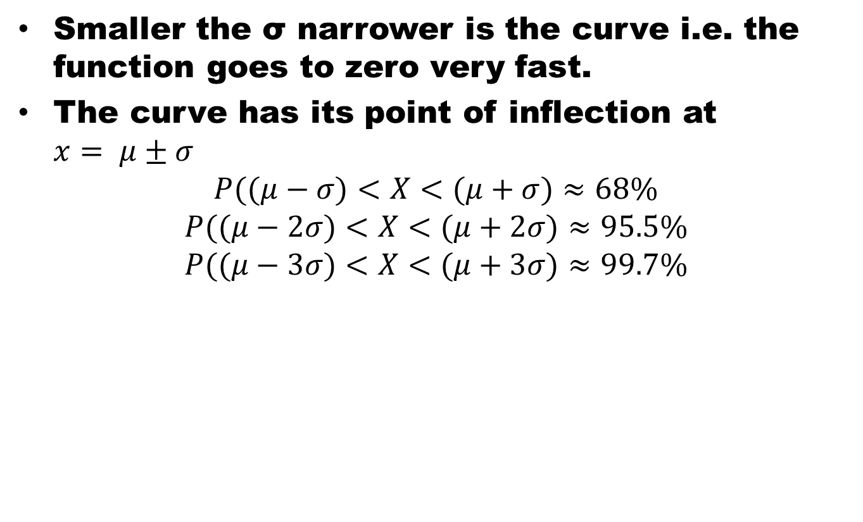
Normal Distribution
Smaller the σ narrower is the curve i.e. the function goes to zero very fast.
The curve has its point of inflection at $x= μ±σ$
$$P((μ−σ)<X<(μ+σ)≈68\%$$
$$P((μ−2σ)<X<(μ+2σ)≈95.5\%$$
$$P((μ−3σ)<X<(μ+3σ)≈99.7\%$$

Slide 22
Normal Distribution

Slide 23
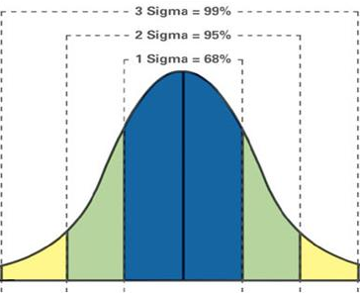
Normal Distribution

Slide 24
Beauty of Normal Distribution
No matter what μ and σ are, the area between μ-σ and μ+σ is about 68%; the area between μ-2σ and μ+2σ is about 95%; and the area between μ-3σ and μ+3σ is about 99.7%. Almost all values fall within 3 standard deviations.

Slide 25
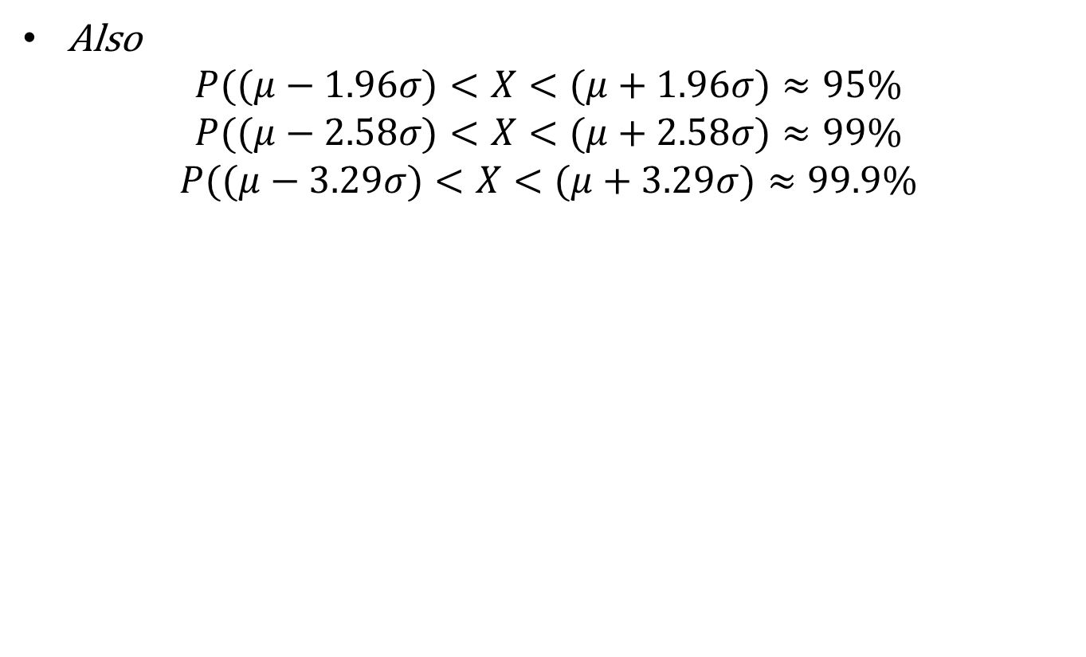
Normal Distribution
Also
$$P((μ−1.96σ)<X<(μ+1.96σ)≈95\%$$
$$P((μ−2.58σ)<X<(μ+2.58σ)≈99\%$$
$$P((μ−3.29σ)<X<(μ+3.29σ)≈99.9\%$$

Slide 26
Summary
Summary
Normal distribution
References
Probability and Statistics for Engineers and Scientists by Walpole
Schaum outline series in Probability and Statistics

