Slide 1
Mathematical Statistics
Lecture 22
Prof. Dr. M. Junaid Mughal

Slide 2
Last Class
Binomial Distribution
Poisson Process
Poisson Distribution

Slide 3
Today’s Agenda
Poisson Distribution (Contd)
Continuous Distributions
  Uniform Distribution

Slide 4
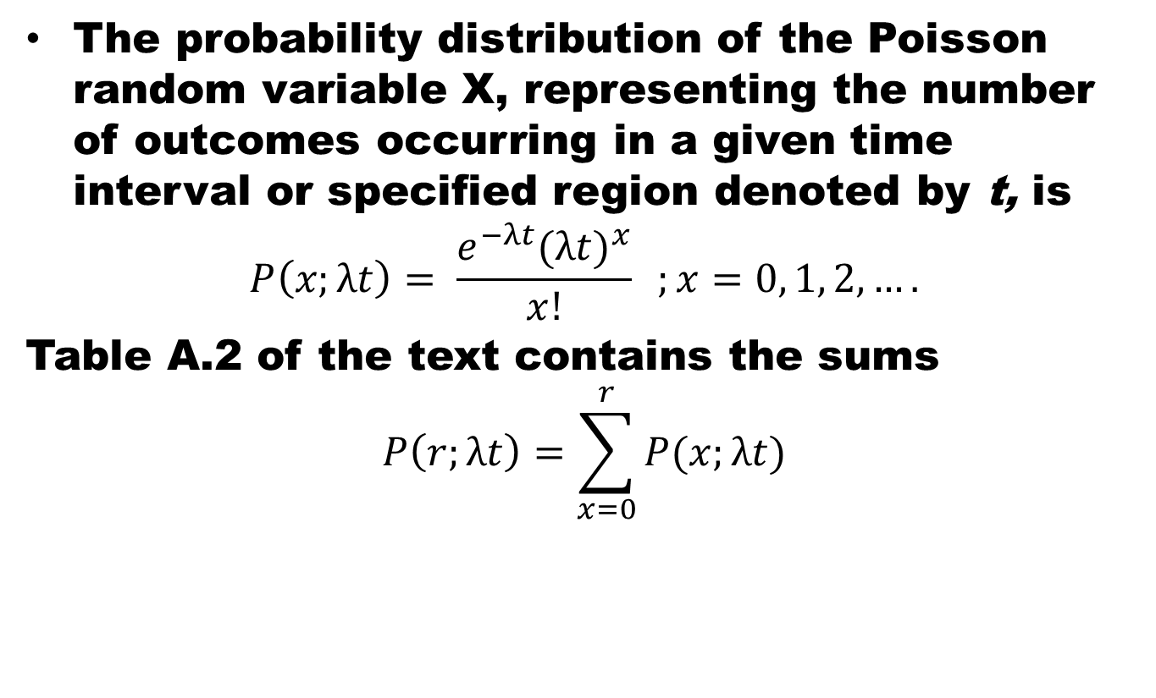
Poisson Distribution
The probability distribution of the Poisson random variable X, representing the number of outcomes occurring in a given time interval or specified region denoted by t, is
$$P\left(x;λt\right)= \frac{e^{−λt}{(λt)}^{x}}{x!} ;x=0, 1, 2, ….$$
Table A.2 of the text contains the sums
$$P\left(r;λt\right)=\sum_{x=0}^{r}{P(x;λt)}$$
where λ is the average number of outcomes per unit time, distance, area, or volume, and e = 2.71828 • • •.

Slide 5
Poisson Distribution Normalized

Slide 6
Poisson Distribution
Theorem:
  Both the mean and variance of the Poisson distribution p(x; λt) are λt.
Proof:

Slide 7
Poisson Distribution
Theorem:
  Both the mean and variance of the Poisson distribution p(x; λt) are λt.

Slide 8
Poisson Dist. as Limiting case of Binom. Dist.
It should be evident from the three principles of the Poisson process that the Poisson distribution relates to the binomial distribution.
Although the Poisson usually finds applications in space and time problems but it can be viewed as a limiting form of the binomial distribution.
In the case of the binomial, if n is quite large and p is small, the conditions begin to simulate the continuous space or time region implications of the Poisson process.
The independence among Bernoulli trials in the binomial case is consistent with property 2 of the Poisson process.

Slide 9
Poisson Dist. as Limiting case of Binom. Dist.
Allowing the parameter p to be close to zero relates to property 3 of the Poisson process. Indeed, if n is large and p is close to 0, the Poisson distribution can be used, with p = np, to approximate binomial probabilities.
If p is close to 1, we can still use the Poisson distribution to approximate binomial probabilities by interchanging what we have defined to be a success and a failure, thereby changing p to a value close to 0.

Slide 10
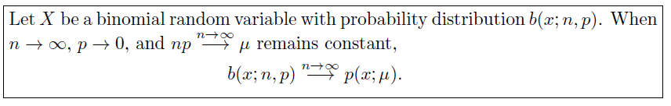
Poisson Dist. as Limiting case of Binom. Dist.

Slide 11
Example
The probability of an accident on any given day is 0.005 and accidents are independent of each other.
(a) What, is the probability that in any given period of 400 days there will be an accident on one day?
(b) What is the probability that there are at most three days with an accident?

Slide 12
Example
On average, 1 in every 1000 of these items produced has one or more bubbles. What is the probability that a random sample of 8000 will yield fewer than 7 items possessing bubbles?

Slide 13
Continuous Distributions

Slide 14
Uniform Distribution
One of the simplest continuous distributions in all of statistics is the continuous uniform distribution. This distribution is characterized by a density function that is "flat," and thus the probability is uniform in a closed interval, say [A, B].

Slide 15
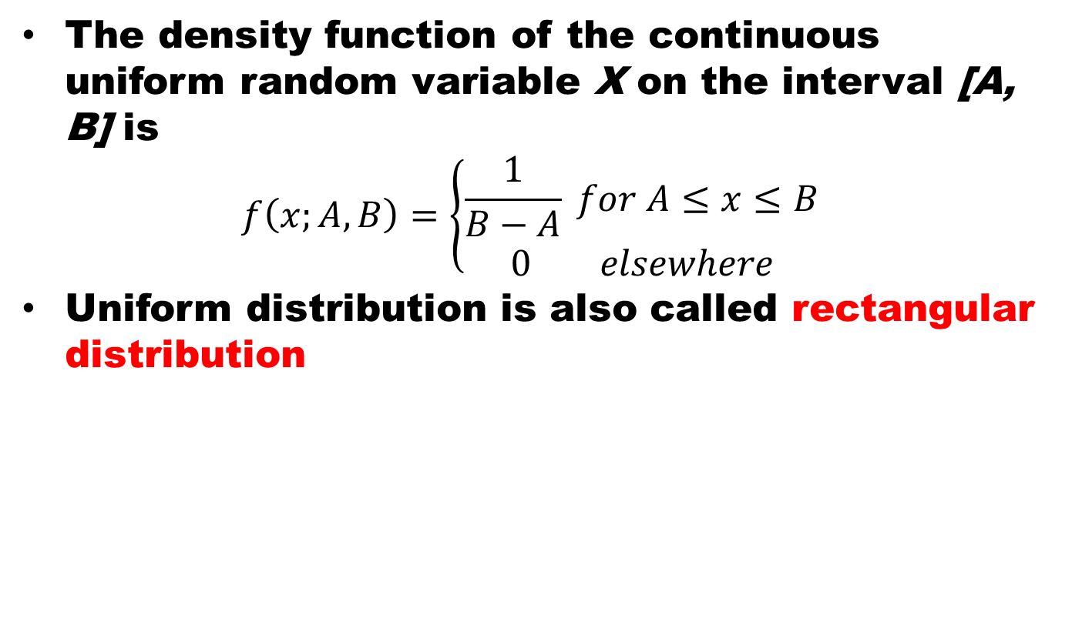
Uniform Distribution
The density function of the continuous uniform random variable X on the interval [A, B] is
$$f\left(x;A,B\right)=\left\{\begin{aligned}\frac{1}{B−A} for A≤x≤B \\ 0 elsewhere\end{aligned}\right.$$
Uniform distribution is also called rectangular distribution

Slide 16
Example
Suppose that a large conference room for a certain company can be reserved for no more than 4 hours. However, the use of the conference room is such that both long and short conferences occur quite often. In fact, it can be assumed that length X of a conference has a uniform distribution on the interval [0, 4].
What is the probability density function?
What is the probability that any given conference lasts at least 3 hours?

Slide 17
Mean of Uniform Distribution $μ=\frac{A+B}{2}$

Slide 18
Variance of Uniform Distribution $σ^{2}=\frac{{(B−A)}^{2}}{12}$

Slide 19
Normal Distribution

Slide 20
Summary
Summary
Poisson Distribution (Contd)
Continuous Distributions
  Uniform Distribution
References
Probability and Statistics for Engineers and Scientists by Walpole
Schaum outline series in Probability and Statistics

