Slide 1
Mathematical Statistics
Lecture 20
Prof. Dr. M. Junaid Mughal

Slide 2
Last Class
Chebyshev’s Theorem
Examples

Slide 3
Today’s Agenda
Examples
Uniform Distributions
Bournollie’s Process
Binomial Distribution

Slide 4
Exercise
4.60 Seventy new jobs are opening up at an automobile
manufacturing plant, but 1000 applicants show up for the 70 positions. To select the best 70 from among the applicants, the company gives a test that covers mechanical skill, manual dexterity, and mathematical ability. The mean grade on this test turns out to be 60, and the scores have a standard deviation 6. Can a person who has an 84 score count on getting one of the jobs? [Hint Use Chebyshev's theorem.] Assume that the distribution is symmetric about the mean.

Slide 5
Exercise
4.61 An electrical firm manufactures a 100-watt light
bulb, which, according to specifications written on the
package, has a mean life of 900 hours with a standard
deviation of 50 hours. At most, what percentage of
the bulbs fail to last even 700 hours? Assume that the
distribution is symmetric about the mean.

Slide 6
Exercise
4.62 A local company manufactures telephone wire. The average length of the wire is 52 inches with a standard deviation of 6.5 inches. At most, what percentage of the telephone wire from this company exceeds 71.5 inches? Assume that the distribution is symmetric about the mean.

Slide 7
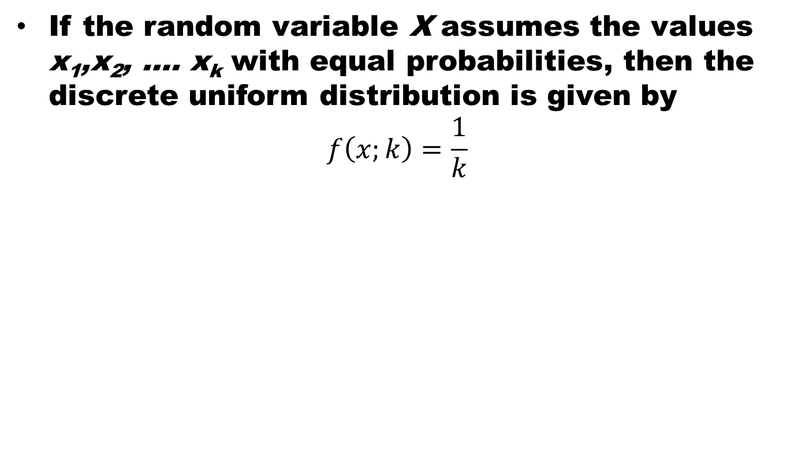
Discrete Uniform Distribution
If the random variable X assumes the values x₁,x₂, …. x_{k}with equal probabilities, then the discrete uniform distribution is given by
$$f\left(x;k\right)=\frac{1}{k}$$

Slide 8
Explanation / Examples

Slide 9
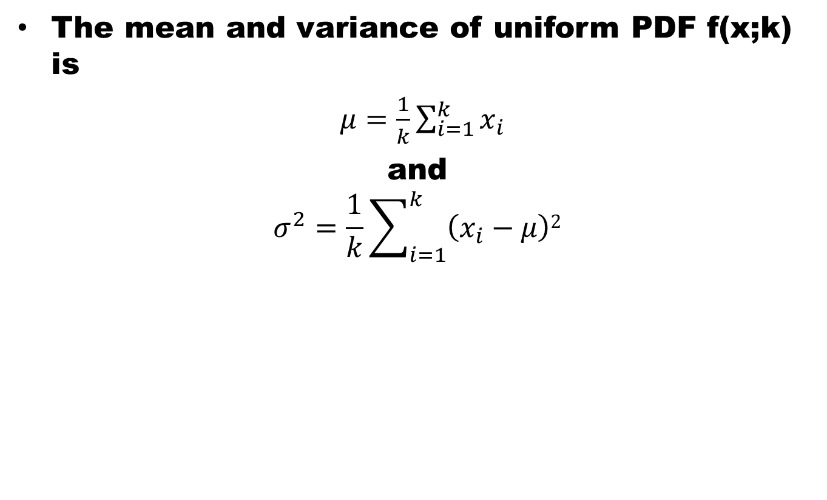
Theorem
The mean and variance of uniform PDF f(x;k) is
$μ=\frac{1}{k}\sum_{i=1}^{k}{x_{i}}$
and
$$σ^{2}=\frac{1}{k}\sum_{i=1}^{k}{\left(x_{i}−μ\right)2}$$

Slide 10
Example
Mean and variance of rolling of a die experiment

Slide 11
Bournoulli’s Process / Trail
The Bournoulli’s process possesses following properties
  The experiments consists of repeated trails
  The probability of success is same in each trail
  There are n trails and n is constant
  The n – trails are independent.

Slide 12
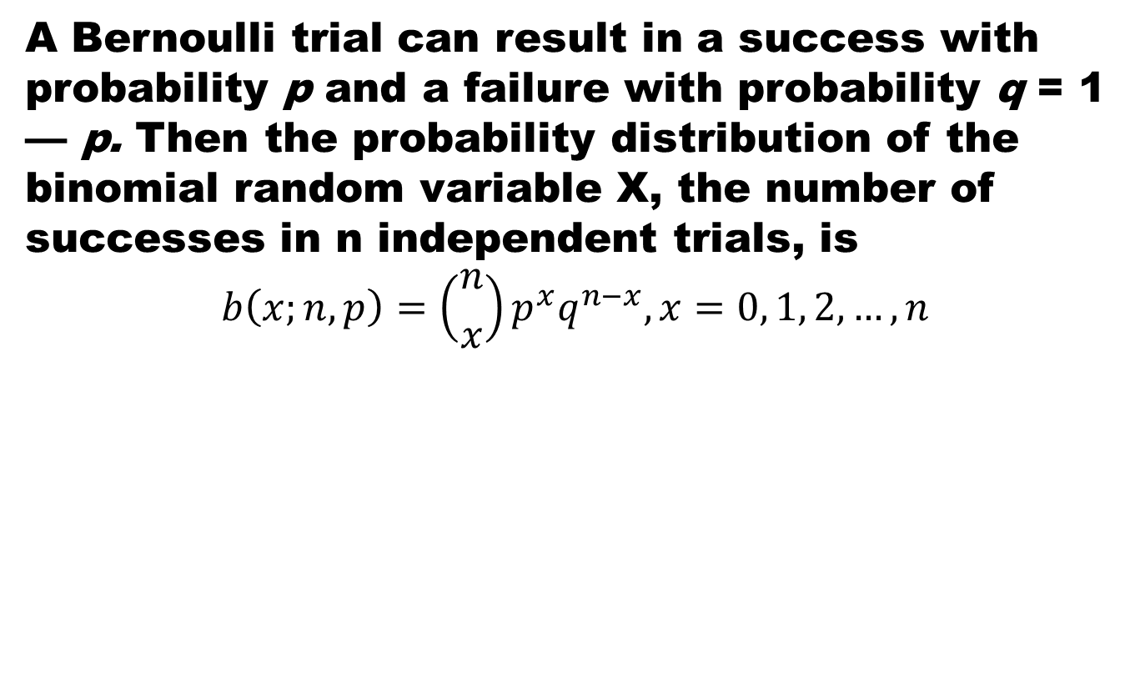
Binomial Distribution
A Bernoulli trial can result in a success with probability p and a failure with probability q = 1 — p. Then the probability distribution of the binomial random variable X, the number of successes in n independent trials, is
$$b\left(x;n,p\right)=\left({n \atop x}\right)p^{x}q^{n−x}, x=0, 1, 2,…, n$$

Slide 13
Example
The probability that a certain kind of component will survive a shock test is 3/4. Find the probability that exactly 2 of the next. 4 components tested survive.

Slide 14
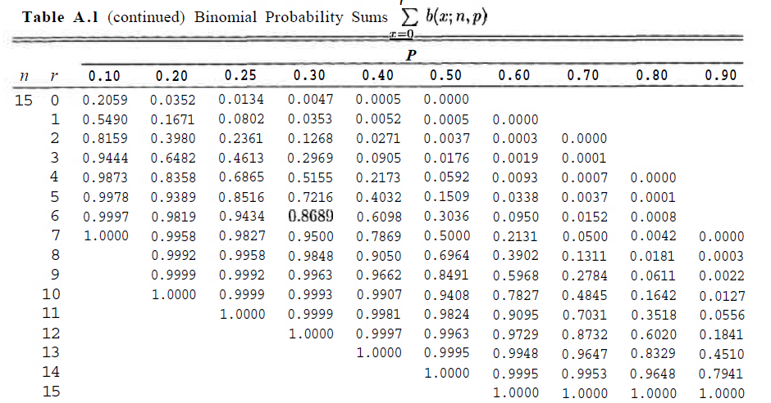
Table of Binomial Sum

Slide 15
Example
The probability that a patient recovers from a rare blood disease is 0.4. If 15 people are known to have contracted this disease, what is the probability that (a) at least 10 survive, (b) from 3 to 8 survive, and (c) exactly 5 survive?

Slide 16
Example
A large chain retailer purchases a certain kind of electronic device from a manufacturer. The manufacturer indicates that the defective rate of the device is 3%.
  (a) The inspector of the retailer randomly picks 20 items from a shipment. What is the probability that there will be at least one defective item among these 20?

Slide 17
Example
  (b) Suppose that the retailer receives 10 shipments in a month and the inspector randomly tests 20 devices per shipment. What is the probability that there will be 3 shipments containing at least one defective device?

Slide 18
Summary
Summary
Uniform Distributions
Bournollie’s Process
Binomial Distribution
References
Probability and Statistics for Engineers and Scientists by Walpole
Schaum outline series in Probability and Statistics

