Slide 1
Mathematical Statistics
Lecture 19
Prof. Dr. M. Junaid Mughal

Slide 2
Last Class
Correlation Coefficient
Theorems on Mean and Variance of Linear Combination of Random Variables

Slide 3
Today’s Agenda
Chebyshev’s Theorem
Examples

Slide 4
Chebyshev’s Theorem
The variance of a random variable tells us about the variability of the observations about the mean.
If a random variable has a small variance or standard deviation, we would expect most of the values to be grouped around the mean.
Therefore, the probability' that a random variable assumes a value within a certain interval about the mean is greater than for a similar random variable with a larger standard deviation.

Slide 5
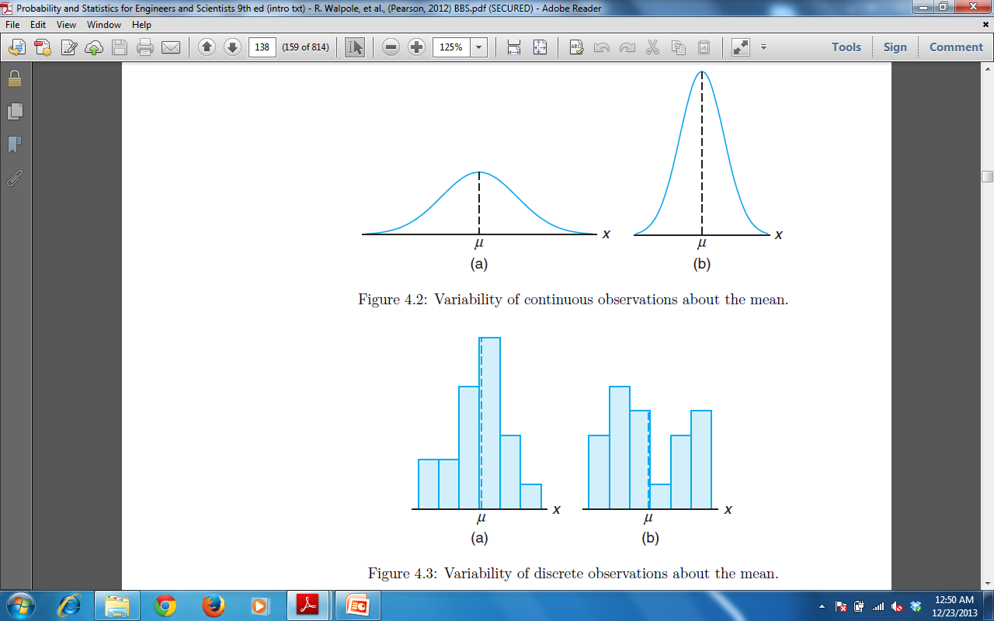
Chebyshev’s Theorem
If we think of probability in terms of area, we would expect a continuous distribution with a large value of σ to indicate a greater variability, and therefore we should expect the area to be more spread out, as in Figure (a). However, a small standard deviation should have most of its area close to µ, as in Figure (b).

Slide 6
Chebyshev’s Theorem
We can argue the same way for a discrete distribution. The area in the probability histogram in Figure (b) is spread out much more than that Figure (a) indicating a more variable distribution of measurements or outcomes.

Slide 7
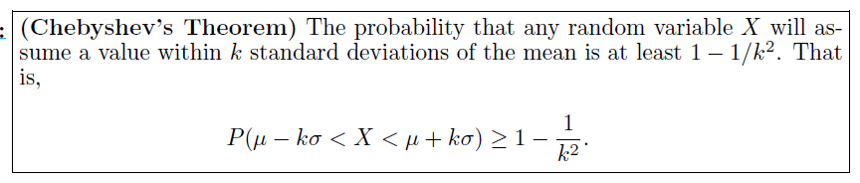
Chebyshev’s Theorem
The Russian mathematician P. L. Chebyshev (1821-1894) discovered that the fraction of the area between any two values symmetric about the mean is related to the standard deviation. Since the area under a probability distribution curve or in a probability histogram adds to 1, the area between any two numbers is the probability of the random variable assuming a value between these numbers.

Slide 8
Chebyshev’s Theorem
Proof:

Slide 9
Chebyshev’s Theorem (Proof)

Slide 10
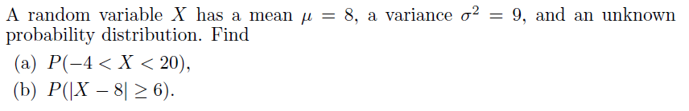
Example

Slide 11
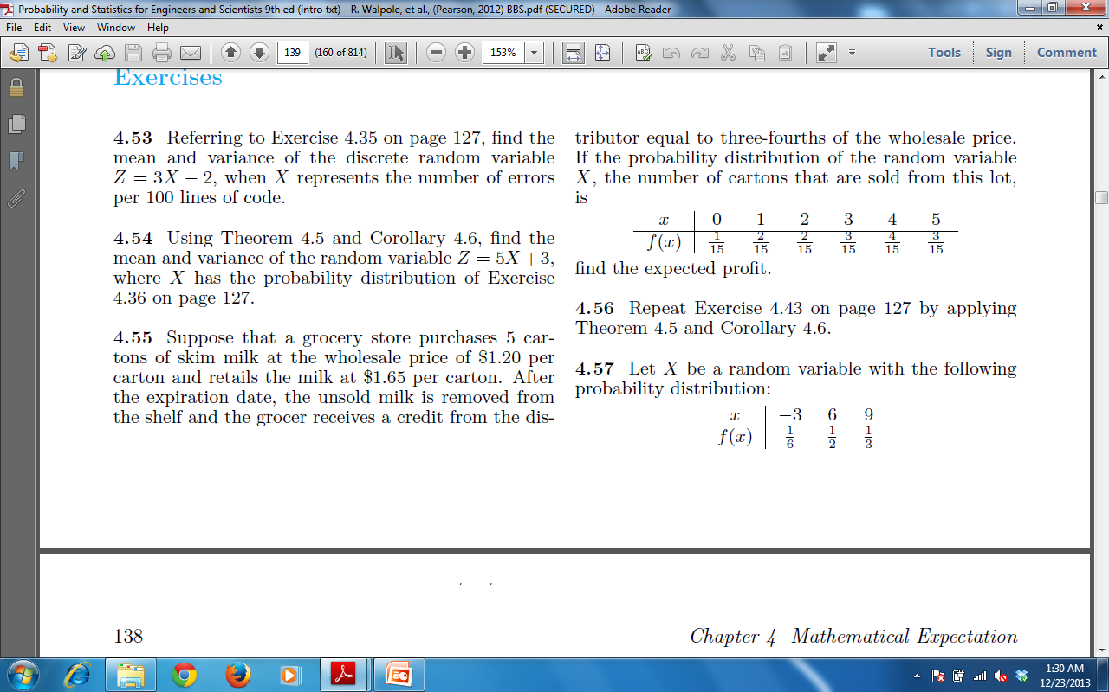
Exercise

Slide 12
Exercise (contd)

Slide 13
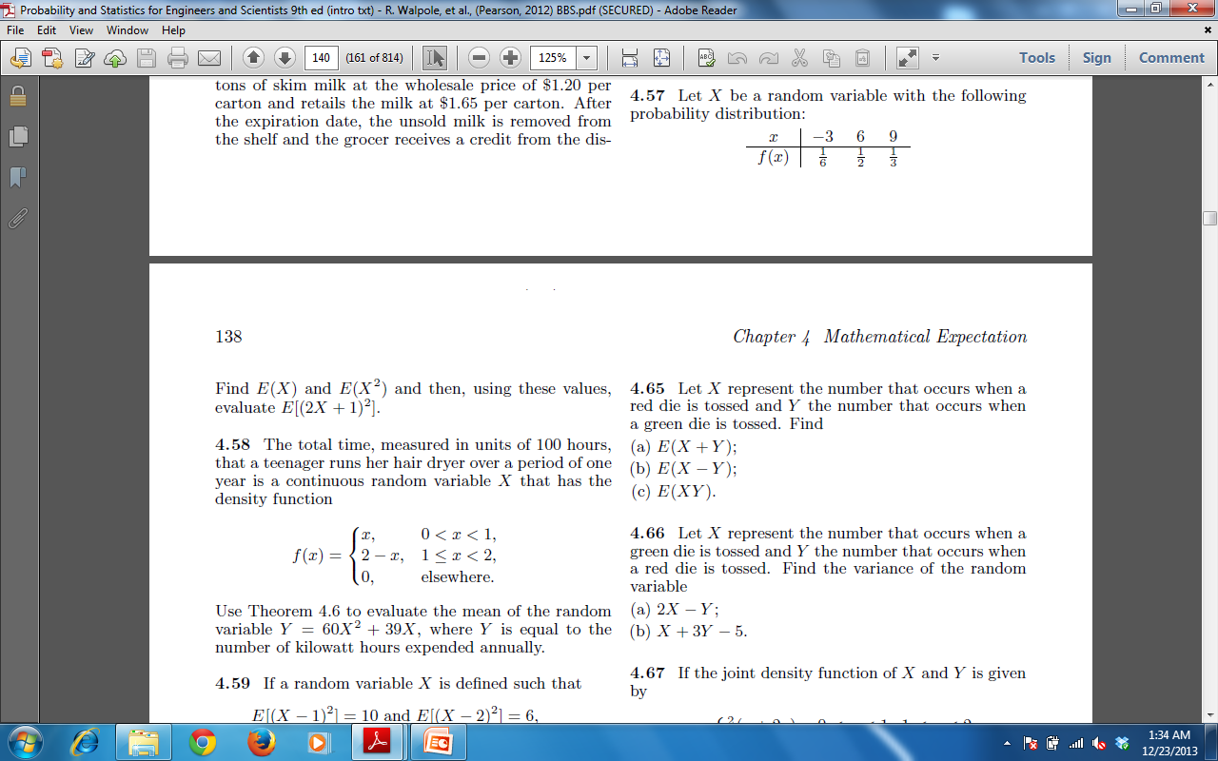
Exercise

Slide 14
Exercise

Slide 15
Exercise (Contd)

Slide 16
Summary
Summary
Chebyshev’s Theorem
Examples
References
Probability and Statistics for Engineers and Scientists by Walpole
Schaum outline series in Probability and Statistics

