Slide 1
Mathematical Statistics
Lecture 18
Prof. Dr. M. Junaid Mughal

Slide 2
Last Class
Review
  Mean and Variance
  Theorems on Variance
  Covariance
Exercises

Slide 3
Today’s Agenda
Correlation Coefficient
Theorems on Mean and Variance of Linear Combination of Random Variables

Slide 4
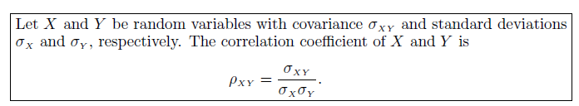
Correlation Coefficient
It should be noted that ρ_{XY} is free of the units of X and Y.
The correlation coefficient satisfies the inequality - 1 < ρ_{XY} < 1.
It assumes a value of zero when σ_{XY} = 0.
Where there is an exact linear dependency, say Y = a + bX,
  ρ_{XY} = 1 if b > 0 and ρ_{XY} = -1 if b < 0.

Slide 5
Correlation Coefficient
Where there is an exact linear dependency, say Y = a + bX,
  ρ_{XY} = 1 if b > 0 and ρ_{XY} = -1 if b < 0.
Proof

Slide 6
Correlation Coefficient

Slide 7
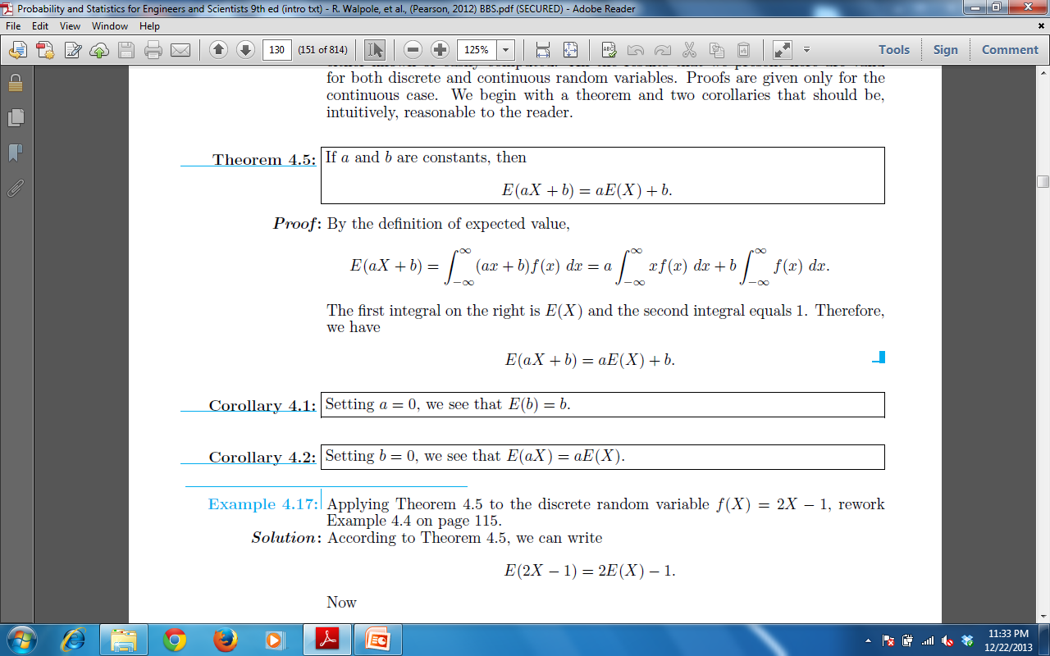
Mean and Variance of Linear Combination of Random Variables
Theorem:
Proof

Slide 8
Mean and Variance of Linear Combination of Random Variables
Corollary:
Proof:

Slide 9
Mean and Variance of Linear Combination of Random Variables
Corollary:
Proof:

Slide 10
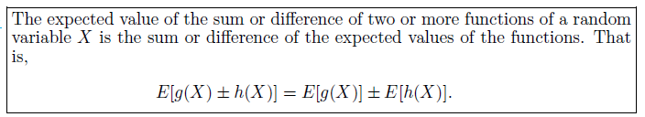
Mean and Variance of Linear Combination of Random Variables
Theorem:
Proof:

Slide 11
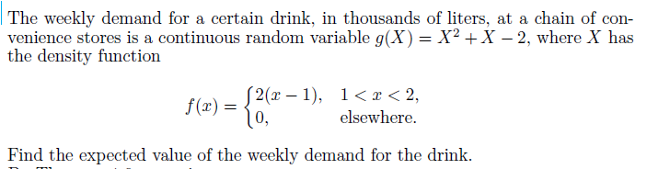
Example

Slide 12
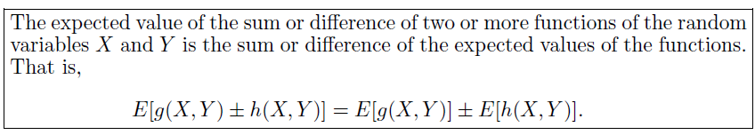
Mean and Variance of Linear Combination of Random Variables
Theorem:
Proof:

Slide 13
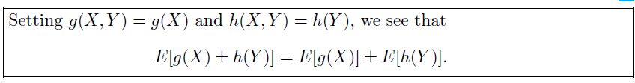
Mean and Variance of Linear Combination of Random Variables
Corollary:
Proof:

Slide 14
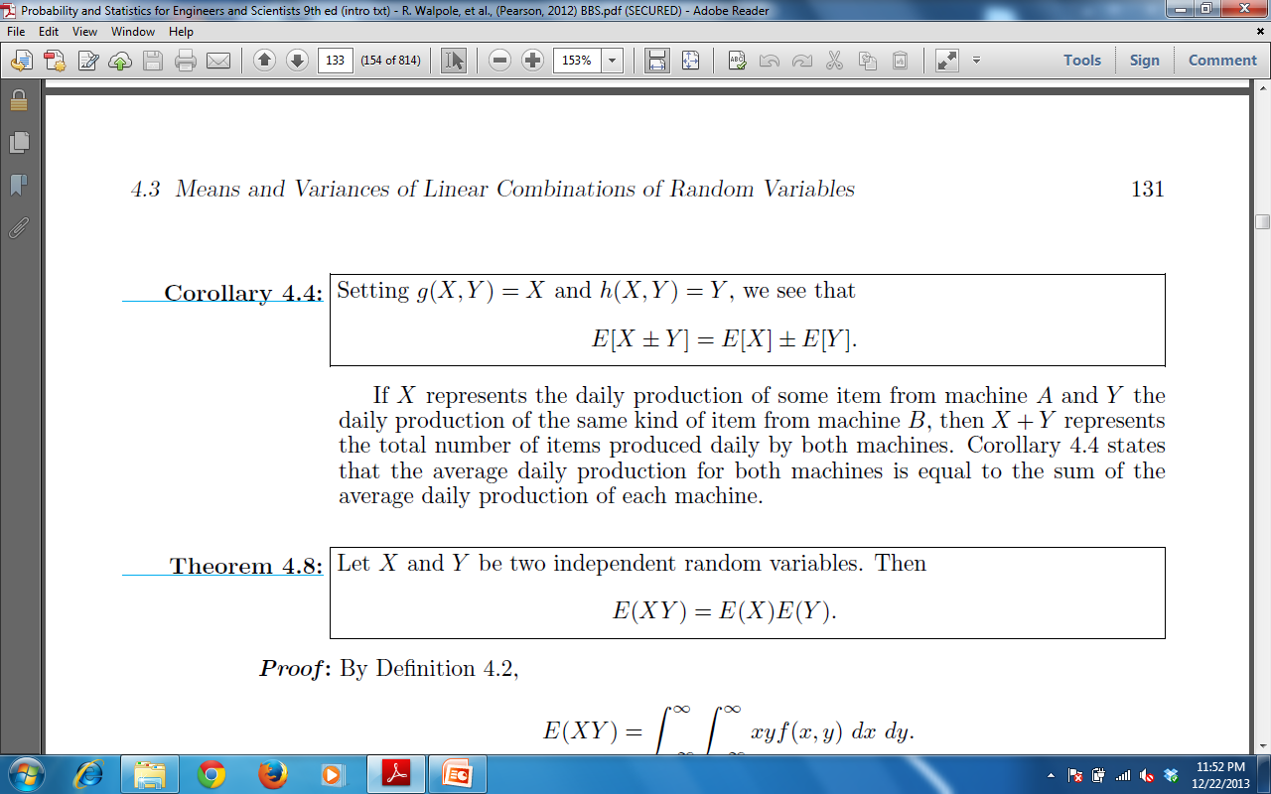
Mean and Variance of Linear Combination of Random Variables
Corollary:
Proof:

Slide 15
Mean and Variance of Linear Combination of Random Variables
Theorem:
Proof:

Slide 16
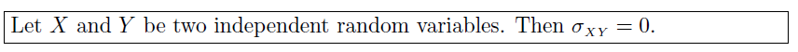
Mean and Variance of Linear Combination of Random Variables
Corollary:
Proof:

Slide 17
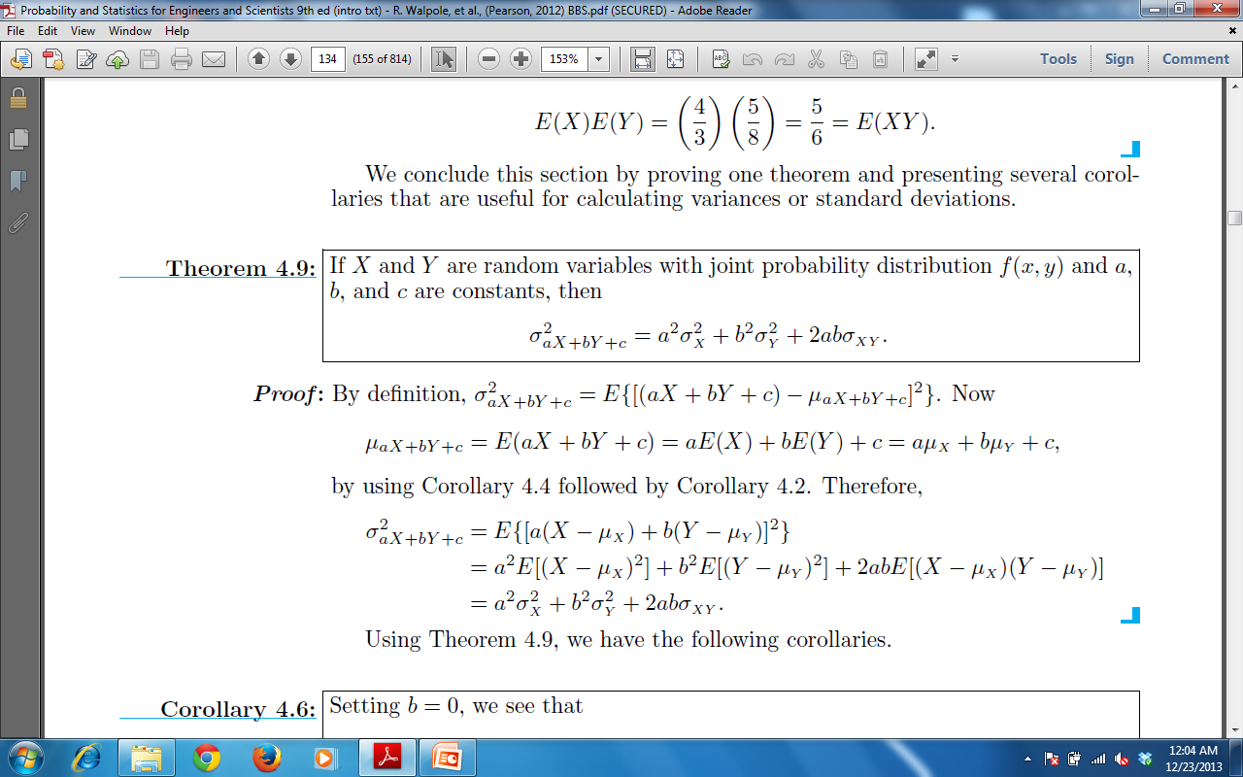
Mean and Variance of Linear Combination of Random Variables
Theorem:
Proof:

Slide 19
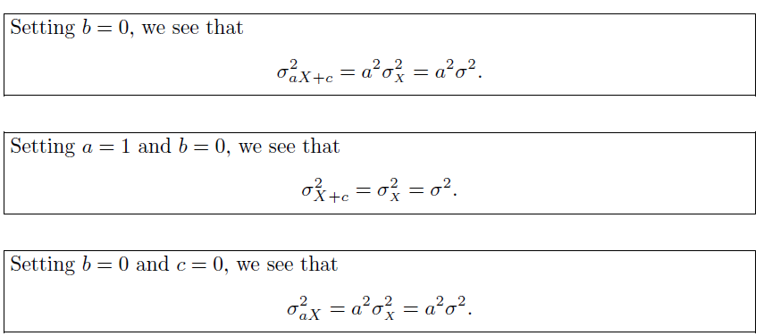
Mean and Variance of Linear Combination of Random Variables
Corollary:
Remember

Slide 20
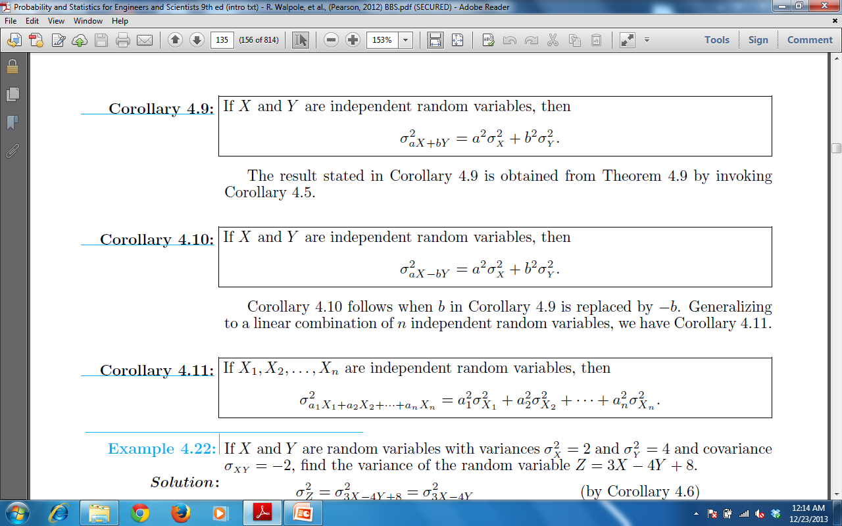
Mean and Variance of Linear Combination of Random Variables
Corollary:
Remember

Slide 21
Mean and Variance of Linear Combination of Random Variables
Corollary:

Slide 22
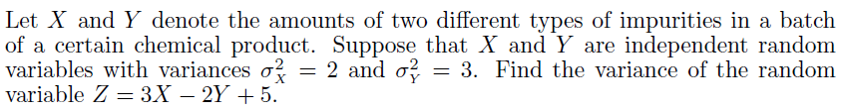
Example

Slide 23
Summary
Summary
Correlation Coefficient
Theorems on Mean and Variance of Linear Combination of Random Variables
References
Probability and Statistics for Engineers and Scientists by Walpole
Schaum outline series in Probability and Statistics

