Slide 1
Mathematical Statistics
Lecture 16
Prof. Dr. M. Junaid Mughal

Slide 2
Last Class
Statistical Independence
Mean and Variance of a distribution

Slide 3
Today’s Agenda
Mean and Variance (continued)
Theorems on Variance
Covariance

Slide 4
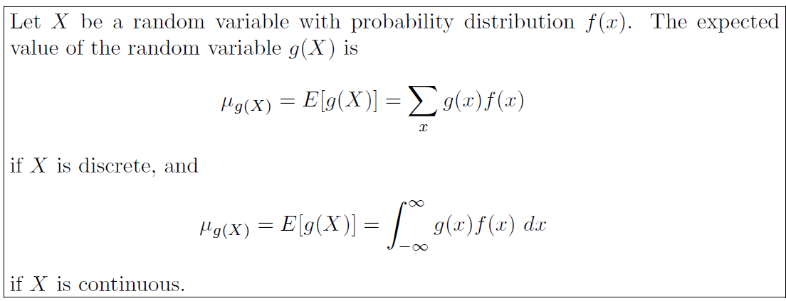
Mean of a function of Random Variable

Slide 5
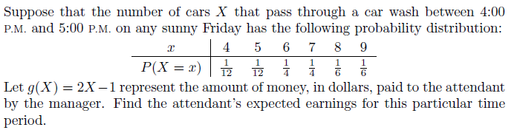
Example

Slide 6
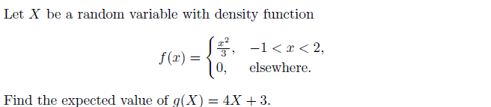
Example

Slide 7
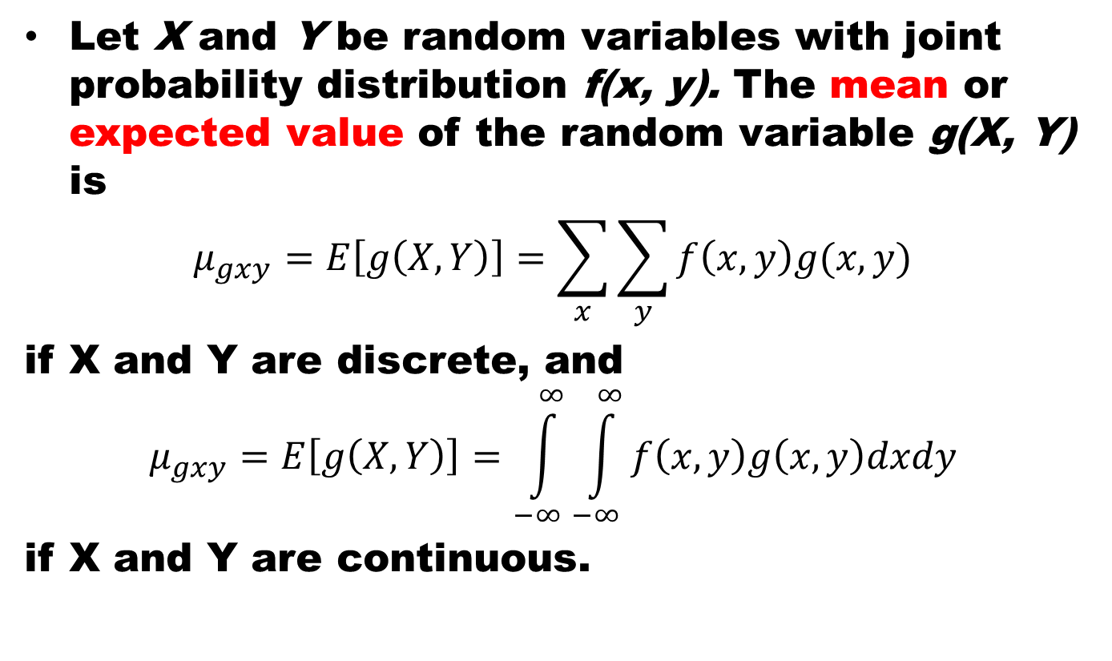
Mean of Joint Dist.
Let X and Y be random variables with joint probability distribution f(x, y). The meanor expectedvalue of the random variable g(X, Y) is
$$μ_{gxy}=E\left[g\left(X, Y\right)\right]=\sum_{x}{\sum_{y}{f\left(x,y\right)g(x,y)}}$$
if X and Y are discrete, and
$$μ_{gxy}=E\left[g\left(X, Y\right)\right]=\int_{−∞}^{∞}{\int_{−∞}^{∞}{f\left(x,y\right)g\left(x,y\right)dxdy}}$$
if X and Y are continuous.

Slide 8
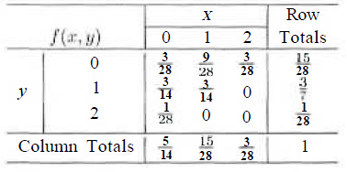
Example
Let X and Y be the random variables with joint probability distribution indicated in given Table. Find the expected value of g(X, Y) = XY

Slide 9
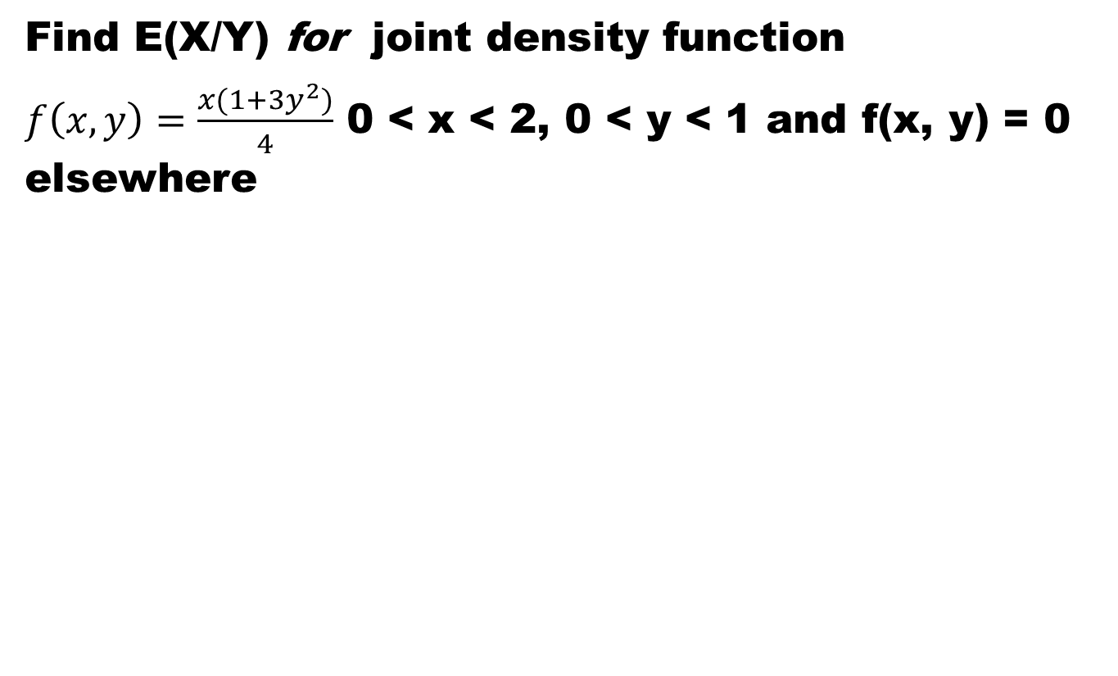
Example
Find E(X/Y)for joint density function
$f\left(x,y\right)=\frac{x(1+3y^{2})}{4}$ 0 < x < 2, 0 < y < 1 and f(x, y) = 0 elsewhere

Slide 10
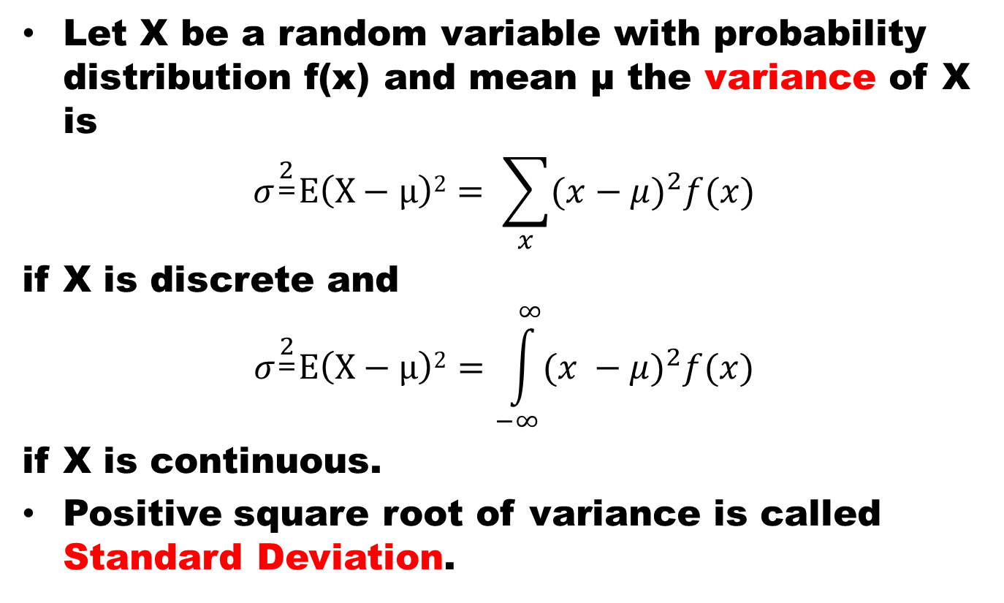
Variance
Let X be a random variable with probability distribution f(x) and mean μ the variance of X is
$$σ^{\begin{aligned}2 \\ =\end{aligned}}E\left(X−μ\right)2= \sum_{x}{{(x−μ)}^{2}f(x)}$$
if X is discrete and
$$σ^{\begin{aligned}2 \\ =\end{aligned}}E\left(X−μ\right)2=\int_{−∞}^{∞}{{(x −μ)}^{2}f(x)}$$
if X is continuous.
Positive square root of variance is called StandardDeviation.

Slide 11
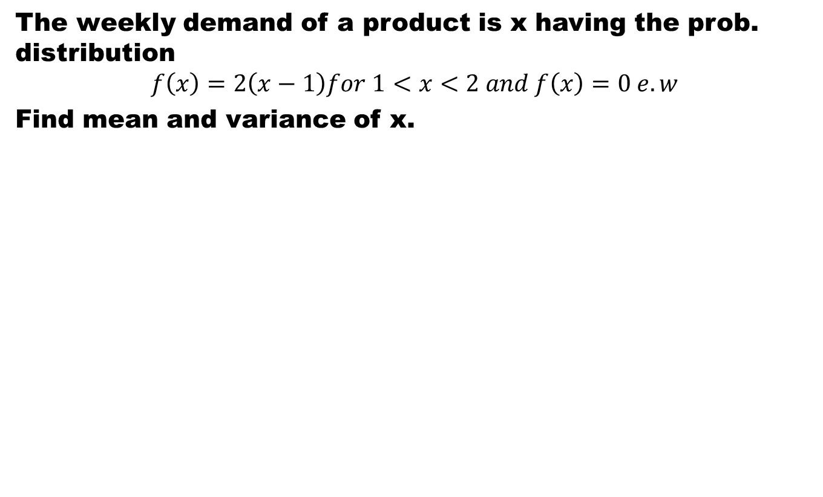
Example
The weekly demand of a product is x having the prob. distribution
$$f\left(x\right)=2\left(x−1\right)for 1<x<2 and f\left(x\right)=0 e. w$$
Find mean and variance of x.

Slide 12
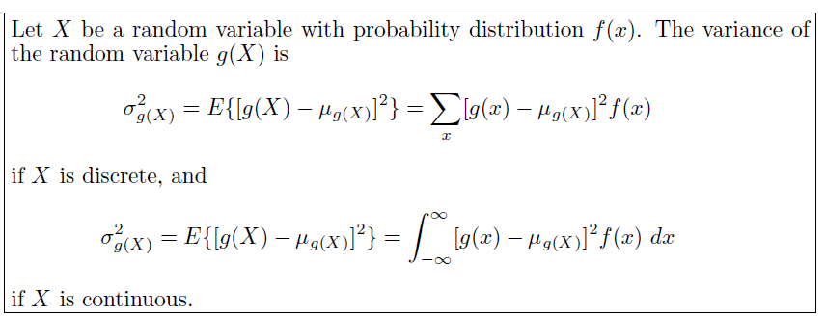
Variance of a function of Random Variable

Slide 13
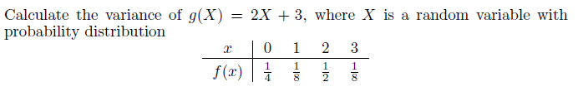
Example

Slide 14
Example
variance

Slide 15
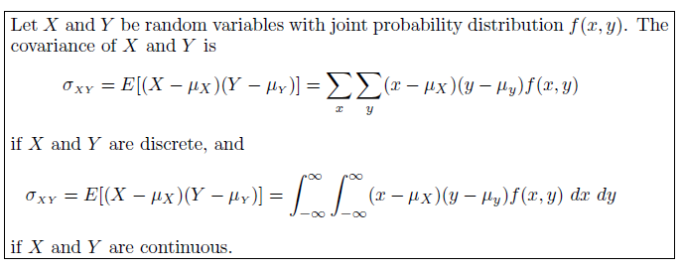
Covariance

Slide 16
Covariance
The covariance between two random variables is a measurement of the nature of the association between the two.
If large values of X often result in large values of Y or small values of X result in small values of Y. Then positive (x — µ_{x}) will often result in positive (y — µ_{y}), and negative (x — µ_{x}) will often result in negative (y — µ_{y}). Thus (x — µ_{x})(y — µ_{y}) will tend to be positive.
On the other hand, if large X values often result in small Y values, the product (x — µ_{x})(y — µ_{y}) will tend to be negative.
Thus the sign of the covariance indicates whether the relationship between two dependent random variables is positive or negative.

Slide 17
Covariance
When X and Y are statistically independent, the covariance is zero, because some of the values of (x — µ_{x})(y — µ_{y}) will be positive and some will be negative, resulting in the sum to be zero.
The converse, however, is not generally true. Two variables may have zero covariance and still not be statistically independent.
Note that the covariance only describes the linear relationship between two random variables. Therefore, if a covariance between X and Y is zero, X and Y may have a nonlinear relationship, which means that they are not necessarily independent.

Slide 18
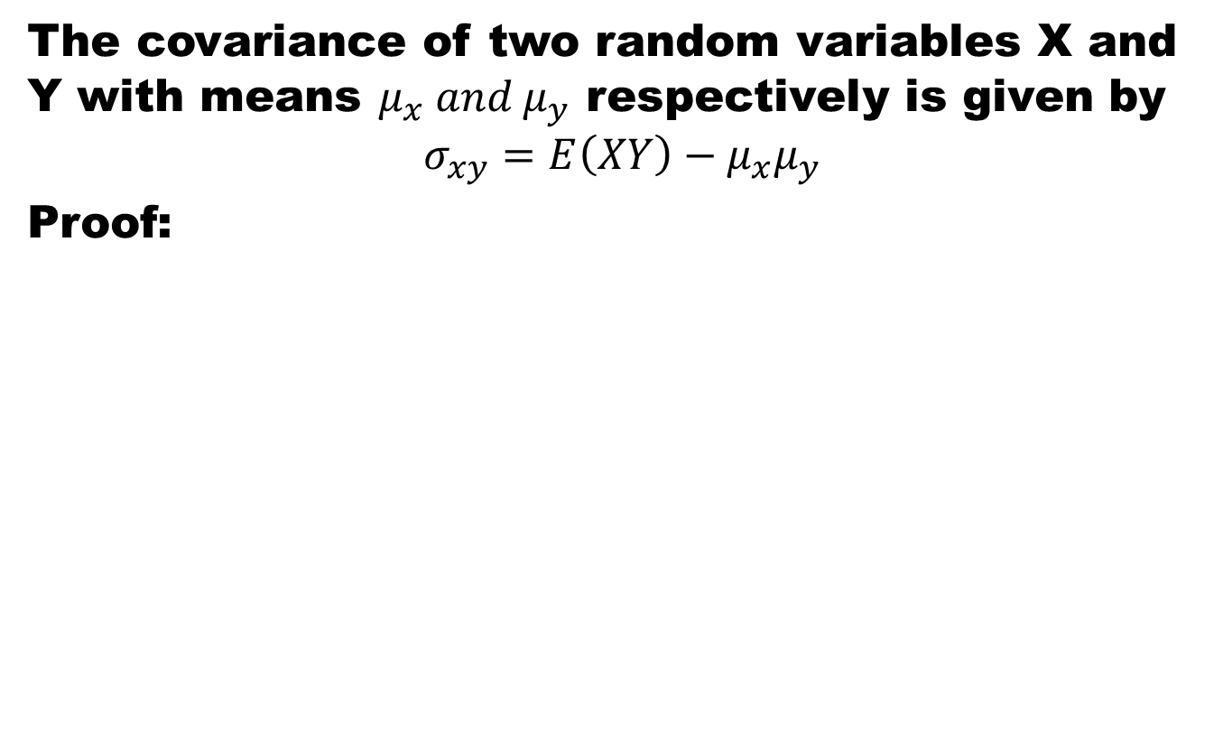
Theorem
The covariance of two random variables X and Y with means $μ_{x} and μ_{y}$ respectively is given by
$$σ_{xy}=E\left(XY\right)−μ_{x}μ_{y}$$
Proof:

Slide 19
Summary
Summary
Variance of a distribution
Covariance
References
Probability and Statistics for Engineers and Scientists by Walpole
Schaum outline series in Probability and Statistics

