Slide 1
Mathematical Statistics
Lecture 15
Prof. Dr. M. Junaid Mughal

Slide 2
Last Class
Joint Probability distribution
Marginal Probability
Conditional probability

Slide 3
Today’s Agenda
Probability Distribution Functions(continued)

Slide 4
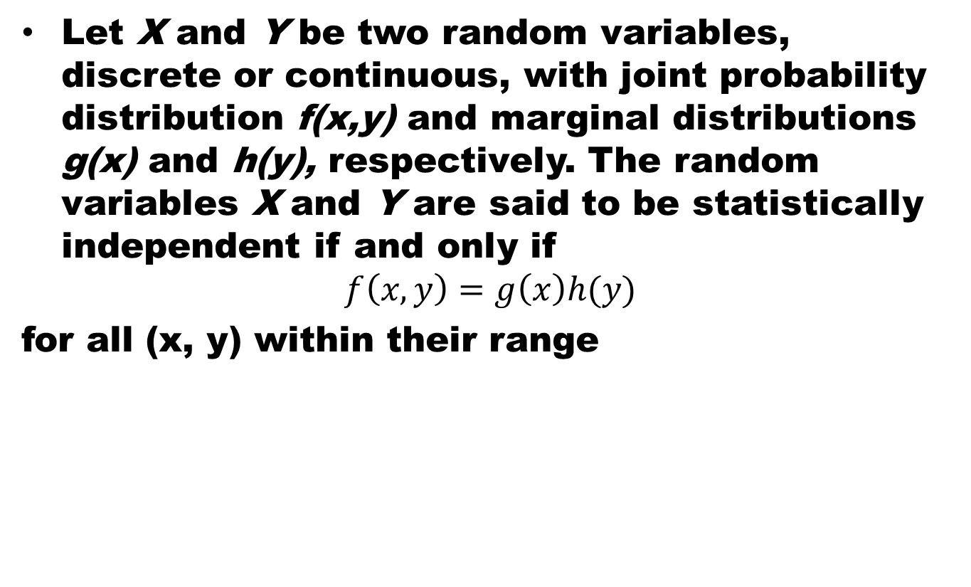
Statistical Independence
Let X and Y be two random variables, discrete or continuous, with joint probability distribution f(x,y) and marginal distributions g(x) and h(y), respectively. The random variables X and Y are said to be statistically independent if and only if
$$f\left(x,y\right)=g\left(x\right)h(y)$$
for all (x, y) within their range

Slide 5
Proof

Slide 6
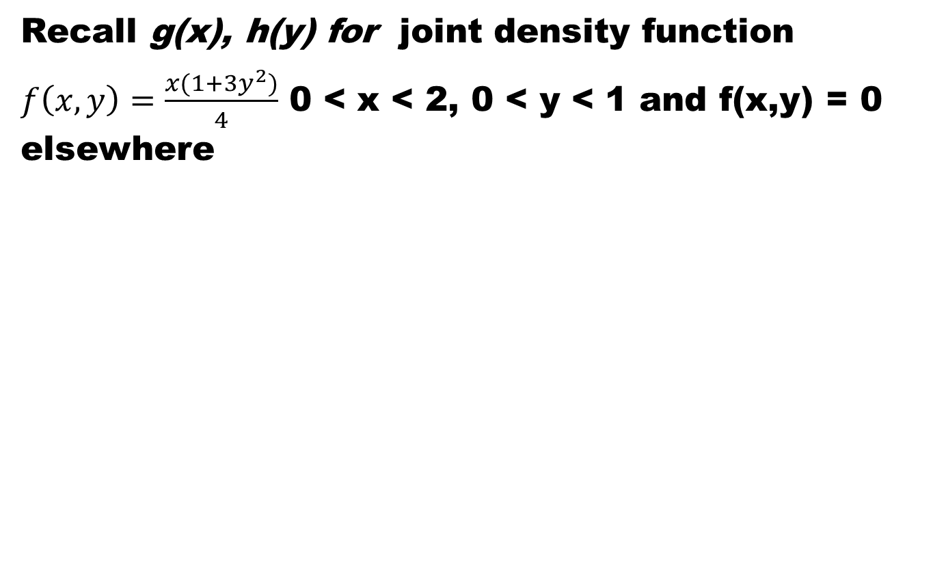
Example
Recall g(x), h(y) for joint density function
$f\left(x,y\right)=\frac{x(1+3y^{2})}{4}$ 0 < x < 2, 0 < y < 1 and f(x,y) = 0 elsewhere

Slide 7
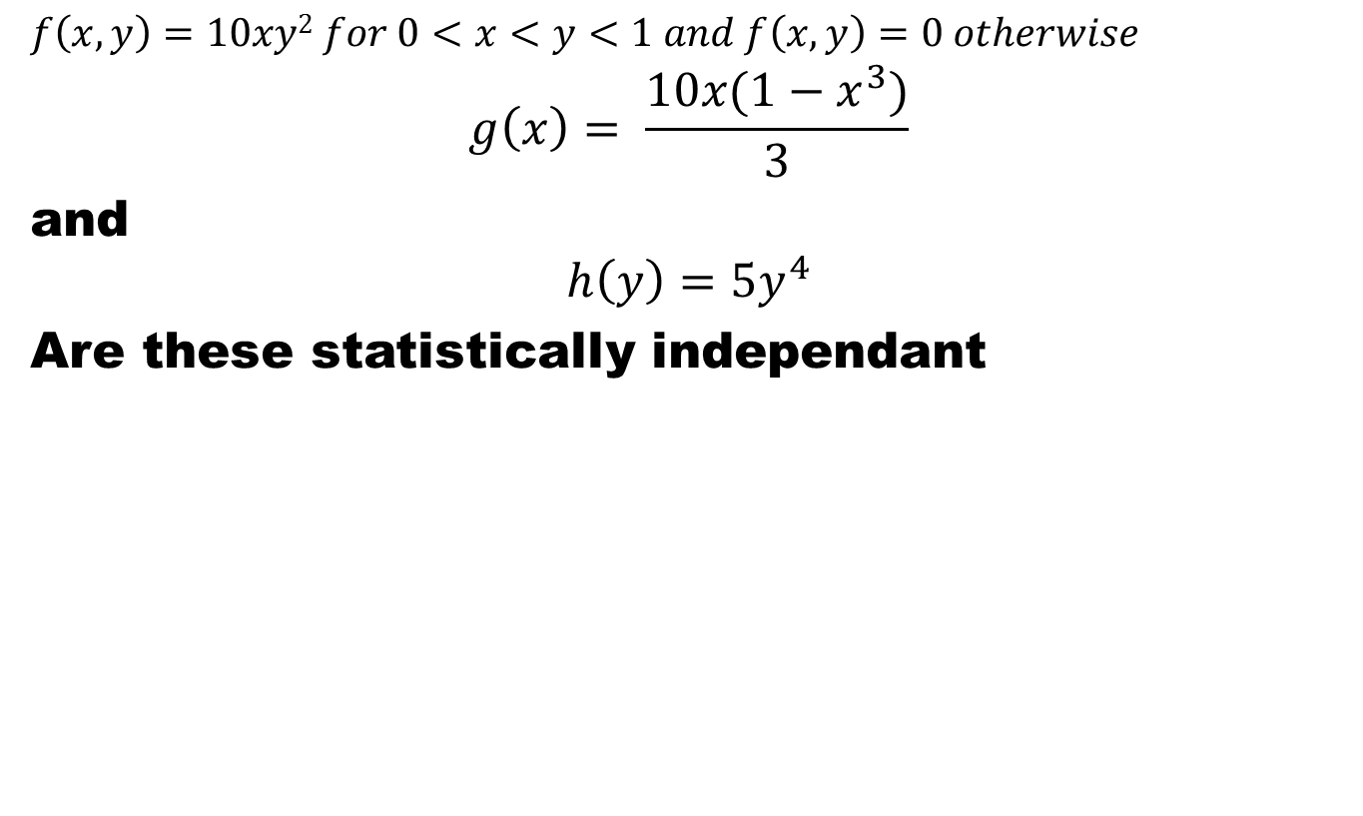
Example
$$f\left(x,y\right)=10xy2 for 0<x<y<1 and f\left(x,y\right)=0 otherwise$$
$$g\left(x\right)= \frac{10x(1−x^{3})}{3}$$
and
$$h\left(y\right)=5y^{4}$$
Are these statistically independant

Slide 8
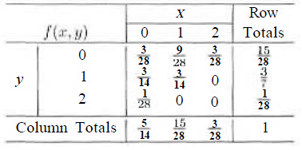
Example
Statistical Independence of

Slide 9
Joint PDF
Joint PDF of more than two variables

Slide 10
Explanation

Slide 11
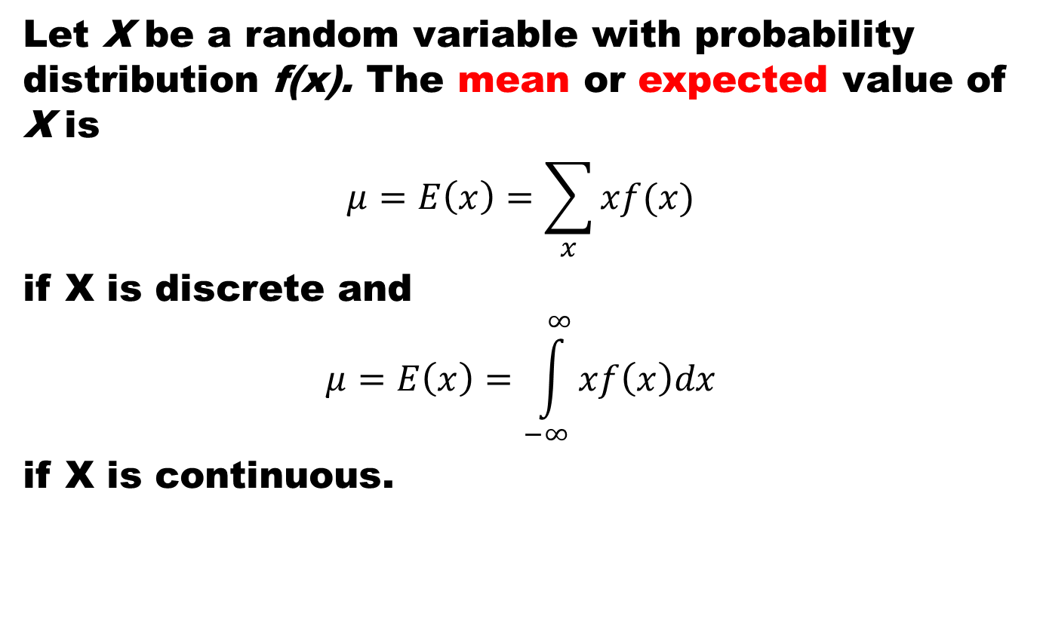
Mean of a Distribution
Let X be a random variable with probability distribution f(x). The mean or expected value of X is
$$μ=E\left(x\right)=\sum_{x}{xf(x)}$$
if X is discrete and
$$μ=E\left(x\right)=\int_{−∞}^{∞}{xf\left(x\right)dx}$$
if X is continuous.

Slide 12
Example
A lot containing 7 components is sampled by a quality inspector; the lot contains 4 good components and 3 defective components. A sample of 3 is taken by the inspector. Find the expected value of the number of good components in this sample.

Slide 13
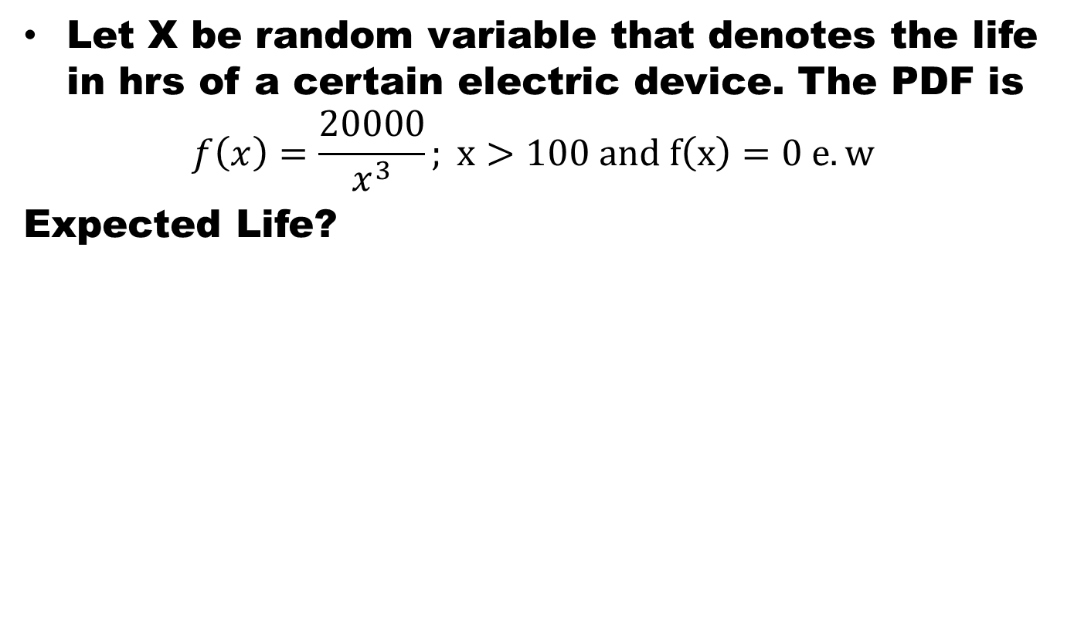
Example
Let X be random variable that denotes the life in hrs of a certain electric device. The PDF is
$$f\left(x\right)=\frac{20000}{x^{3}}; x>100 and f\left(x\right)=0 e.w$$
Expected Life?

Slide 14
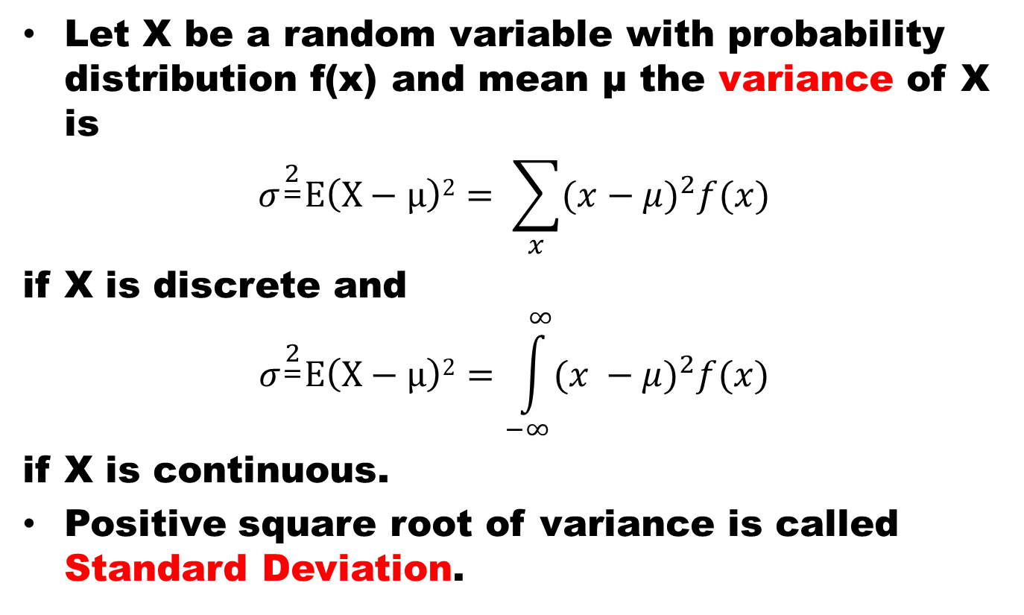
Variance
Let X be a random variable with probability distribution f(x) and mean μ the variance of X is
$$σ^{\begin{aligned}2 \\ =\end{aligned}}E\left(X−μ\right)2= \sum_{x}{{(x−μ)}^{2}f(x)}$$
if X is discrete and
$$σ^{\begin{aligned}2 \\ =\end{aligned}}E\left(X−μ\right)2=\int_{−∞}^{∞}{{(x −μ)}^{2}f(x)}$$
if X is continuous.
Positive square root of variance is called Standard Deviation.

Slide 15


Example
Let the random variable X represent the number of automobiles that are used for official business purposes on any given workday. The probability distribution for company A is
and for company B is
Variance of A and B

Slide 16
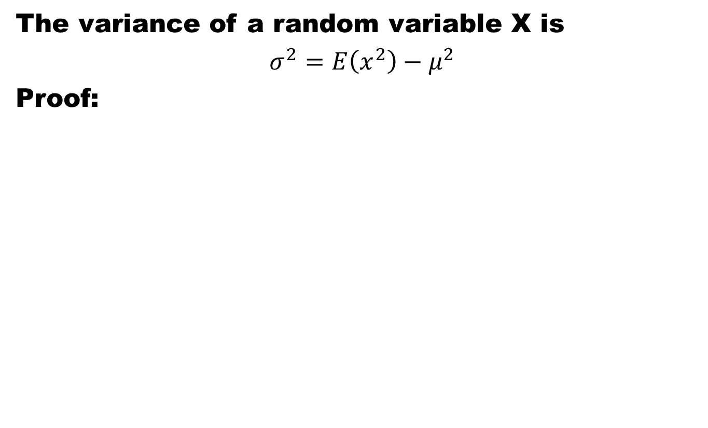
Theorem
The variance of a random variable X is
$σ^{2}=E\left(x^{2}\right)−μ^{2}$
Proof:

Slide 17
Summary
Statistical Independence
Mean and Variance of a distribution

Slide 18
References
Probability and Statistics for Engineers and Scientists by Walpole
Schaum outline series in Probability and Statistics

