Slide 1
Mathematical Statistics
Lecture 14
Prof. Dr. M. Junaid Mughal

Slide 2
Last Class
Review of
  Discrete and Continuous Random Variables
  Discrete Probability Distribution
  Continuous Probability Distribution
Exercises

Slide 3
Today’s Agenda
Joint Probability distribution
Marginal Probability
Conditional probability

Slide 4
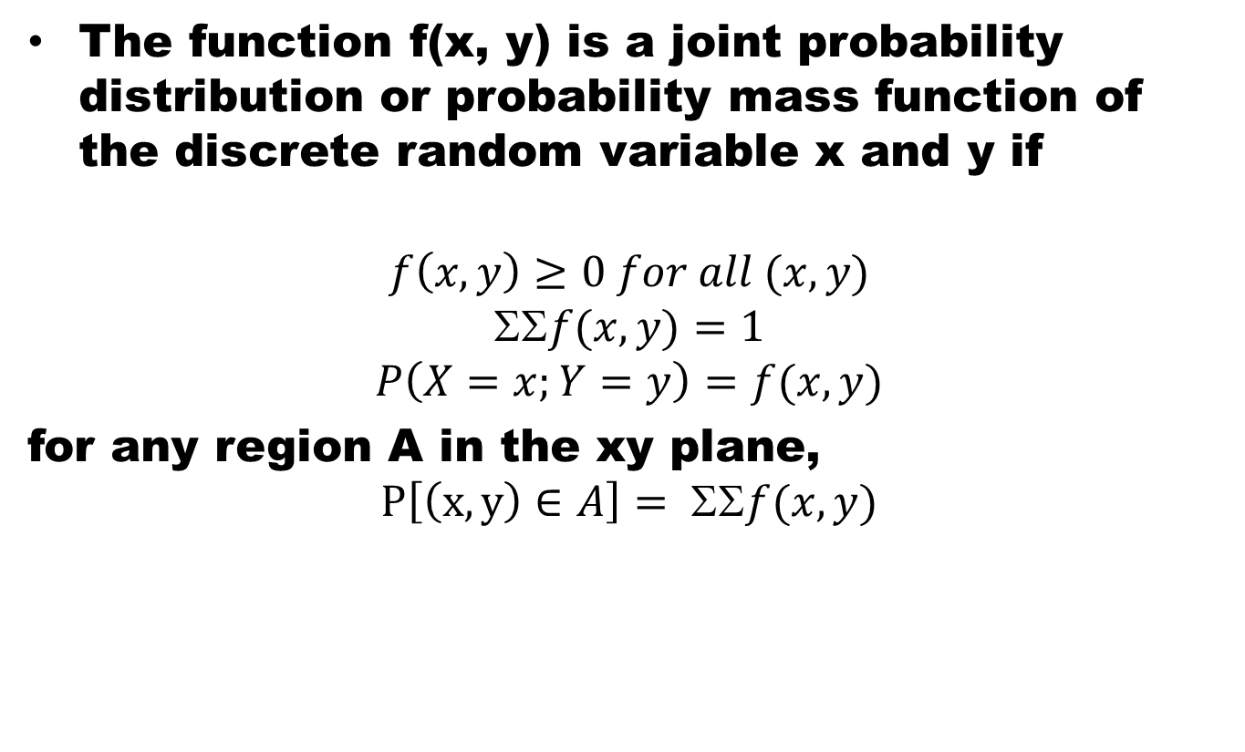
Joint Probability Distribution
The function f(x, y) is a joint probability distribution or probability mass function of the discrete random variable x and y if
$$f\left(x, y\right)≥0 for all (x, y)$$
$$f(x, y)=1$$
$$P\left(X=x;Y=y\right)=f(x, y)$$
for any region A in the xy plane,
$$P\left[\left(x, y\right)∈A\right]= ΣΣf(x, y)$$

Slide 5
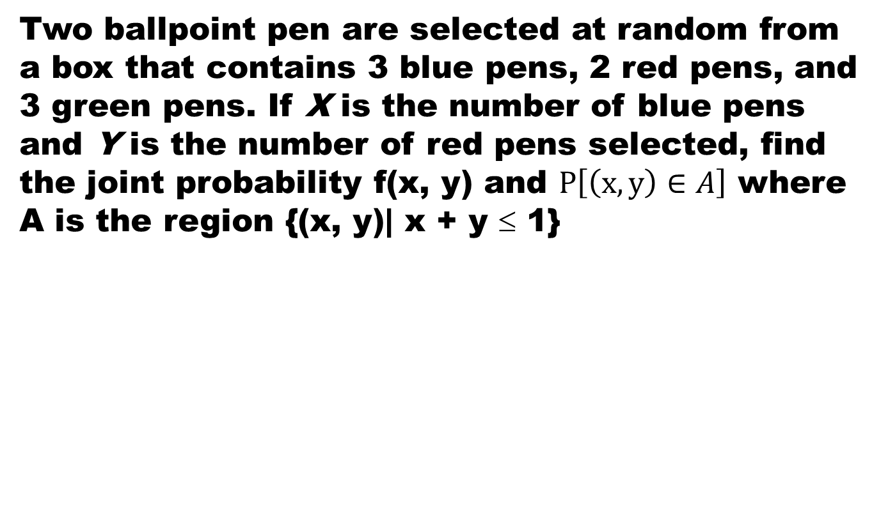
Example
Two ballpoint pen are selected at random from a box that contains 3 blue pens, 2 red pens, and 3 green pens. If X is the number of blue pens and Y is the number of red pens selected, find the joint probability f(x, y) and $P\left[\left(x, y\right)∈A\right]$ where A is the region {(x, y)| x + y ≤ 1}

Slide 6
Example (contd…)
Two ballpoint pen are selected at random from a box that contains 3 blue pens, 2 red pens, and 3 green pens. If X is the number of blue pens and Y is the number of red pens selected, find the joint probability f(x, y) and $P\left[\left(x, y\right)∈A\right]$ where A is the region {(x, y)| x + y ≤ 1}

Slide 7
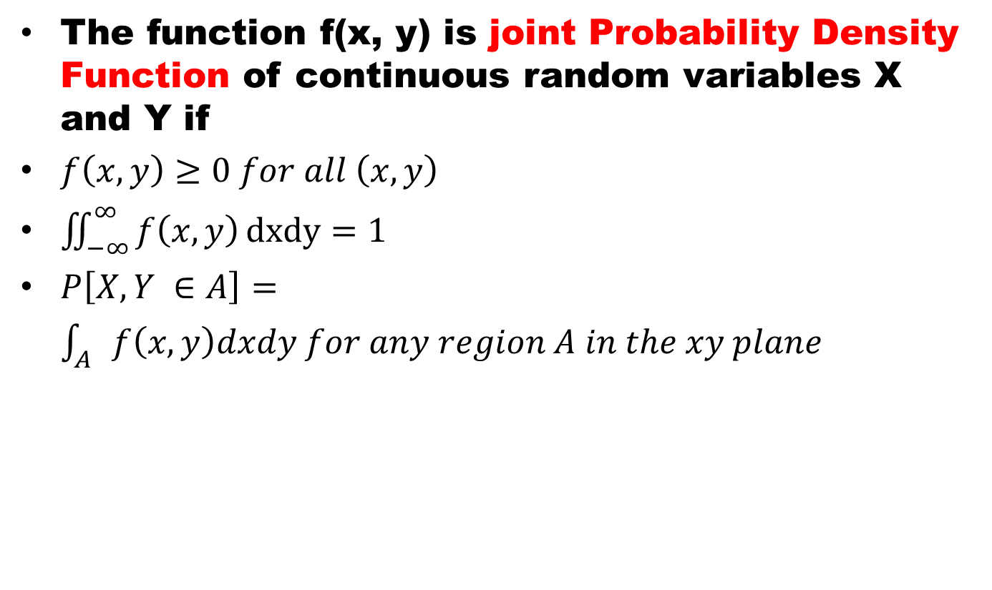
Continuous Joint PDF
The function f(x, y) is joint Probability Density Function of continuous random variables X and Y if
$f\left(x, y\right)≥0 for all \left(x, y\right)$
$\iint_{−∞}^{∞}{f\left(x, y\right)}dxdy=1$
$P\left[X, Y ∈A\right]=\int_{A}{f\left(x,y\right)dxdy for any region A in the xy plane}$

Slide 8
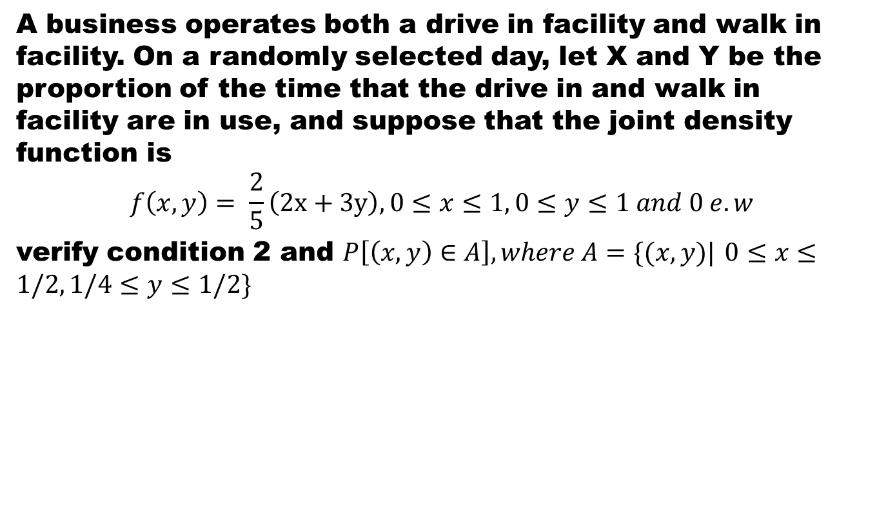
Example
A business operates both a drive in facility and walk in facility. On a randomly selected day, let X and Y be the proportion of the time that the drive in and walk in facility are in use, and suppose that the joint density function is
$$f\left(x,y\right)= \frac{2}{5}\left(2x+3y\right), 0≤x≤1, 0≤y≤1 and 0 e.w$$
verify condition 2 and $P\left[\left(x,y\right)∈A\right], where A=\{(x,y)|$ $0≤x≤1/2, 1/4≤y≤1/2\}$

Slide 9
Example (contd..)
A business operates both a drive in facility and walk in facility. On a randomly selected day, let X and Y be the proportion of the time that the drive in and walk in facility are in use, and suppose that the joint density function is
$$f\left(x,y\right)= \frac{2}{5}\left(2x+3y\right), 0≤x≤1, 0≤y≤1 and 0 e.w$$
verify condition 2 and $P\left[\left(x,y\right)∈A\right], where A=\{(x,y)|$ $0≤x≤1/2, 1/4≤y≤1/2\}$

Slide 10
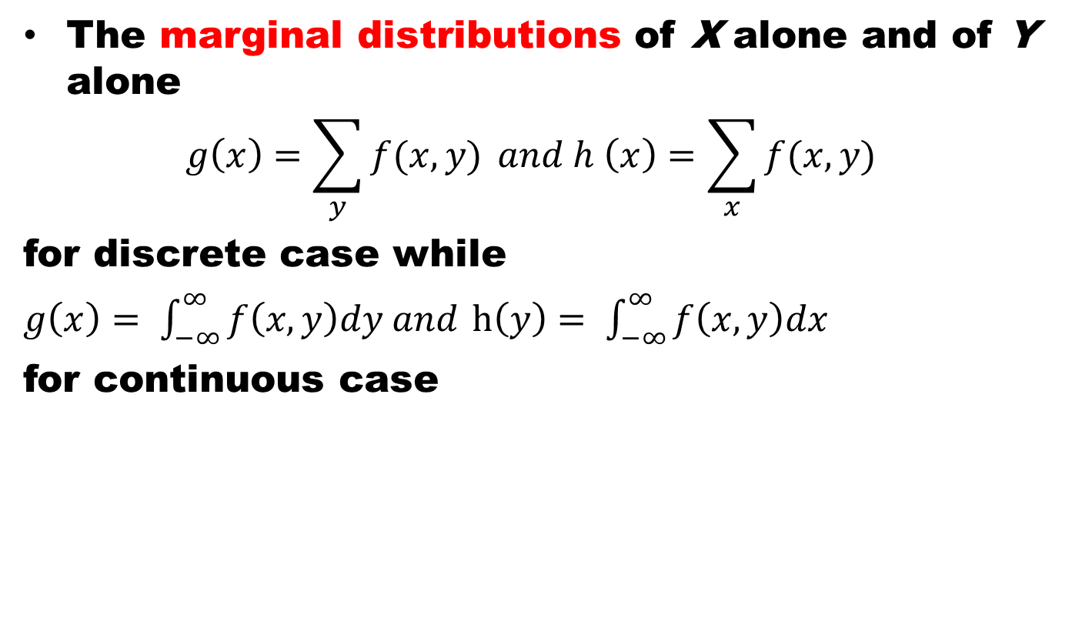
Marginal Distribution
The marginal distributions of X alone and of Y alone
$$g\left(x\right)=\sum_{y}{f(x,y)} and h \left(x\right)=\sum_{x}{f(x,y)}$$
for discrete case while
$g\left(x\right)= \int_{−∞}^{∞}{f\left(x,y\right)dy and}$ $h\left(y\right)= \int_{−∞}^{∞}{f\left(x,y\right)dx}$
for continuous case

Slide 11
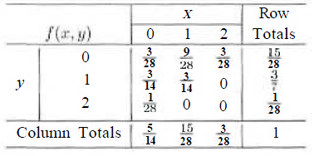
Example
Show that rows and columns of the previous problem are marginal distributions.

Slide 12
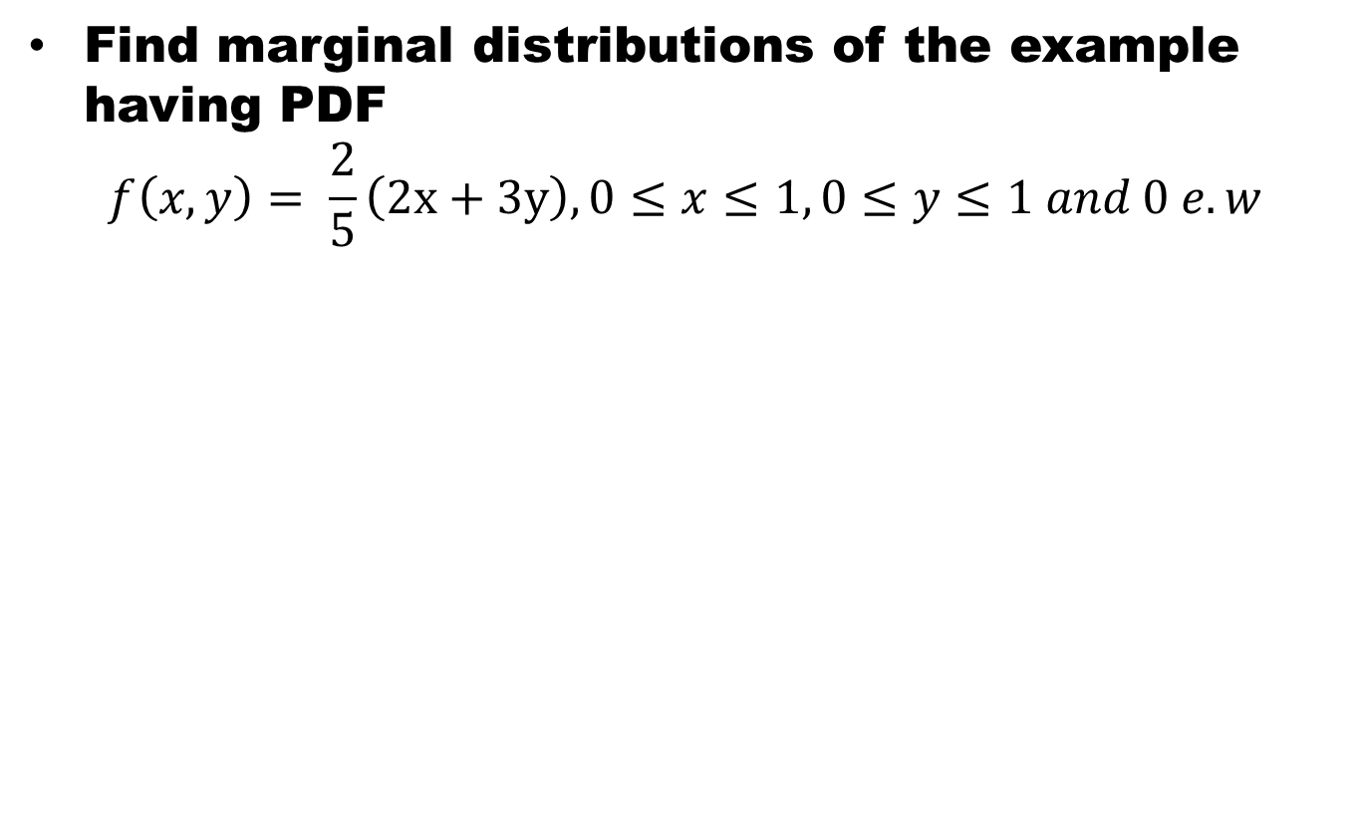
Example
Find marginal distributions of the example having PDF
$$f\left(x,y\right)= \frac{2}{5}\left(2x+3y\right), 0≤x≤1, 0≤y≤1 and 0 e.w$$

Slide 13
Marginal Distributions
The fact that the marginal distributions g(x) and h(y) are indeed the probability distributions of the individual variables X and Y alone can be verified by showing that the conditions of definitions of probability function are satisfied.
The set of ordered pairs (x, f(x)) is a probability function , probability mass function or probability distribution of discrete random variable x, if for each possible outcome x
  f(x) ≥ 0
  Σf(x) = 1
  P(X = x) = f(x)

Slide 14
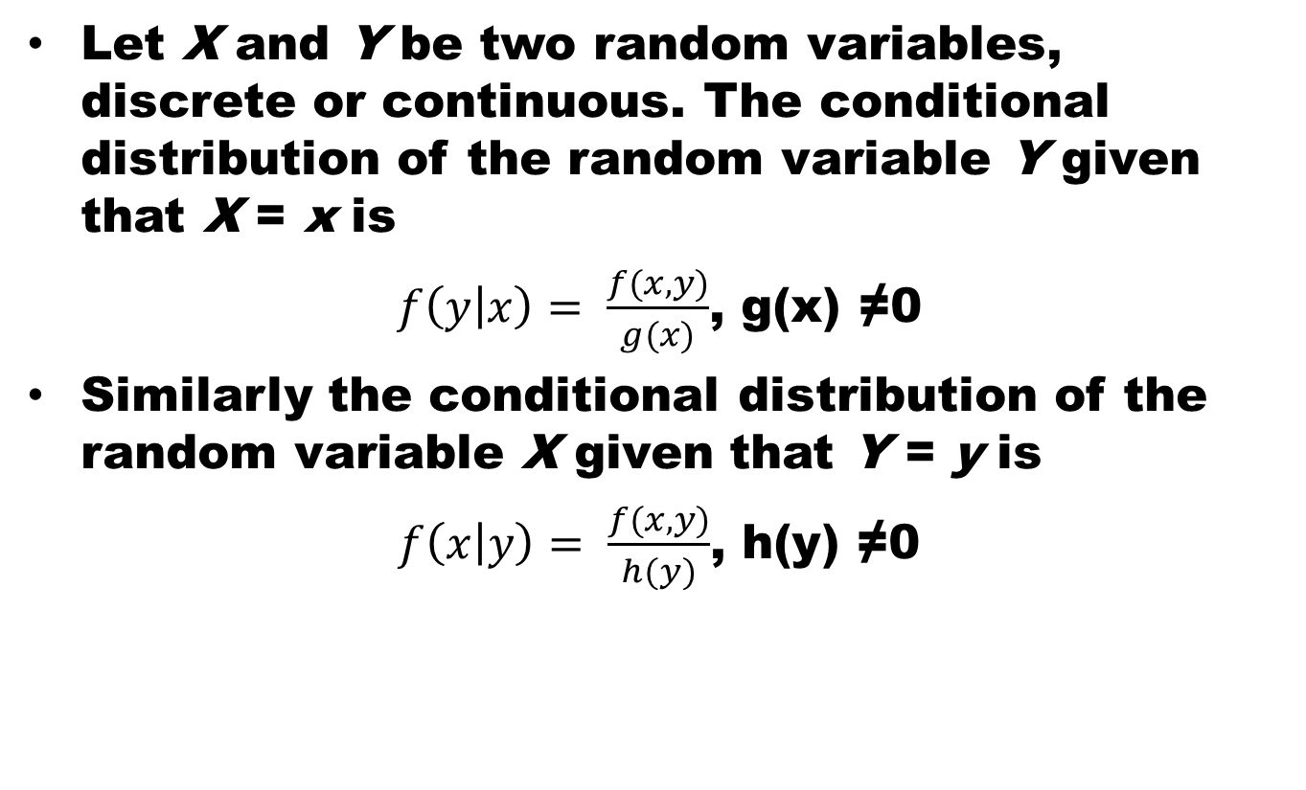
Conditional Distribution
Let X and Y be two random variables, discrete or continuous. The conditional distribution of the random variable Y given that X = x is
$f\left(y | x\right)= \frac{f(x,y)}{g(x)}$, g(x) ≠0
Similarly the conditional distribution of the random variable X given that Y = y is
$f\left(x | y\right)= \frac{f(x,y)}{h(y)}$, h(y) ≠0

Slide 15
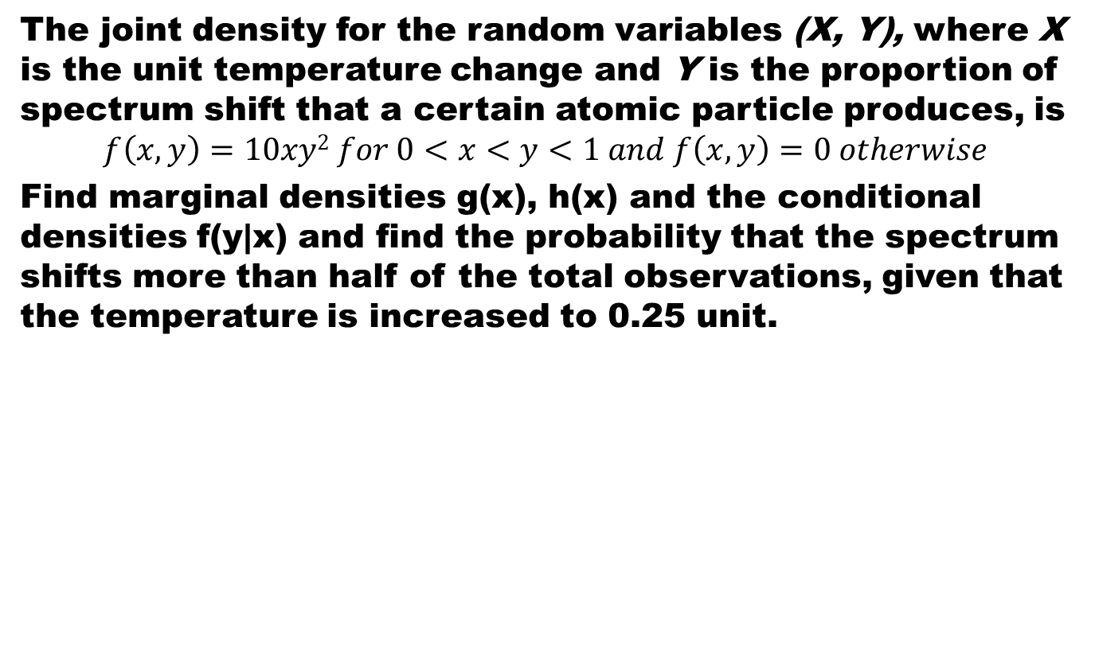
Example
The joint density for the random variables (X, Y), where X is the unit temperature change and Y is the proportion of spectrum shift that a certain atomic particle produces, is
$$f\left(x,y\right)=10xy2 for 0<x<y<1 and f\left(x,y\right)=0 otherwise$$
Find marginal densities g(x), h(x) and the conditional densities f(y|x) and find the probability that the spectrum shifts more than half of the total observations, given that the temperature is increased to 0.25 unit.

Slide 16
Example (cont)

Slide 17
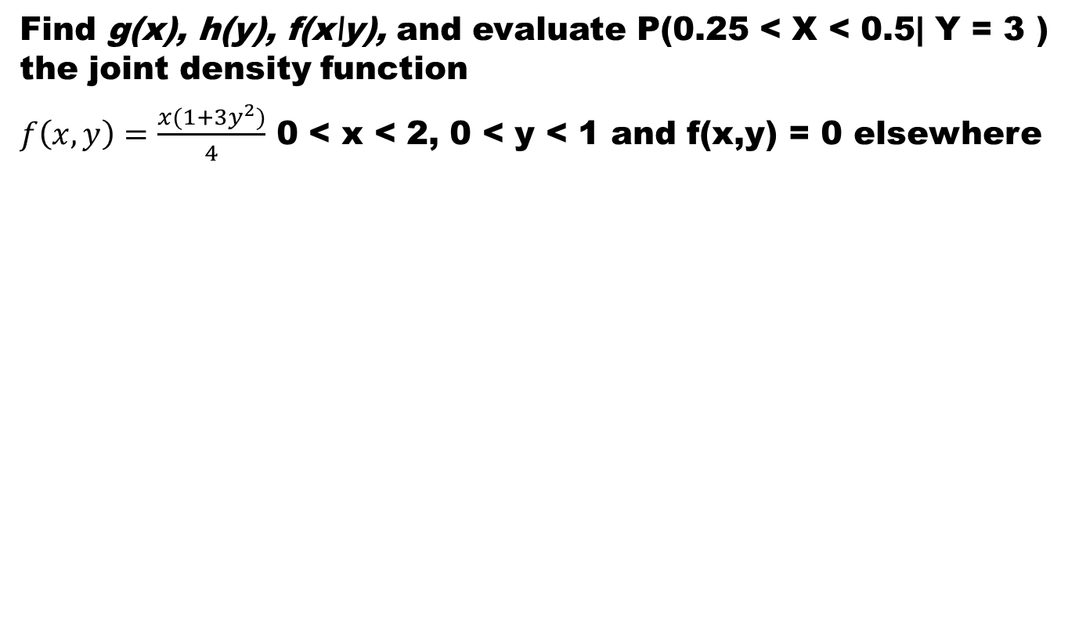
Example
Find g(x), h(y), f(x\y), and evaluate P(0.25 < X < 0.5| Y = 3 ) the joint density function
$f\left(x,y\right)=\frac{x(1+3y^{2})}{4}$ 0 < x < 2, 0 < y < 1 and f(x,y) = 0 elsewhere

Slide 18
Example

Slide 19
Summary
Joint distribution functions
Marginal Probability
Conditional probability
References
Probability and Statistics for Engineers and Scientists by Walpole
Schaum outline series in Probability and Statistics

