Slide 1
Mathematical Statistics
Lecture 13
Prof. Dr. M. Junaid Mughal

Slide 2
Last Class
Introduction to Probability (continued)
Random Variable
Discrete and Continuous Random Variables
Discrete Probability Distribution
  Continuous Probability Distribution

Slide 3
Today’s Agenda
Review of
  Discrete and Continuous Random Variables
  Discrete Probability Distribution
  Continuous Probability Distribution
Exercises

Slide 4
Random Variables
A random variable is a function that associates a real number with each element in the sample space.

Slide 5
Discrete Random Variables
A Discrete Random Variable is the one that has a countable set of outcomes.
Example:
  Number of tosses of a fair coin until a head comes.
    X={1,2,3,4,5,……..}
  Number of people visiting an ATM machine in a day.
    Y = {0,1,2,3,…….}
  Outcome of a fair die
    W = {1,2,3,4,5,6}

Slide 6
Continuous Random Variables
When a random variable takes on values on continuous scale, the variable is regarded as continuous random variable.
Example
  Amount of rain a certain city receives per year
  Height of first year students in college
  Time taken by 100 students to complete the assignment

Slide 7
Discrete Probability Distribution
The set of ordered pairs (x, f(x)) is a probability function , probability mass function or probability distribution of discrete random variable x, if for each possible outcome x
  f(x) ≥ 0
  Σ f(x) = 1
  P(X = x) = f(x)

Slide 8
Discrete Probability Distribution
x | 0 | 1 | 2
f(x) | 10/28 | 15/28 | 3/28
Bar Chart
Histogram

Slide 9
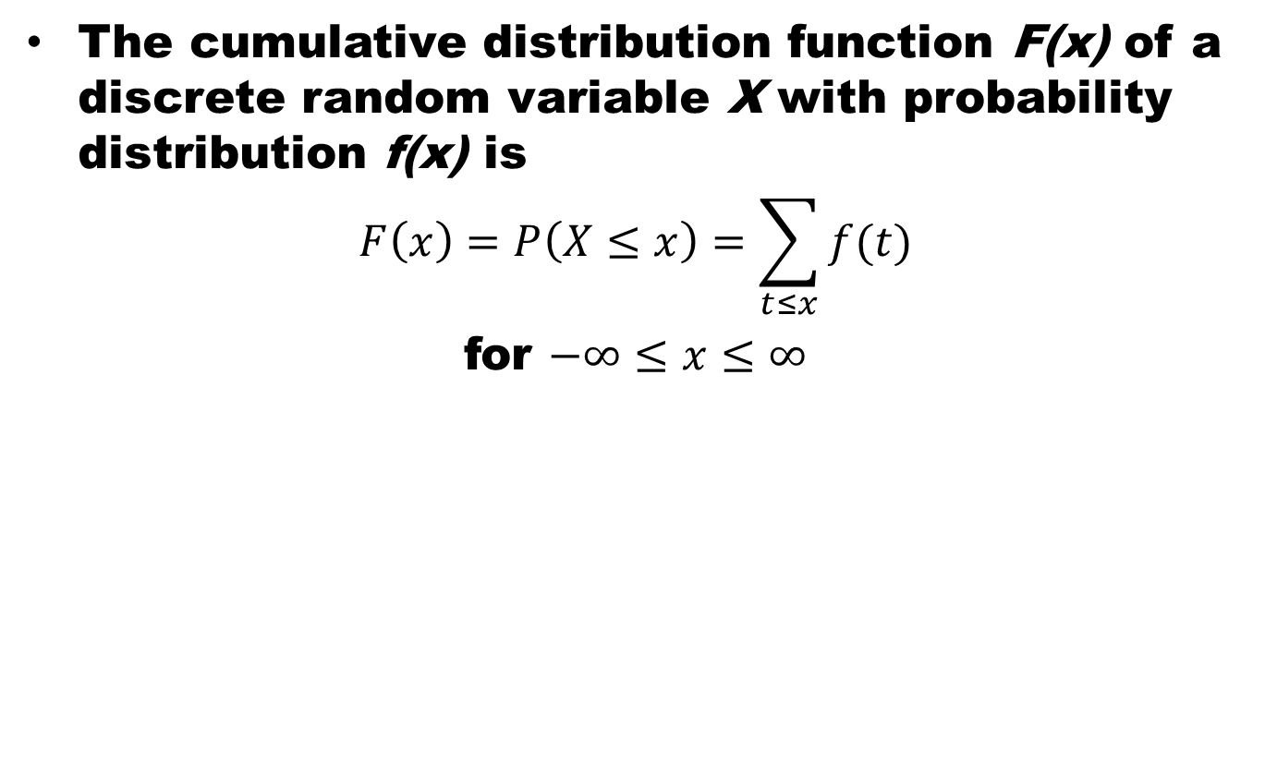
Cumulative Distribution
The cumulative distribution function F(x) of a discrete random variable X with probability distribution f(x) is
$$F\left(x\right)=P\left(X≤x\right)=\sum_{t≤x}{f(t)}$$
for $−∞≤x≤∞$

Slide 10
Cumulative Distribution
x | 0 | 1 | 2
f(x) | 10/28 | 15/28 | 3/28

Slide 11
Continuous Probability Distribution
Continuous probability distribution cannot be written in tabular form but it can be stated as a formula. Such a formula would necessarily be a function of the numerical values of the continuous random variable X and as such will be represented by the functional notation f(x). The function f(x) usually called probability density function or density function of X.

Slide 12
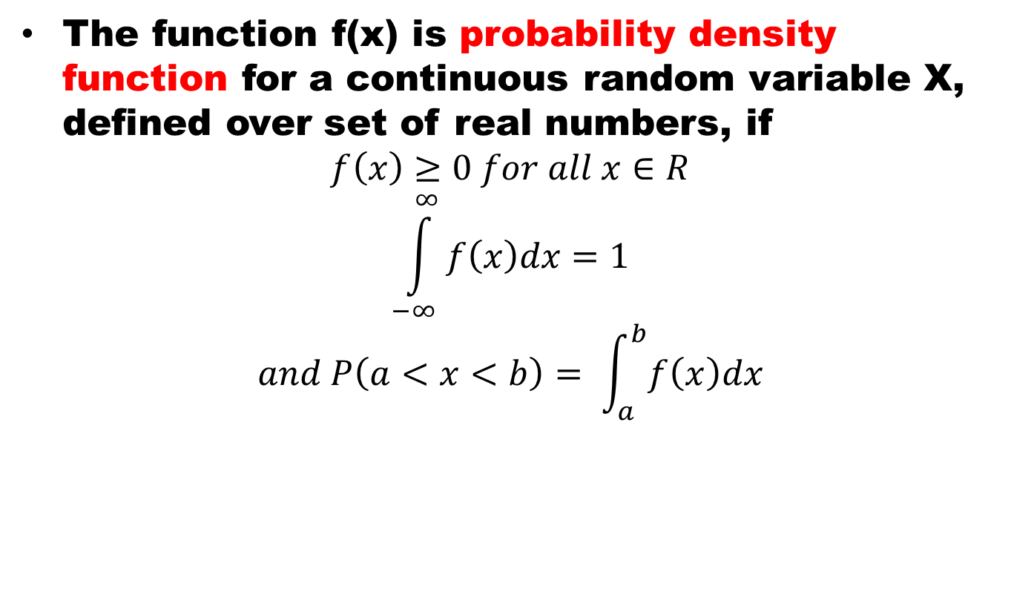
Continuous PDF
The function f(x) is probability density function for a continuous random variable X, defined over set of real numbers, if
$$f\left(x\right)≥0 for all x∈R$$
$$\int_{−∞}^{∞}{f\left(x\right)dx=1}$$
$$and P\left(a<x<b\right)= \int_{a}^{b}{f\left(x\right)dx}$$

Slide 13
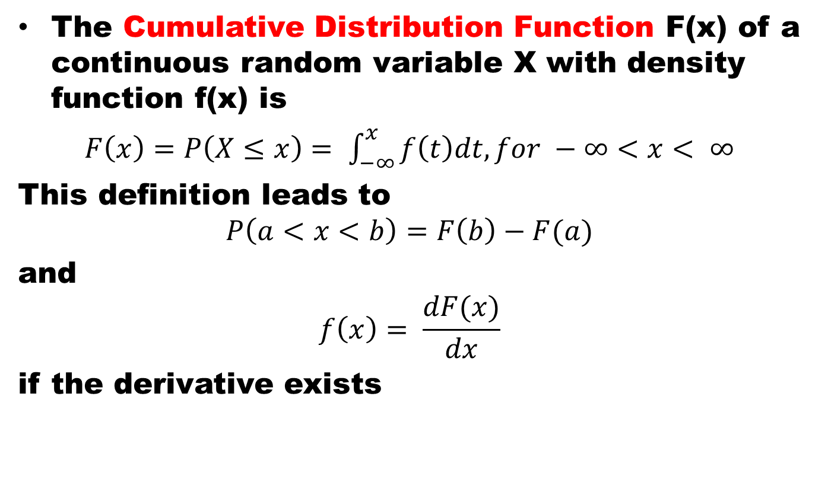
Cumulative Distribution Function
The Cumulative Distribution Function F(x) of a continuous random variable X with density function f(x) is
$F\left(x\right)=P\left(X≤x\right)= \int_{−∞}^{x}{f\left(t\right)dt, for −∞<x< ∞}$
This definition leads to
$$P\left(a<x<b\right)=F\left(b\right)−F(a)$$
and
$$f\left(x\right)= \frac{dF(x)}{dx}$$
if the derivative exists

Slide 14
Exercise 1
3.1 Classify the following random variables as discrete or continuous:
  X: the number of automobile accidents per year in Virginia.
  Y: the length of time to play 18 holes of golf.
  M: the amount of milk produced yearly by a particular cow.
  N: the number of eggs laid each month by a hen.
  P: the number of building permits issued each month in a certain city.
  Q: the weight of grain produced per acre.

Slide 15
Exercise 2
3.3 Let W be a random variable giving the number of heads minus the number of tails in three tosses of a coin. List the elements of the sample space S for the three tosses of the coin and to each sample point assign a value w of W.

Slide 16
Exercise 3
3.4 A coin is flipped until 3 heads in succession occur. List only those elements of the sample space that require 6 or less tosses. Is this a discrete sample space?

Slide 17
Exercise 4 (a)
3.5 Determine the value c so that each of the following functions can serve as a probability distribution of the discrete random variable X:
(a) f(x) = c(x² + 4), for x= 0,1,2,3;

Slide 18
Exercise 4 (b)
3.5 Determine the value c so that each of the following functions can serve as a probability distribution of the discrete random variable X:
(b)

Slide 19
Exercise 5
3.6 The shelf life, in days, for bottles of a certain prescribed medicine is a random variable having the density function
Find the probability that a bottle of this medicine will have a shelf life of
(a) at least 200 days;
(b) anywhere from 80 to 120 days.

Slide 20
Exercise 5 (solution)
Find the probability that a bottle of this medicine will have a shelf life of
(a) at least 200 days;
(b) anywhere from 80 to 120 days.

Slide 21
Exercise 6
3.9 The proportion of people who respond to a certain mail-order solicitation is a continuous random variable X that has the density function
(a) Show that P(0 < X < 1) = 1.
(b) Find the probability that more than 1/4 but fewer than 1/2 of the people contacted will respond to this type of solicitation.

Slide 22
Exercise 6 (solution)
(a) Show that P(0 < X < 1) = 1.
(b) Find the probability that more than 1/4 but fewer than 1/2 of the people contacted will respond to this type of solicitation.

Slide 23

Exercise 7
3.13 The probability distribution of X, the number of imperfections per 10 meters of a synthetic fabric in continuous rolls of uniform width, is given by
Construct the cumulative distribution function of X.

Slide 24
Exercise 7 (solution)
Construct the cumulative distribution function of X.

Slide 25
Exercise 8
3.14 The waiting time, in hours, between successive speeders spotted by a radar unit is a continuous random variable with cumulative distribution function
Find the probability of waiting less than 12 minutes between successive speeders
(a) using the cumulative distribution function of X;
(b) using the probability density function of X.

Slide 26
Exercise 8 (solution)
Find the probability of waiting less than 12 minutes between successive speeders
(a) using the cumulative distribution function of X;
(b) using the probability density function of X.

Slide 27
Summary
Random Variable
Probability Distributions
References
Probability and Statistics for Engineers and Scientists by Walpole
Schaum outline series in Probability and Statistics

Slide 28
Example

