Slide 1
Mathematical Statistics
Lecture 12
Prof. Dr. M. Junaid Mughal

Slide 2
Last Class
  Conditional Probability
  Bayes Rule
  Random Variable
  Examples

Slide 3
Today’s Agenda
Introduction to Probability (continued)
Random Variable
Discrete and Continuous Random Variables
Discrete Probability Distribution

Slide 4
Random Variables
A random variable is a function that associates a real number with each element in the sample space.
Example
  Two balls are drawn in succession without replacement from an urn containing 4 red balls and 3 black balls it’s sample space is

Slide 5
Discrete and Continuous Sample Space
If a sample space contains a finite number of possibilities or an unending sequence with as many elements as there are whole numbers, it is called a discrete sample space.
If a sample space contains an infinite number of possibilities equal to the number of points on a line segment, it is called a continuous sample space.

Slide 6
Discrete and Continuous Random Variables
A Discrete Random Variable is the one that has a countable set of outcomes.
When a random variable takes on values on continuous scale, the variable is regarded as continuous random variable.

Slide 7
Examples of Discrete Random Variables
Number of tosses of a fair coin until a head comes.
  X={1,2,3,4,5,……..}
Number of people visiting an ATM machine in a day.
  Y = {1,2,3,…….}

Slide 8
Example of Continuous Random Variables
Interest centers around the proportion of people who respond to a certain mail order solicitation. Let X be that proportion. X is a random variable that takes on all values x for which 0 < x < 1.
Let X be the random variable defined by the: waiting time, between successive speeders spotted by a radar unit. The random variable X takes on all values x for which t > 0.

Slide 9
Discrete and Continuous Random Variables
A Discrete Random Variable is the one that has a countable set of outcomes.
When a random variable takes on values on continuous scale, the variable is regarded as continuous random variable.

Slide 10
Discrete Probability Distribution
The set of ordered pairs (x, f(x)) is a probability function , probability mass function or probability distribution of discrete random variable x, if for each possible outcome x
  f(x) ≥ 0
  Σf(x) = 1
  P(X = x) = f(x)

Slide 11
Example
A shipment of 8 computers to a retail outlet contains 3 of that are defective. If a school makes a random purchase of 2 of these computers, find the probability distribution for the number of defectives.

Slide 12
Example
If a car agency sells 50% of its inventory of a certain foreign car equipped with airbags. Find a formula for the probability distribution of the number of cars with airbags among the next 4 cars sold by the agency.

Slide 13
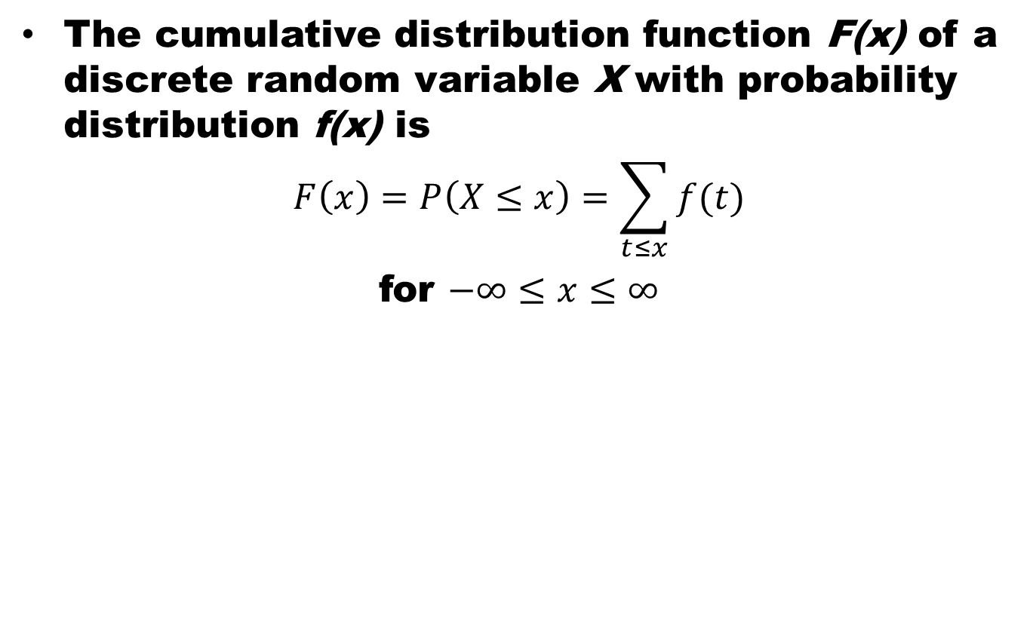
Cumulative Distribution
The cumulative distribution function F(x) of a discrete random variable X with probability distribution f(x) is
$$F\left(x\right)=P\left(X≤x\right)=\sum_{t≤x}{f(t)}$$
for $−∞≤x≤∞$

Slide 14
Probability Bar Chart and Histogram
f( 0 )= 1/16, f( 1 ) = 1/4, f(2)= 3/8, f(3)= 1/4, and f( 4 )= 1/16.

Slide 15
Examples
f( 0 )= 1/16, f( 1 ) = 1/4, f(2)= 3/8, f(3)= 1/4, and f( 4 )= 1/16. CDF

Slide 16
Cumulative Distribution Function

Slide 17
Cumulative Distribution
The cumulative distribution function F(x) of a discrete random variable X with probability distribution f(x) is
$$F\left(x\right)=P\left(X≤x\right)=\sum_{t≤x}{f(t)}$$
for $−∞≤x≤∞$

Slide 18
Continuous Probability Distribution
Continuous probability distribution cannot be written in tabular form but it can be stated as a formula. Such a formula would necessarily be a function of the numerical values of the continuous random variable X and as such will be represented by the functional notation f(x). The function f(x) usually called probability density function or density function of X.

Slide 19
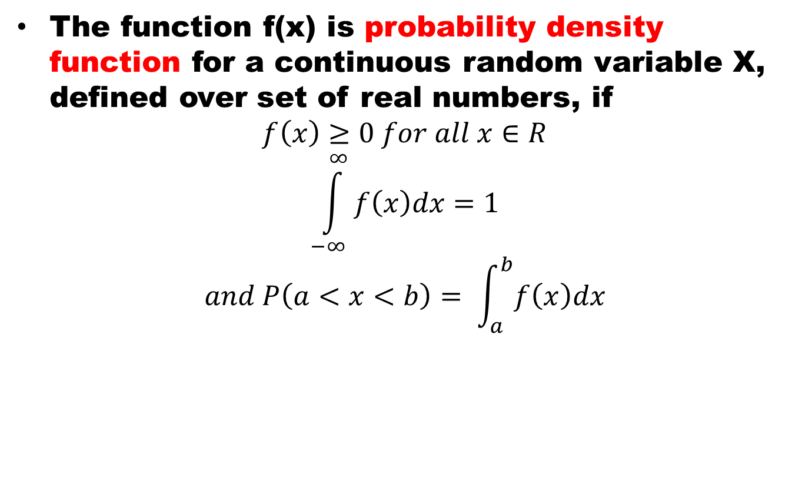
Continuous PDF
The function f(x) is probability density function for a continuous random variable X, defined over set of real numbers, if
$$f\left(x\right)≥0 for all x∈R$$
$$\int_{−∞}^{∞}{f\left(x\right)dx=1}$$
$$and P\left(a<x<b\right)= \int_{a}^{b}{f\left(x\right)dx}$$

Slide 20
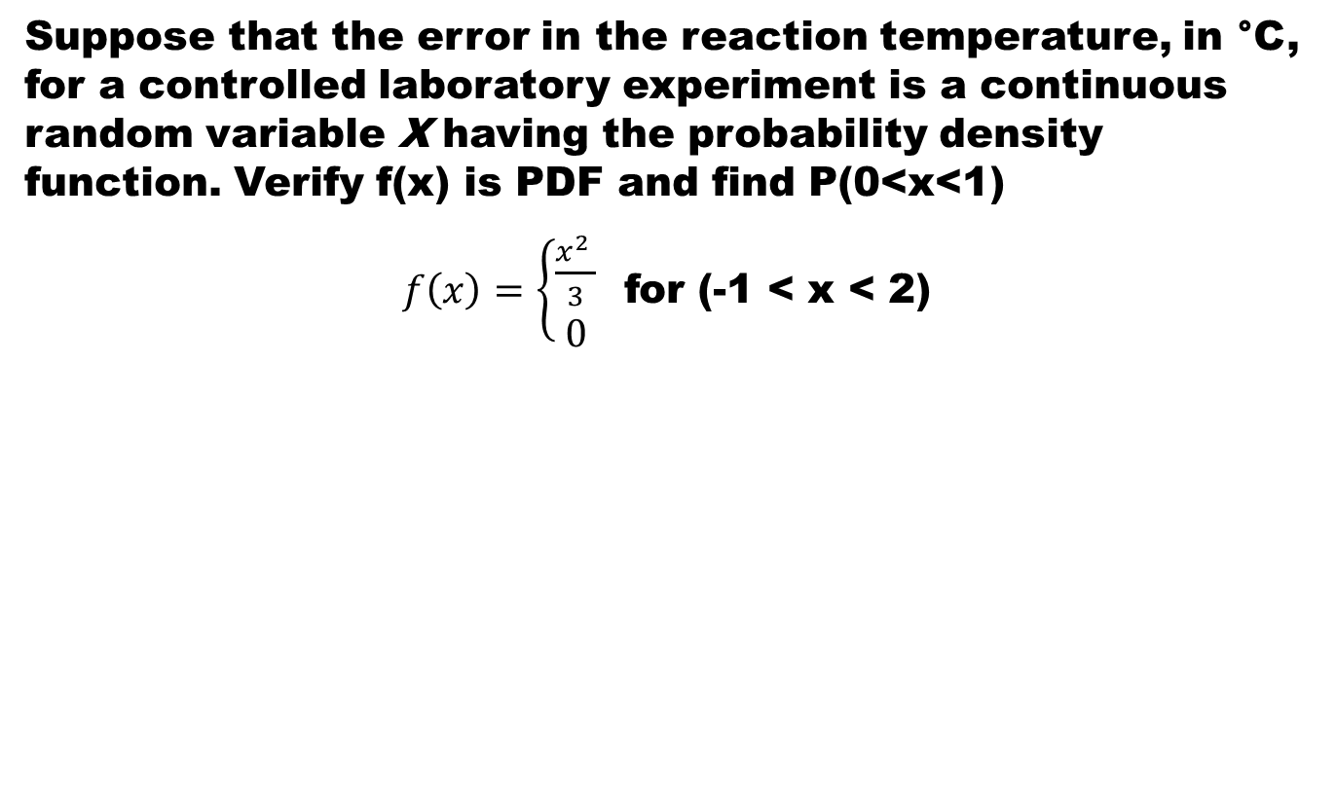
Example
Suppose that the error in the reaction temperature, in °C, for a controlled laboratory experiment is a continuous random variable X having the probability density function. Verify f(x) is PDF and find P(0<x<1)
$f\left(x\right)=\left\{\begin{aligned}\frac{x^{2} }{3} \\ 0\end{aligned}\right.$ for (-1 < x < 2)

Slide 21
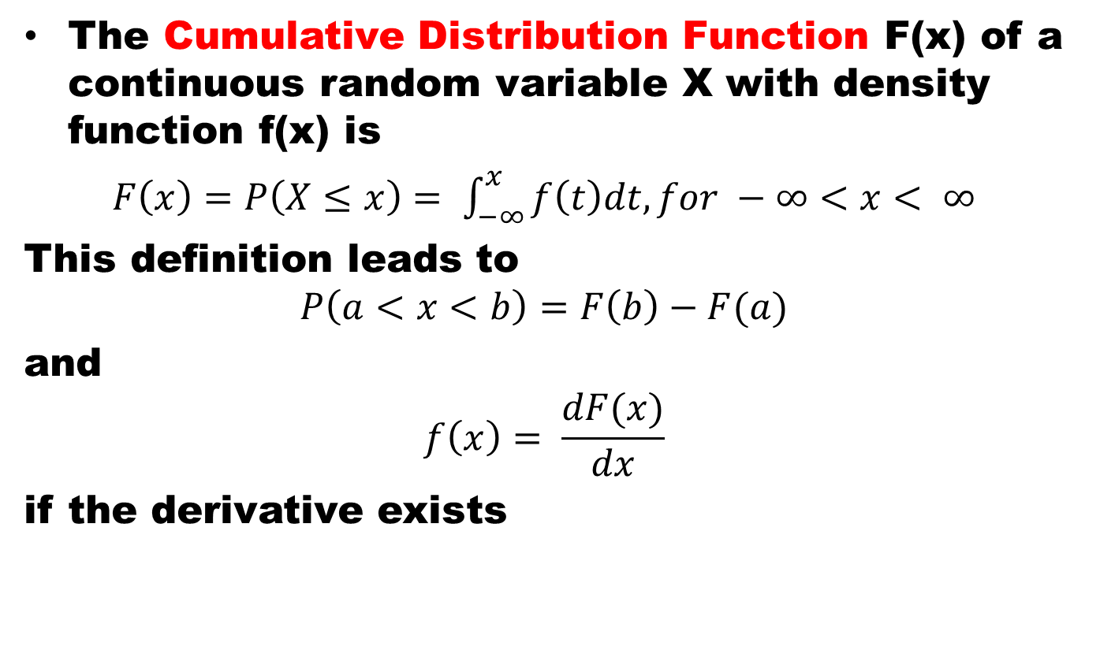
Cumulative Distribution Function
The Cumulative Distribution Function F(x) of a continuous random variable X with density function f(x) is
$F\left(x\right)=P\left(X≤x\right)= \int_{−∞}^{x}{f\left(t\right)dt, for −∞<x< ∞}$
This definition leads to
$$P\left(a<x<b\right)=F\left(b\right)−F(a)$$
and
$$f\left(x\right)= \frac{dF(x)}{dx}$$
if the derivative exists

Slide 22
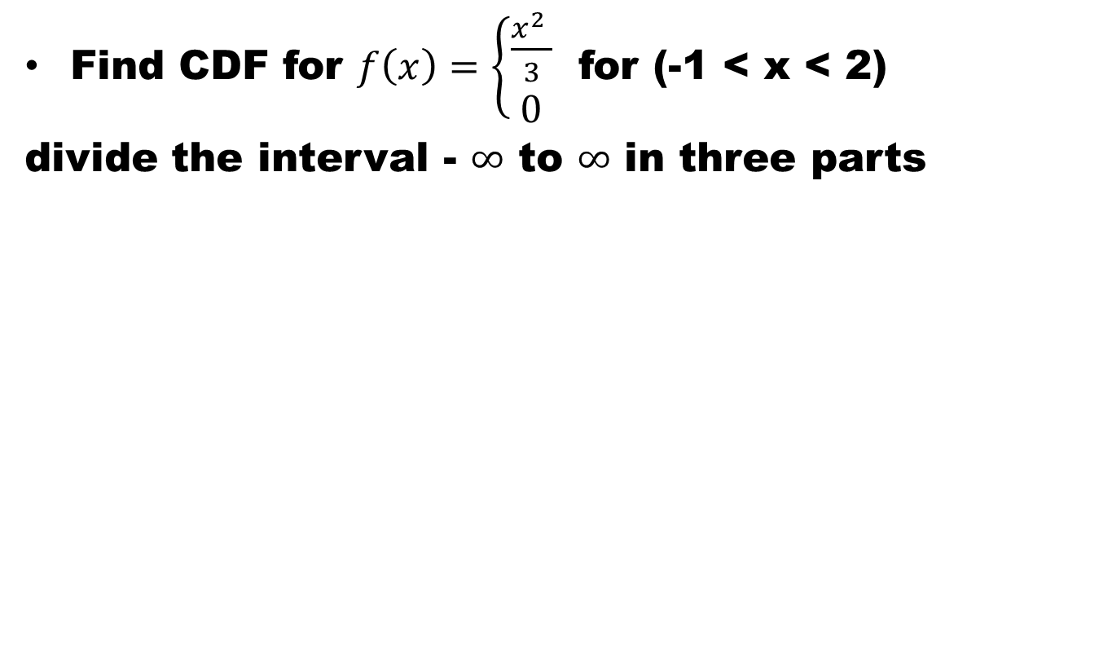
Example
Find CDF for $f\left(x\right)=\left\{\begin{aligned}\frac{x^{2} }{3} \\ 0\end{aligned}\right.$ for (-1 < x < 2)
divide the interval -$∞$ to $∞$ in three parts

Slide 23
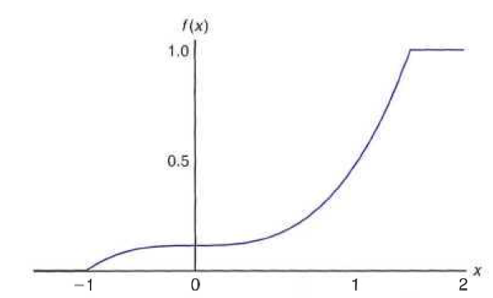
Example cont.

Slide 24
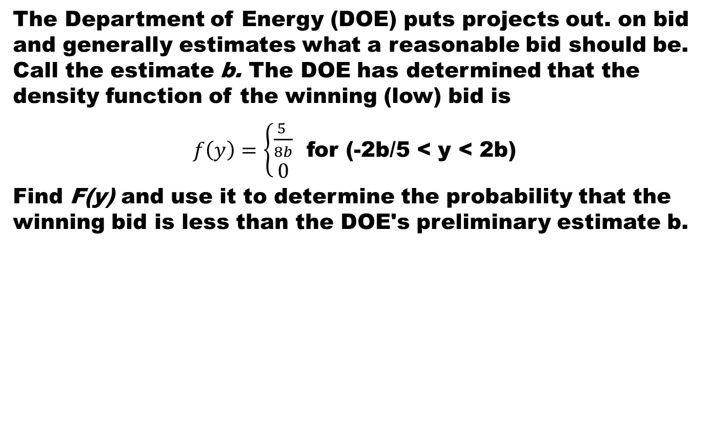
Example
The Department of Energy (DOE) puts projects out. on bid and generally estimates what a reasonable bid should be. Call the estimate b. The DOE has determined that the density function of the winning (low) bid is
$f\left(y\right)=\left\{\begin{aligned}\frac{5 }{8b} \\ 0\end{aligned}\right.$ for (-2b/5 <y <2b)
Find F(y) and use it to determine the probability that the winning bid is less than the DOE's preliminary estimate b.

Slide 25
Summary
Random Variable
Probability Distribution
References
Probability and Statistics for Engineers and Scientists by Walpole
Schaum outline series in Probability and Statistics

