Slide 1
Mathematical Statistics
Lecture 01
Prof. Dr. M. Junaid Mughal

Slide 2
About Instructor
MSc in Electronics (Gold Medal) and M.Phil in Electronis (Gold Medal) 1994 and 1996 respectively from Quaid-e-Azam University
PhD in Electronics and Electrical Engineering (Merit Scholarship) from The University of Birmingham. U.K. in 2001
Served Nuoincs Inc. USA as Director of Engineering from 2001 to 2003
Joined GIK Institute, TOPI, Pakistan in 2003 as Assistant Professor and was promoted as Associate Professor in 2006, and as Full Professor in 2012.

Slide 3
About Instructor (Contd…)
In GIK, worked as
  Dean Faculty of Electronic Engineering,
  Dean Faculty of Computer Science and Engineering
  Dean Student Affairs
Joined COMSATS, Islamabad, in July 2013 as Professor in the Department of Electrical Engineering
Research Interests Electromagnetics, Fiber Optics and Communications
Teaching Interests, High Frequency Electromagnetics, Stochastic Processes, Microwave Engineering, Satellite and Mobile Communications, Comm. System Design and Performance Analysis, Electromagnetic Fields and waves, Communication Theory, Signals and Systems, Probability and Random Variables

Slide 4
Course Contents
Descriptive Statistics
Measure of Central Tendency
Measure of Dispersion
Measure of Skewness and Kurtosis
Mathematical theory of Probability
Permutations and Combinations
Fundamental Laws of Probability
Conditional Probability
Baye's Formula
Discrete Random Variables
Continuous Random Variables
Distribution Function
Probability Density Function
Expectation of Random Variables
Moments and Moments Generating Functions

Slide 5
Course Contents (Contd…)
Comulants and Comulant Generating Functions
Probability density functions
  Bernoulli distribution
  Binomial distribution
  Geometric distribution
  Negative Binomial distribution
  Hypergeometric distribution
  The Poisson distribution
  Uniform distribution
  Exponential distribution
  Gamma distribution
  Beta distribution
  Weibul Distribution
  Normal Distribution
  Log Normal Distribution

Slide 6
Course Objectives
At the end of this course students should be able to understand and implement the techniques of statistics by using mathematical approach. It generally deals with derivations of general expressions and theorems of statistics and their application.

Slide 7
Why Statistics and Probability
Analyses of Data in all fields
  Sciences (Natural, Social and Management)
    E.g., estimating the average number of electrons generated from a solar cell when a known intensity of light falls on it
    If a company wants to hire a mathematician, he would need some data about the average salary a mathematician would demand
  Engineering, Manufacturing and Industry
    E.g., it would be beneficial for the car industry to know how many car will be needed to fulfill the demand in 2014
    Estimating the number of defective parts in manufacturing
  Governance (for surveys, planning and prediction)
    E.g, if the government is able to gather data of the current population and the growth rate, then they would be able to estimate the population in 2020 and can plan how many schools would be required for the children
    Traffic light timing adjustment

Slide 8
Recommended Text
Probability and Statistics for Engineers and Scientists 9th Edition, by Walpole, Myers 2012
For Reference
“Advanced Engineering Mathematics” by E Kreyszig (Chapters for Statistics and Probability)
Probability Theory and Mathematical Statistics by Marek Fisz, 3rd Edition, 1967
Schaums Easy Outline of Probability and Statistics

Slide 9
Statistics
According to Wikipedia “Statistics is the study of the collection, organization, analysis, interpretation and presentation of data. It deals with all aspects of data, including the planning of data collection in terms of the design of surveys and experiments”.
  Uncertainty is present in Data (e.g. population survey)
  Variation in data (e.g. number of car at an intersection)
  Data collected is used for “Inferences”
  This information is used to improve the quality.
Notes:
Trafic example

Slide 10
Statistical Methods
Data: Data are values of qualitative or quantitative variable belonging to a set of items (Wikipedia).
Data Collection
  Simple Random Sampling
    Data collected in this process is called Raw Data
  Experimental Design
    E.g., How many people need public transport to go to cities from villages and how often they need to go?
      Problem Definition and issues to be addressed
      Demarcation of population of interest
      Sampling
      Definition of Experimental Design
  Data Analyses
  Statistical Inference
Notes:
How many people need public transport to go to cities from villages and how often they need to go

Slide 11
Data Representation
Data can be represented
  Numerically
    Numbers
      For example the age of 10 students in a M.Sc Mathematics class can be represented as
      {20, 21, 20, 22, 23, 19, 23, 19, 20, 22}

Slide 12
Data Representation
Data can be represented
  Numerically
    Grouped Data
      A raw dataset can be organized by constructing a table showing the frequency distribution of the variable
      As in the above example we can represent the data
      {20, 21, 20, 22, 23, 19, 23, 19, 20, 22}
Age years | Number of students
19 | 2
20 | 3
21 | 1
22 | 2
23 | 2

Slide 13
Data Representation
Data can be represented
  Numerically
    Tables
      A table is a means of arranging data in rows and columns
      e.g. age of people
Name | Age (years)
Faisal | 25
Amir | 29
Waqar | 39
Waseem | 40
Kamran | 28

Slide 14
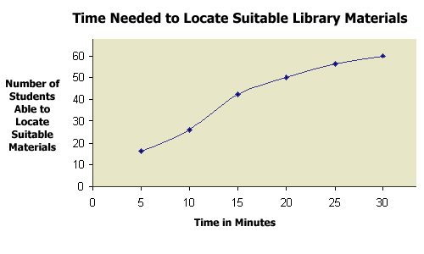
Data Representation
  Graphically
    Curves

Slide 15
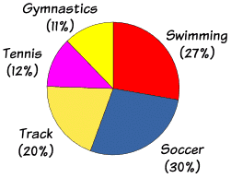
Data Representation
  Graphically
    Pie Chart
      A pie chart (or a circle graph) is a circular chart divided into sectors, illustrating numerical proportion.
      E.g., a survey of all the sportsmen in a certain country show

Slide 16
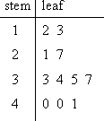
Data Representation
  Graphically
  Stem and Leaf plot
    Stem-and-leaf plots are a method for showing the frequency with which certain classes of values occur.
    For instance, suppose you have the following list of values:
      12, 13, 21, 27, 33, 34, 35, 37, 40, 40, 41.
      We can represent it as
The "stem" is the left-hand column which contains the tens digits. The "leaves" are the lists in the right-hand column, showing all the ones digits for each of the tens, twenties, thirties, and forties

Slide 17
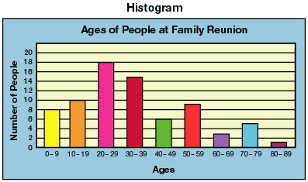
Data Representation
  Graphically
    Bar Chart / Histogram
      A bar chart or bar graph is a chart with rectangular bars with lengths proportional to the values that they represent. The bars can be plotted vertically or horizontally. A vertical bar chart is sometimes called a column bar chart.

Slide 18
Data Representation (Summary)
Data can be represented
  Numerically
    Numbers
    Grouped Data
    Tables
  Graphically
    Curves
    Pie Chart
    Stem and Leaf plot
    Bar Chart / Histogram

Slide 19
Data Representation (Example)
89 84 87 81 89 86 91 90 78 89 87 99 83 89
Sort this data
78 81 83 84 86 87 87 89 89 89 89 90 91 99
Group this data
  Make 5 groups
Group | No of Elements
75 - 79 | 1
80 - 84 | 3
85 - 89 | 7
90 - 94 | 2
94 - 99 | 1

Slide 20
Data Representation (Example)
Representing this data as Bar chart
Group | No of Elements
75 - 79 | 1
80 - 84 | 3
85 - 89 | 7
90 - 94 | 2
94 - 99 | 1

Slide 21
Data Representation (Example)
78 81 83 84 86 87 87 89 89 89 89 90 91 99
Representing the same data in stem and leaf plot,
Stem | Leaf
7 | 8
8 | 1 3 4
8 | 6 7 7 9 9 9 9
9 | 0 1
9 | 9

Slide 22
Data Representation (Example)
78 81 83 84 86 87 87 89 89 89 89 90 91 99
Counting how many leaves a certain stem has, we write that number in the left most column, and call it absolute frequency
Absolute frequency | Stem | Leaf
1 | 7 | 8
3 | 8 | 1 3 4
7 | 8 | 6 7 7 9 9 9 9
2 | 9 | 0 1
1 | 9 | 9

Slide 23
Data Representation (Example)
78 81 83 84 86 87 87 89 89 89 89 90 91 99
To find the cumulative absolute frequency, we add up the absolute frequencies up to the line of the leaf
Cumulative Absolute frequency | Absolute frequency | Group | No of Elements
1 | 1 | 7 | 8
4 | 3 | 8 | 1 3 4
11 | 7 | 8 | 6 7 7 9 9 9 9
13 | 2 | 9 | 0 1
14 | 1 | 9 | 9

Slide 24
Data Representation (Example)
Individual entries of left most column in stem and leaf plot are called Cumulative Absolute Frequency CAS, i. e. the sum of the absolute frequencies of values up to the line of the leaf.
  For example, 11 shows that there 11 values in the data not exceeding 89.
Dividing the CAS by n (total number of entries in the data) gives Cumulative Relative Frequency .

Slide 25
Summary
Introduction to the course
What is statistics and statistical methods
Data and its representation

