Slide 1
Project Management Software Application
PRM 705
Lecture 9

Slide 2
Recap
Network View
Setting project information
Changing Date Format
Automatic scheduling
Entering tasks

Slide 3
Today’s Outline
Working times
Calendars
Adding new column
Linking tasks
Assigning calendar to multiple activities
Checking project total time
Entering durations

Slide 4
Working days
There could be different timings and working days for
  Different organizations
  Different Projects
  Different Tasks
  Different resources

Slide 5
Calendar Precedence
Resource calendar
Customized calendar
Default Calendar
Task Calendar

Slide 6
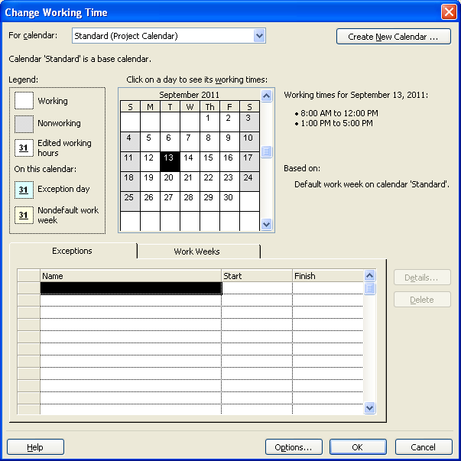
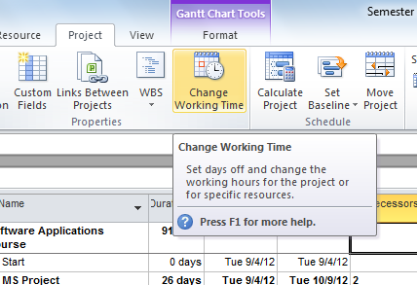
Working time & Calendars

Slide 7
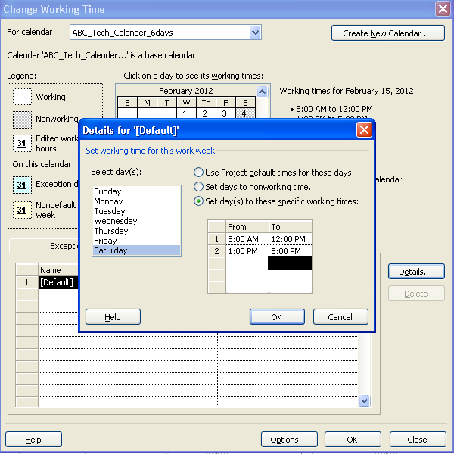
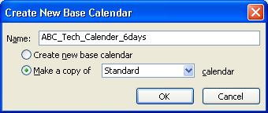
Creating Your Own Calendar
You can change working time
  (work weeks)
You can add holidays
  (Exceptions)

Slide 8
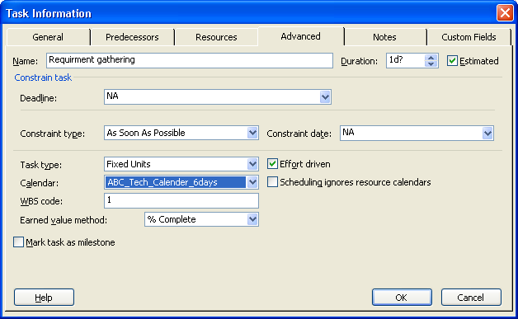
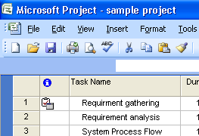
Assigning Calendar To a Task
Select Task > Project > Task Information > Advanced > Select calendar

