Slide 1
Project Management Software Application
PRM 705
Lecture 8

Slide 2
Recap
Timeline
Different views
  Gantt Chart View
  Resource Sheet
  Resource Usage
  Task Usage
Setting Project Properties

Slide 3
Today’s Outline
Network View
Setting project information
Changing Date Format
Automatic Schedule
Entering tasks
Working times
Calendars

Slide 4
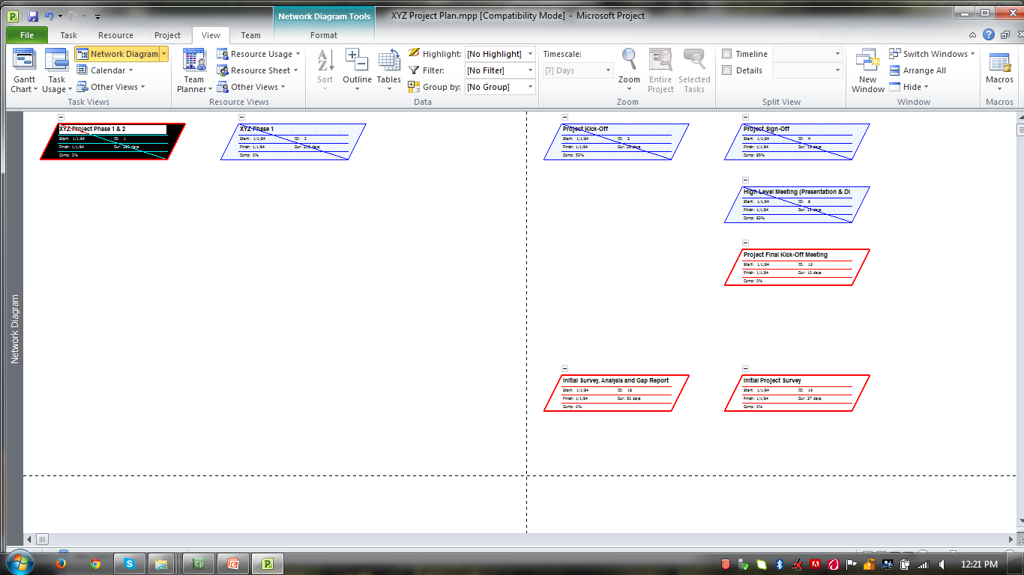
Network Diagram View

Slide 5
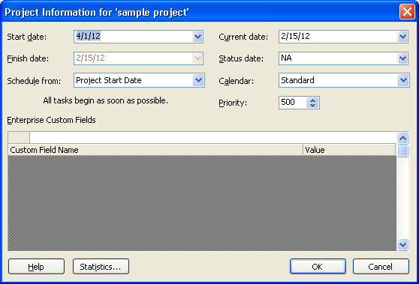
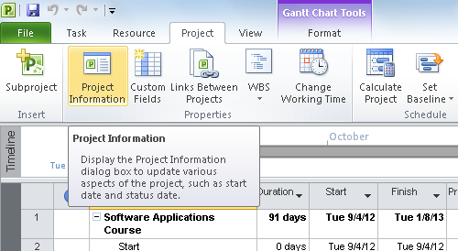
Project Information

Slide 6
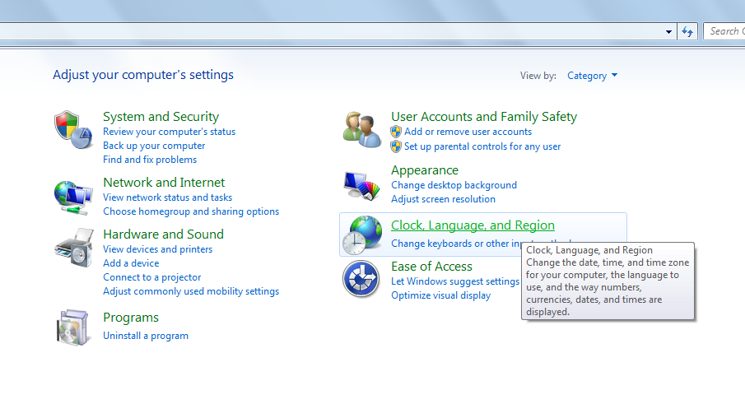
Change Date Format
Goto “Control Panel”

Slide 7
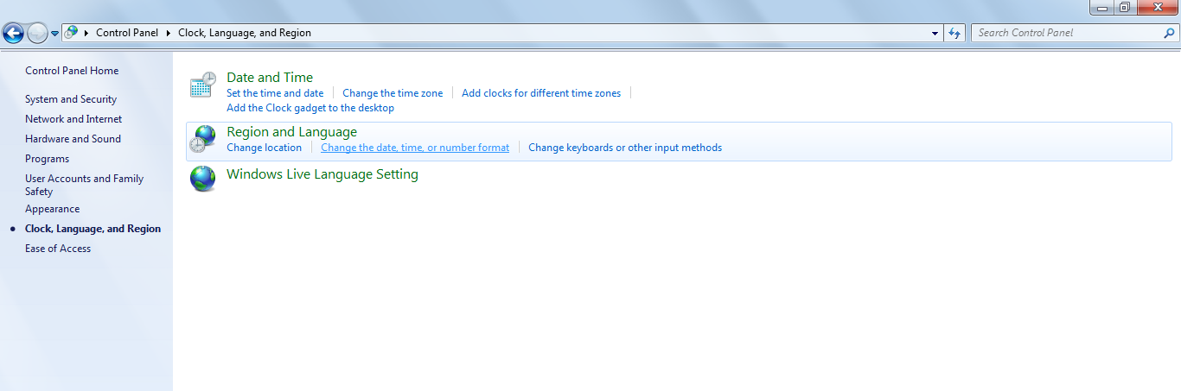
Change Date Format
Goto “Change the date, time or number format”

Slide 8
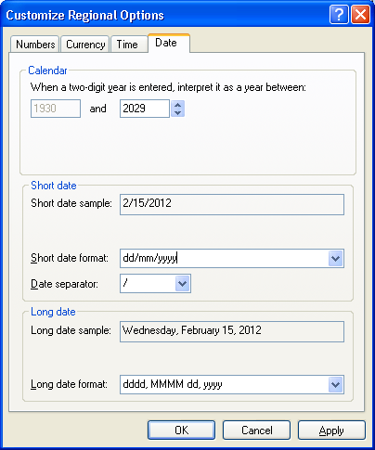
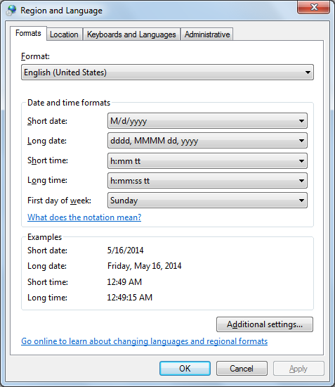
Change Date Format
For Wndows XP and Windows 7

Slide 9
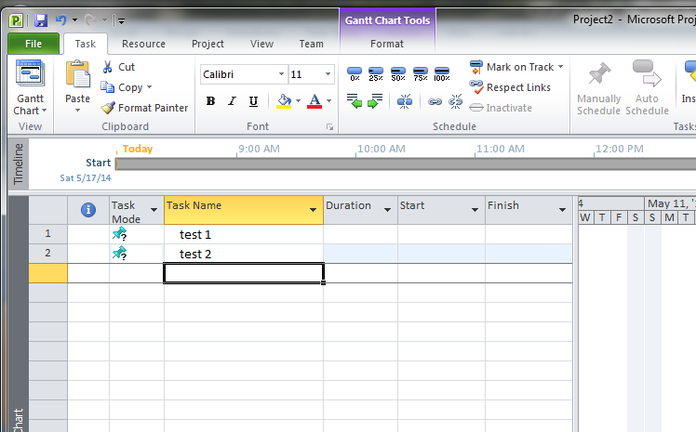
Setting to automatic schedule

Slide 10
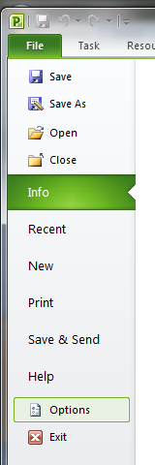
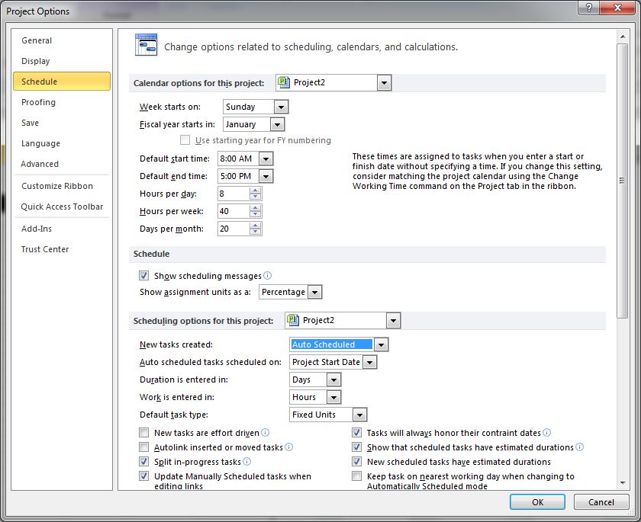
Setting to automatic schedule

Slide 11
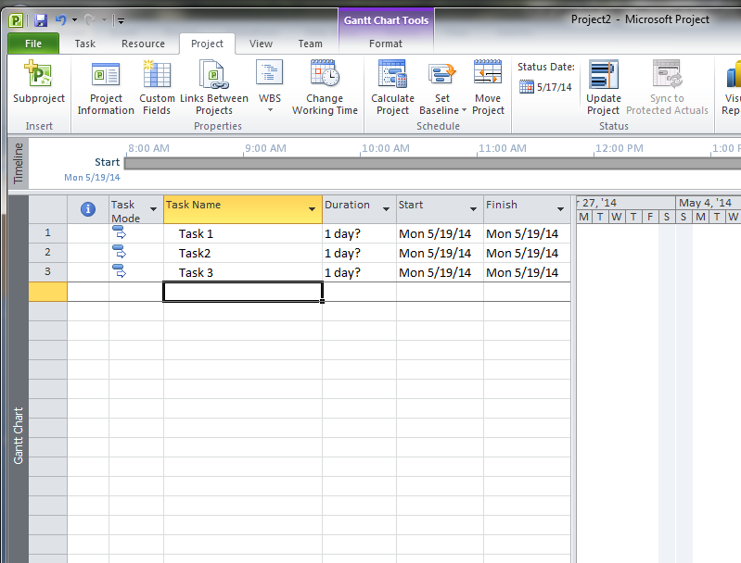
Setting to automatic schedule

Slide 12
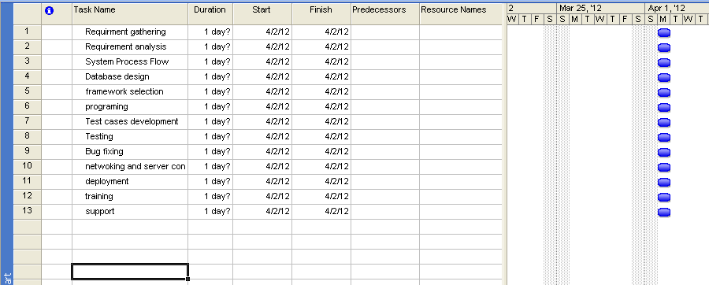
Entering Tasks

Slide 13
Thank You

