Slide 1
Project Management Software Application
PRM 705
Lecture 7

Slide 2
Recap
Why to use a software?
MS Project Environment
Customizing toolbar
Customizing Ribbon
Getting help

Slide 3
Today’s Outline
Timeline
Different views
Setting Project Properties
Setting project information
Entering tasks
Working times
Calendars

Slide 4
Timeline
On the View tab, in the Split View group, click the Timeline check box.
Project displays the Timeline view. The Timeline view is a handy way of seeing the “big picture” of the project plan.

Slide 5
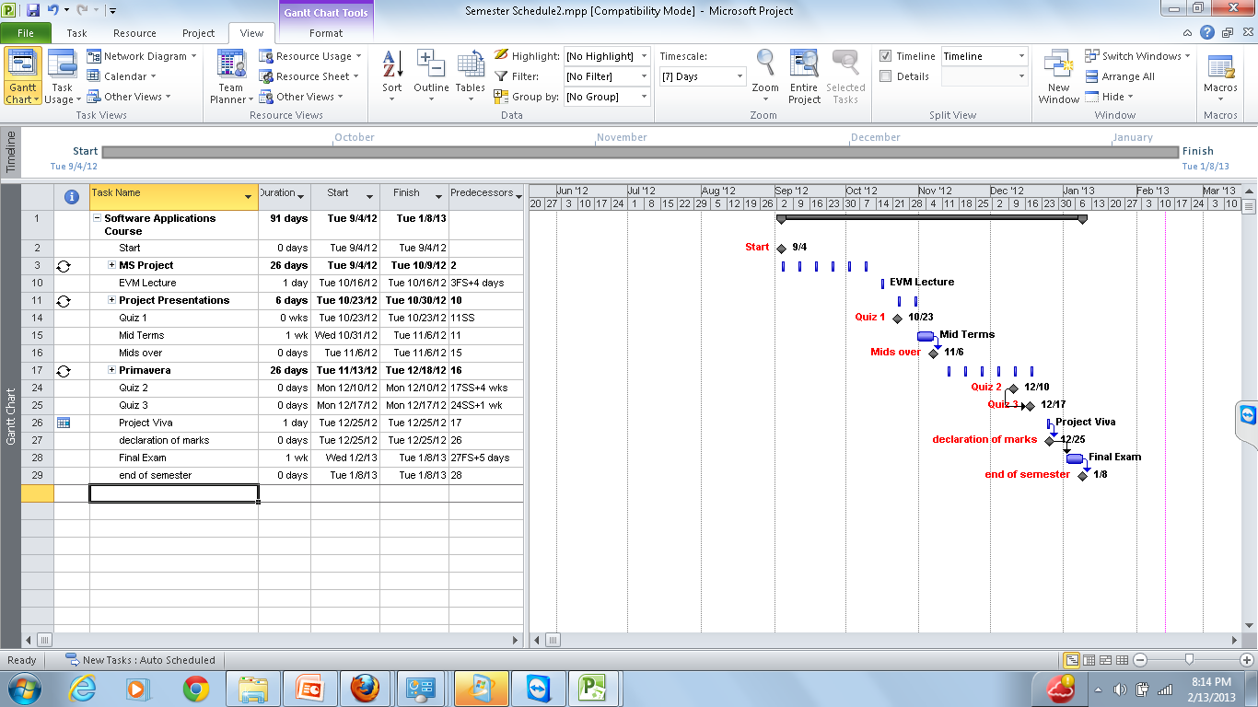
How to show timeline at top
Timeline

Slide 6
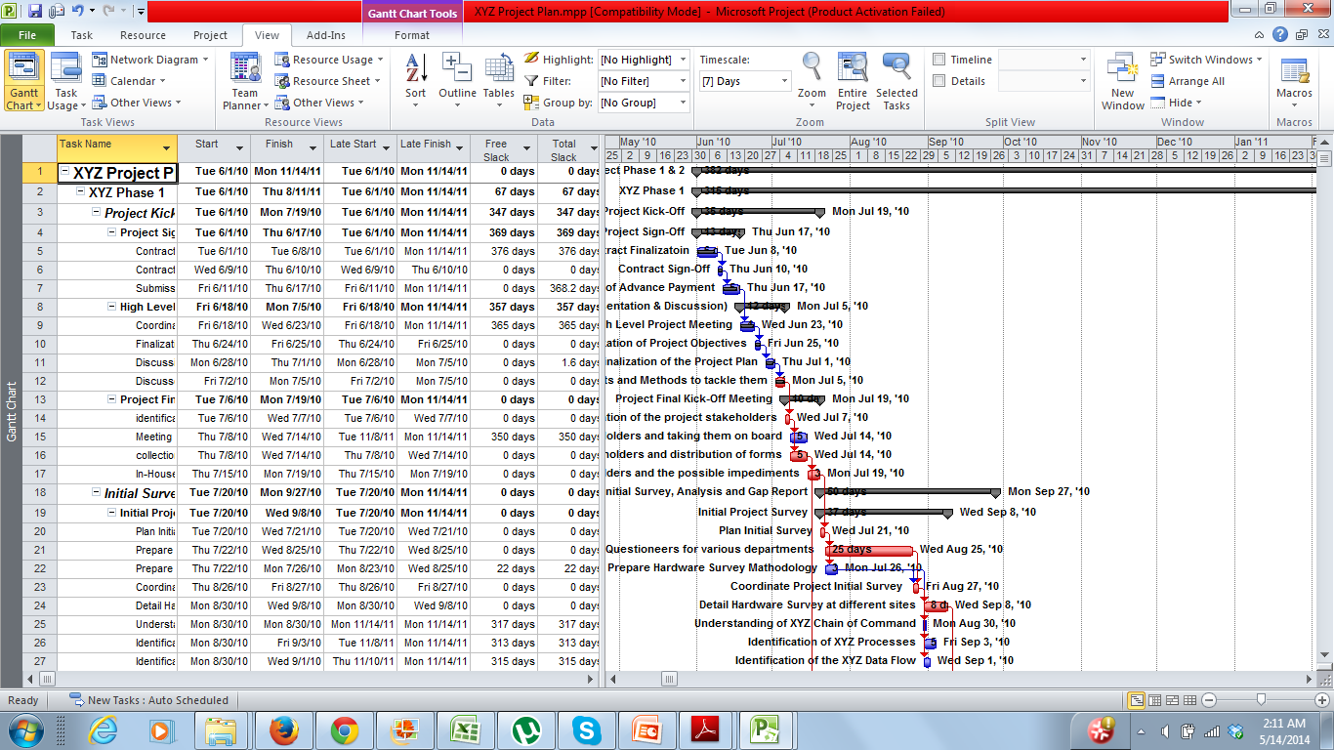
Gantt Chart View

Slide 7
Resource Sheet
The Resource Sheet view displays details about resources in a row-and-column format (called a table), with one resource per row.

Slide 8
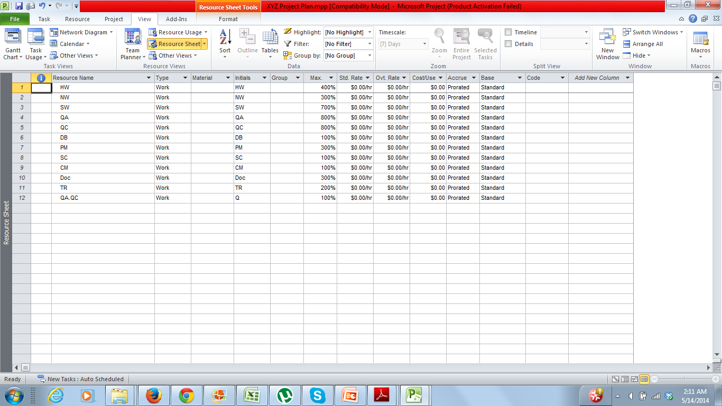
Resource Sheet

Slide 9
Resource Usage
On the View tab, in the Resource Views group, click Resource Usage.
This usage view groups the tasks to which each resource is assigned and shows you the work assignments per resource on a timescale, such as daily or weekly.

Slide 10
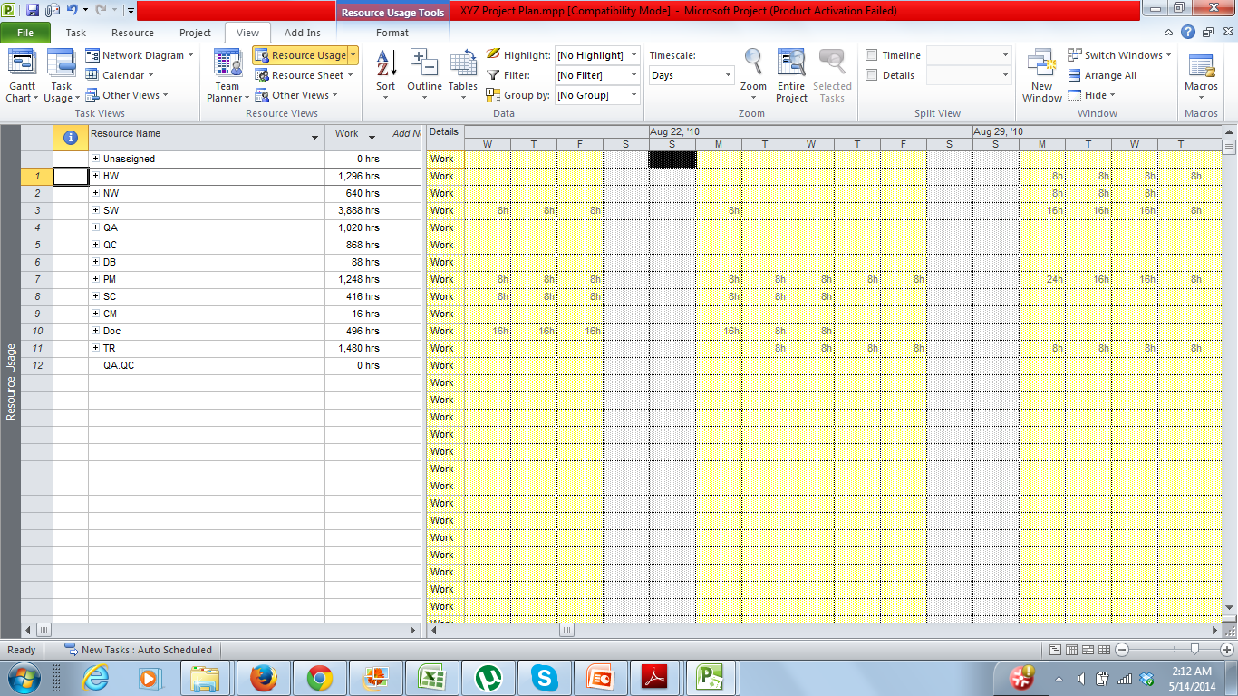
Resource Usage

Slide 11
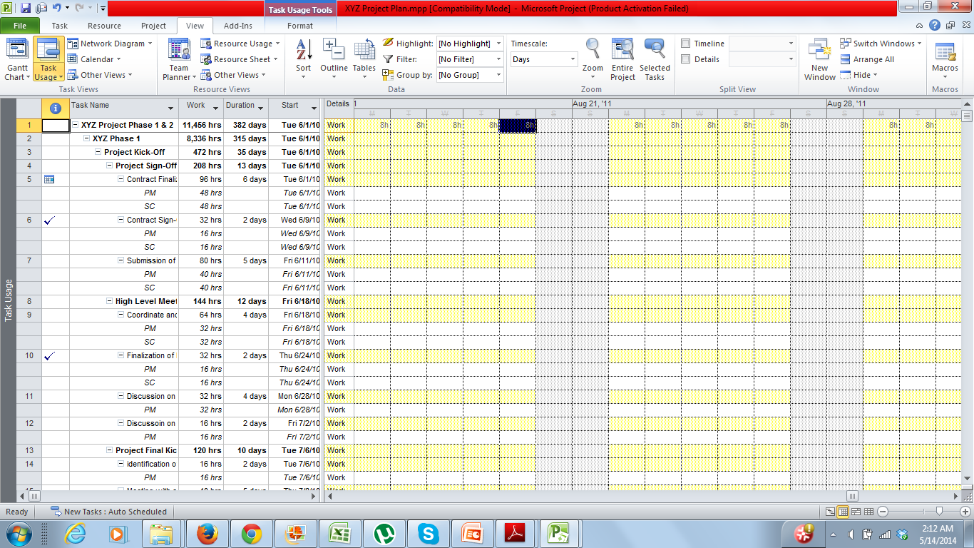
Task Usage

Slide 12
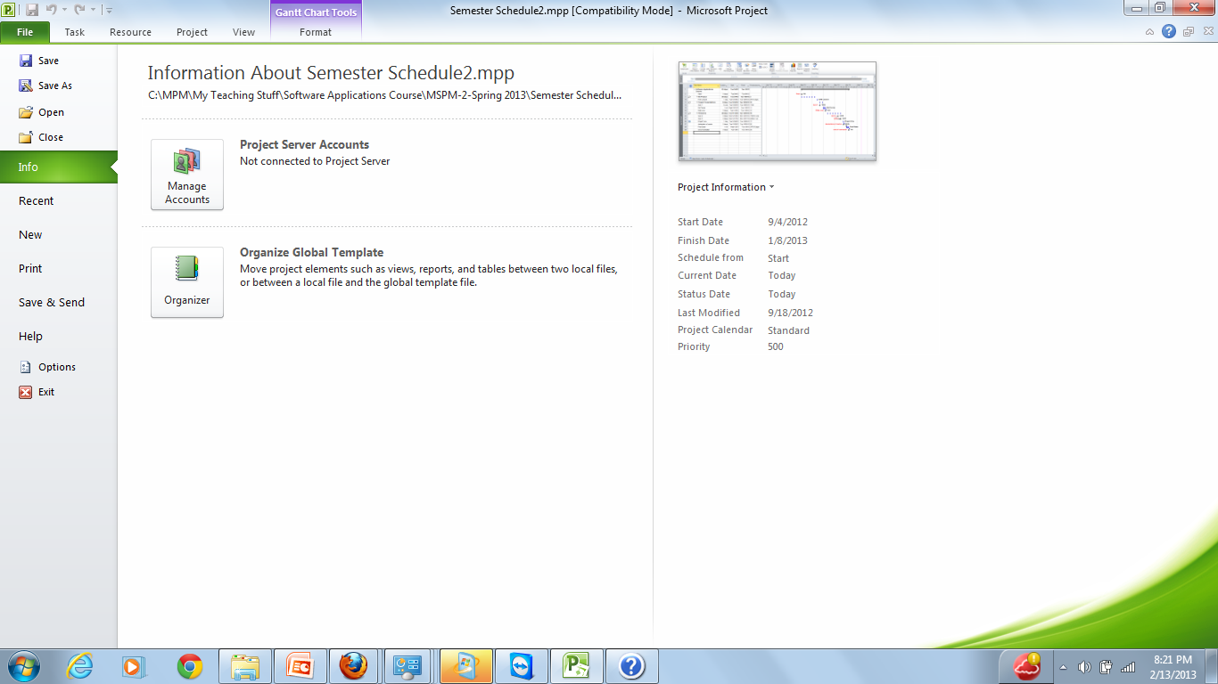
Setting Properties For Your Project

Slide 13
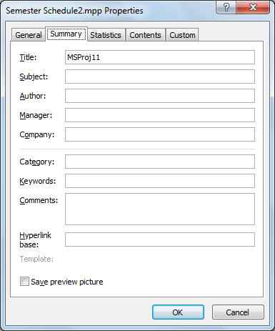
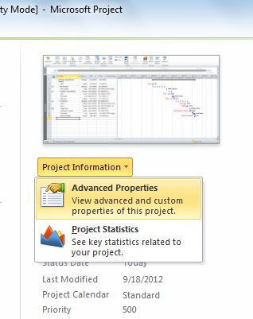
Setting Properties For Your Project

Slide 14

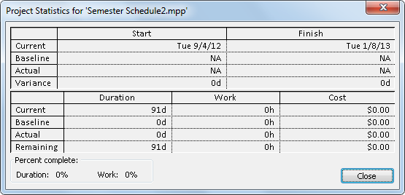
Project Basic Statistics

Slide 15
Thank You

