Slide 1
Project Management Software Application
PRM 705
Lecture 6

Slide 2
Recap
Network diagram
CPM
Gantt Chart
Slack
Fast Tracking
Crashing

Slide 3
Today’s Outline
Why to use a software?
MS Project Environment
Customizing toolbar
Customizing Ribbon
Getting help
Timeline
Various important views
Setting project properties
Setting project information

Slide 4

Getting started with
MS Project 2010

Slide 5

Do you want to learn…???
OR

Slide 6

Or you want to be in this situation..

Slide 7


Slide 8
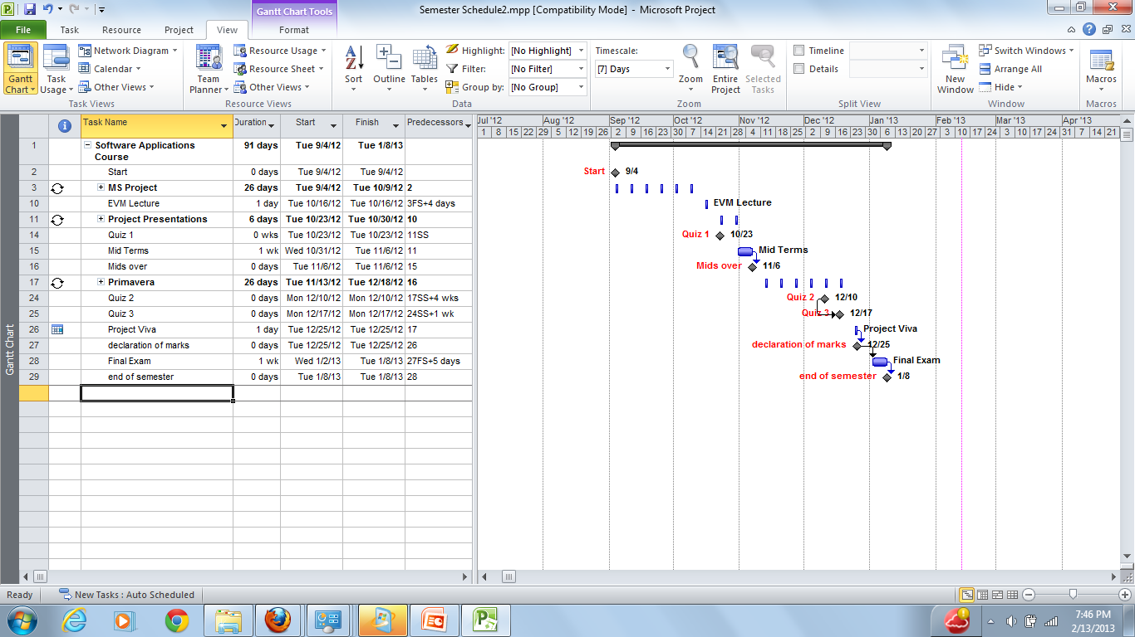
Quick Access Toolbar
Tool Bar
Time Scale
Ribbon
View Shortcuts
Status Bar
Task Area
Gantt Chart Area
Zoom Slider

Slide 9
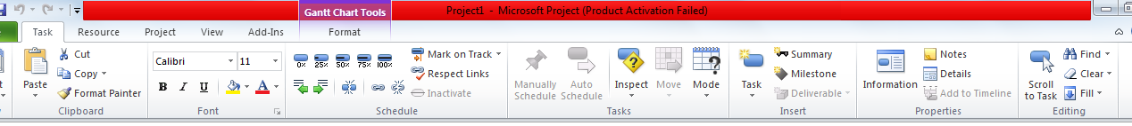
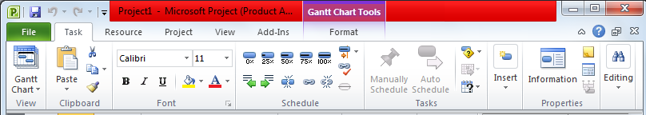
Dynamic Ribbon Elements
Drop Down List
Small Labelled Button
Large Button
If you decrease width of ribbon
Small un-Labelled Button
Group Button

Slide 10
Getting Help
If your question is about Microsoft Project 2010, please search Microsoft Support or the Microsoft Knowledge Base at:
http://support.microsoft.com
Or

Slide 11
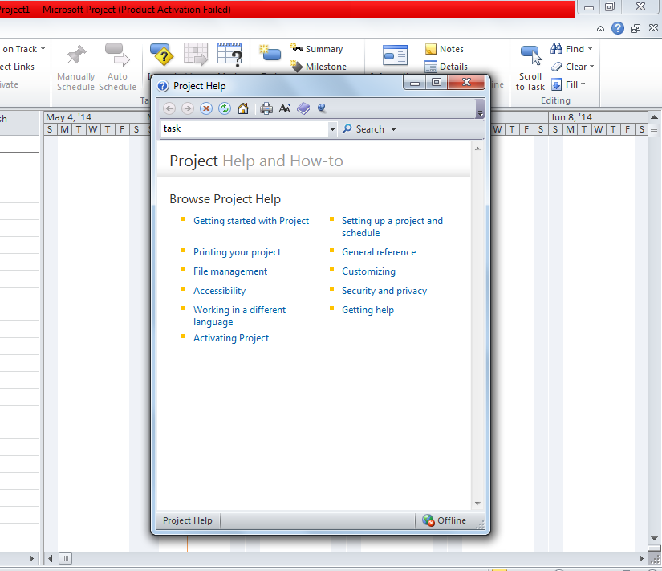
Getting Help

Slide 12
Customizing Quick Access Toolbar
The Quick Access toolbar is a customizable area of the interface where you can add your favorite or frequently used commands.
Right click on any menu in ribbon
Select customize quick access toolbar

Slide 13
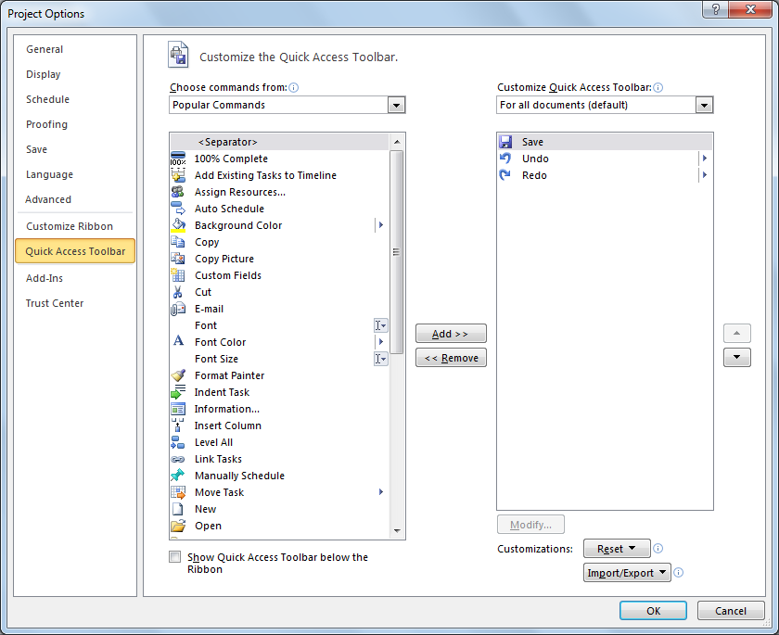
Customizing Quick Access Toolbar

Slide 14
Customizing Ribbon
Project 2010 joins other Office applications in adopting the Fluent interface. The most prominent parts of this new interface are the tabs and ribbon that span the top of the Project window.
Right click on any menu in ribbon
Select customize ribbon

Slide 15
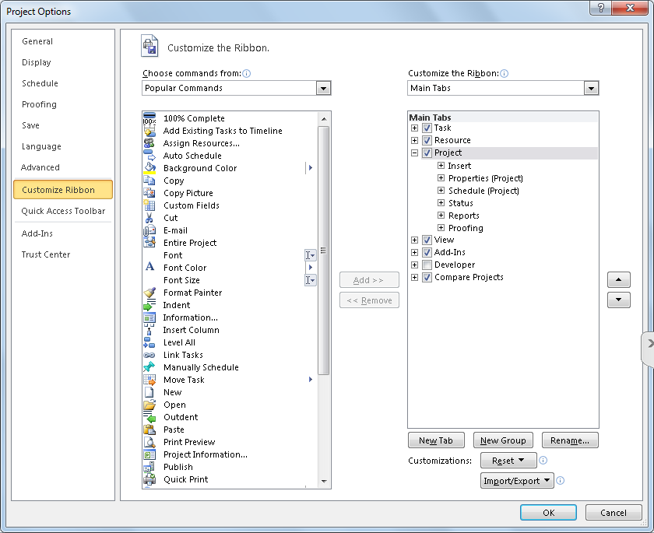
Customize Ribbon

Slide 16
Timeline
On the View tab, in the Split View group, click the Timeline check box.
Project displays the Timeline view. The Timeline view is a handy way of seeing the “big picture” of the project plan.

Slide 17
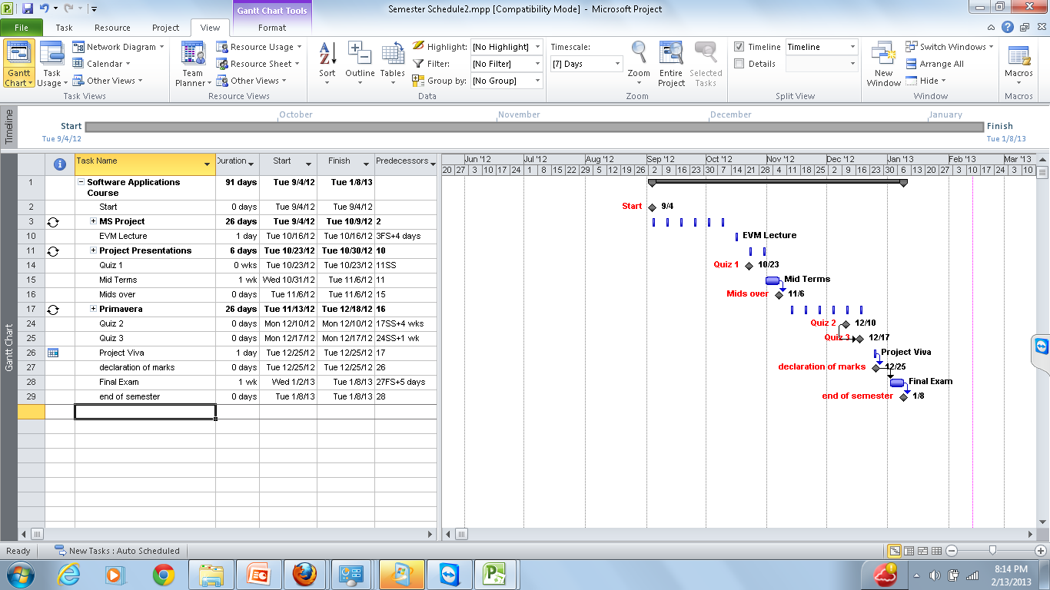
How to show timeline at top
Timeline

Slide 18
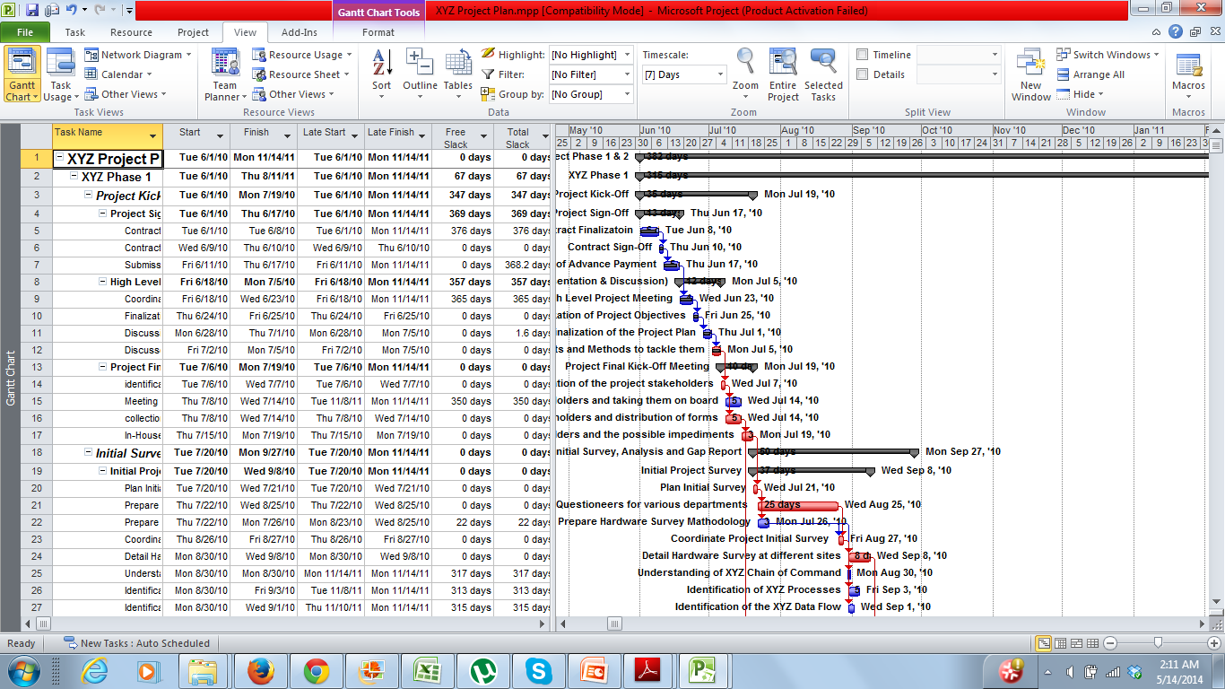
Gantt Chart View

Slide 19
Resource Sheet
The Resource Sheet view displays details about resources in a row-and-column format (called a table), with one resource per row.

Slide 20
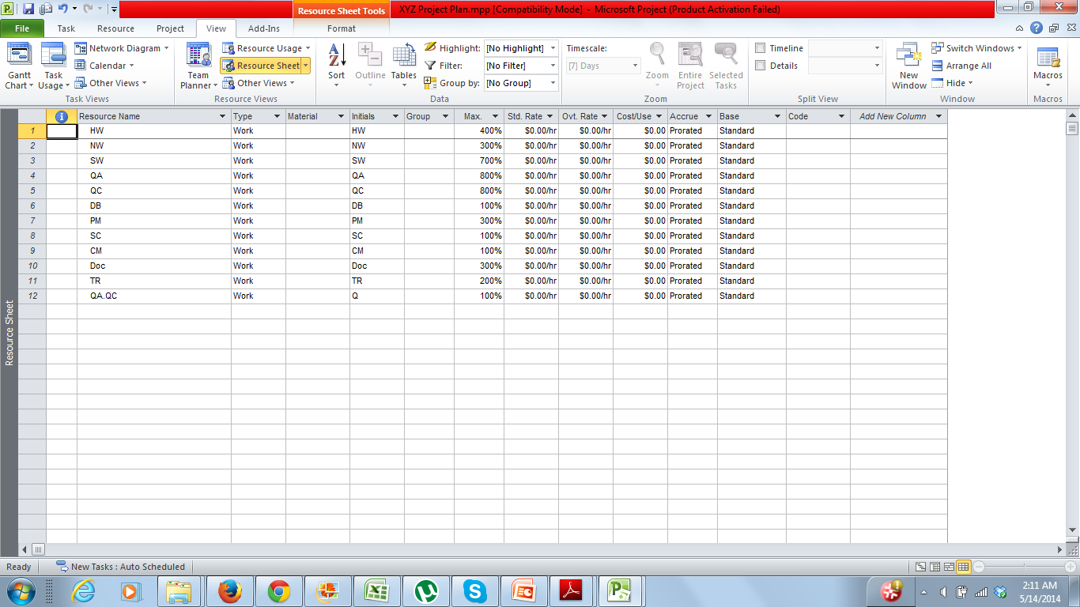
Resource Sheet

Slide 21
Resource Usage
On the View tab, in the Resource Views group, click Resource Usage.
This usage view groups the tasks to which each resource is assigned and shows you the work assignments per resource on a timescale, such as daily or weekly.

Slide 22
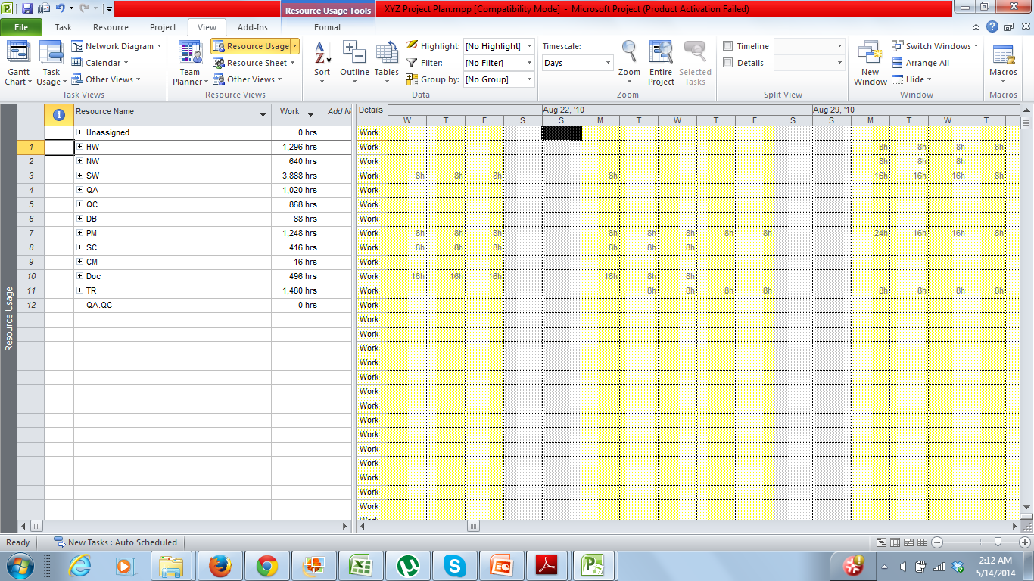
Resource Usage

Slide 23
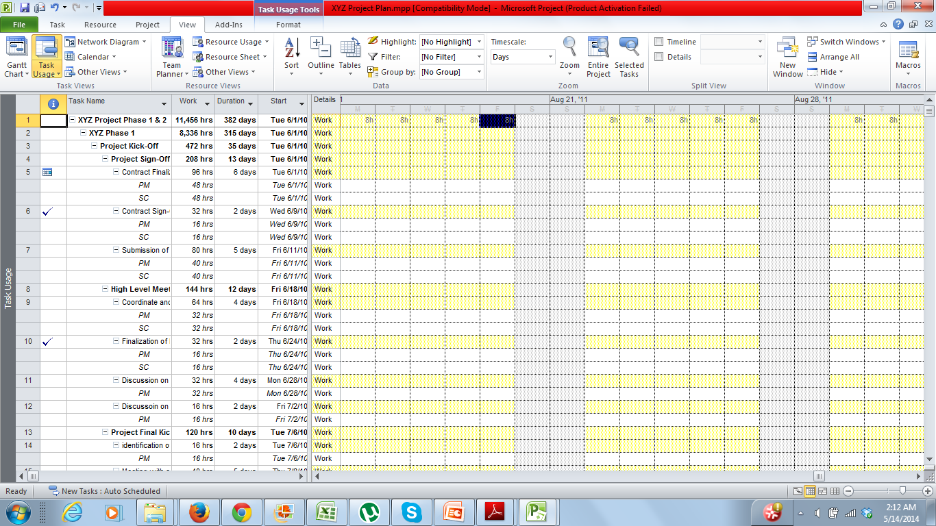
Task Usage

Slide 24
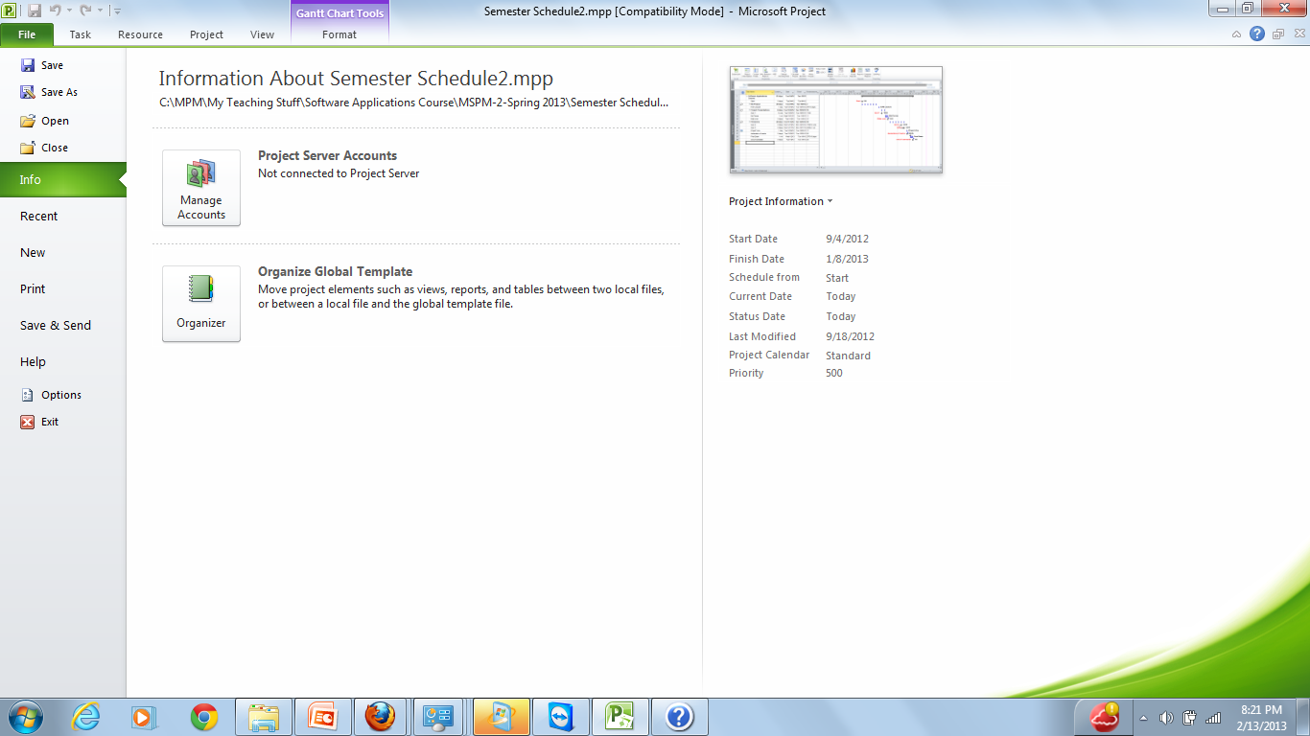
Setting Properties For Your Project

Slide 25
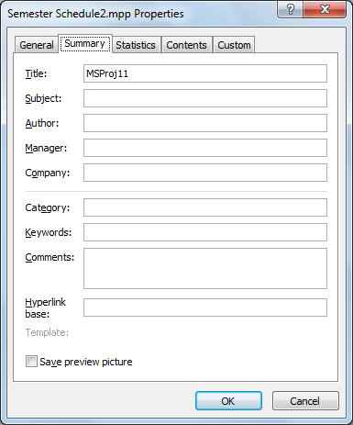
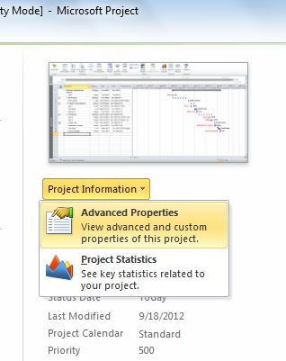
Setting Properties For Your Project

Slide 26

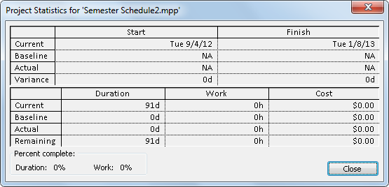
Project Basic Statistics

Slide 27
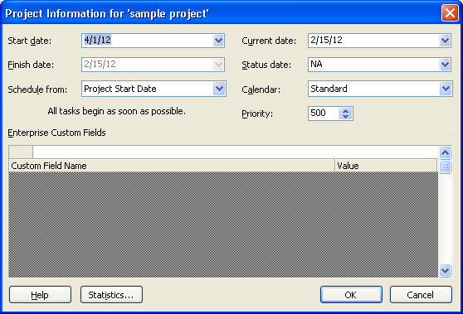
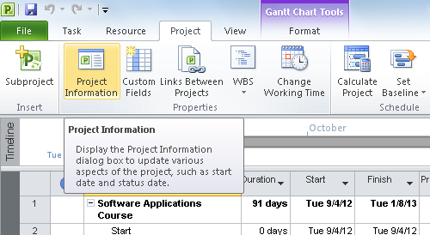
Project Information

Slide 28
Today We Studied
Why to use a software?
MS Project Environment
Customizing toolbar
Customizing Ribbon
Getting help
Timeline
Various important views
Setting project properties
Setting project information

Slide 29
Thank You

