Slide 1
Project Management Software Application
PRM 705
Lecture 5

Slide 2
Recap
Dependency Types
Lag & Lead
Over-allocation
Resource Leveling
PERT

Slide 3
Today’s Outline
Lag & Lead
Network diagram
CPM
Gantt Chart
Slack

Slide 4
Gantt Charts
Gantt charts provide a standard format for displaying project schedule information by listing project activities and their corresponding start and finish dates in a calendar format.
Symbols include:
  Black diamonds: Milestones
  Thick black bars: Summary tasks
  Lighter horizontal bars: Durations of tasks
  Arrows: Dependencies between tasks

Slide 5
How to create a simple Gantt Chart

Slide 6
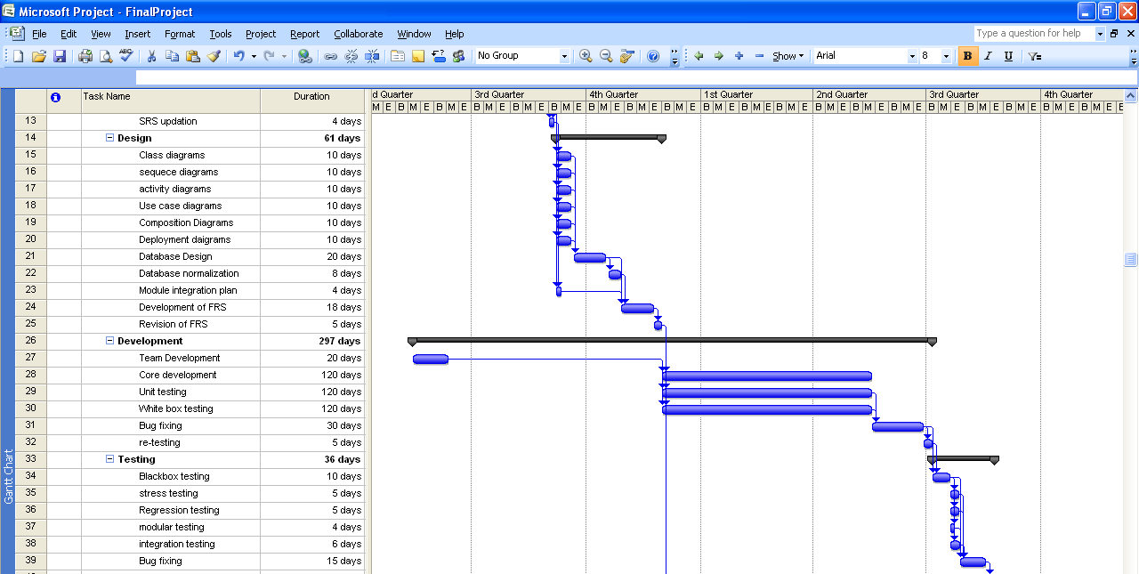
Figure 6-5. Gantt Chart for Project X

Slide 7
Determining the Critical Path for Project X
Activity | Duration | Predecessor
A | 1 | -
B | 2 | -
C | 3 | -
D | 4 | A
E | 5 | B
F | 4 | B
G | 6 | C
H | 6 | D,E
I | 2 | G
J | 3 | H,F,I

Slide 9
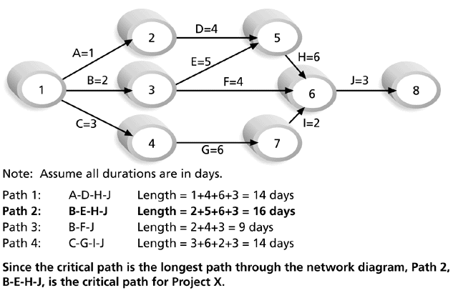
Determining the Critical Path for Project X

Slide 10
Critical Path Method (CPM)
CPM is a network diagramming technique used to predict total project duration.
Earliest time by which the project can be completed.
Longest path through the network diagram
Has the least amount of slack or float.
Slack or float is the amount of time an activity can be delayed without delaying a succeeding activity or the project finish date.
  Free Float
  Total Float
  Project Float

Slide 11
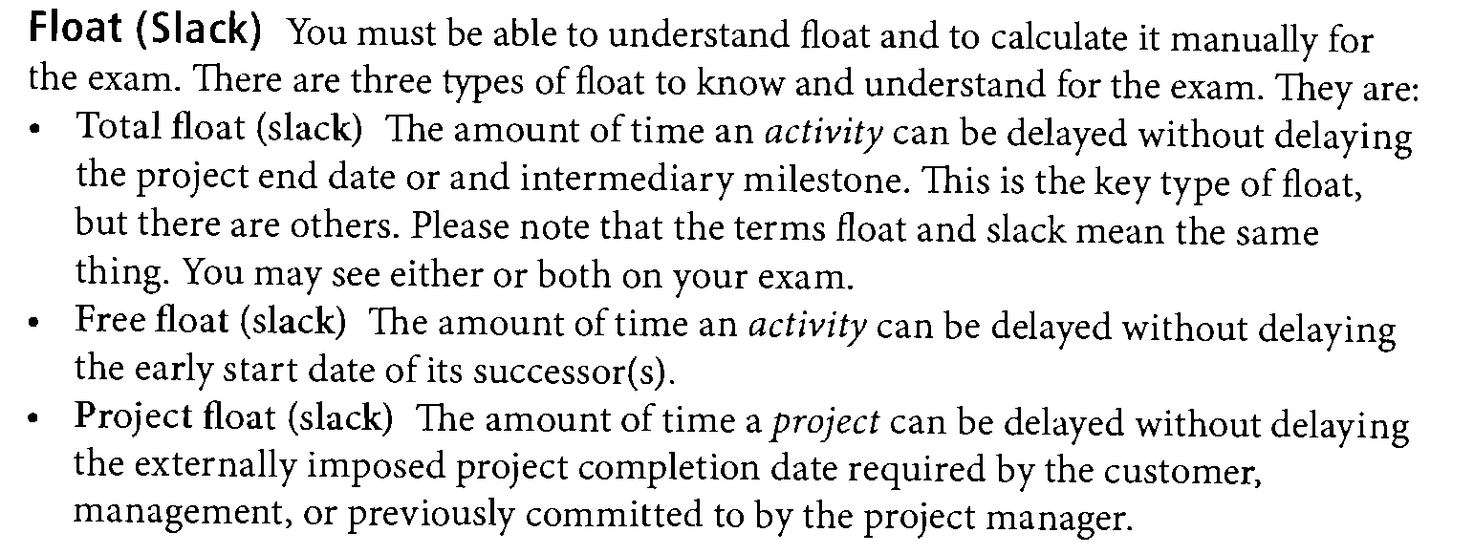
Float (Slack)

Slide 12
Schedule Compression
Schedule compression is used when the desired result is to create output faster than indicated in the original project, without having to change the project scope
This is particularly beneficial if a competitor is working on the same type of project and you need to finish first.
Or may be a company decision

Slide 13
Schedule Compression Techniques
Crashing
  When the crashing approach is used, any additional costs associated with rushing the project are reviewed against the possible benefits of completing the project on a faster timeline.
    Adding more resources for the project
    Allowing additional overtime
    Paying extra to receive delivery of critical components more quickly, etc.
  Crashing may not work in situations like "the concrete in the foundation has to dry for 3 days”

Slide 14
Schedule Compression Techniques
Fast Tracking
  re-scheduling various activities within the project to be worked on simultaneously instead of waiting for each piece to be completed separately
  This method is best used when activities can be overlapped
  Problem is dependencies
  So if you work on design and production at the same time your risk is that you need to rework production if the design is change half way through the process.

Slide 15
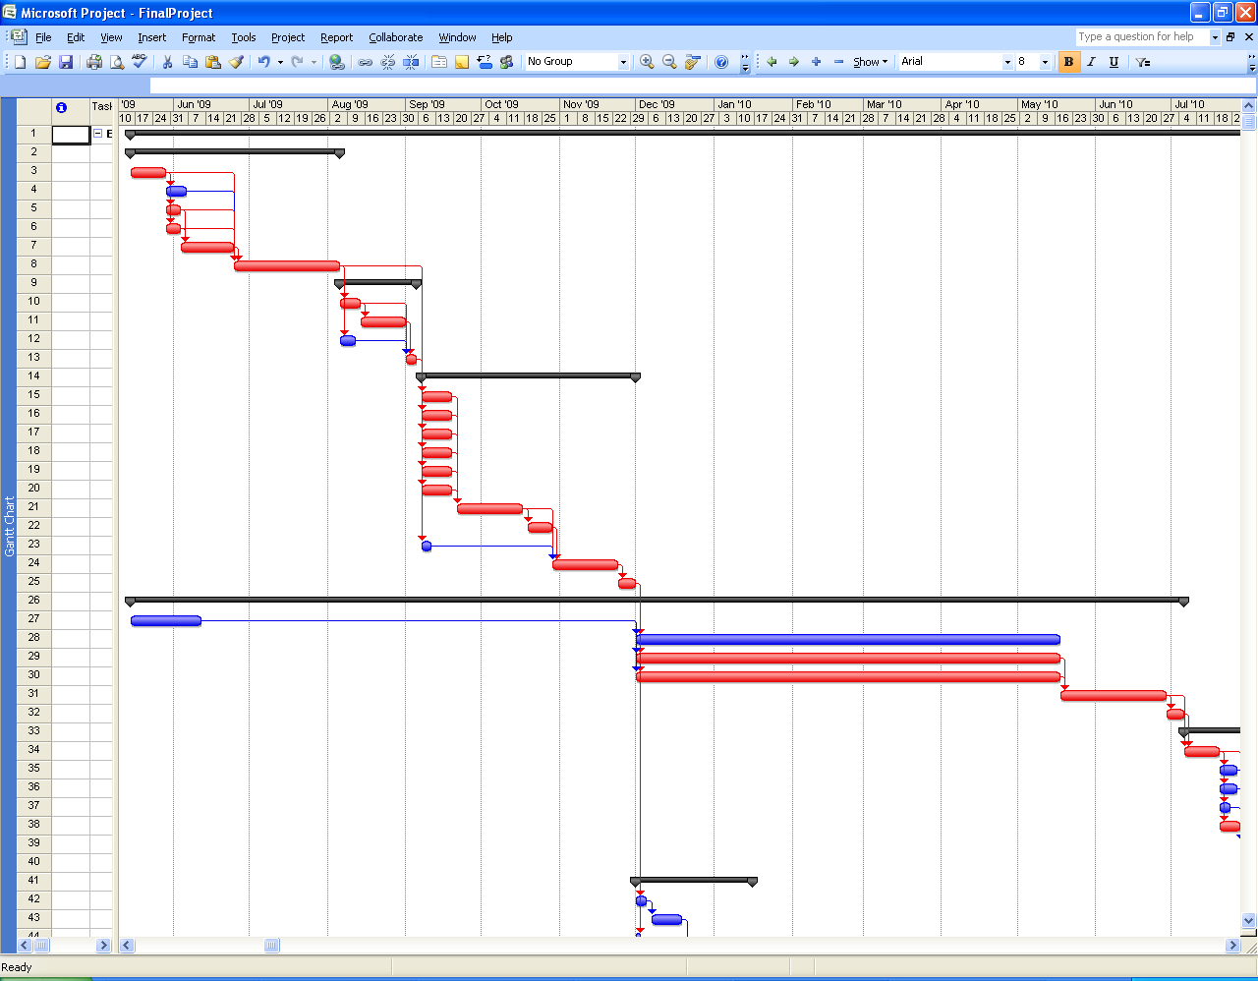
Critical Path

Slide 16
Using the Critical Path to Shorten a Project Schedule
Three main techniques for shortening schedules:
  Shortening the duration of critical activities or tasks by adding more resources or changing their scope.
  Crashing activities by obtaining the greatest amount of schedule compression for the least incremental cost.
  Fast tracking activities by doing them in parallel or overlapping them.

Slide 17
Sample Project
Project XYZ

Slide 18
Today We Studied
Requirement gathering
WBS
WBS Dictionary
PBS
RAM
Resources
Dependency Types
Lag & Lead
Over-allocation
Resource Leveling

Slide 19
Thank You

