Slide 1
Project Management Software Application
PRM 705
Lecture 4

Slide 2
Recap
Requirement gathering
WBS
WBS Dictionary
PBS
RAM
Resources

Slide 3
Today’s Outline
Dependency Types
Lag & Lead
Over-allocation
Resource Leveling
Network diagram
CPM
Gantt Chart
Slack

Slide 4
Predecessor Task
A task (or activity) that must be started or finished before another task or milestone can be performed.

Slide 5
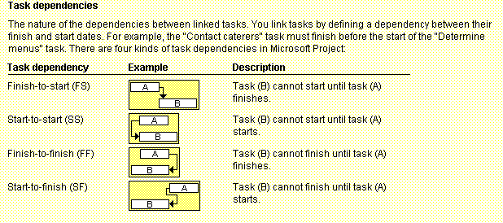
Figure 6-3. Task Dependency Types

Slide 6
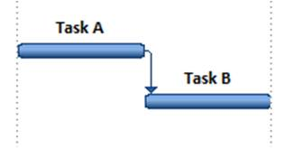
Finish to Start
Finish to start (FS)
  A FS B = B can't start before A is finished, or in another words Activity A must be completed before Activity B can begin.
  (Foundations dug) FS (Concrete poured)

Slide 7
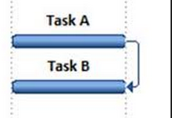
Finish to Finish
Finish to finish (FF)
  A FF B = B can't finish before A is finished or in another words Activity A must be complete before Activity B can finish.^{[2]}
  (Last chapter written) FF (Entire book written)

Slide 8
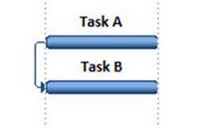
Start to Start
Start to start (SS).
  A SS B = B can't start before A starts or in another words Activity B can start after Activity A has started.^{[2]}
  (Project work started) SS (Project management activities started)

Slide 9
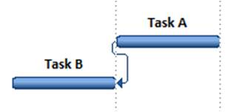
Start to Finish
Start to finish (SF)
  A SF B = B can't finish before A starts
  (New shift started) SF (Previous shift finished)

Slide 10
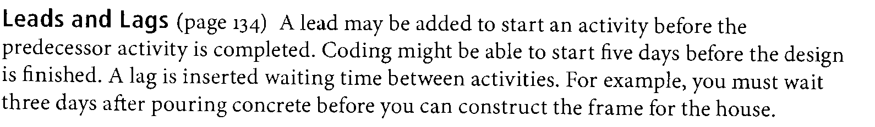
Leads & Lags

Slide 11
Over Allocation
Over Allocation is when a project calls for more time than a team member has.

Slide 12
Resource Leveling
To get the best performance and results from resources, you need to manage resource workloads to avoid over-allocations and under-allocations.

Slide 13
Resource Leveling
Over Allocation can be solved by number of ways for example:
  Changing the relationships i.e. (SS, FS, SF, FF)
  Changing lag to “zero” or change it to lead
  Changing working time
  Changing Units
  Adding extra overtime hours to that particular resource

Slide 14
Program Evaluation and Review Technique (PERT)
PERT is a network analysis technique used to estimate project duration when there is a high degree of uncertainty about the individual activity duration estimates.
PERT uses probabilistic time estimates:
  Duration estimates based on using optimistic, most likely, and pessimistic estimates of activity durations, or a three-point estimate.

Slide 15
PERT Formula and Example
PERT weighted average =
  optimistic time + 4X most likely time + pessimistic time
  6
  Example:
  PERT weighted average =
  8 workdays + 4 X 10 workdays + 24 workdays = 12 days 6
  where:
  optimistic time= 8 days
  most likely time = 10 days
  pessimistic time = 24 days
  Therefore, you’d use 12 days on the network diagram instead of 10 when using PERT for the above example.

Slide 16
Thank You

