Slide 1
Project Management Software Application
PRM 705
Lecture 31

Slide 2
Recap
Creating resource dictionary
Resource assignment
Resource leveling
Milestones
Activity types
Resource curves
Customized curves
Cash flow
S curve

Slide 3
Today’s Outline
Costing
Cost Accounts
Indirect costing
Tracking
  Milestones
  Baseline
  Update progress
  Activity % complete
  Progress using activity steps

Slide 4
Costing
Two types
  Direct
  Indirect (admin expenses etc)

Slide 5
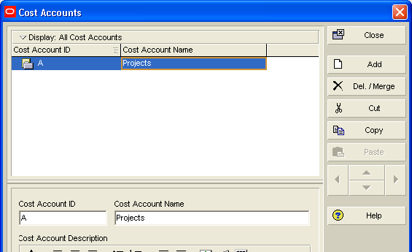
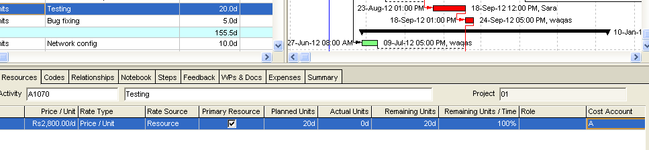
Cost Accounts
Enterprise > cost accounts

Slide 6
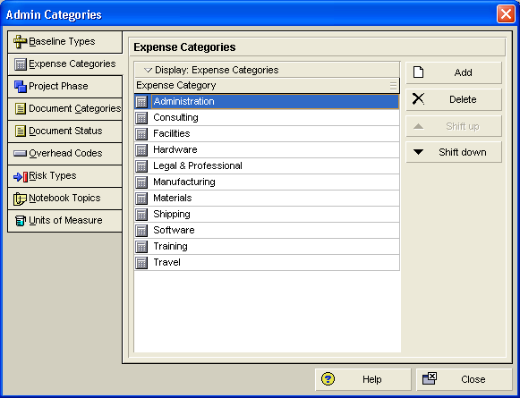
Assign Indirect Costs
Admin > admin categories > expense categories

Slide 7
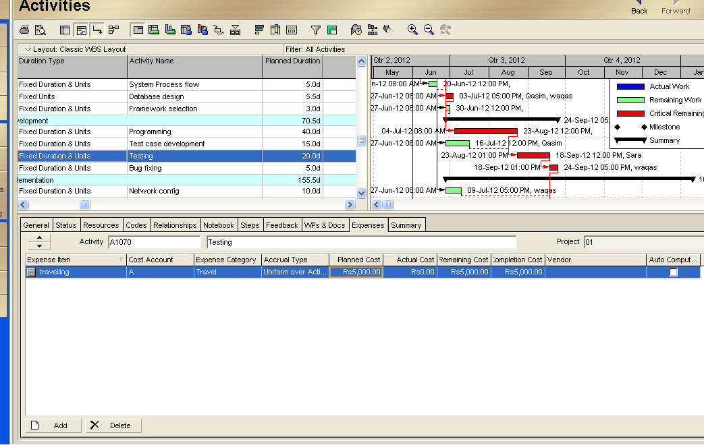
Assign Indirect Costs

Slide 8
Tracking

Slide 9
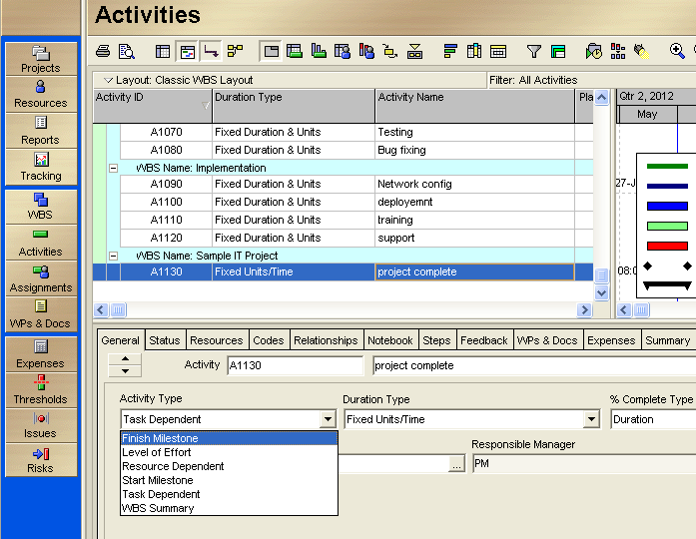
Milestone

Slide 10
Securing your project
Make 3 or 4 copies of your final project at this stage

Slide 11
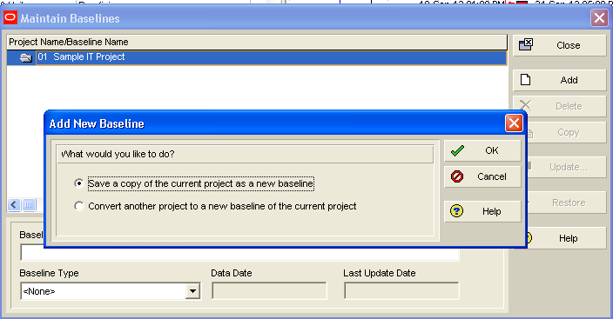
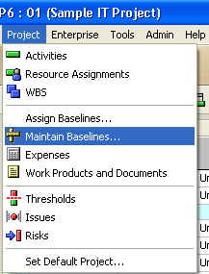
Create baseline of project

Slide 12
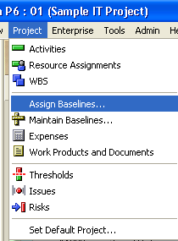
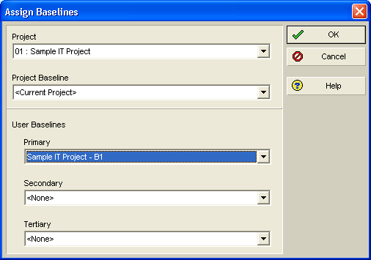
Assign baseline to the project

Slide 13
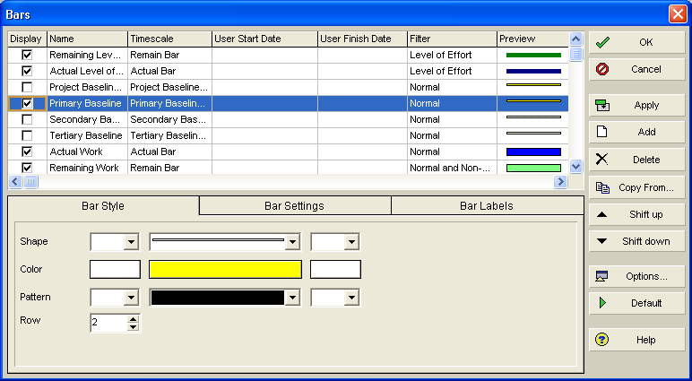
Display the assigned baseline bars
View > bars

Slide 14
Update progress
Important point
  Data date will calculate what should have been done till now.
  Once new data date selected , you can’t go back to any previous date

Slide 15
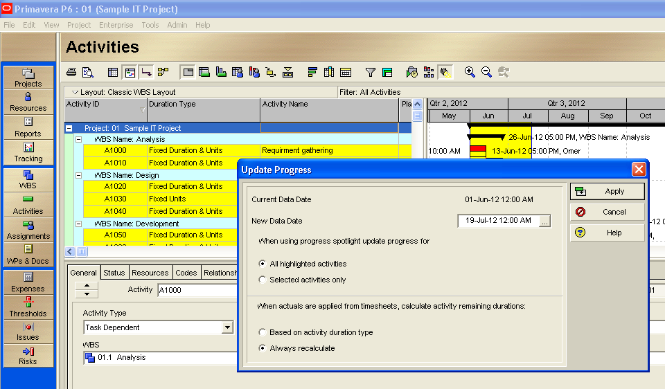
Update progress

Slide 16
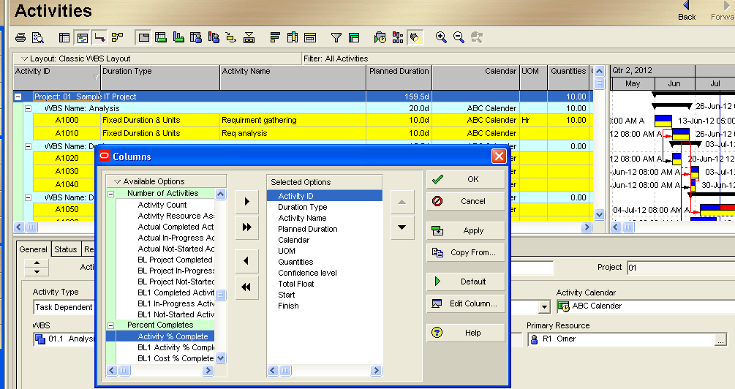
Activity % complete column

Slide 17
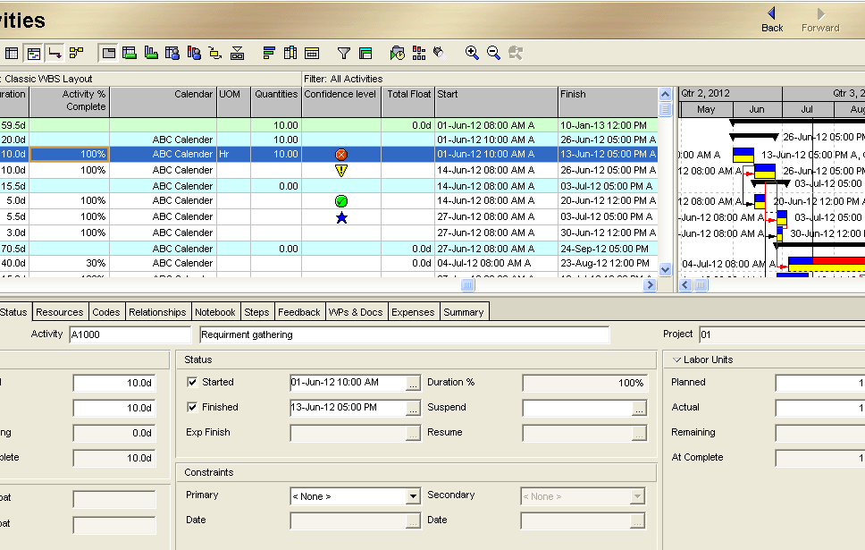
Update project progress

Slide 18
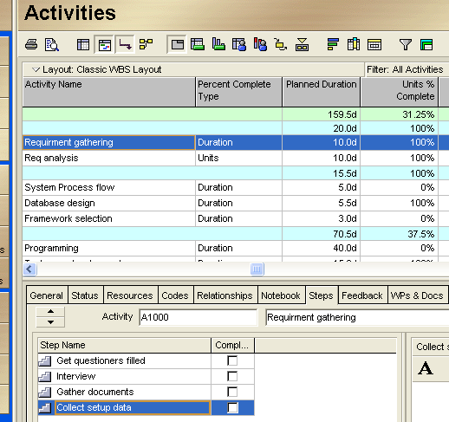
Progress calculations using activity steps
Define steps

Slide 19
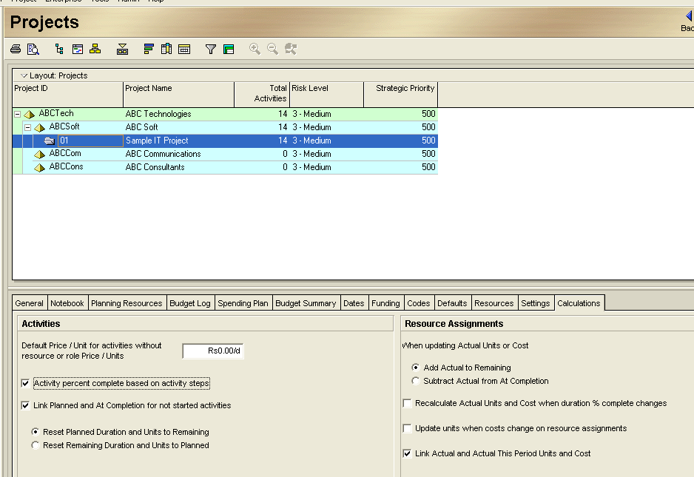
Progress calculations using activity steps

Slide 20
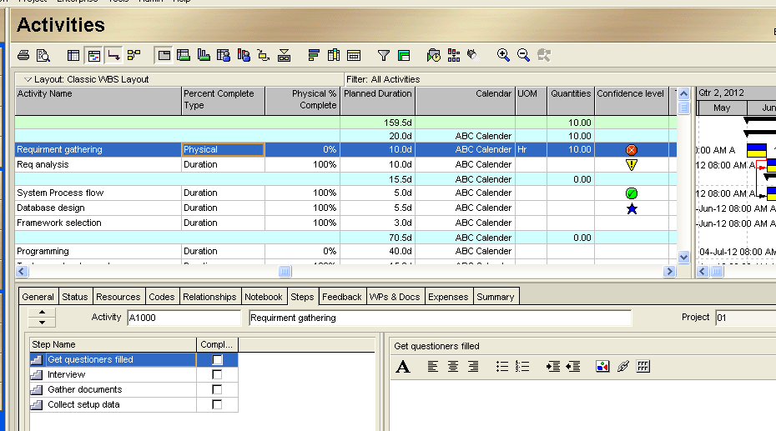
Progress calculations using activity steps

Slide 21
Thank You

