Slide 1
Project Management Software Application
PRM 705
Lecture 30

Slide 2
Recap
Responsible Manager
Activity Codes
Resources
Default Currency
Default Costing Unit
Material Unit
Resource Dictionary
Resource Assignment

Slide 3
Today’s Outline
Creating resource dictionary
Resource assignment
Resource leveling
Milestones
Activity types
Resource curves
Customized curves
Cash flow
S curve

Slide 4
Creating resource dictionary
OBS is organizational structure
Resources are people working on the project in actual
Role Vs Resource
  Chief Justice is role
  Iftikhar is resource
We can plan project based on roles or resorces

Slide 5
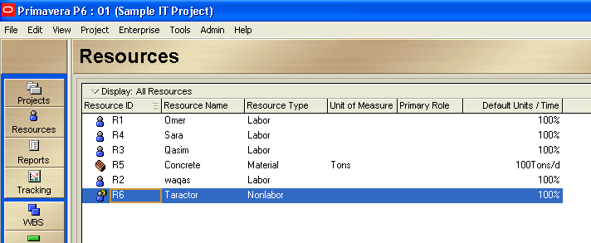
Enter following resources

Slide 6
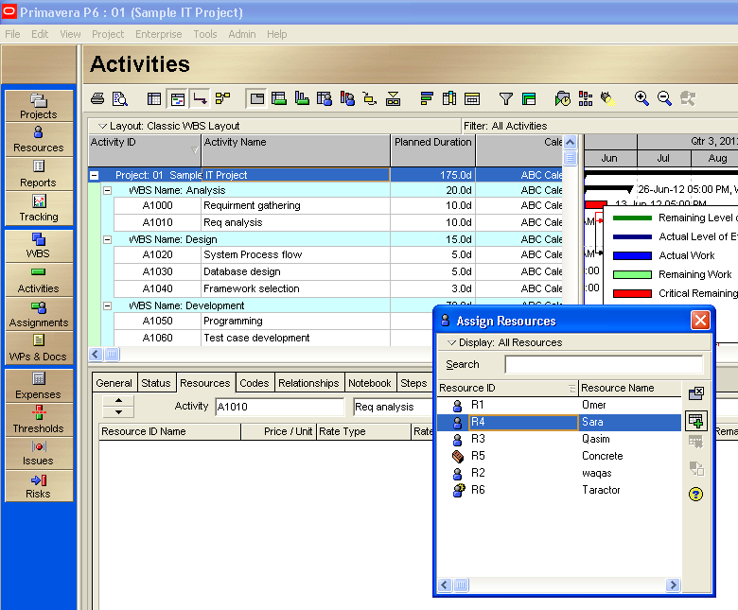
Assigning resources to activities

Slide 7
Assigning resources to activities
Now assign resources to your every activity.

Slide 8
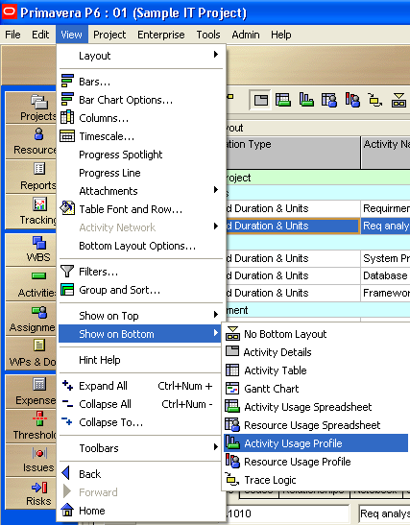
Resource Leveling

Slide 9
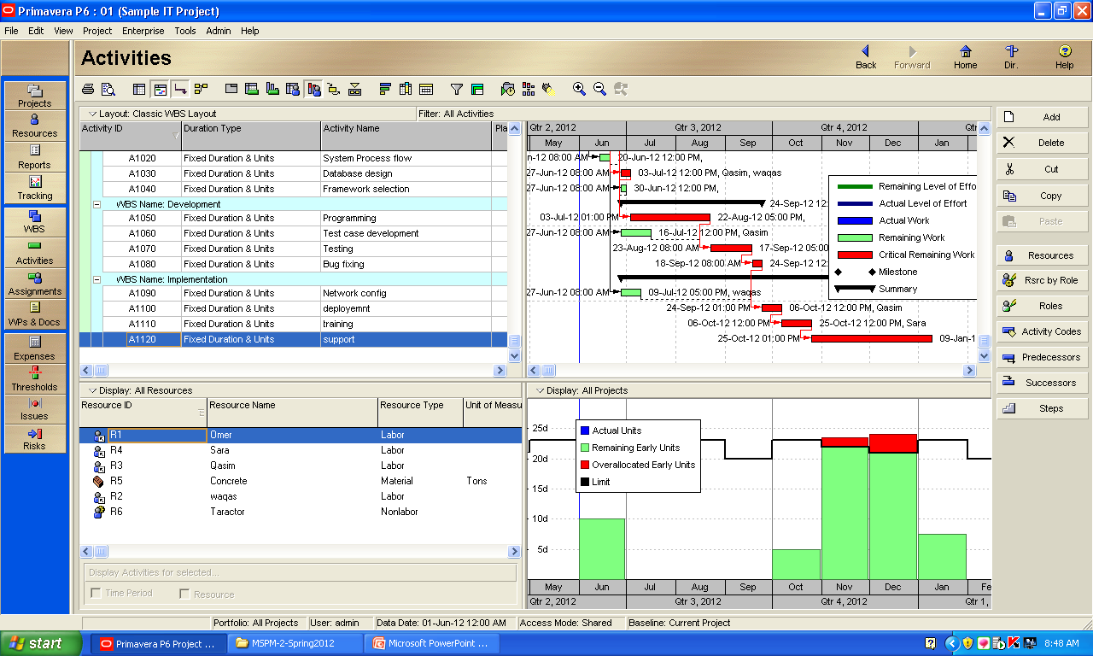
Resource Leveling

Slide 10
Resource Leveling
There may be problem in resource leveling if the resource calendar is different from activity / project calendar
In start of project add a general resource calendar and use it during project.

Slide 11
Milestones
Start Milestone –This type is typically used to mark the beginning of a phase or to communicate project deliverables.
  Zero-duration activity
  Only has a start date
  You can assign a primary resource
  You cannot assign roles
Finish Milestone –This type is typically used to mark the end of a phase or to communicate project deliverables.
  Zero-duration activity
  Only has a finish date
  You can assign a primary resource
  You cannot assign roles

Slide 12
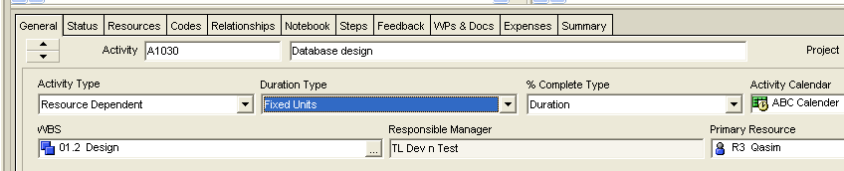
Activity Types
The Activity Type determines whether the activity calendar or resource calendar is used during scheduling.
Resource dependent & task dependent
Task dependent is default
For effort driven (in activity details)

Slide 13
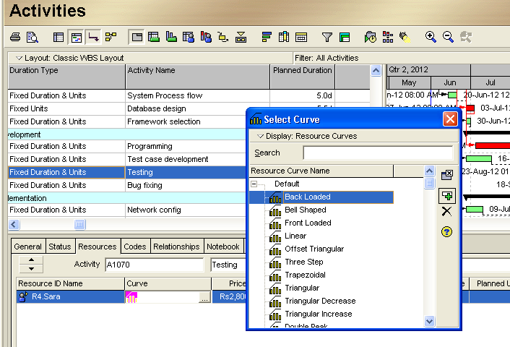
Resource curves
Add a column for resource curve

Slide 14
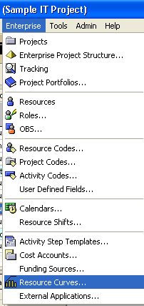
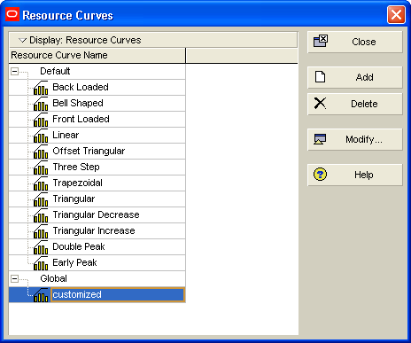
Adding your own customize curves

Slide 15
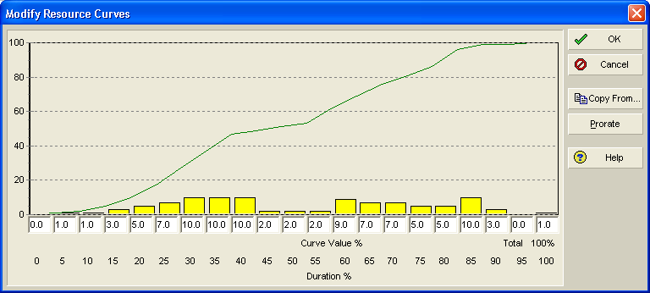
Adding your own customize curves

Slide 16
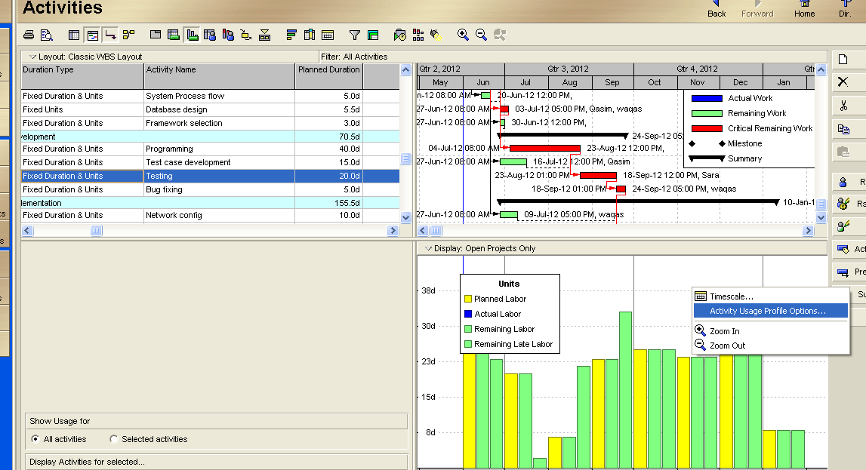
Cost usage – cash flow
Bottom layout > activity usage profile

Slide 17
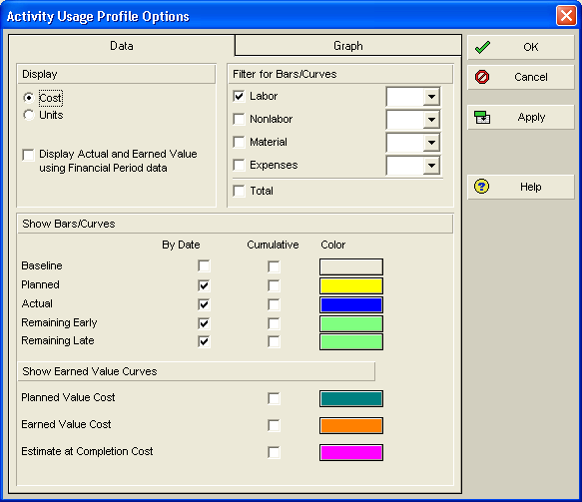
Cost usage – cash flow

Slide 18
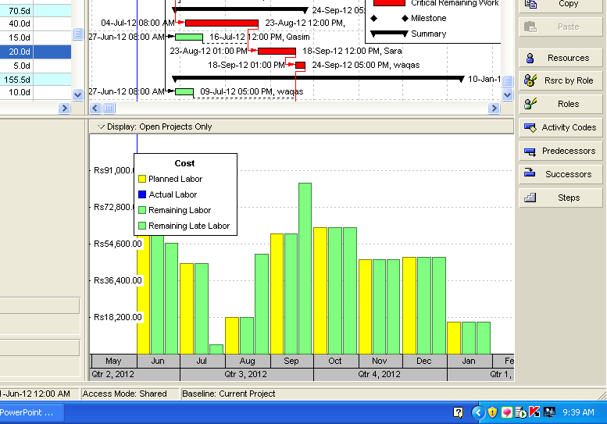
Cost usage – cash flow

Slide 19

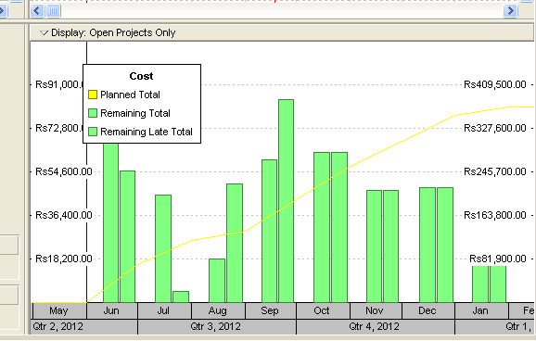
S-Curve

Slide 20
Costing
Two types
  Direct
  Indirect (admin expenses etc)

Slide 21
Thank You

