Slide 1
Project Management Software Application
PRM 705
Lecture 3

Slide 2
Recap
What is Project?
What is Program?
What is Portfolio?
What is Project Management?
Importance of PM
What makes a project successful
Benefits of Project Management Tools

Slide 3
Recap
Murphy’s Law
Parkinson’s Law
OBS
Types of organizations
  Functional
  Projectized
  Matrix

Slide 4
Today’s Outline
Requirement gathering
WBS
WBS Dictionary
PBS
RAM
Resources
Dependency Types
Lag & Lead
Over-allocation
Resource Leveling

Slide 5
Requirement Gathering for a Project
Interviewing
Focus groups
  Help from subject matter experts
Brainstorming
  Group thinking
  An idea is floated which leads to another and so on

Slide 6
Requirement Gathering for a Project
Delphi techniques
  Request for information is sent to subject experts who participate anonymously
Mind maps
  Diagram of ideas
  To help generate, classify or record information

Slide 7
Requirement Gathering for a Project
Surveys
Observations
  Job shadowing
Prototypes

Slide 8
Balancing Requirements
Prioritizing requirements
Resolve contradictions
Project objectives are to be achieved

Slide 9
WBS
Running a project without a WBS is like
going to a strange land without a roadmap.
J. Phillips

Slide 10
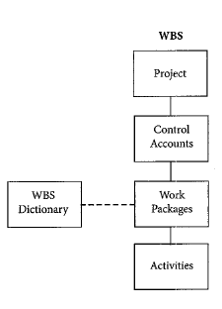
WBS
WBS allows you to break down a seemingly overwhelming project into pieces you can plan, organize, manage and control
It is top down effort to decompose the deliverables and the work required to produce them
Each work package normally consist of nouns – things, rather than actions
WBS is deliverable oriented

Slide 11
WBS
Is foundation upon which the project is built
Should exist for every project
Forces you to think through all aspects of a project
Can be reused for other projects

Slide 12
WBS
Why Break up?
  Improves work management
    Understand resource and time constraints
    Set millstones for progress
  See alternative sequencing
WBS
  Hierarchical tree structure
  Divides the project scope

Slide 13
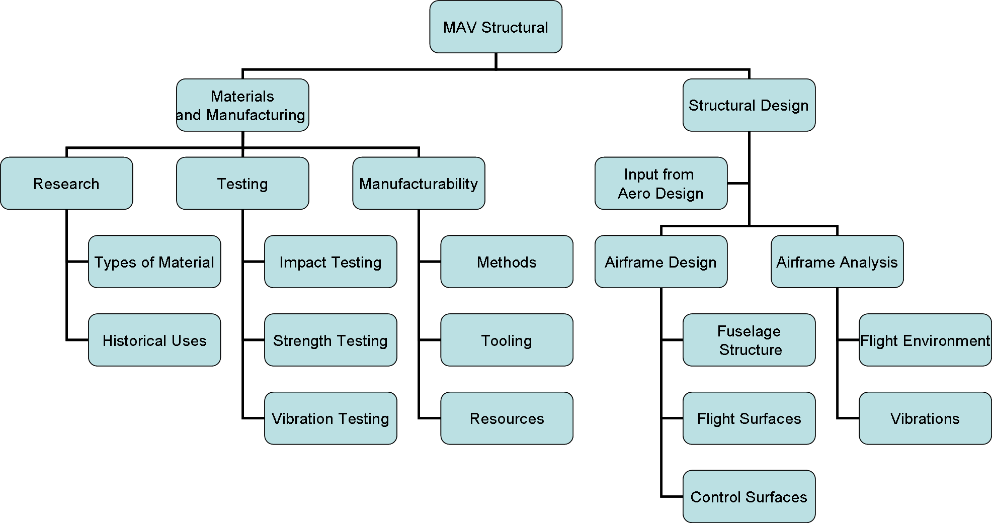
WBS

Slide 14
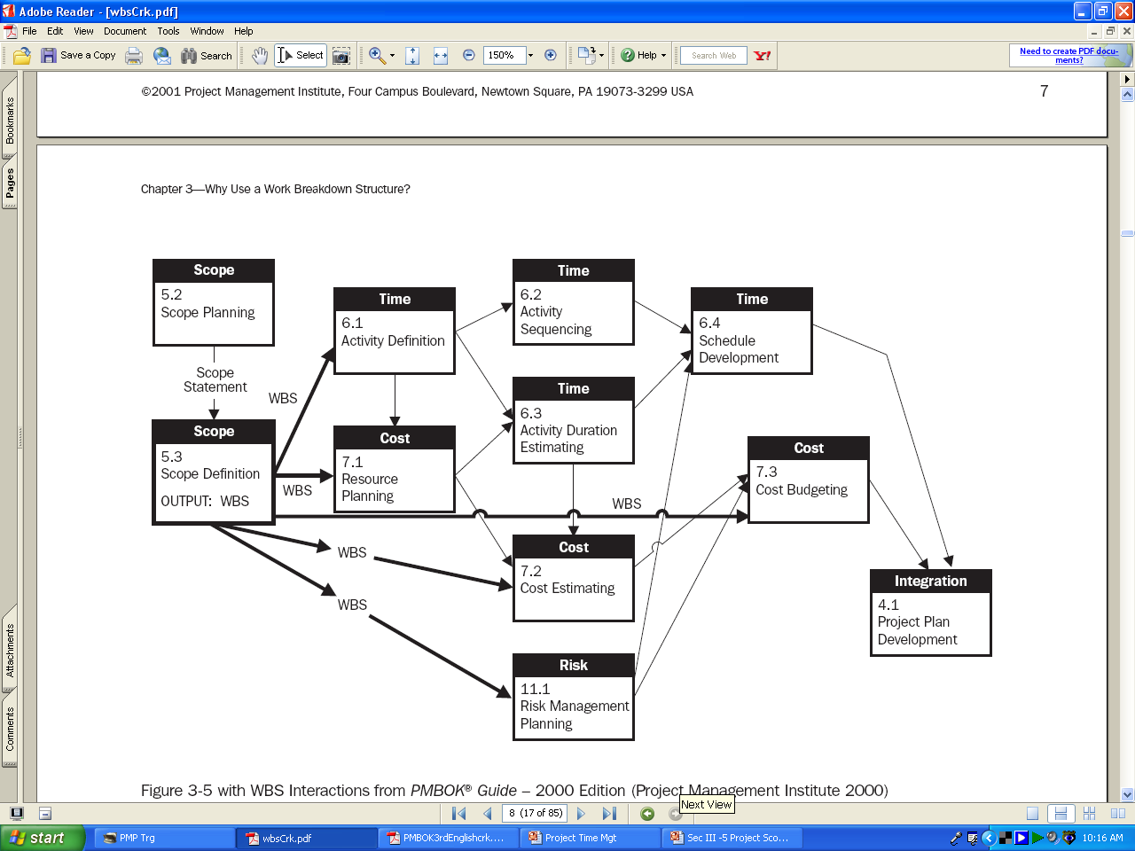

Slide 15
Rules for WBS
WBS is created with the help of the team
First level is completed before the work is broken down further
Each level of WBS is the smaller level of above
WBS includes only deliverables that are required by the project
Deliverables not in WBS are not the part of project

Slide 16
The WBS in the Project
The Work Breakdown Structure is central to the development of a realistic schedule for the project
The WBS consists of an ordered set of activities and tasks, based upon a hierarchical decomposition of the phases of the Project Life Cycle
The starting point for the WBS is thus the chosen life cycle model
The resulting structure can take a number of forms,

Slide 17
WBS Dictionary
This document provides description of the work to be done for each WBS work package
Helps make sure the resulting work better matches what is needed.

Slide 18
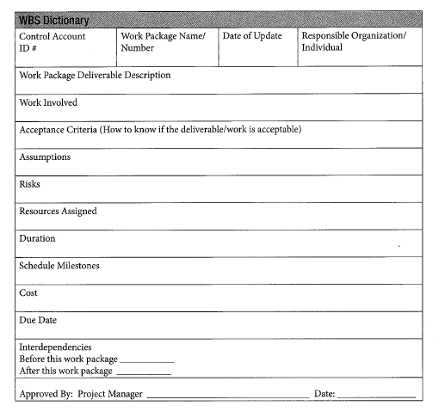
WBS Dictionary

Slide 19
Activity List
Contains activity attributes
Defines activity in detail
Milestone
  Significant event that normally has no duration

Slide 20
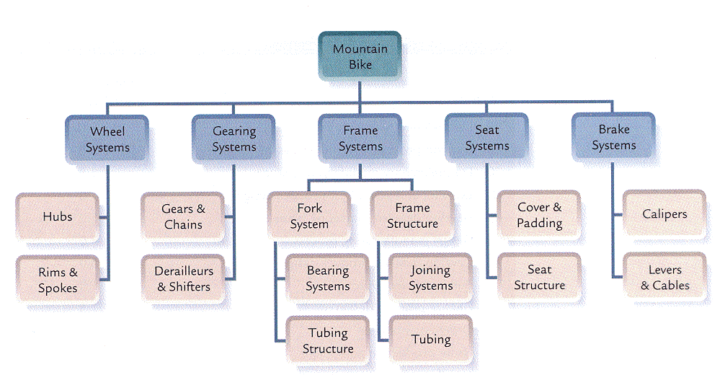
PBS
Product Breakdown Structure

Slide 21
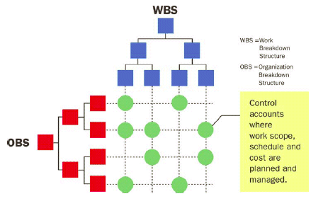
OBS & WBS

Slide 22
Responsibility Assignment Matrix (RAM)
RAM uses the WBS and OBS to link deliverables and/or activities to resources.
The RAM provides a realistic picture of the resources needed and can identify if you have enough resources for the project.

Slide 23
Project Resources
Resources are the people, equipment, materials, time and cost required to accomplish project tasks and goals.
Types of resources
  Work (People, equipment etc)
  Material (Consumable Supplies)
  Cost
  Time

Slide 24
Predecessor Task
A task (or activity) that must be started or finished before another task or milestone can be performed.

Slide 25
Task Dependencies
Mandatory dependencies
  They are inherent in nature (Must design before construct)
Discretionary dependencies
  PM or Team determine these
External dependencies
  Need or desire of party outside the project (Government or supplier)

Slide 26
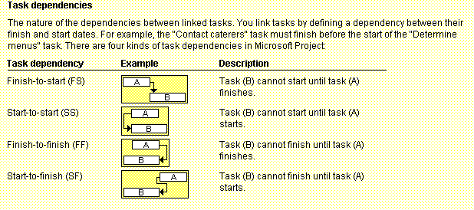
Figure 6-3. Task Dependency Types

Slide 27
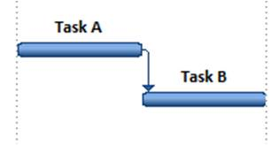
Finish to Start
Finish to start (FS)
  A FS B = B can't start before A is finished, or in another words Activity A must be completed before Activity B can begin.
  (Foundations dug) FS (Concrete poured)

Slide 28
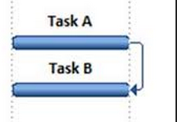
Finish to Finish
Finish to finish (FF)
  A FF B = B can't finish before A is finished or in another words Activity A must be complete before Activity B can finish.^{[2]}
  (Last chapter written) FF (Entire book written)

Slide 29
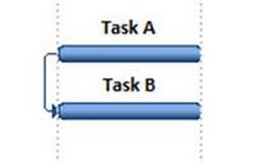
Start to Start
Start to start (SS).
  A SS B = B can't start before A starts or in another words Activity B can start after Activity A has started.^{[2]}
  (Project work started) SS (Project management activities started)

Slide 30
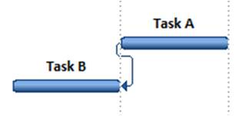
Start to Finish
Start to finish (SF)
  A SF B = B can't finish before A starts
  (New shift started) SF (Previous shift finished)

Slide 31
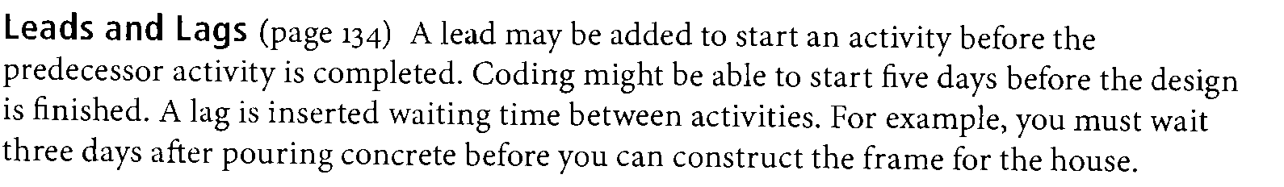
Leads & Lags

Slide 32
Over Allocation
Over Allocation is when a project calls for more time than a team member has.

Slide 33
Resource Leveling
To get the best performance and results from resources, you need to manage resource workloads to avoid over-allocations and under-allocations.

Slide 34
Resource Leveling
Over Allocation can be solved by number of ways for example:
  Changing the relationships i.e. (SS, FS, SF, FF)
  Changing lag to “zero” or change it to lead
  Changing working time
  Changing Units
  Adding extra overtime hours to that particular resource

Slide 35
Program Evaluation and Review Technique (PERT)
PERT is a network analysis technique used to estimate project duration when there is a high degree of uncertainty about the individual activity duration estimates.
PERT uses probabilistic time estimates:
  Duration estimates based on using optimistic, most likely, and pessimistic estimates of activity durations, or a three-point estimate.

Slide 36
PERT Formula and Example
PERT weighted average =
  optimistic time + 4X most likely time + pessimistic time
  6
  Example:
  PERT weighted average =
  8 workdays + 4 X 10 workdays + 24 workdays = 12 days 6
  where:
  optimistic time= 8 days
  most likely time = 10 days
  pessimistic time = 24 days
  Therefore, you’d use 12 days on the network diagram instead of 10 when using PERT for the above example.

Slide 37
Gantt Charts
Gantt charts provide a standard format for displaying project schedule information by listing project activities and their corresponding start and finish dates in a calendar format.
Symbols include:
  Black diamonds: Milestones
  Thick black bars: Summary tasks
  Lighter horizontal bars: Durations of tasks
  Arrows: Dependencies between tasks

Slide 38
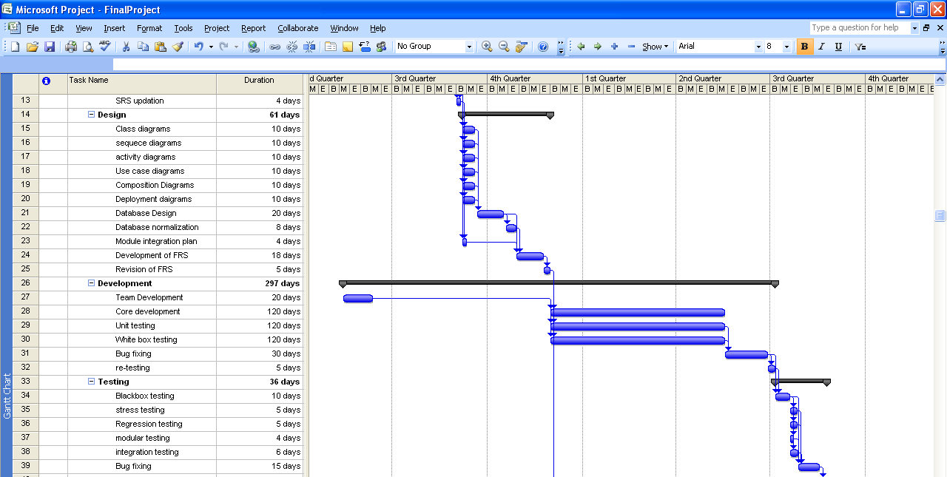
Figure 6-5. Gantt Chart for Project X

Slide 39
Baseline
Benchmark or reference
A project’s baseline is defined as the original scope, cost and schedule. The project’s baseline must be completely defined and documented before the project execution and control activities can begin.
The project’s baseline is used to measure how performance deviates from the plan. Your performance measurement would only be meaningful if you had an accurate baseline.

Slide 40
Today We Studied
Requirement gathering
WBS
WBS Dictionary
PBS
RAM
Resources
Dependency Types
Lag & Lead
Over-allocation
Resource Leveling

Slide 41
Thank You

