Slide 1
Project Management Software Application
PRM 705
Lecture 29

Slide 2
Recap
Printing
WBS
Creating WBS Dictionary
Associating Activities to WBS
User defined fields
OBS

Slide 3
Today’s Outline
Responsible Manager
Activity Codes
Resources
Default Currency
Default Costing Unit
Material Unit
Resource Dictionary
Resource Assignment

Slide 4
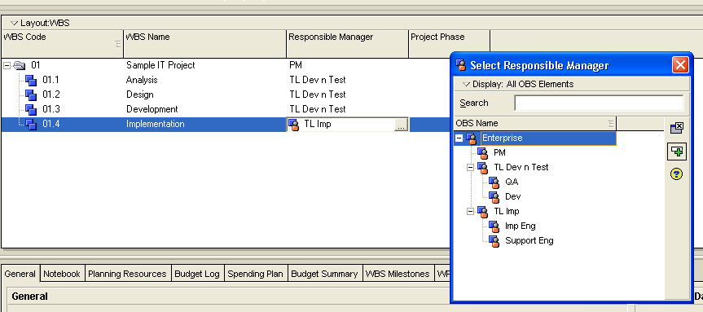
Assign Responsible Manager
Goto WBS mode > add column “responsible manager”

Slide 5
Activity Codes
Activity Codes enable you to classify and categorize activities according to you organizational and project needs.
You can use activity codes to view and roll-up activities in the Activity Table; build reports in the Report Wizard or Report Editor; organize a layout by grouping activities into specific categories; and select and summarize activities.
Examples include Phase, Area, Site, and Division.

Slide 6
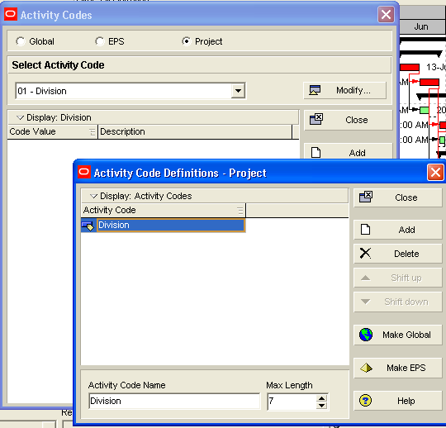
Creating activity codes
Division wise / city wise / contractor wise
Enterprise > activity codes
Used for grouping

Slide 7
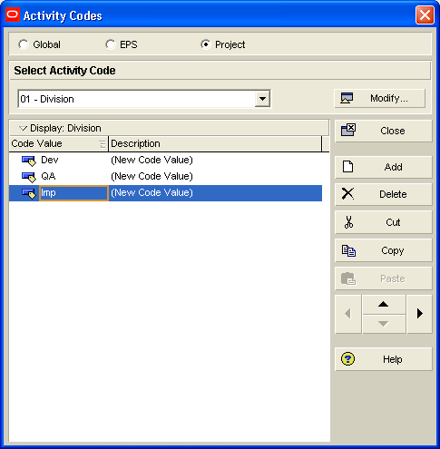
Creating activity codes

Slide 8
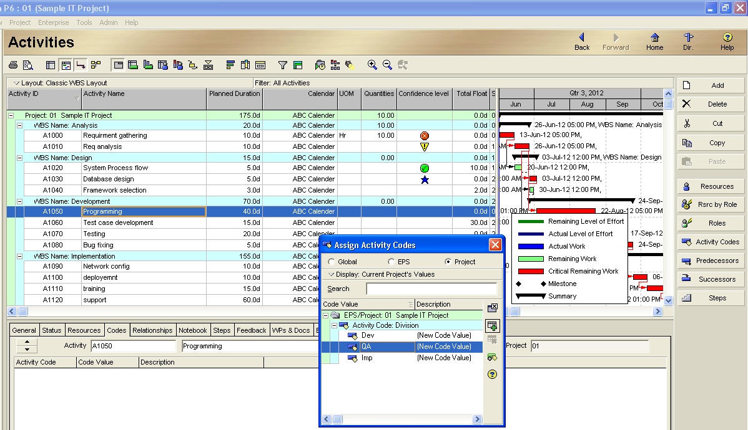
Assigning Activity Codes

Slide 9
Resources

Slide 10
Resources
Pre-requisites for resources
  Default currency
  Costing unit
  Material measuring units

Slide 11
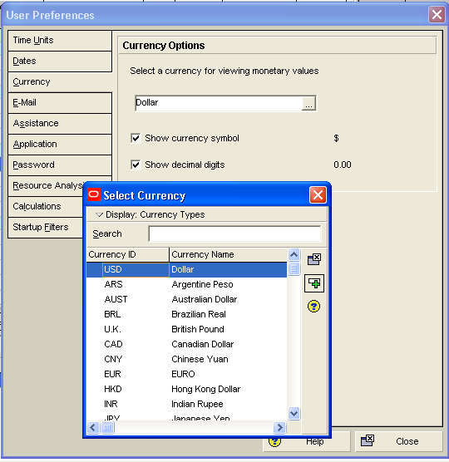
Default currency
Edit > user preferences
PKR won’t be available

Slide 12
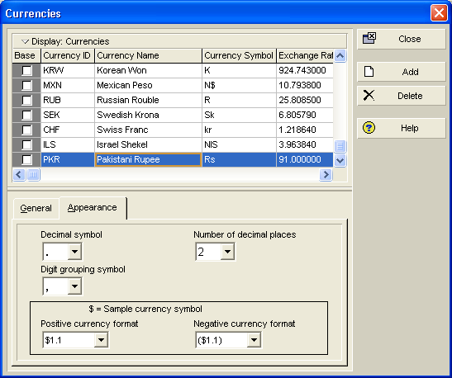
Default currency
Admin > currencies

Slide 13
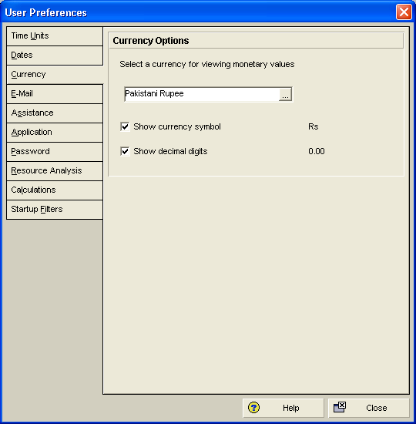
Default currency
Normally contracts are in USD

Slide 14
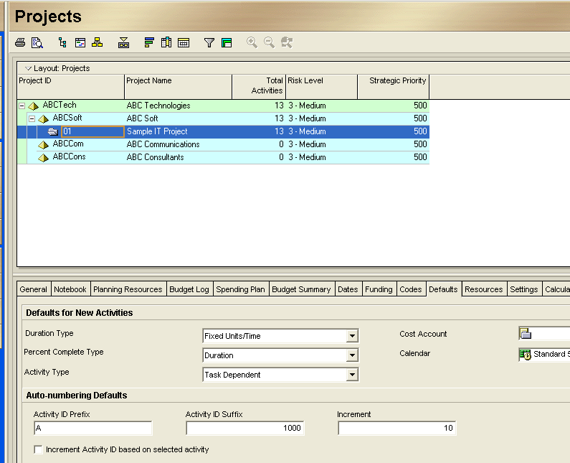
Changing defaults of project

Slide 15
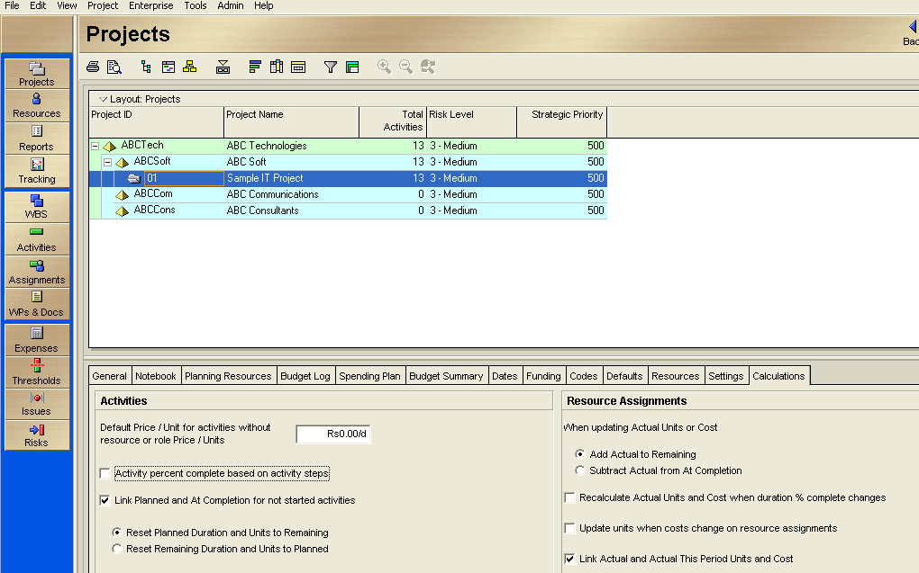
Changing costing unit

Slide 16
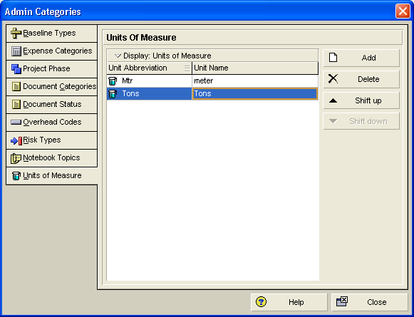
Defining Material Unit
Admin > admin categories

Slide 17
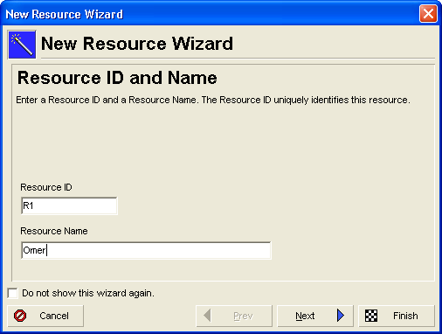
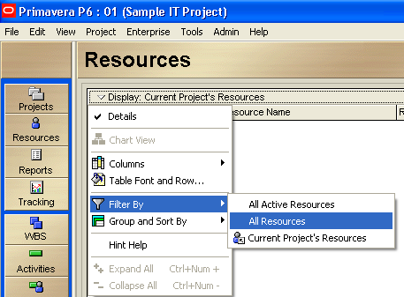
Creating resource dictionary
Enterprise > resources

Slide 18
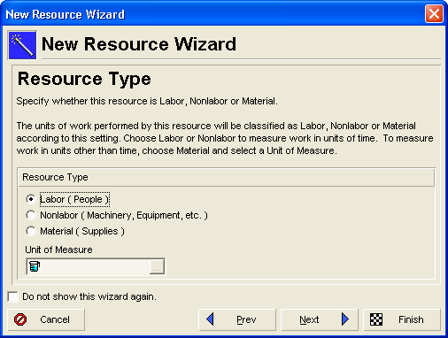
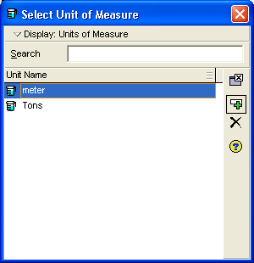
Creating resource dictionary

Slide 19
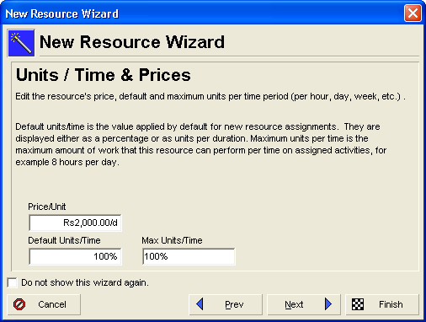
Creating resource dictionary

Slide 20
Thank You

