Slide 1
Project Management Software Application
PRM 705
Lecture 28

Slide 2
Recap
Another way of changing relationship
Row height
Background color
Progress spot light
Curtains
Timescale

Slide 3
Today’s outline
Printing
WBS
Creating WBS Dictionary
Associating Activities to WBS
User defined fields
OBS
Activity Codes

Slide 4
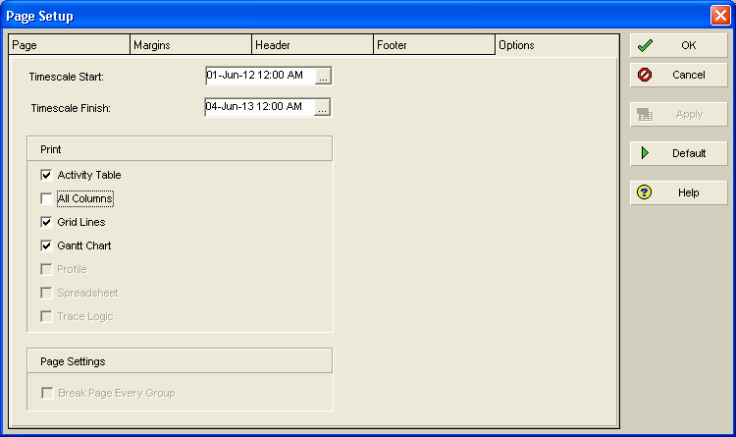
Printing
To print according to your divide line

Slide 5
To print some specific interval

Slide 6
WBS

Slide 7
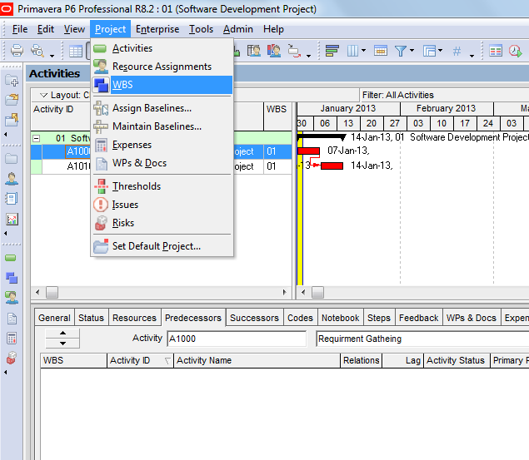
Creating WBS Dictionary

Slide 8
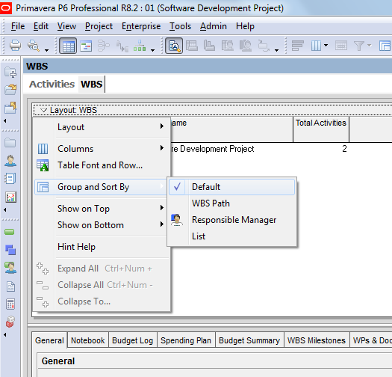
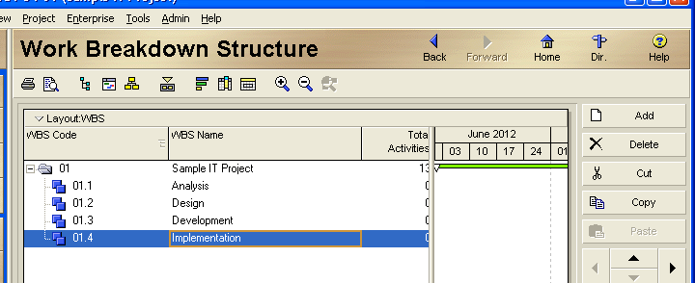
Creating WBS Dictionary

Slide 9
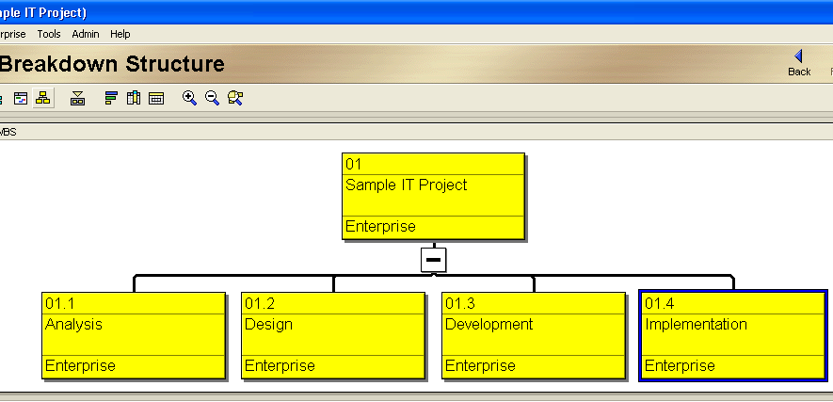
Creating WBS Dictionary

Slide 10
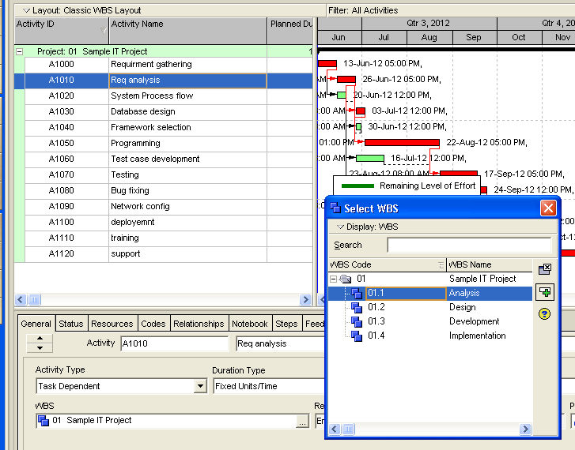
Adding activities to WBS

Slide 11
Adding activities to WBS
Another method of doing same thing is to add a WBS column and select WBS from there

Slide 12
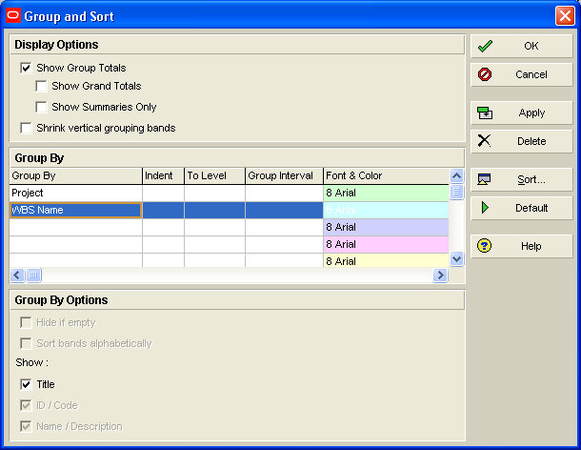
Grouping according to WBS
View > group n sort

Slide 13
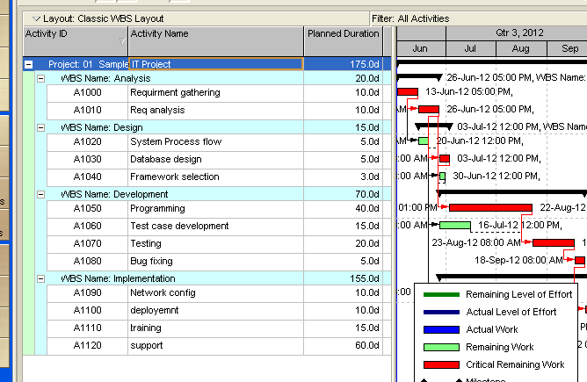
Apply this WBS

Slide 14
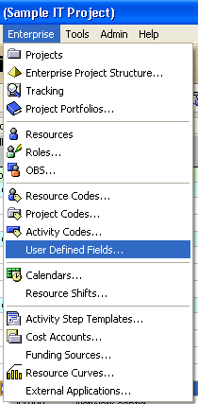
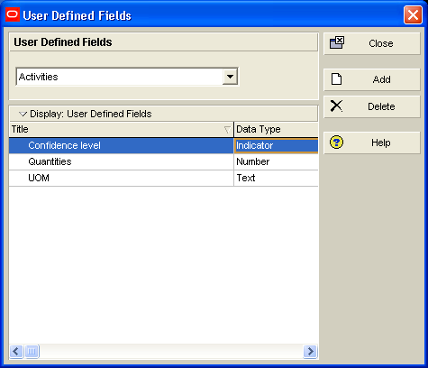
Adding user defined fields

Slide 15
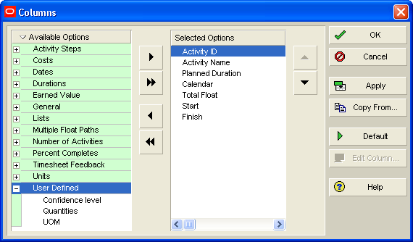
Adding user defined fields
Add columns

Slide 16
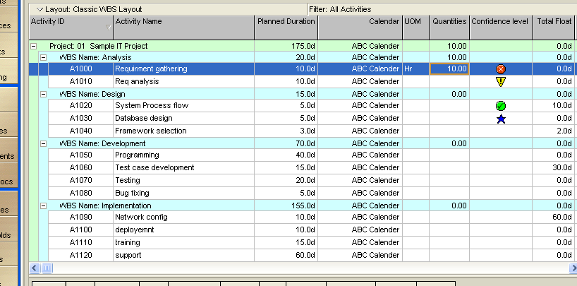
Adding user defined fields

Slide 17
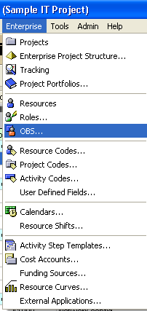
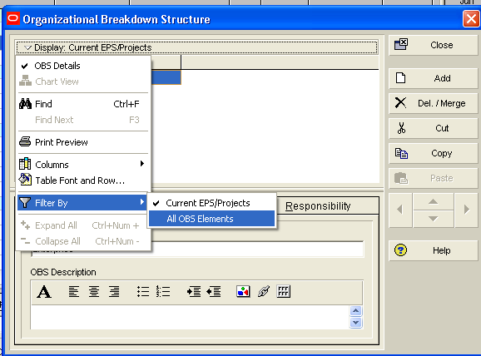
Creating OBS

Slide 18
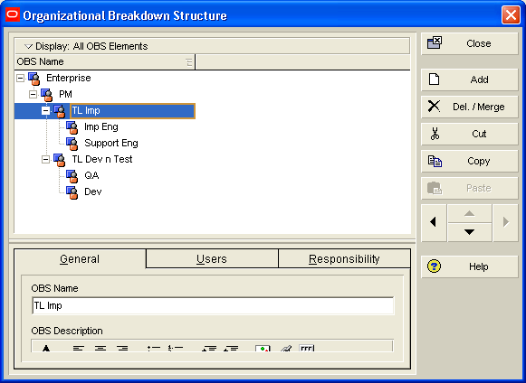
Create this OBS

Slide 19
Thank You

