Slide 1
Project Management Software Application
PRM 705
Lecture 27

Slide 2
Recap
Edit relationship
Finding Free slack
Date formatting
Bar formatting
Info near the bar
Bar legend
Customizing detailed layout

Slide 3
Today’s outline
Another way of changing relationship
Row height
Background color
Progress spot light
Curtains
Timescale
printing

Slide 4
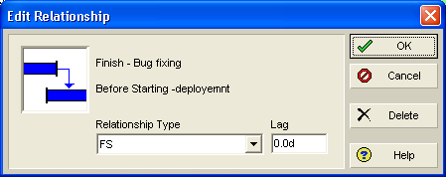
Another way of changing relationship
Move your mouse near link arrow on Gantt chart and double click when you see up arrow

Slide 5
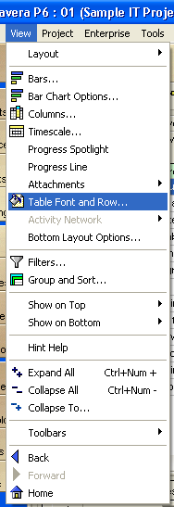
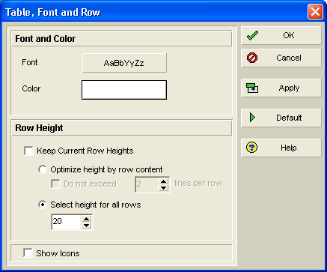
How to change row height

Slide 6
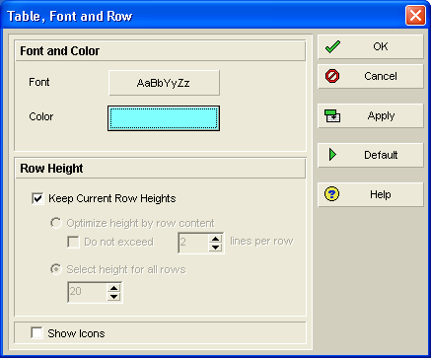
Changing background color
This is not for printing, just for display

Slide 7
Progress spot light
Sometimes it’s the little things that can really differentiate a product from its competitors. One feature I really find invaluable and unique to Primavera P6 is the Progress Spotlight. Whenever you’re in the process of updating the status of your schedule, this little gem can really take the guesswork out of what needs to be updated

Slide 8
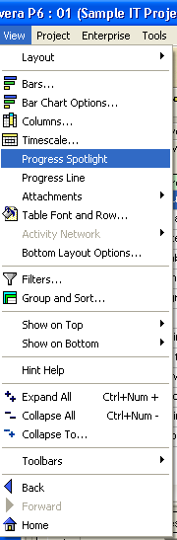
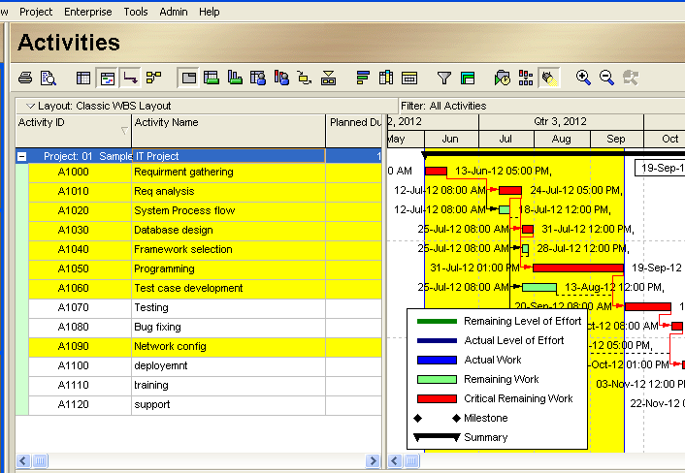
Progress spot light

Slide 9
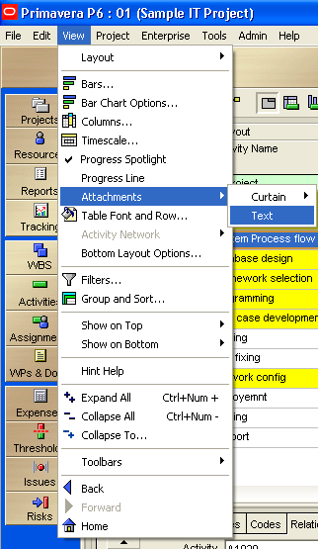
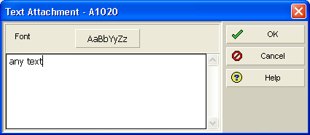
To write comments on timeline area

Slide 10

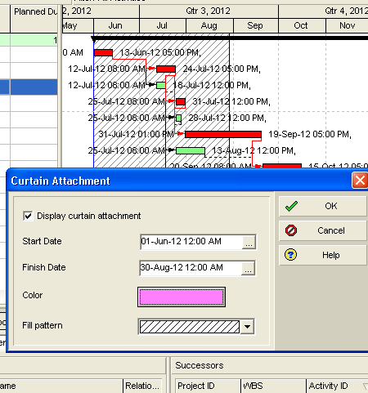
Different phases of project

Slide 11
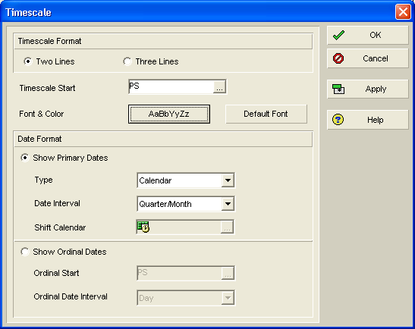
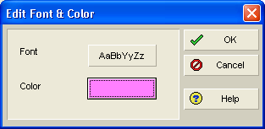
Changing header color of timescale
View > Timescale

Slide 12
Time scale start
View > Timescale

Slide 13
Thank You

