Slide 1
Project Management Software Application
PRM 705
Lecture 26

Slide 2
Recap
Applying relationships
Automatic scheduling
Applying calendar to multiple activities
Checking project duration
Project Export
Project Import

Slide 3
Today’s Outline
Edit relationship
Finding Free slack
Date formatting
Bar formatting
Info near the bar
Bar legend
Customizing detailed layout
Changing row height and background color

Slide 4
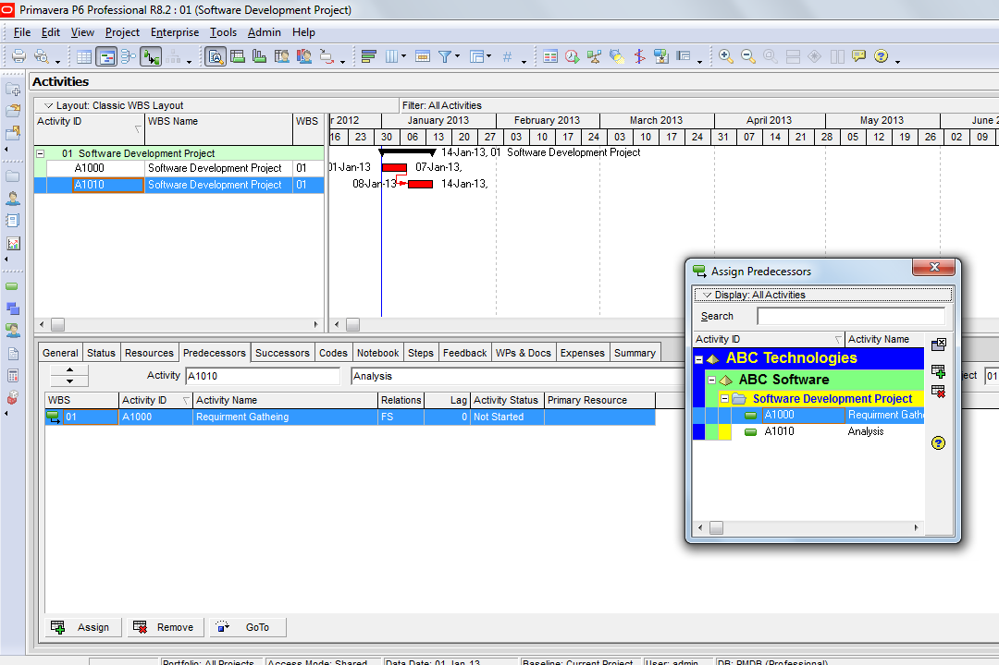
How to edit relationships

Slide 5
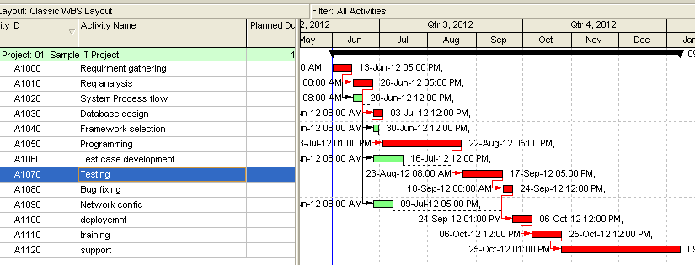
Apply these relationships

Slide 6
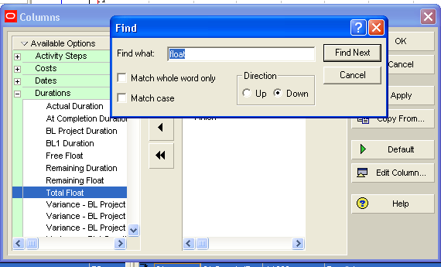
Find total float or free slack

Slide 7
Insert an activity somewhere between existing activities
Add activity
Change ID as required
Update relationship

Slide 8
EDITING
FORMATTING CUSTOMIZATIONS

Slide 9
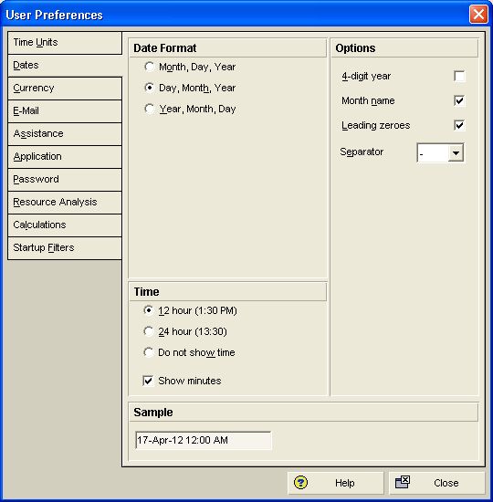
How to format the dates
Edit > Use preferences

Slide 10
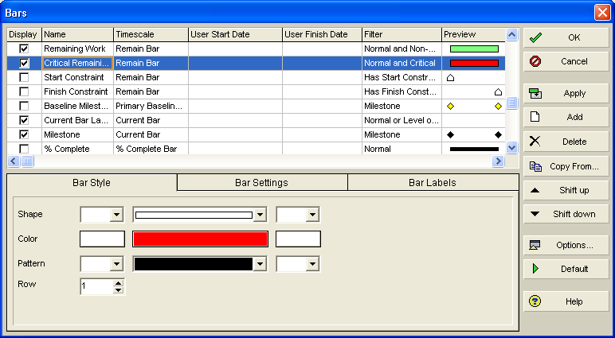
Changing bar format
View > Bars

Slide 11
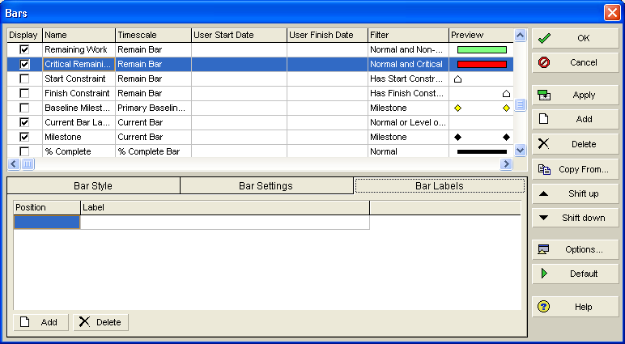
Showing info near bar
View > Bars

Slide 12
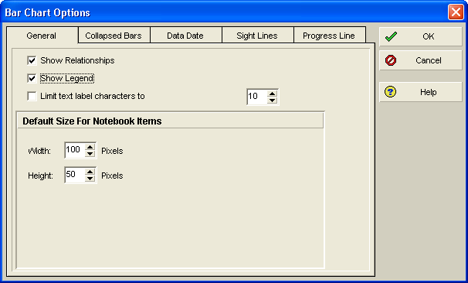
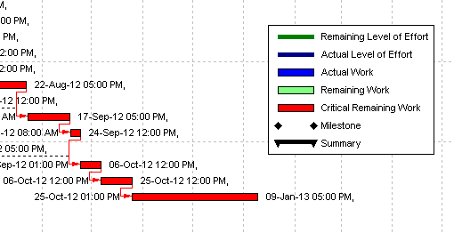
Showing legend for bars
View > Bar > options

Slide 13
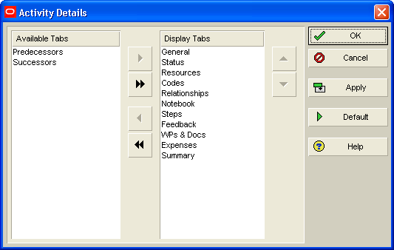
Bottom layout options to add remove tabs
View > Bottom layout options

Slide 14
Thank You

