Slide 1
Project Management Software Application
PRM 705
Lecture 25

Slide 2
Recap
  Bottom layout
  Calendar
  Applying calendar
  Durations column
  Entering durations
  Applying relationships

Slide 3
Today’s Outline
Applying relationships
Automatic scheduling
Applying calendar to multiple activities
Checking project duration
Project Export
Project Import
Edit relationship
Finding Free slack

Slide 4
Applying relationships
Now you can see links but without any calculation (you cannot see waterfall)
This is because by default calculation mode in on “manual” settings
Change calculations mode to “Automatic”

Slide 5
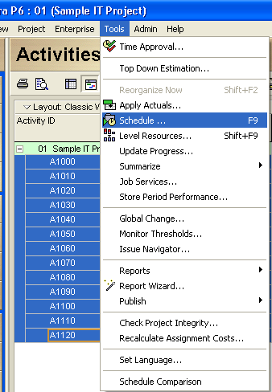
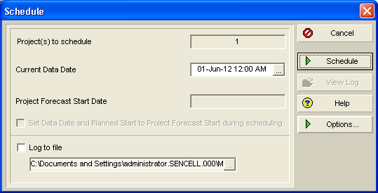
Applying relationships

Slide 6
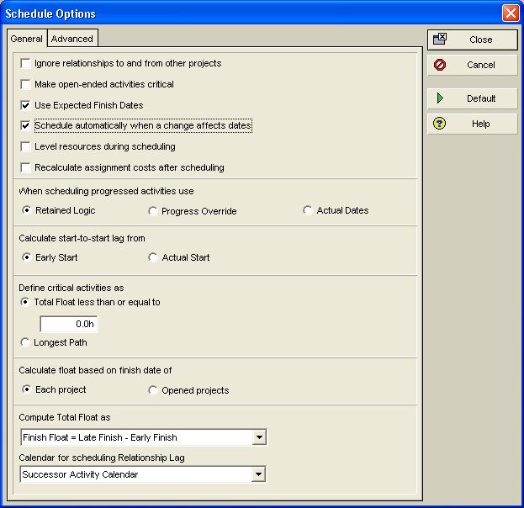
Applying relationships

Slide 7
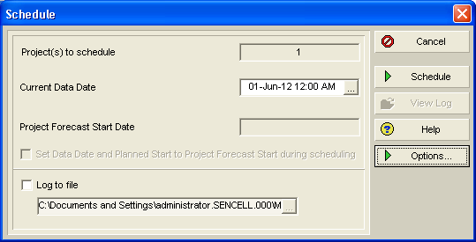
Applying relationships
While in planning phase, your current data date should be project start date

Slide 8
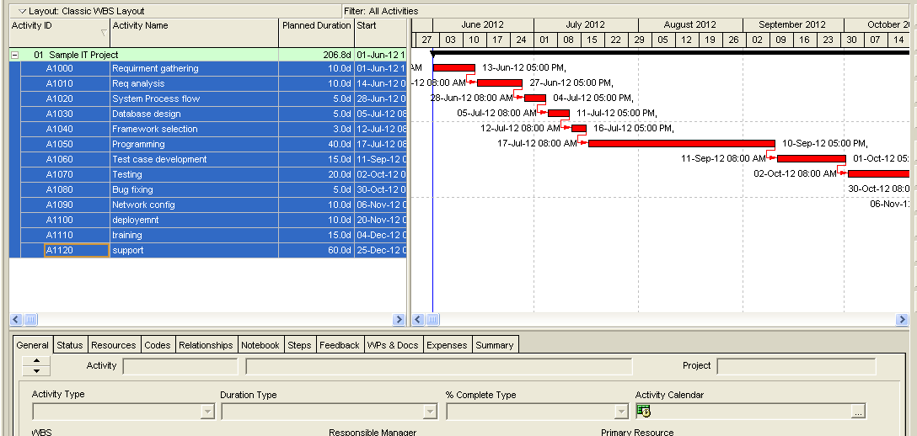
Applying relationships

Slide 9
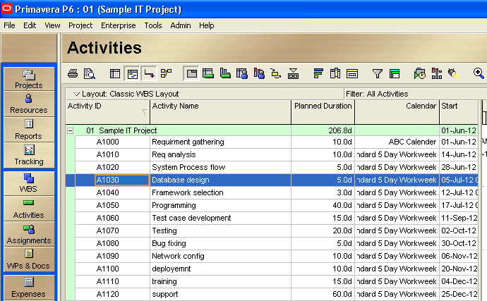
How to apply calendar on all activities
Insert a column showing calendar

Slide 10
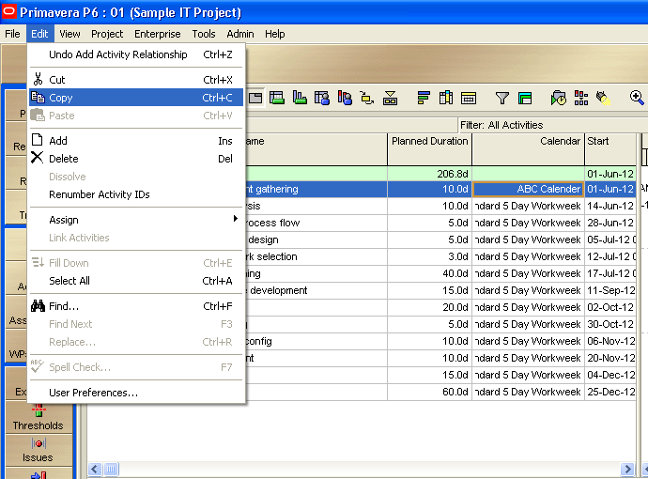
How to apply calendar on all activities

Slide 11
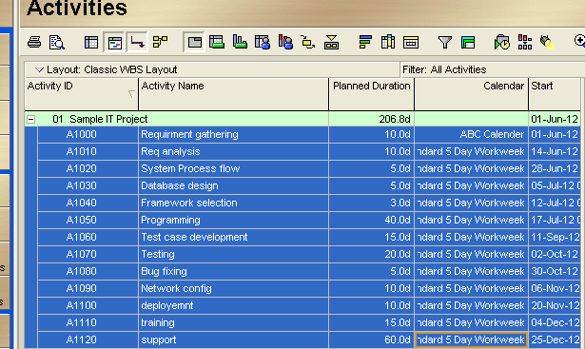
How to apply calendar on all activities
Select all activities including row one.

Slide 12
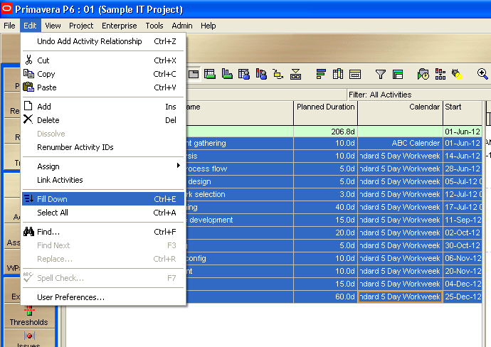
How to apply calendar on all activities

Slide 13

How to apply calendar on all activities

Slide 14
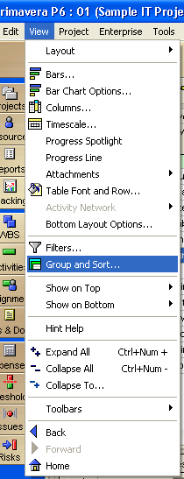
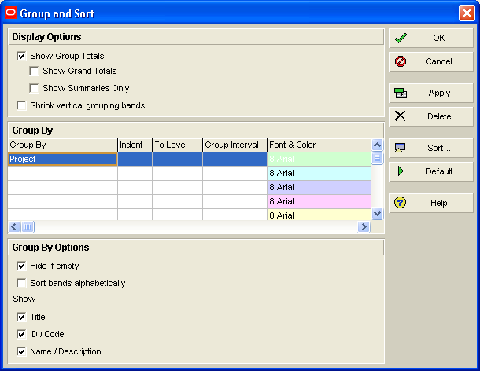
How to show total length of the project

Slide 15
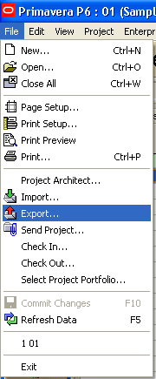
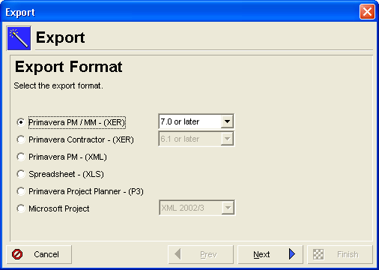
Export your project

Slide 16
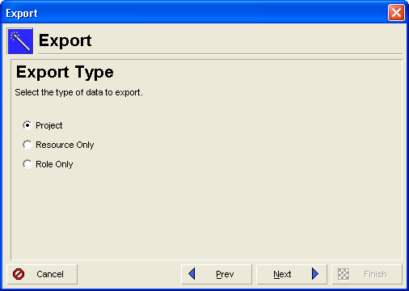
Export your project

Slide 17
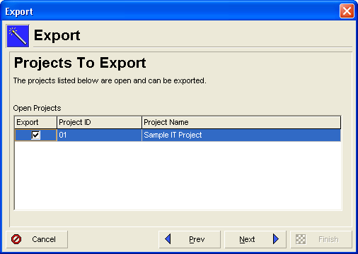
Export your project

Slide 18
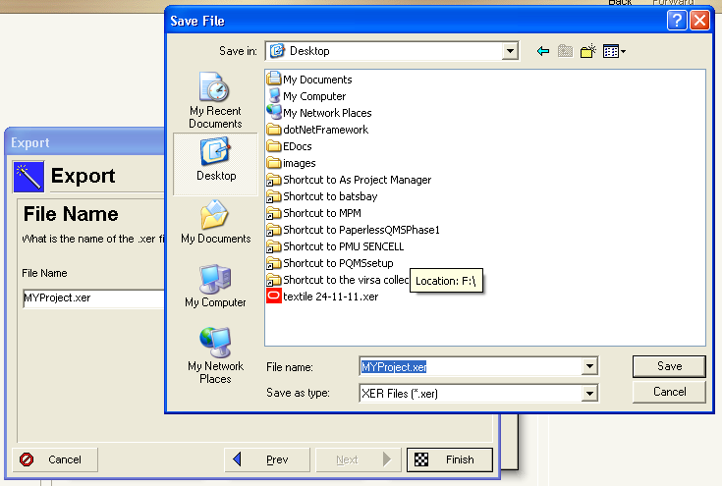
Export your project

Slide 19
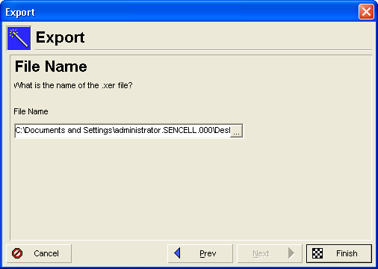
Export your project

Slide 20
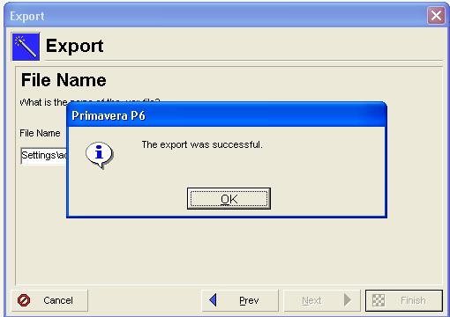
Export your project

Slide 21
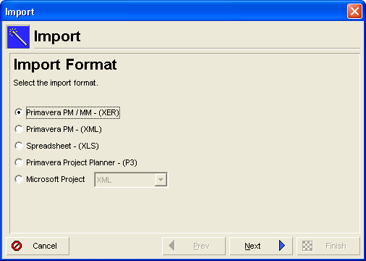
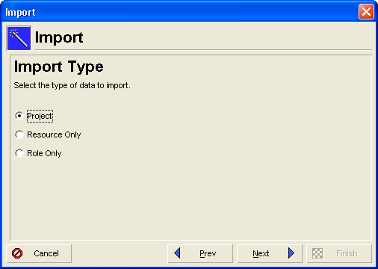
Import your project

Slide 22
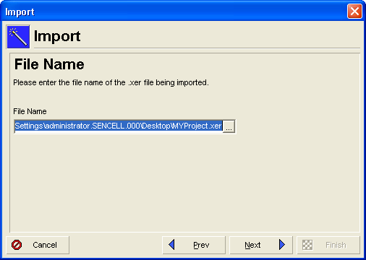
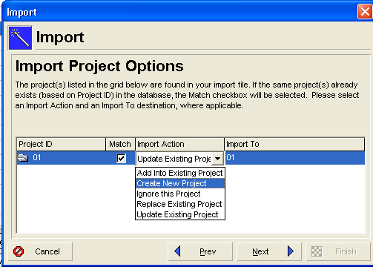
Import your project

Slide 23
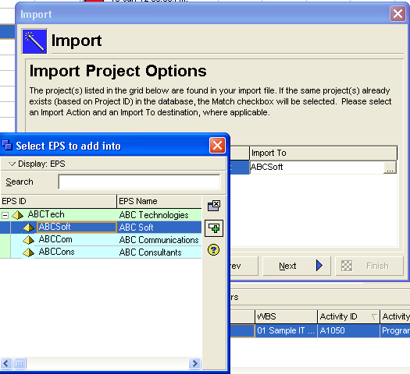
Import your project

Slide 24
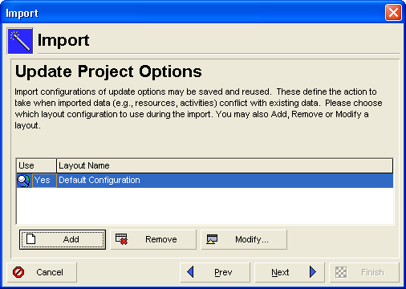
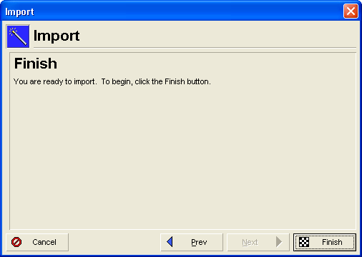
Import your project

Slide 25
Thank You

