Slide 1
Project Management Software Application
PRM 705
Lecture 24

Slide 2
Recap
  EPS
  Creating new project
  Creating activities
  Toolbar
  Setting up column

Slide 3
Today’s Outline
  Bottom layout
  Calendar
  Applying calendar
  Durations column
  Entering durations
  Applying relationships

Slide 4
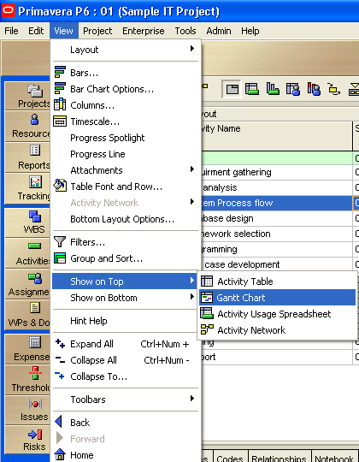
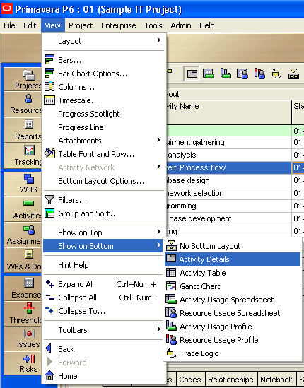
Setting up top & bottom view
This is default view

Slide 5
Creating a calendar
Three types
  Global
  Resource
  Project

Slide 6
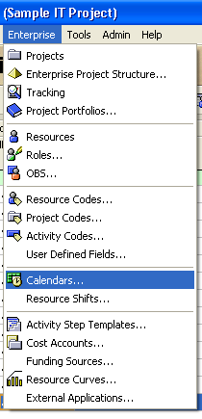
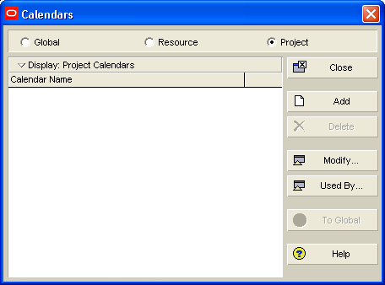
Creating a calendar

Slide 7
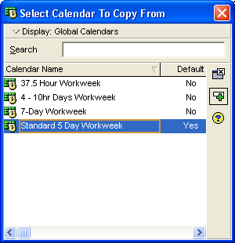
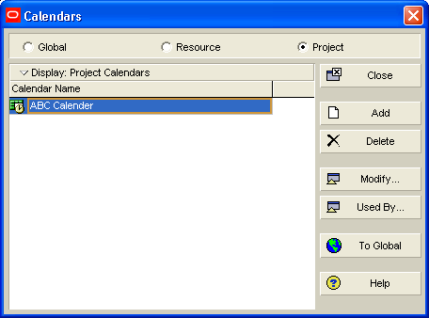
Creating a calendar

Slide 8
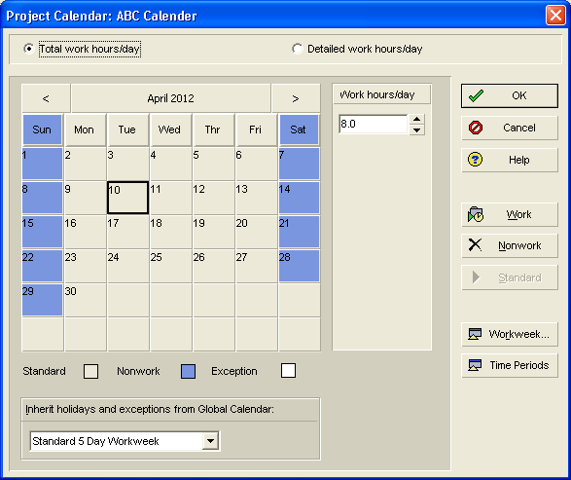
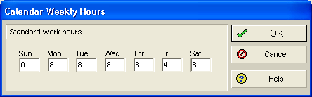
Creating a calendar

Slide 9
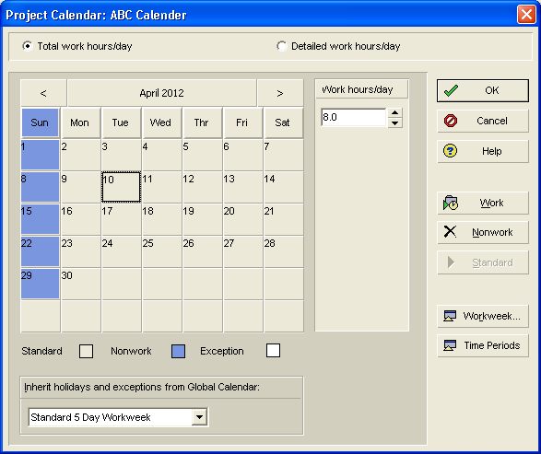
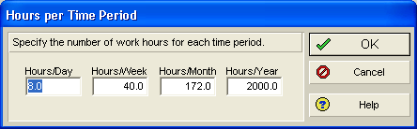
Creating a calendar

Slide 10
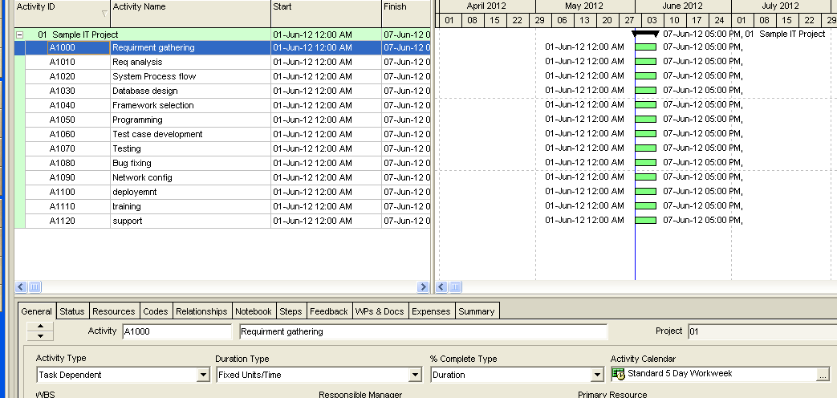
Applying calendar on the activity
Sort activities by ID

Slide 11
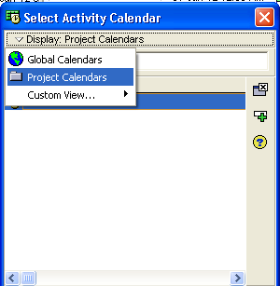
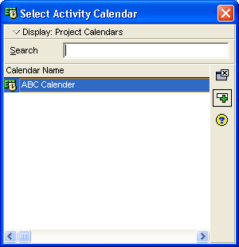
Applying calendar on the activity

Slide 12
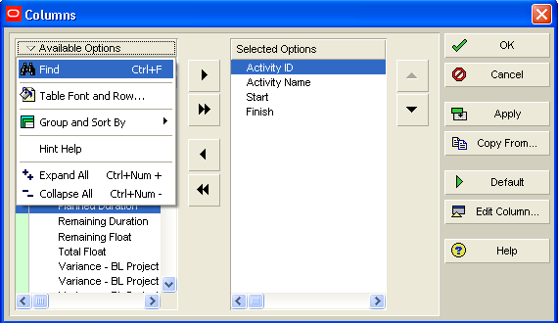
Insert durations column

Slide 13
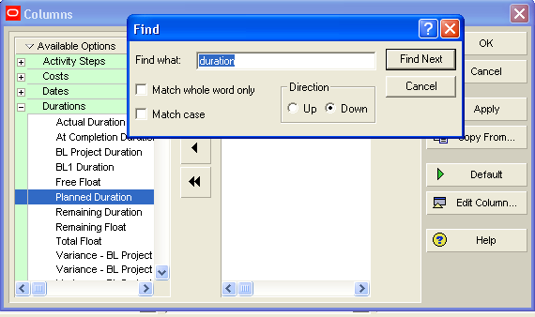
Insert durations column

Slide 14
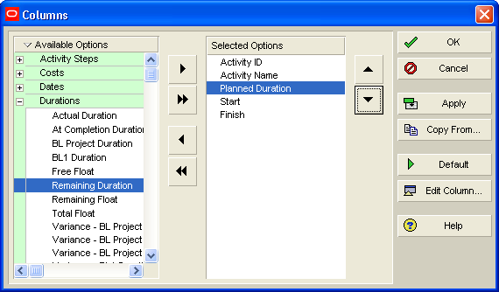
Insert durations column

Slide 15
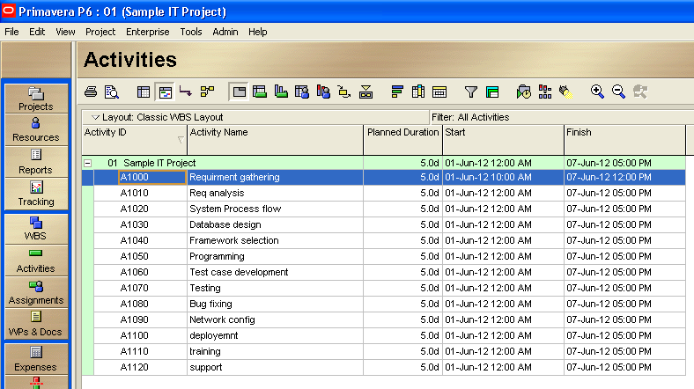
Insert durations column

Slide 16
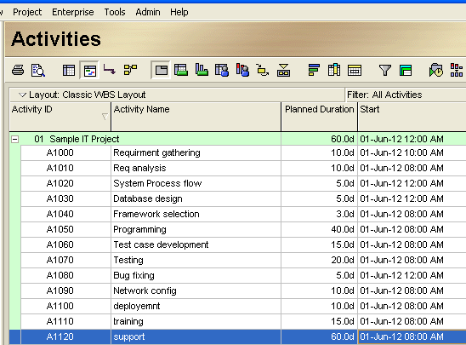
Enter following durations

Slide 17
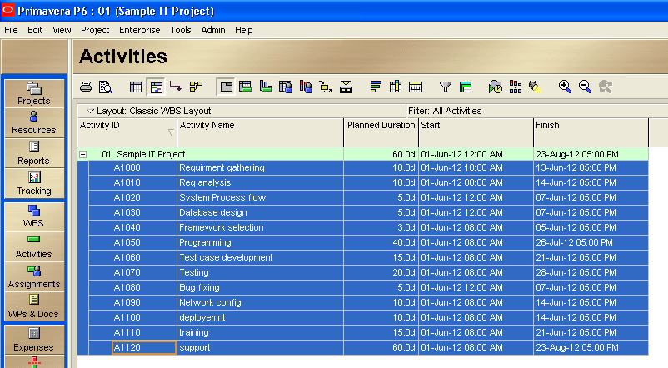
Applying relationships
Default relationship is FS
Select all activities using SHIFT + DOWN ARROW

Slide 18
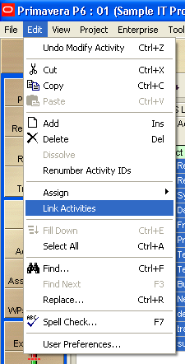
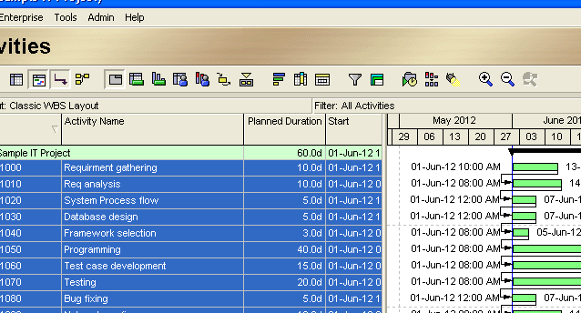
Applying relationships
Don’t press it twice
If you don’t see the links on Gantt chart Press

Slide 19
Thank You

