Slide 1
Project Management Software Application
PRM 705
Lecture 23

Slide 2
Recap
Intro to PV
History & Present
Oracle Primavera
Applications
Solution
Installation
Showing welcome dialog

Slide 3
Today’s Outline
  EPS
  Creating new project
  Creating activities
  Toolbar
  Setting up column
  Bottom view

Slide 4
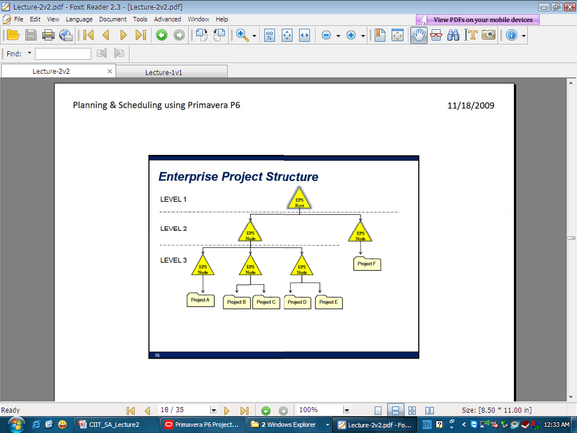
EPS
Lecture Progress

Slide 5
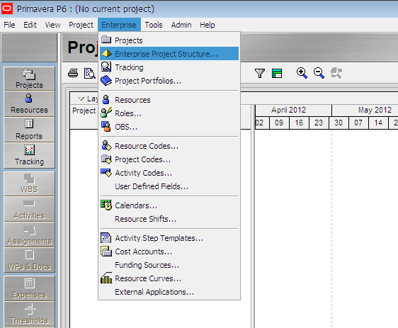
Create a new EPS
Lecture Progress

Slide 6
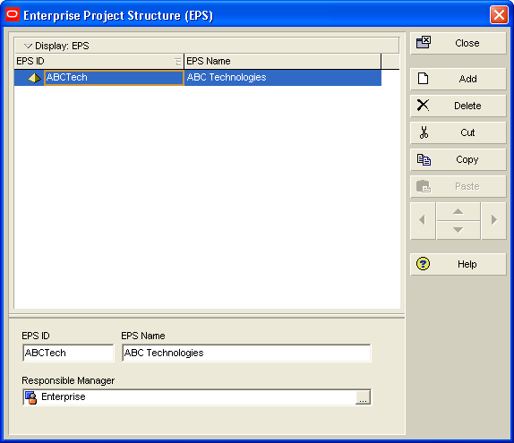
Create a new EPS
Lecture Progress
Click ‘Add’ > click on ‘EPS Name’ and modify it
Click ‘EPS ID’ and change it to any alpha-numeric value

Slide 7
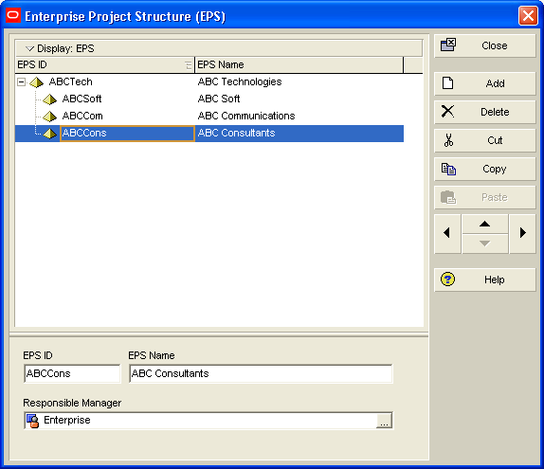
Create a new EPS
Lecture Progress
Add Sub companies for your enterprise
You can use arrow buttons

Slide 8
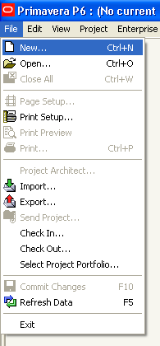
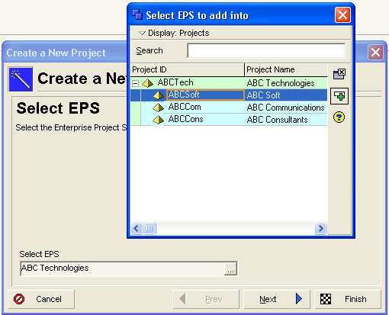
Create new project

Slide 9
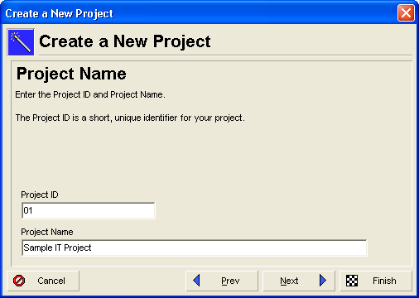
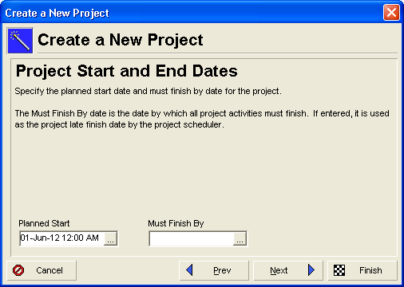
Create new project
Numeric ID is preferred here

Slide 10
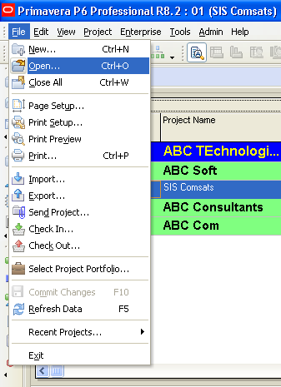
Open a project

Slide 11
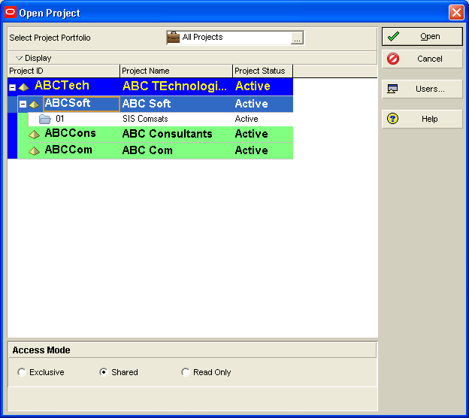
Open a project

Slide 12
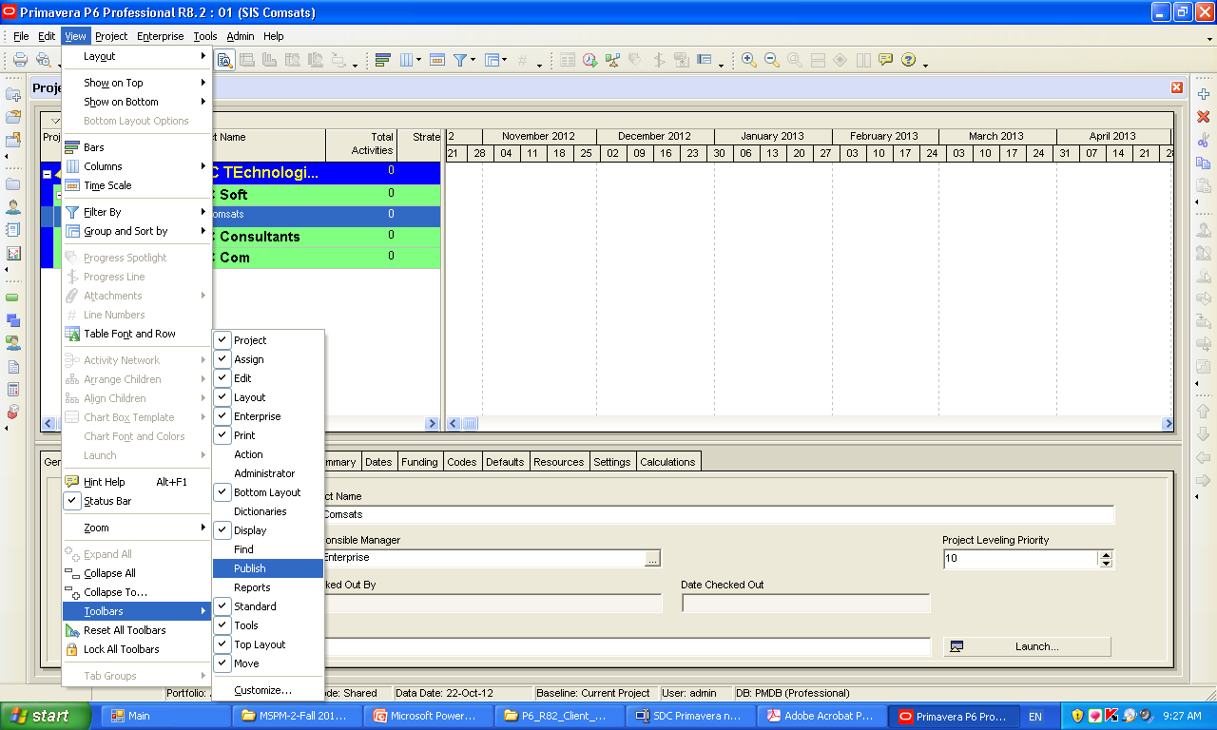
Toolbars

Slide 13
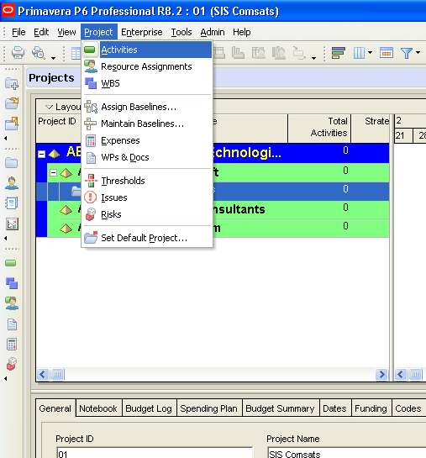
Go to activities mode

Slide 14
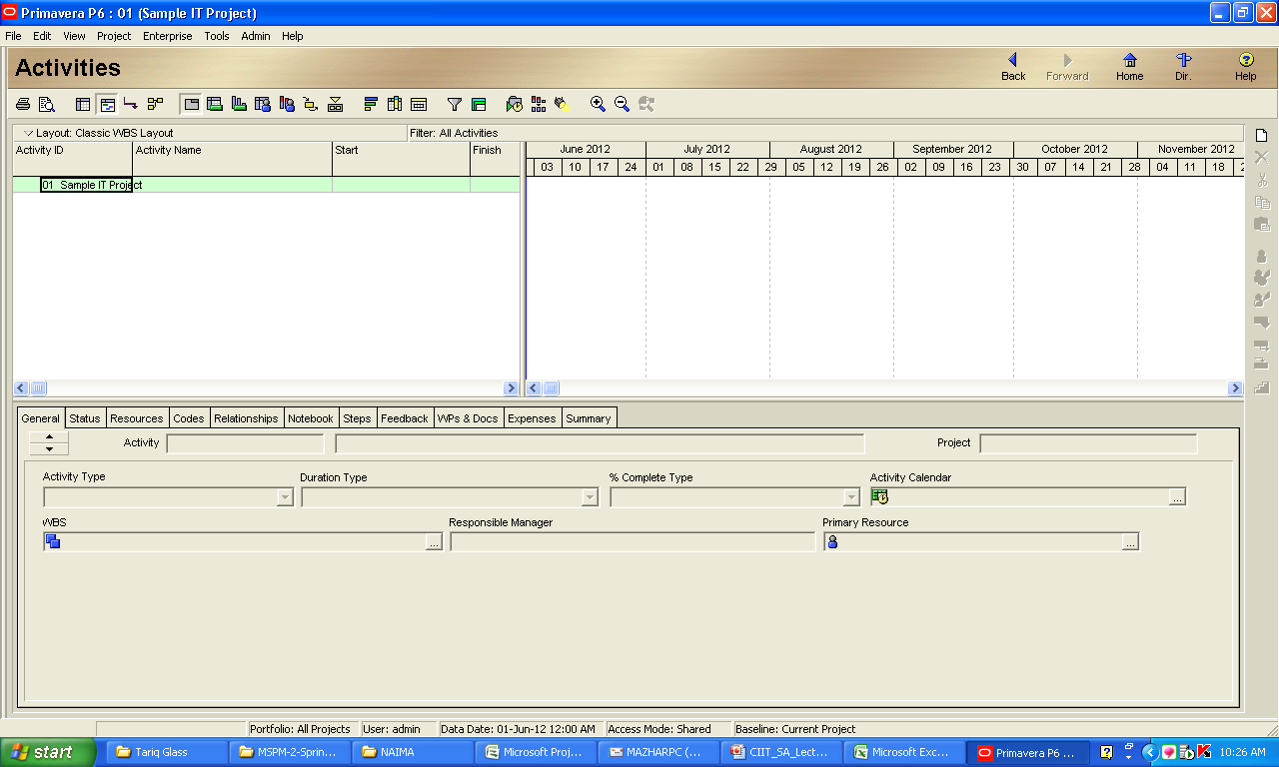
Activities Mode

Slide 15
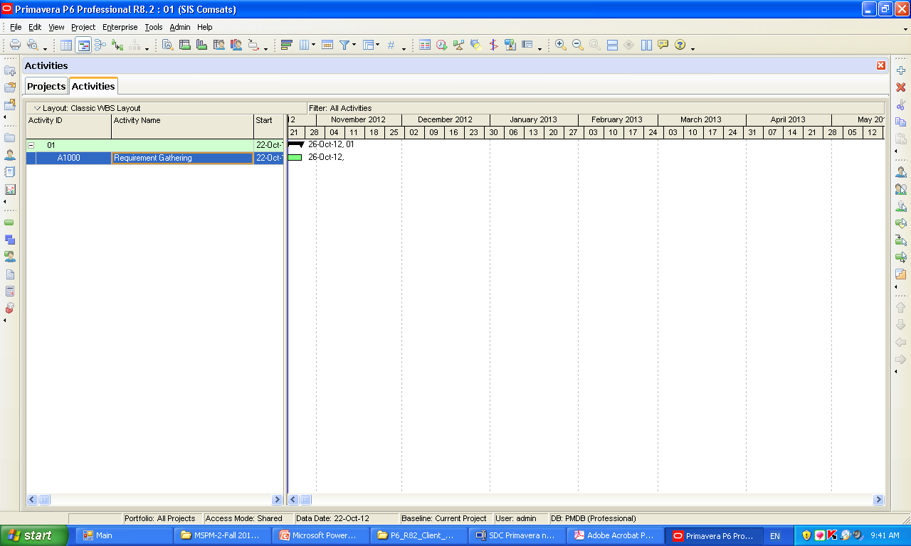
Adding new activity

Slide 16
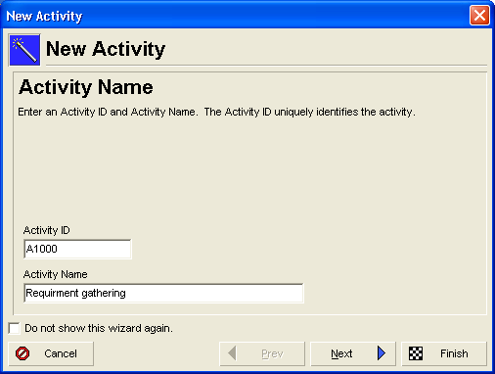
Adding new activity
Add activity name and press finish

Slide 17
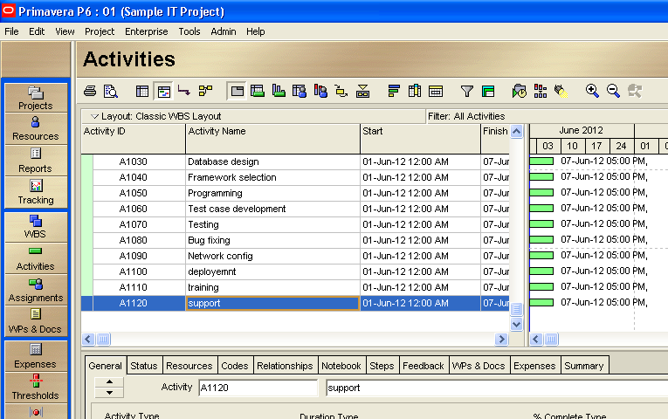
Enter following activities

Slide 18
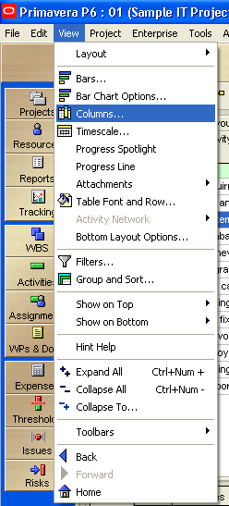
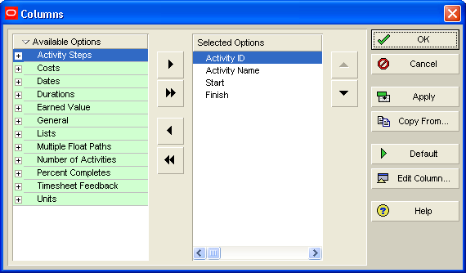
Setting up columns
You can hide columns which you don’t need at this time

Slide 19
Thank You

