Slide 1
Project Management Software Application
PRM 705
Lecture 22

Slide 2
Recap
MSP Review

Slide 3
Today’s Outline
Intro to PV
History & Present
Oracle Primavera
Applications
Solution
Installation

Slide 4
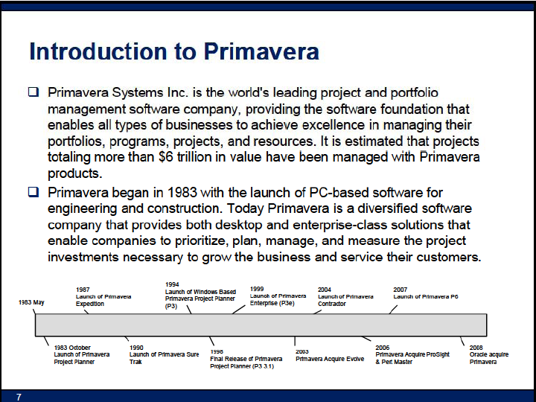

Slide 5
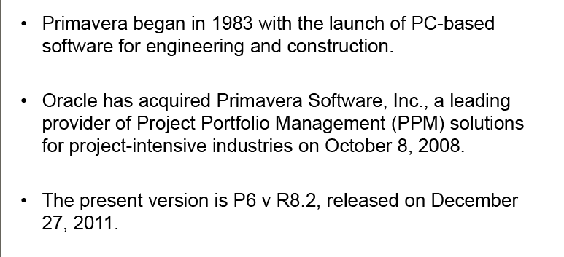
History And Present

Slide 6
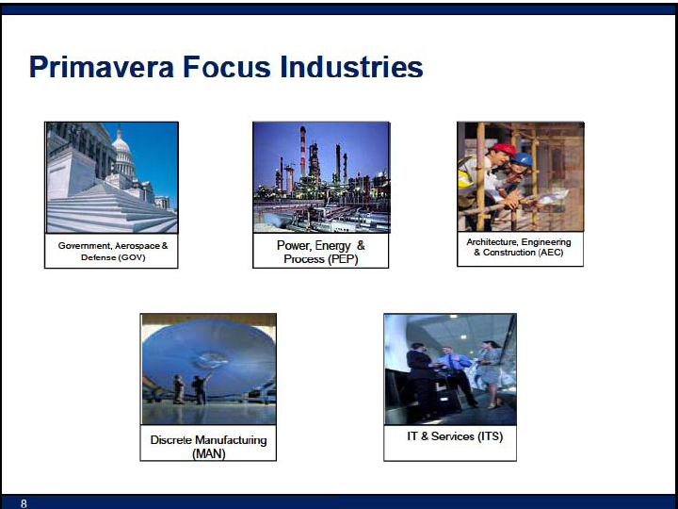

Slide 7
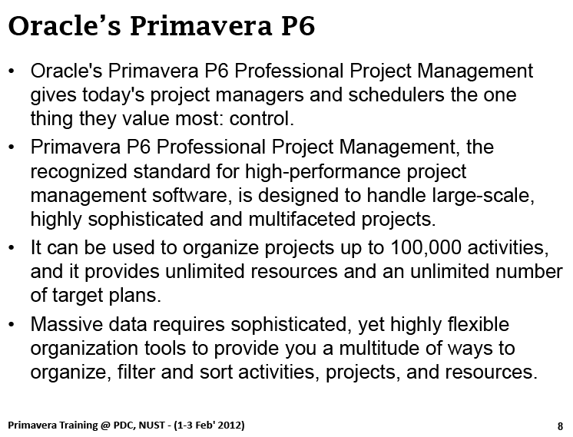

Slide 8
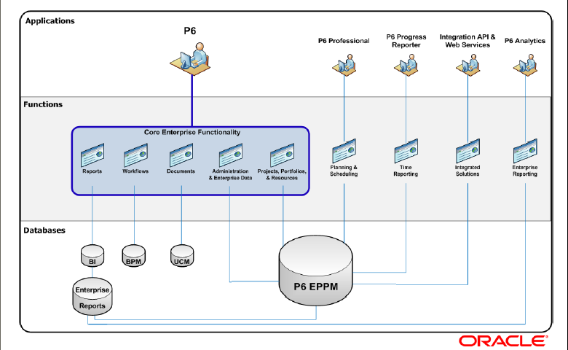
Primavera P6

Slide 9
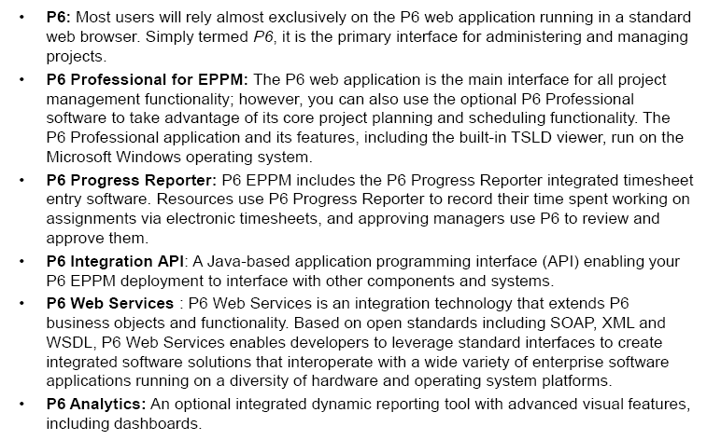
Applications

Slide 10
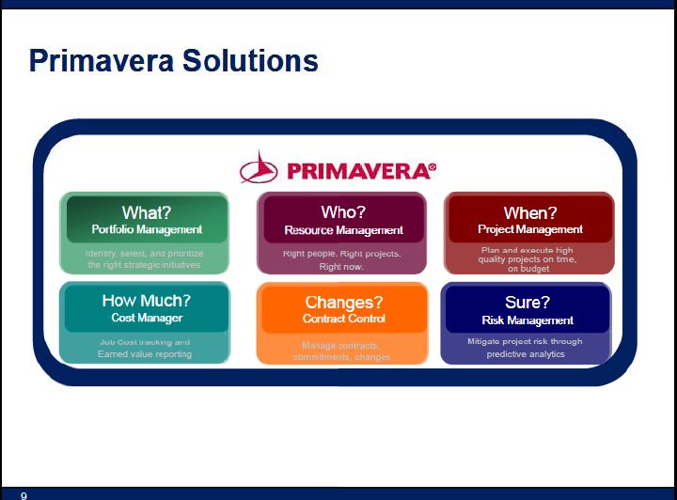

Slide 11
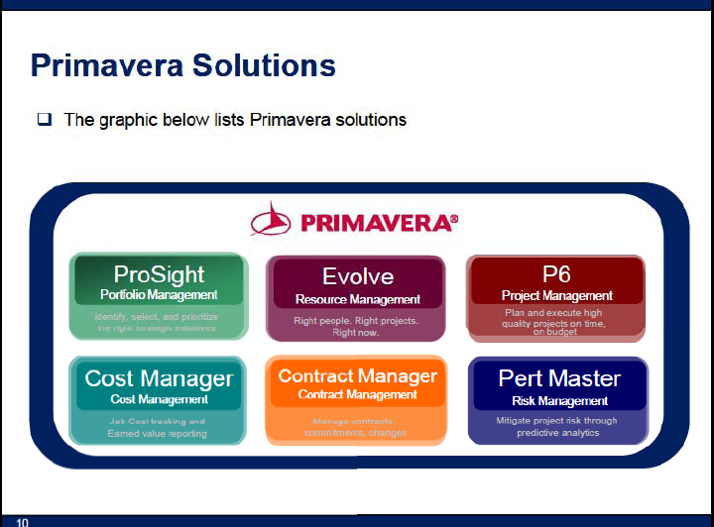

Slide 12
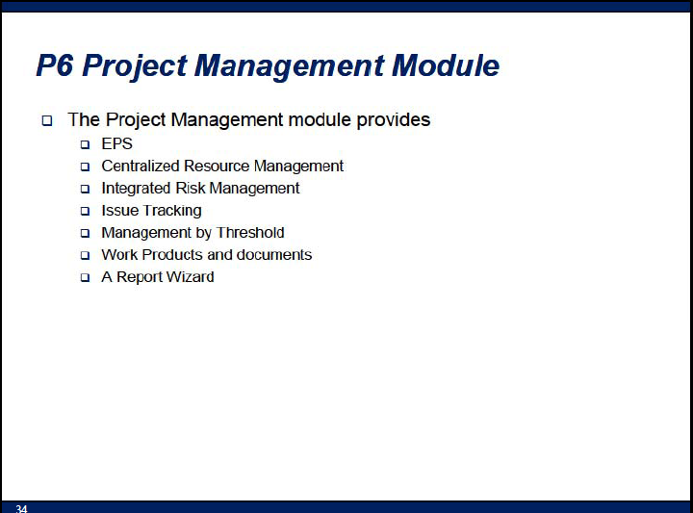

Slide 13
Installation (Primavera P6 R8.2)
Install “windows installer 4.5”
Install “.NET Framework 4.0”
Install “Java”
You must have windows XP sp3 installed
Run setup
Choose “standalone”
Uncheck “install sample projects”
Username: admin
Password: admin123

Slide 14
Working on Primavera

Slide 15
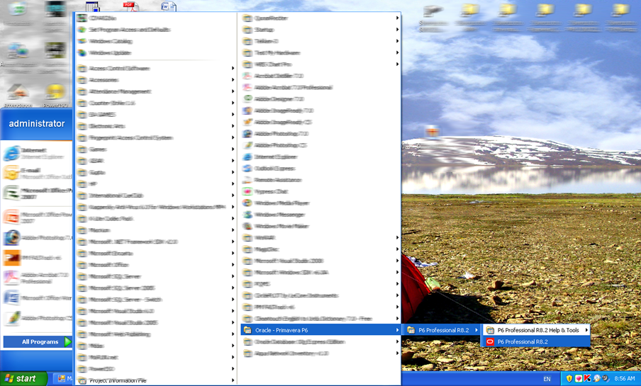
How to Start..
Lecture Progress

Slide 16
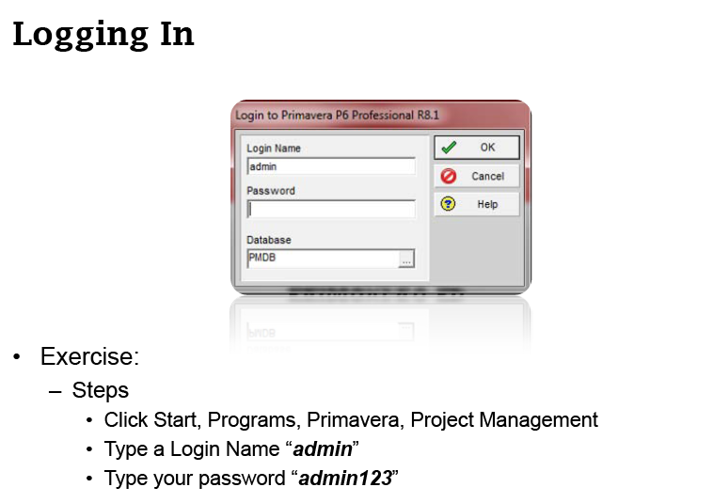
Logging In…
Lecture Progress

Slide 17
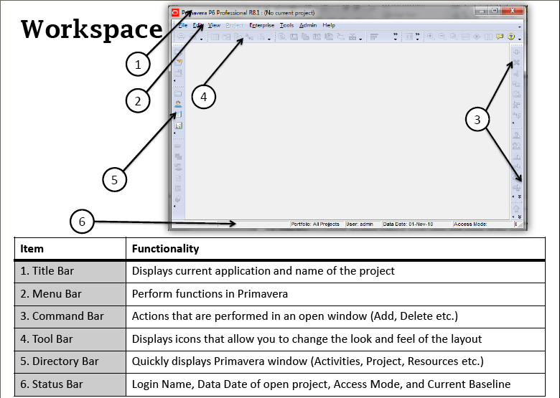
Environment
Lecture Progress

Slide 18
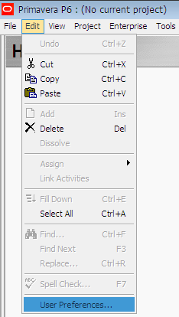
Show Welcome Dialog Box
Lecture Progress
  Show Welcome Dialog Box at start up

Slide 19
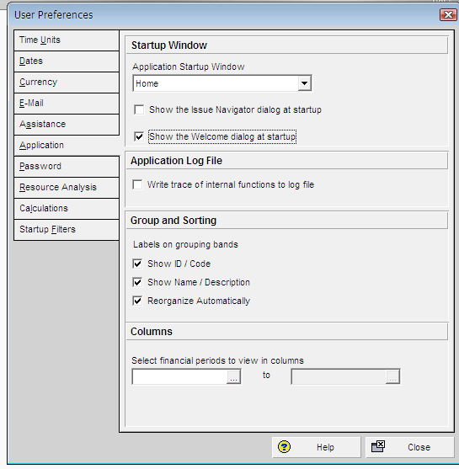
Show Welcome Dialog Box
Lecture Progress
Check this box

Slide 20
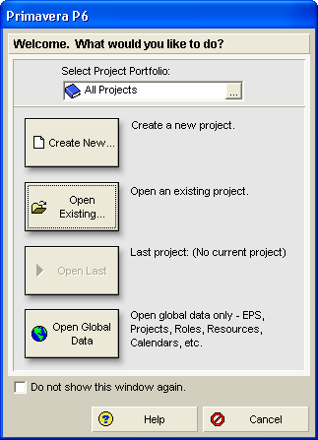
Welcome Dialog Box
Click here for first time

Slide 21
Thank You

