Slide 1
Project Management Software Application
PRM 705
Lecture 21

Slide 2
Recap
Views
Inserting sub projects
Recurring tasks
Splitting Task
Adding Notes
Tracking

Slide 3
Today’s Outline
Baseline
Set and save baseline
Update progress
Showing status line
Tracking Gantt Chart
Reporting

Slide 4
Tracking
After you complete your plan, send final copy to your client for approval
After getting approval, save 3 or 4 copies at different locations (as backup)

Slide 5
Baseline
As your project progresses, some tasks might take longer or shorter than planned Resources might cost more or less than you estimated.
To know whether all the actual mean you’re ahead of schedule or behind, within your budget or exceeding it, you need to be able to compare your actual schedule to some reference point.
That reference point is the baseline.

Slide 6
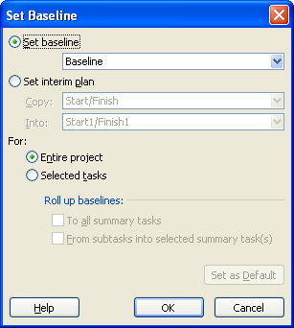
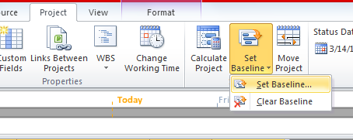
Set & Save a baseline

Slide 7
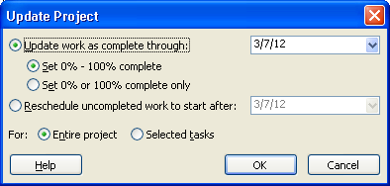
Update the Progress
Project > Update Project

Slide 8
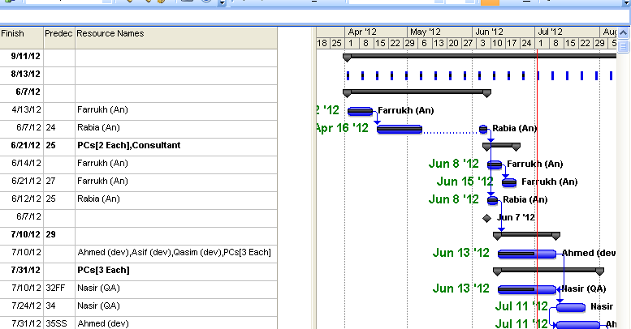
Show status line
Show status gridline
  Format > gridline > status date

Slide 9
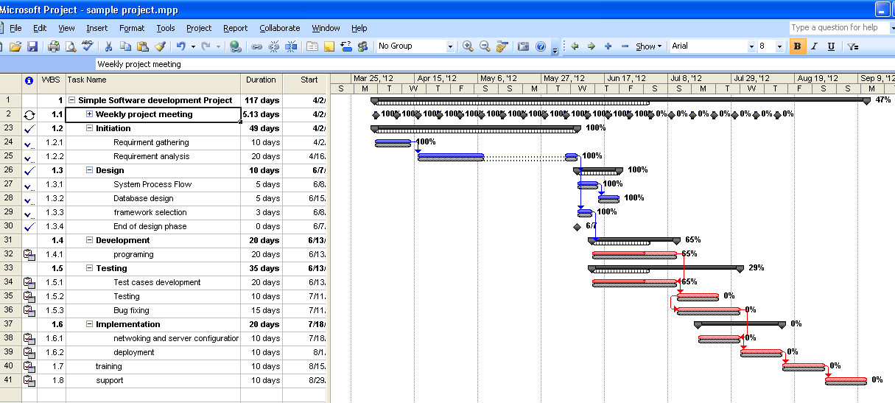
Changing view to tracking gantt chart
View > Gantt Chart > tracking Gantt Chart
View > zoom > entire project

Slide 10
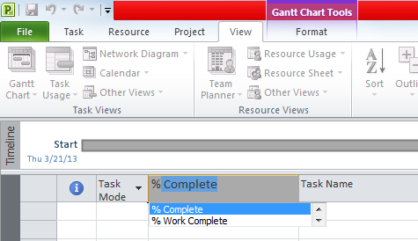
Insert a column for %age complete
Now you go to site and ask site in charge for actual progress

Slide 11
Add columns actual start & actual finish
Use actual start and actual finish as per original progress
Use actual start and % complete as per original progress

Slide 12
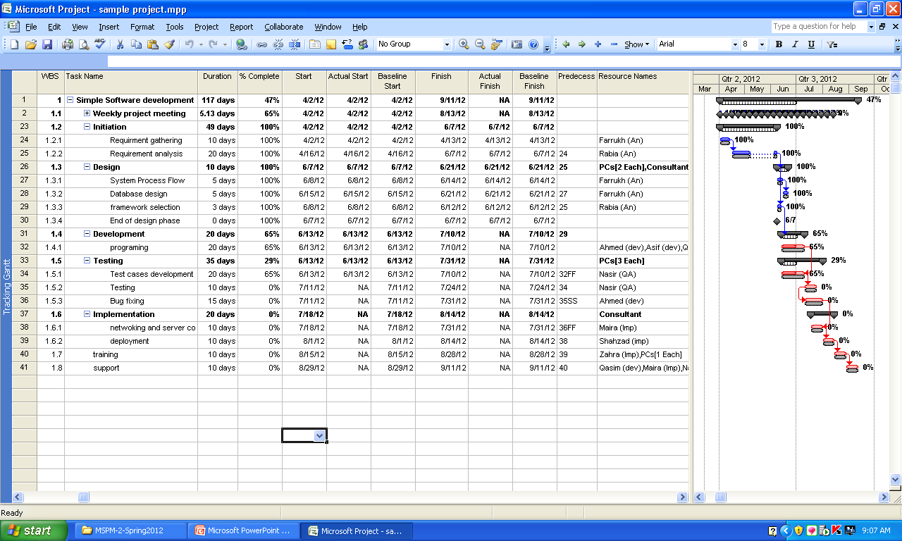
Baseline start & Baseline finish

Slide 13
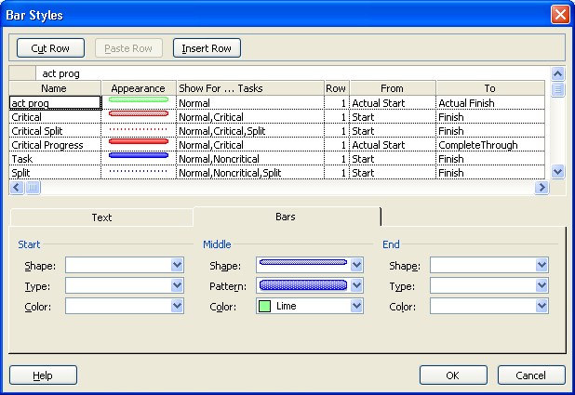
Insert a new bar in gantt chart
Format > Format > bar styles > Insert row

Slide 14
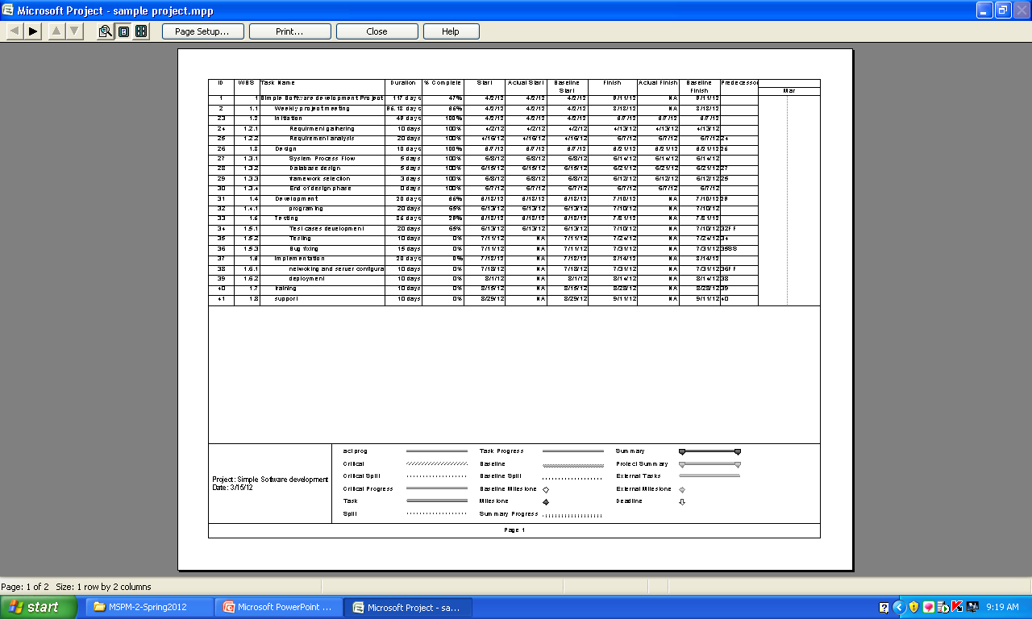
How to modify legend in print preview

Slide 15
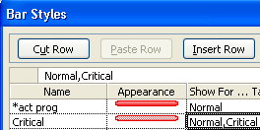
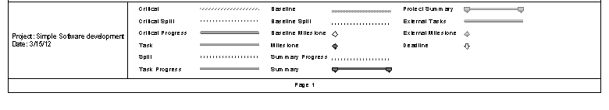
How to modify legend in print preview
If you want to remove any of these from legend just place * in start of name of that bar in
  Format > Format > bar style

Slide 16
Another baseline
You can create more then one baselines, infact 11 different baselines in MSP

Slide 17
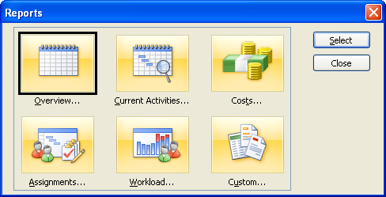
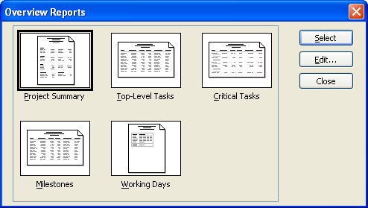
Reports

Slide 18
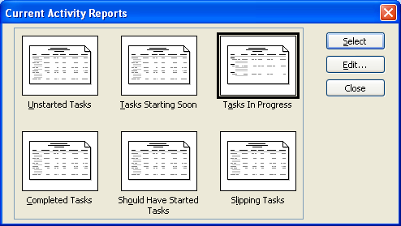
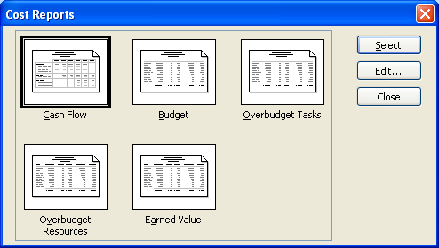
Reports

Slide 19
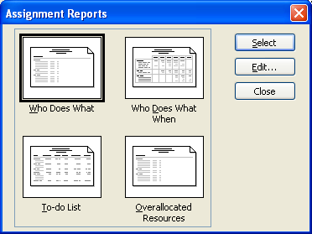
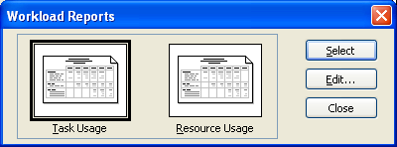
Report

Slide 20
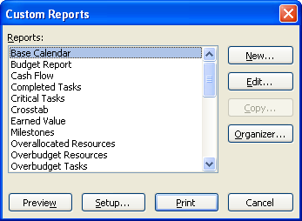
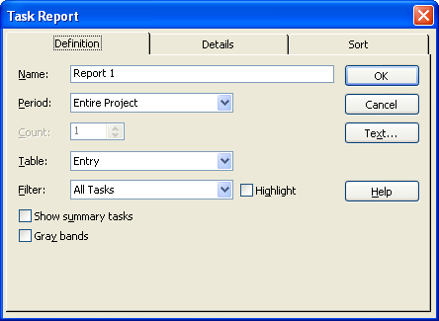
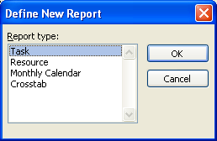
Customized Reports

Slide 21
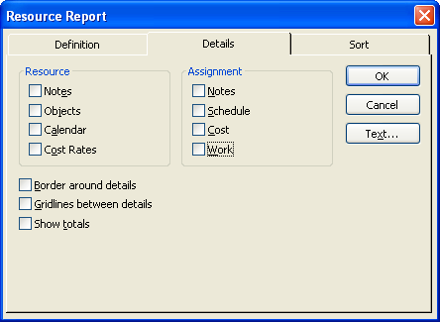
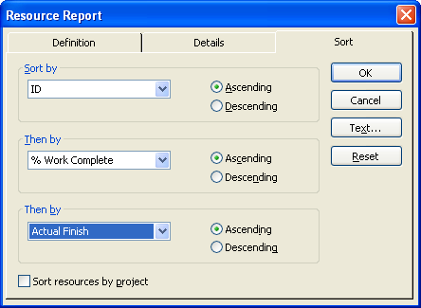
Customized Reports

Slide 22
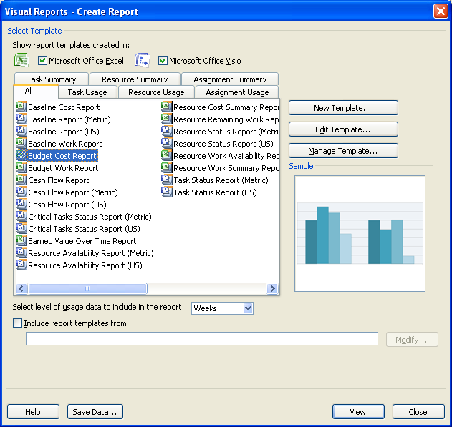
Visual Reports

Slide 23
