Slide 1
Project Management Software Application
PRM 705
Lecture 20

Slide 2
Recap
Fixed Cost
Creating S-Curve
Tables
Grouping
Sorting
Filtering
Work contours

Slide 3
Today’s Outline
Views
Inserting sub projects
Recurring tasks
Splitting Task
Adding Notes
Tracking
Baseline

Slide 4
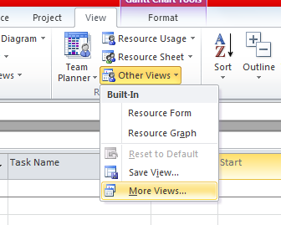
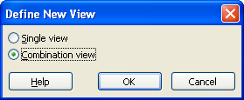
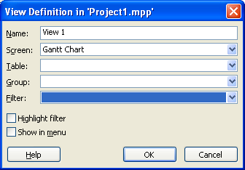
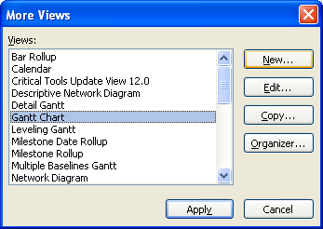
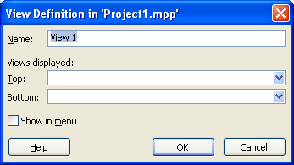
Create Your Own Customized Views

Slide 5
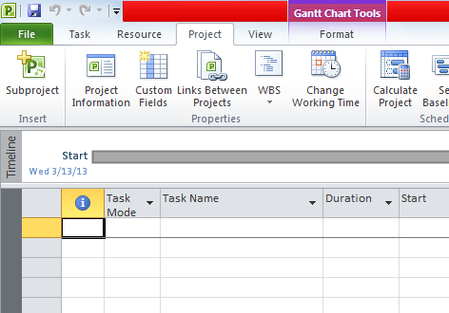
Inserting Sub Projects
Create a copy of your project file
Create a new project named “Main Project”
Insert both projects under main project
Any changes you make in original copy, will be reflected over here

Slide 6
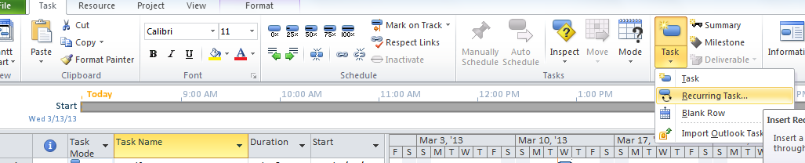
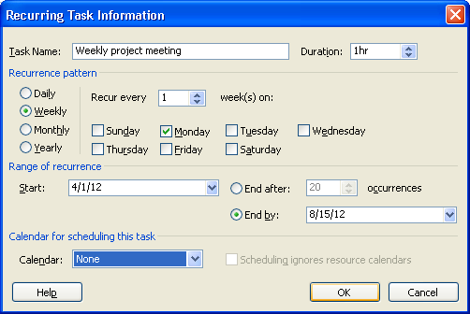
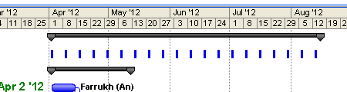
Recurring Task

Slide 7
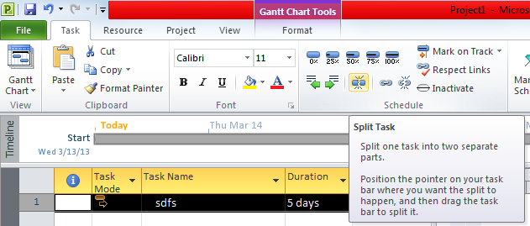
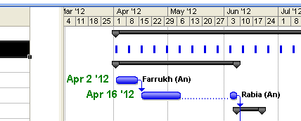
Splitting a task
.

Slide 8
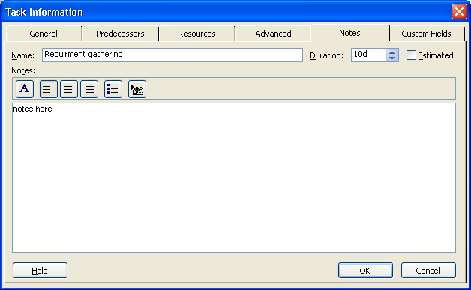
Adding Notes

Slide 9
TRACKING

Slide 10
Thank You

