Slide 1
Project Management Software Application
PRM 705
Lecture 19

Slide 2
Recap
Assignment units
Accrual at fix cost
Effort driven scheduling
Resource allocation

Slide 3
Today’s Outline
Changing resources
Fixed Cost
Creating S-Curve
Tables
Grouping
Sorting
Filtering
Work contours

Slide 4
To Resolve Over Allocation
Replace the resource
Change the relationship
Change the percentage of allocation
Perform automatic leveling (Not recommended)
Resource > Level Resource

Slide 5
Fixed Cost
Sometimes a fixed cost is associated with a task, such as the cost of equipment used to accomplish the task, or a job bid on a flat rate. Such costs are fixed because they remain constant even if a task takes more or less time than planned.

Slide 6
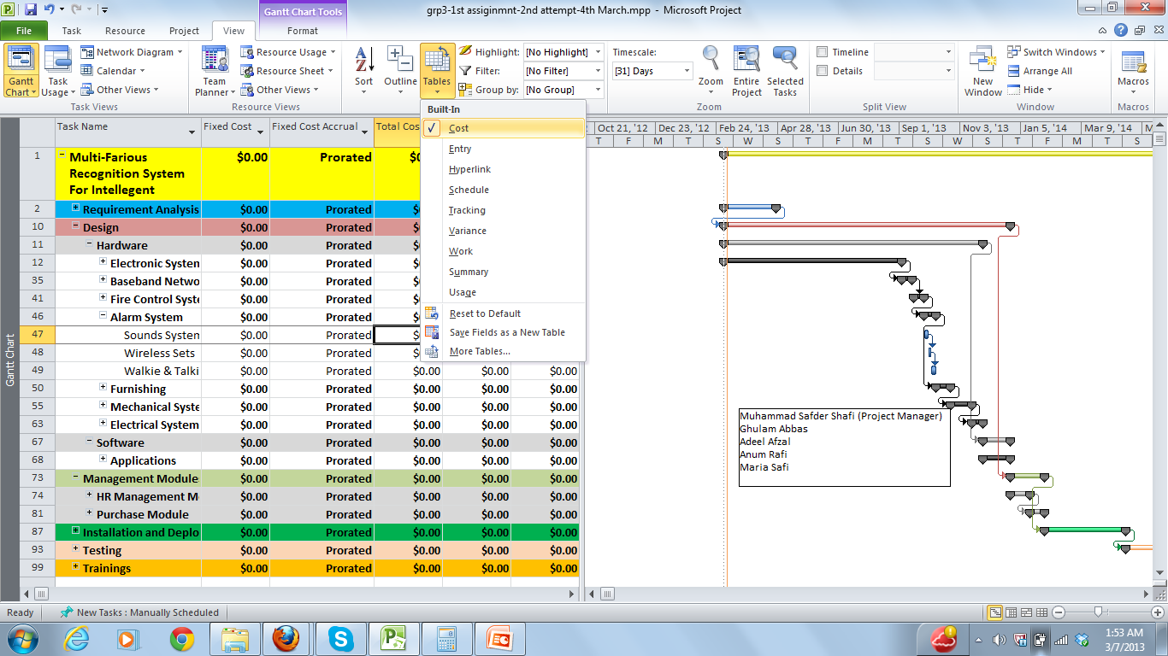
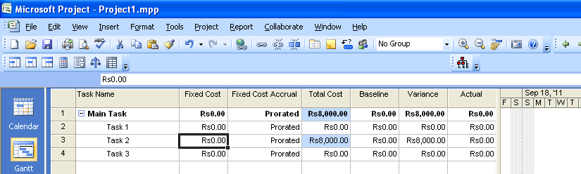
Setting Fixed Cost for a Task

Slide 7
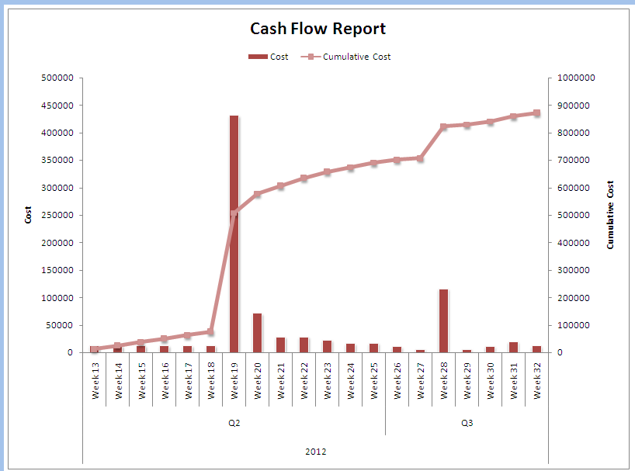
Creating “S Curve”
Project > Visual Report > Cash Flow

Slide 8
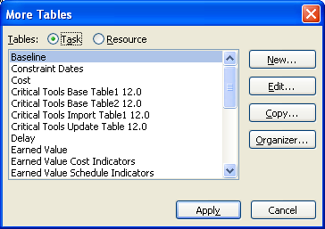
Tables

Slide 9
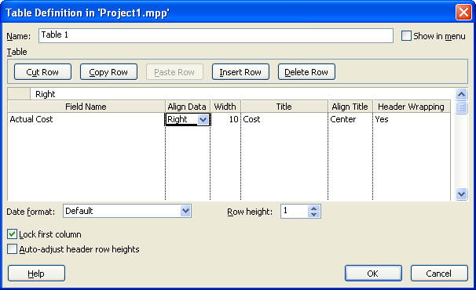
Creating Your Own Customized Tables

Slide 10
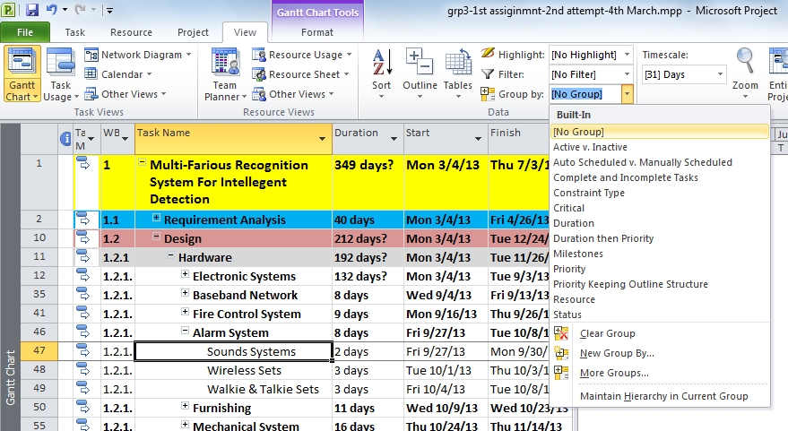
Grouping

Slide 11
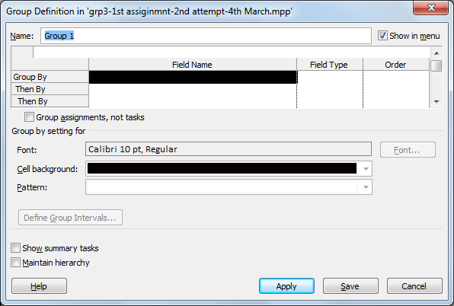
Grouping

Slide 12
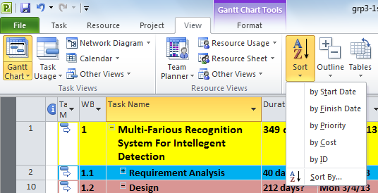
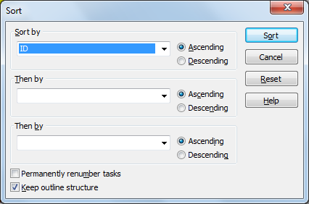
Sorting

Slide 13
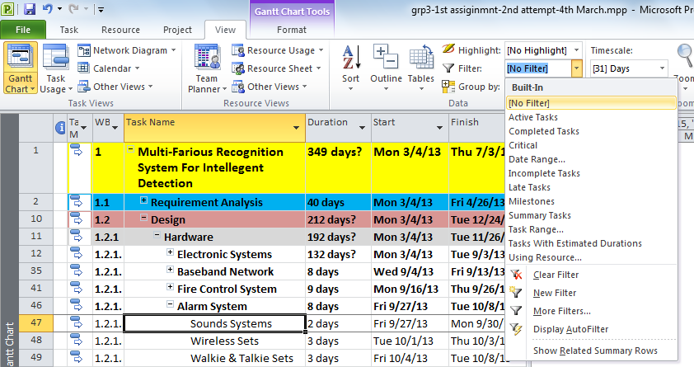
Filters

Slide 14
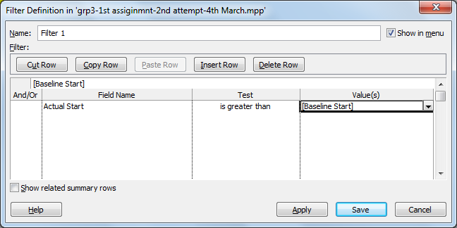
Filters

Slide 15
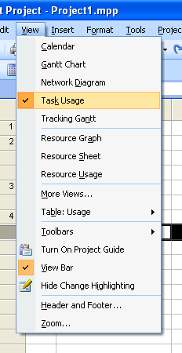
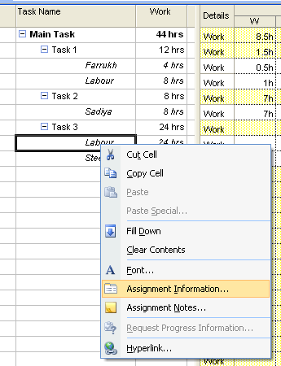
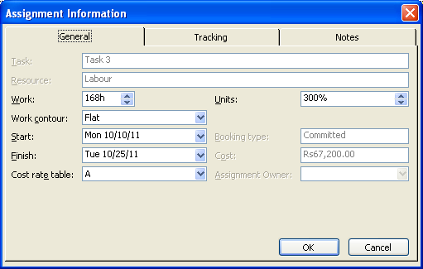
Res. Assignment Information

Slide 16
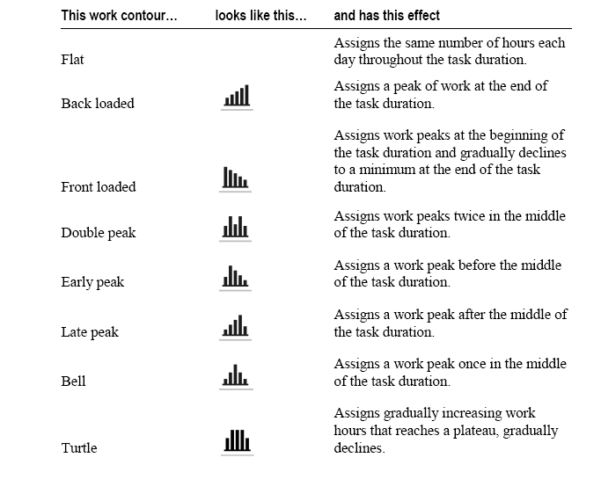
Work Contour

Slide 17
Thank You

