Slide 1
Project Management Software Application
PRM 705
Lecture 18

Slide 2
Recap
Resource Sheet
Task types
Assignment units

Slide 3
Today’s Outline
Assignment units
Accrual at fix cost
Effort driven scheduling
Resource allocation
Changing resources

Slide 4
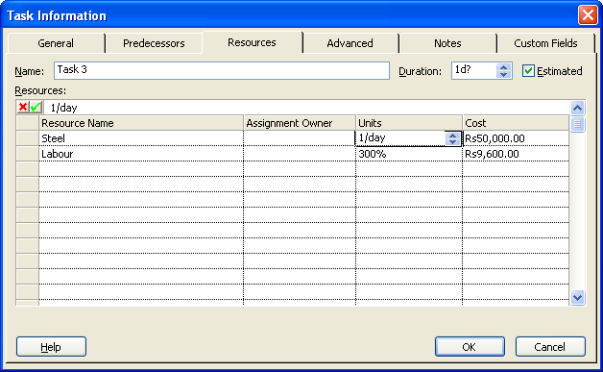
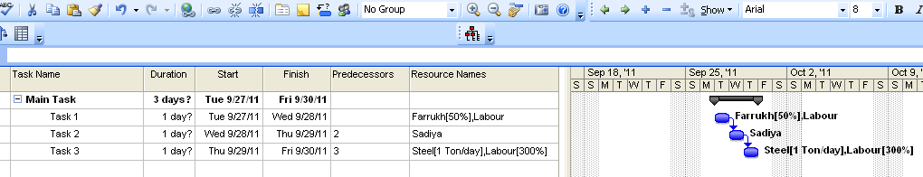
Assignment Unit For Material Resource

Slide 5
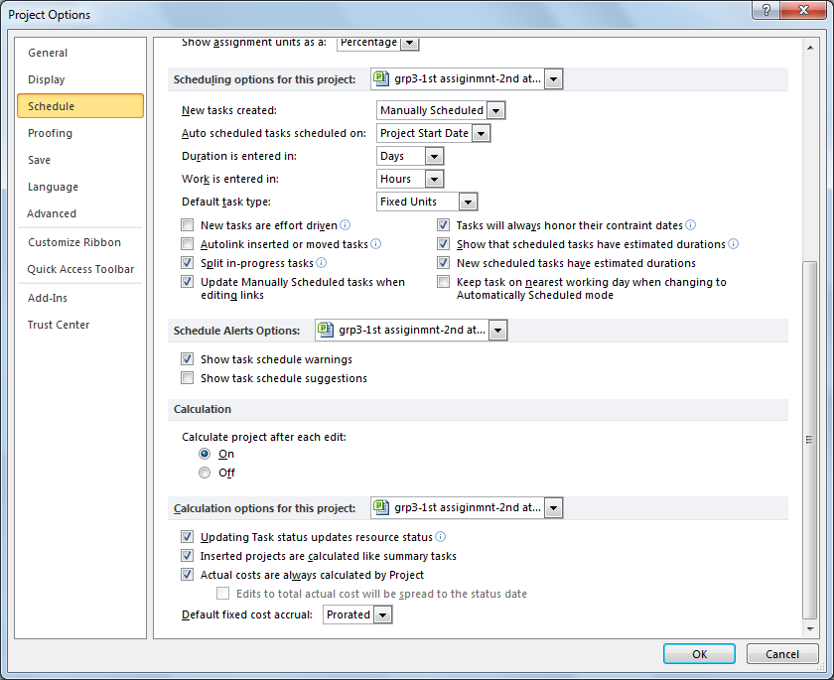
Control How Fixed Costs Are Accrued

Slide 6
Effort Driven Scheduling
Before you assign a resource to a task, the task has the duration you specify but no work associated with it. Only after you assign a resource to the task does Microsoft Project calculate the amount of work required to accomplish it.
By default, the initial calculation of total work required to perform a task stays the same, regardless of the number of additional resources (units) you assign to it. Adding or removing resources can decrease or increase the task duration, but the work remains constant. Duration is calculated according to the following formula:
Duration = Work / Units
This is called Effort Driven Scheduling

Slide 7
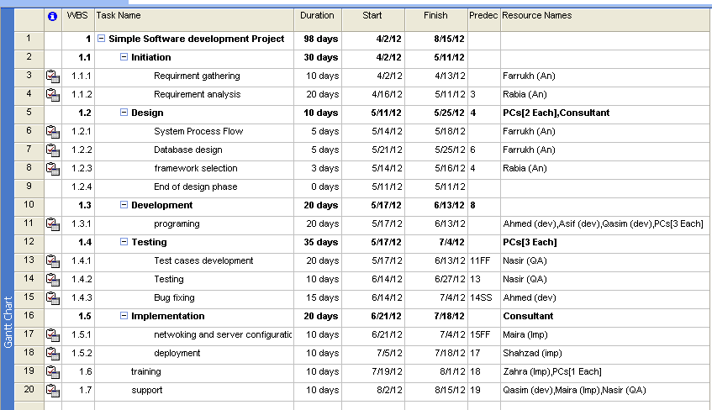
Now Assign Resources

Slide 8
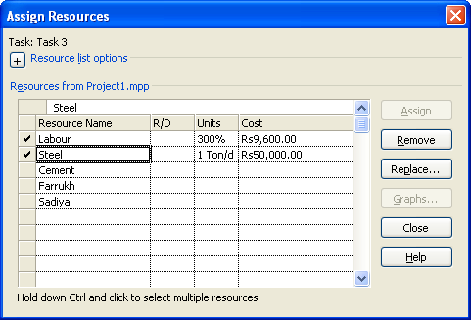
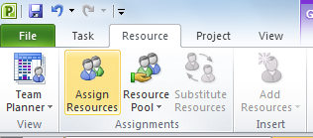
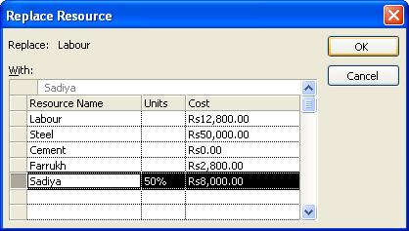
Replace Resources

Slide 9
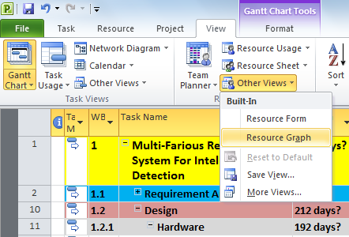
Checking Over Allocation
View > Zoom > Entire Project
OR
View > Resource Sheet

Slide 10
Thank You

