Slide 1
Project Management Software Application
PRM 705
Lecture 17

Slide 2
Recap
Resources
Setting default currency
Cost Types
Resource units
Cost accrual
Resource Sheet

Slide 3
Today’s Outline
Task types
Assignment units
Accrual at fix cost
Effort driven scheduling
Resource allocation
Changing resources

Slide 4
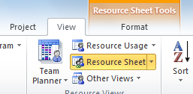
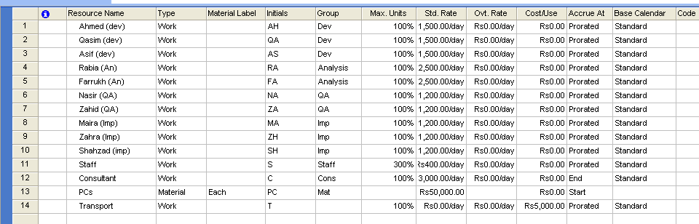
Resource Dictionary
Enter resources, their type, group and units in this sheet

Slide 5
Task Types
The task type indicates whether the duration, work, or units should be kept constant in scheduling the task
Duration = Work / Units
With effort-driven scheduling turned on, work remains constant regardless of the task type you select for a task.

Slide 6
Task Types Duration = Work / Units
Otherwise, the three task types have the following effect when you assign additional resources:
If the task type is fixed units, the default task type, you’ll shorten the duration of the task. The assignment units for each resource remain constant.
If the task type is fixed duration, you’ll decrease the individual unit values for resources. The task duration remains constant.
If the task type is fixed work, you’ll shorten the duration of the task. The total work and the assignment units for each resource remain constant.

Slide 7
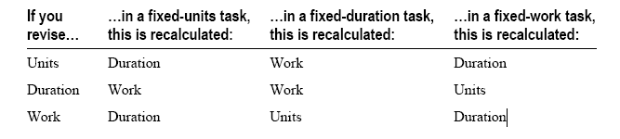
Task Types

