Slide 1
Project Management Software Application
PRM 705
Lecture 16

Slide 2
Recap
Creating WBS
WBS Numbering
Creating Milestone
Constraints and its types
Deadline

Slide 3
Today’s Outline
Resources
Setting default currency
Cost Types
Resource units
Cost accrual
Resource Sheet

Slide 4
What are Resources?
Resources are the people, equipment, and materials required to accomplish project tasks and goals.
There are two types of resources: work resources and material resources.
Work resources are the people and equipment that accomplish the work of a task.
Material resources are the consumable supplies that are used up in the performance on a task. Examples include concrete, steel, and soil.

Slide 5
Working With Resources
Create a resource list
Set the calendars specifying the working days and times
Assign those resources to tasks.

Slide 6
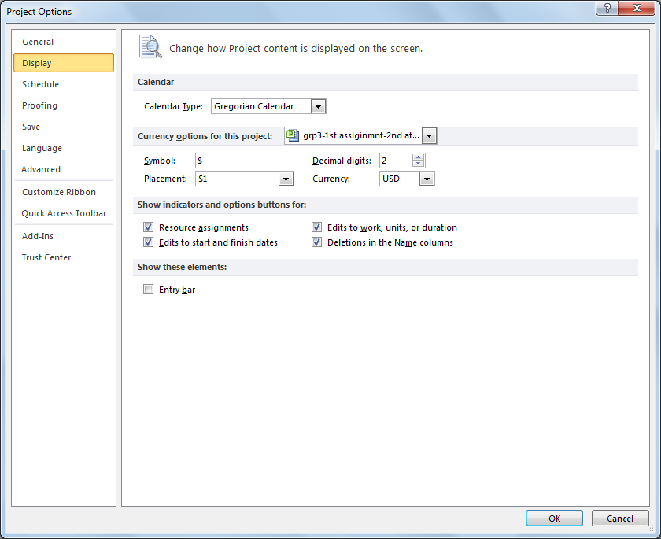
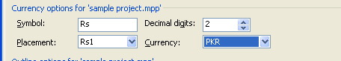
Changing Currency
File > Options

Slide 7
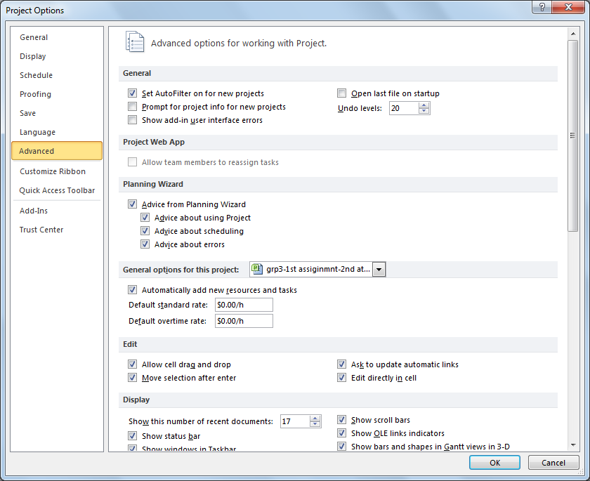
Define Costing Unit

Slide 8
Setting Cost
Variable costs: A variable cost depends on the time spent on assigned tasks. For example, suppose a resource is paid hourly (or weekly or monthly). The longer the resource spends on a task, the greater the resource cost will be for that task.
Fixed costs. A fixed cost remains constant regardless of the amount of time required to accomplish a task or the number of hours a resource spends on the task. For example, contractors often bid a fixed price for a job.
Per-use costs. A per-use cost is a flat usage charge you incur each time, and only each time, you use a resource. For example, the fee for renting a tractor might be $100 per use.

Slide 9
Resource Assignment Units
When you assign a work resource or material resource to a task, you need to indicate how much of that resource is to be devoted to this assignment. The mechanism for doing this is the assignment unit. Normally done in percentage

Slide 10
Control How Resource Cost Are Accrued
You can choose the point at which resource costs are incurred by setting the cost accrual for resources. Your accrual choices are:
  The entire cost at the start of an assignment.
  The entire cost at the end of an assignment.
  The prorated cost across the duration of the assignment as it progress

Slide 11
Thank You

