Slide 1
Project Management Software Application
PRM 705
Lecture 15

Slide 2
Recap
Handshake with other MS Excel
Inserting customized column
Indicator column

Slide 3
Today’s Outline
Creating WBS
Creating Milestone
Constraints and its types
Deadline
Resources

Slide 4
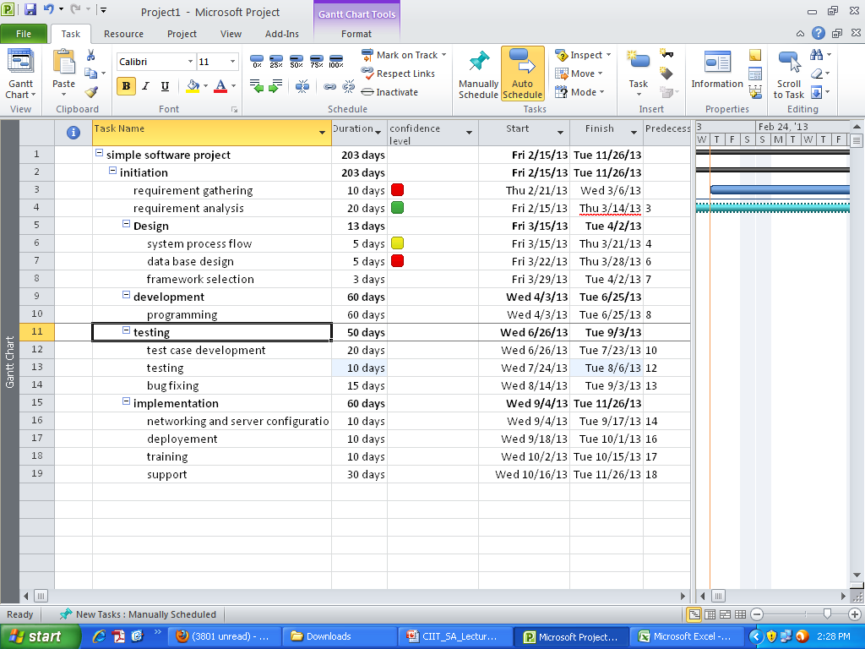
Creating WBS

Slide 5
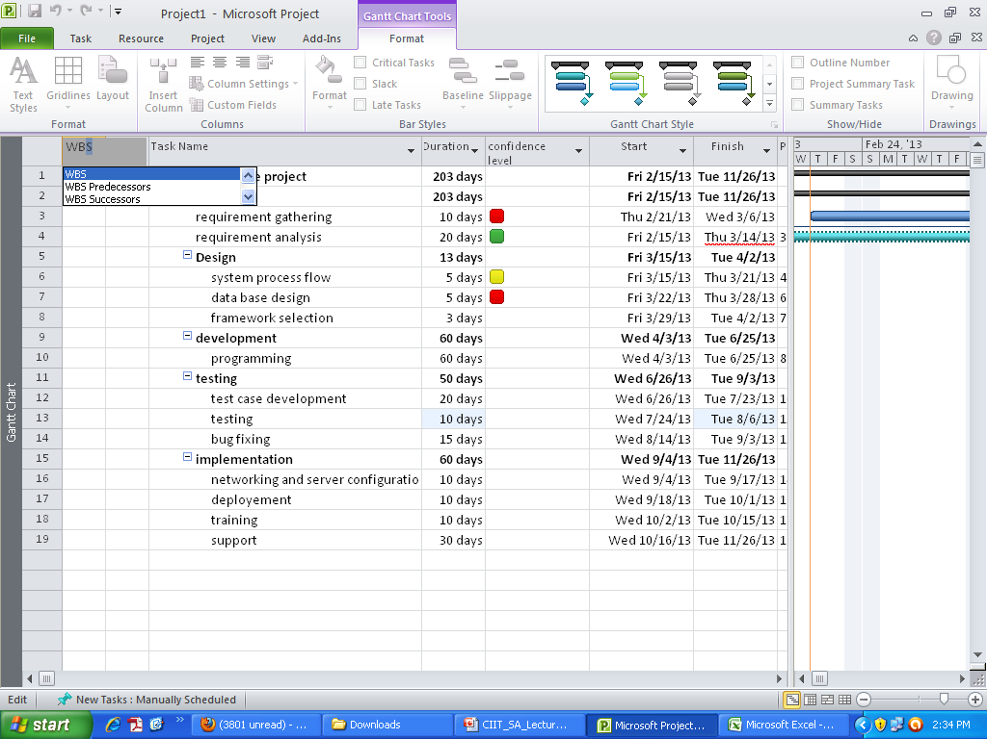
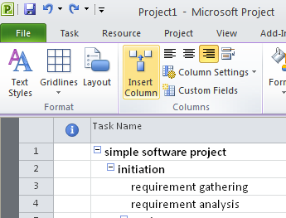
Insert WBS Code

Slide 6
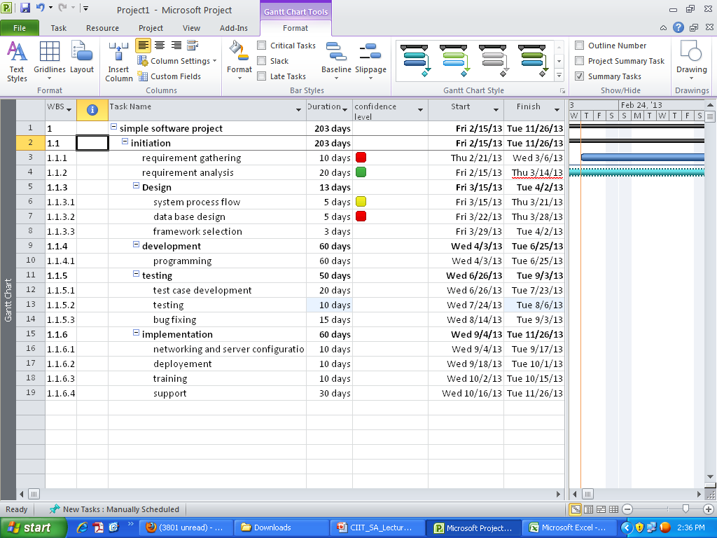
Insert WBS Code

Slide 7
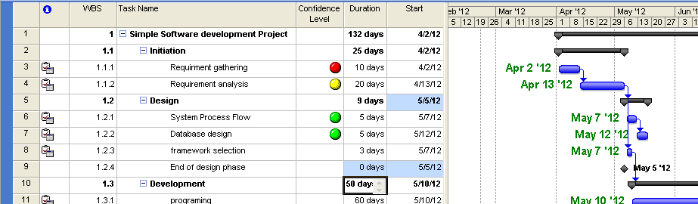
1. Creating a Milestone
Enter 0 days duration for a task, if you want to make it Milestone.

Slide 8
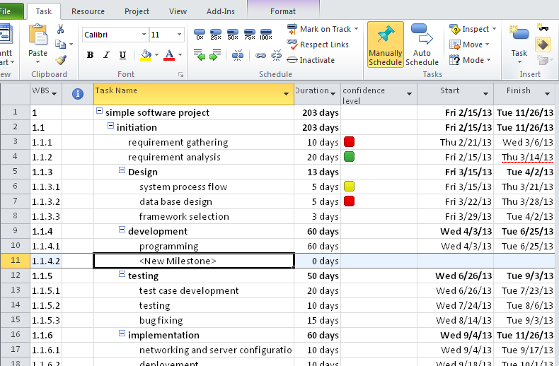
2. Creating a Milestone

Slide 9
Constraints
Flexible constraints.
Moderate constraints.
Inflexible constraints.
A flexible constraint allows a task’s dates to change as the schedule changes. The default constraint, As Soon As Possible, is an example of a flexible constraint.
an inflexible constraint ties a task to a specific date. The Must Start On and Must Finish On constraints are the two inflexible constraints.
Between the flexible and inflexible constraints are moderate constraints. These constraints, such as Start No Earlier Than or Finish No Later Than

Slide 10
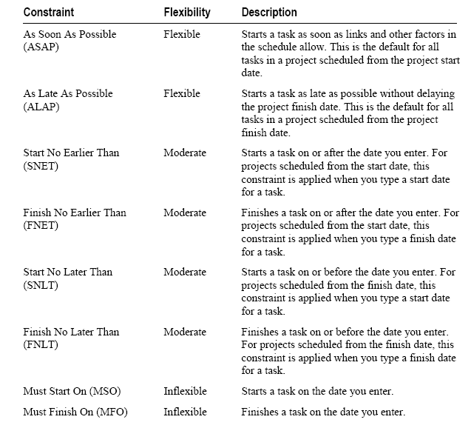

Slide 11
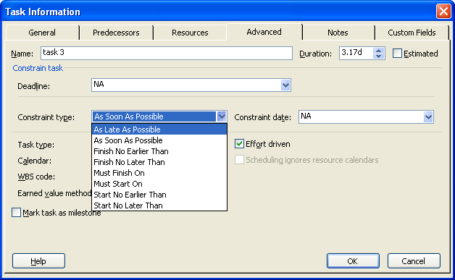
Setting Constraints

Slide 12
Deadlines
Suppose you want to keep a task deadline in mind but you don’t want to lock your schedule by setting an inflexible constraint. Instead, you can set a deadline.
Microsoft Project continues to update the schedule as needed, keeps track of deadline dates, shows them on the Gantt Chart, and displays a deadline indicator if a task finishes after its deadline.

Slide 13
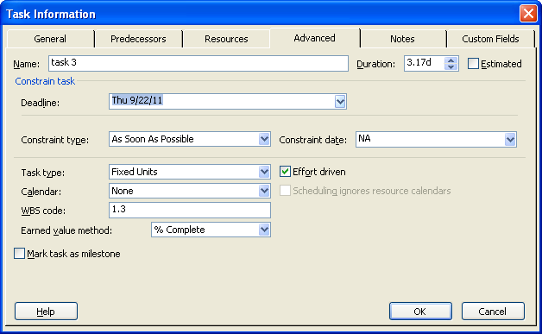
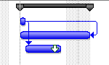
Setting Deadlines

Slide 14
Thank You

