Slide 1
Project Management Software Application
PRM 705
Lecture 14

Slide 2
Recap
Changing timescale
Gridlines
Formatting summery bar
Critical Path on bars
Printing

Slide 3
Today’s Outline
Handshake with other MS Excel
Inserting customized column
Indicator column
Creating WBS
WBS Codes

Slide 4
One of advantages of MS Project over Primavera
We know that MS Excel is excellent calculation tool
We can use MS Project data in MS Excel.
We can also link both

Slide 5
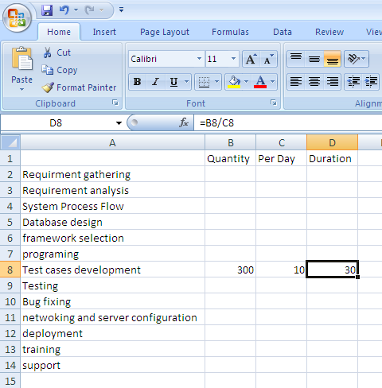
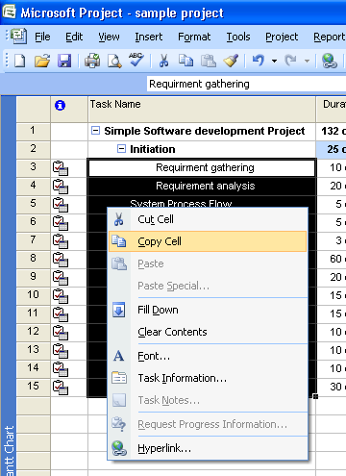
Using MS Excel with MS Project

Slide 6
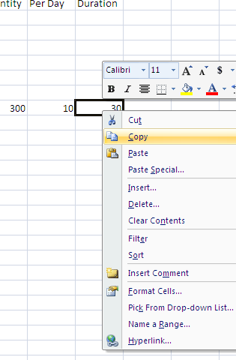
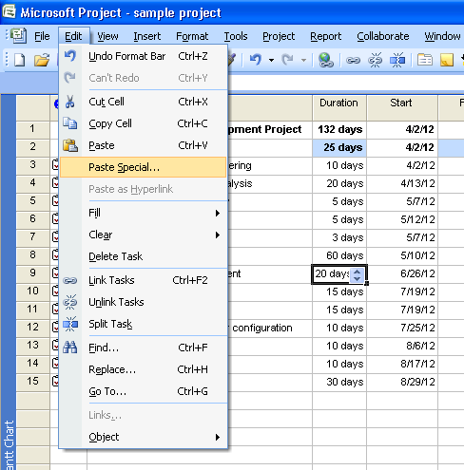
Using MS Excel with MS Project

Slide 7
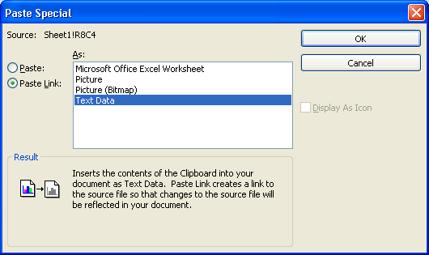
Using MS Excel with MS Project

Slide 8
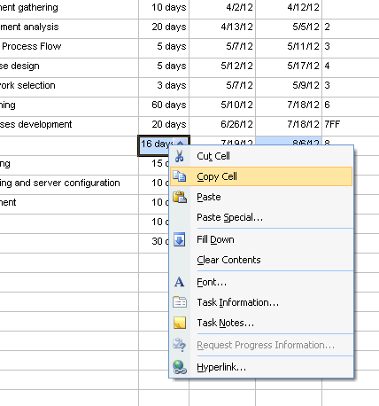
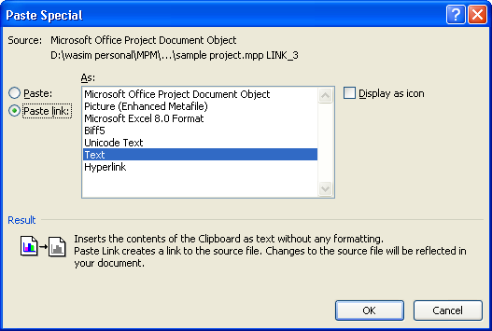
Using it other way
Both files must be in same folder

Slide 9
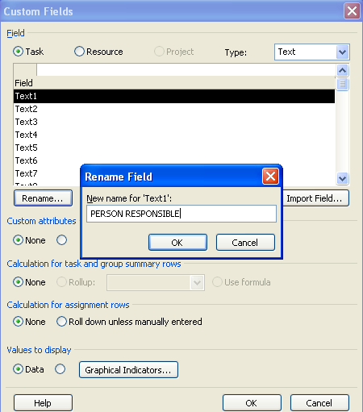
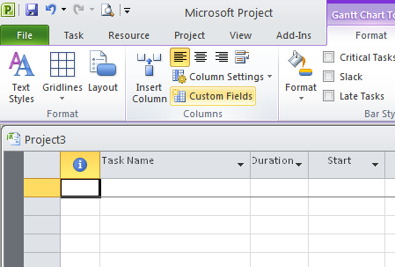
Inserting customized column

Slide 10

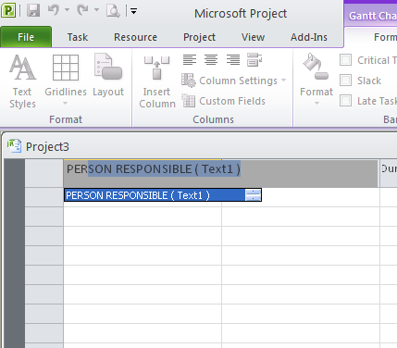
2.Inserting customized column

Slide 11
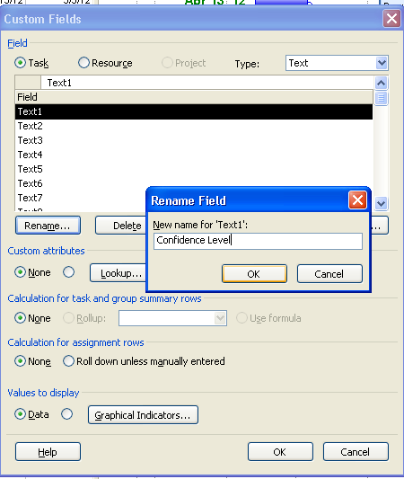
Adding Indicator column

Slide 12
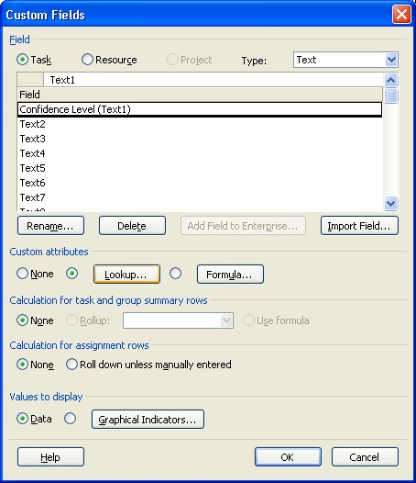
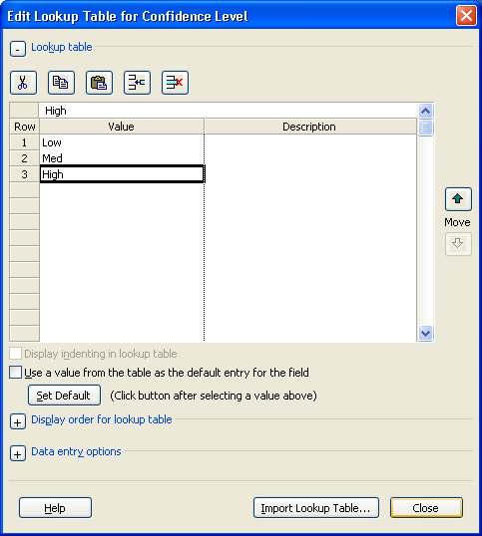
Adding Indicator column

Slide 13
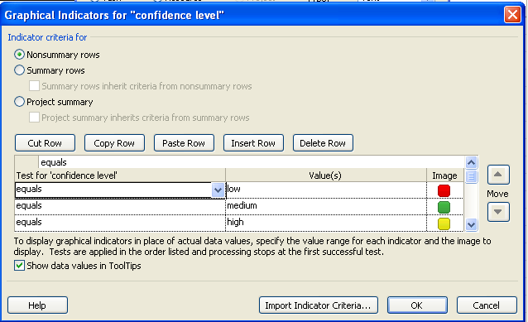
Adding Indicator column
Click “Graphical Indicators”

Slide 14
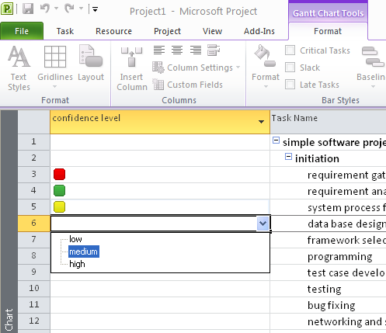
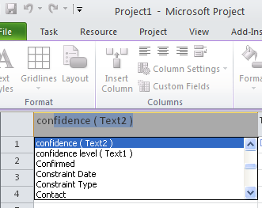
Adding Indicator column
Insert new column

Slide 15
Thank You

