Slide 1
Project Management Software Application
PRM 705
Lecture 13

Slide 2
Recap
Changing Date format
Changing bar format
Putting data near bar
Identifying critical activities

Slide 3
Today’s Outline
Changing timescale
Gridlines
Formatting summery bar
Critical Path on bars
Printing
Handshake with other MS Excel

Slide 4
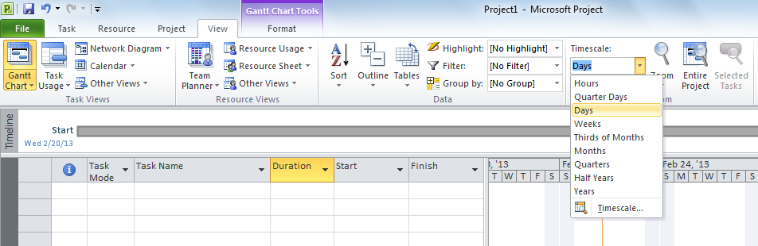
How to change time scale

Slide 5
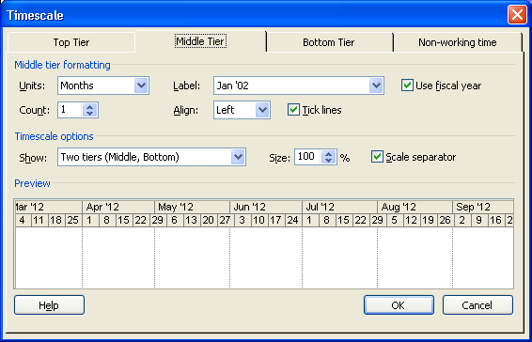
How to change time scale

Slide 6
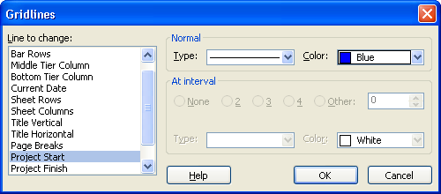
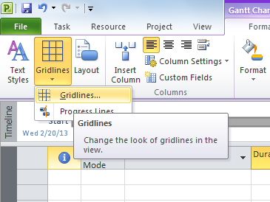
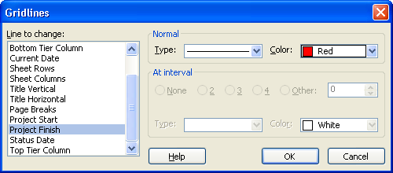
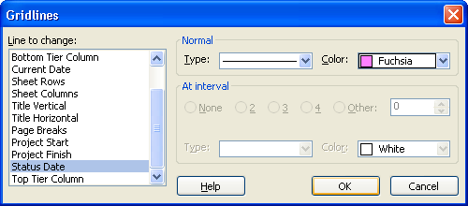
Gridlines

Slide 7
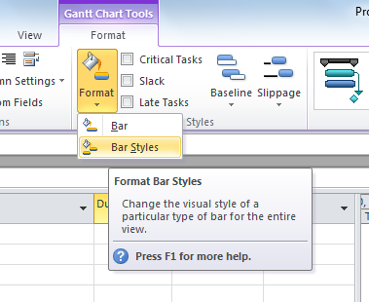
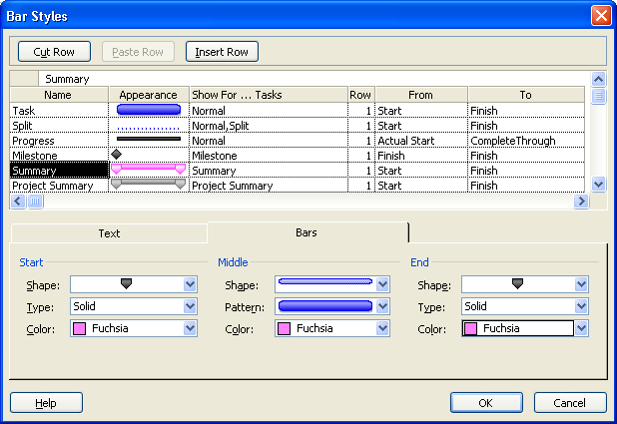
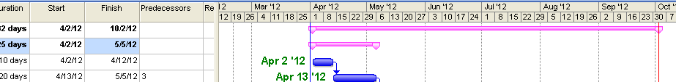
Formatting of Summery Bar

Slide 8
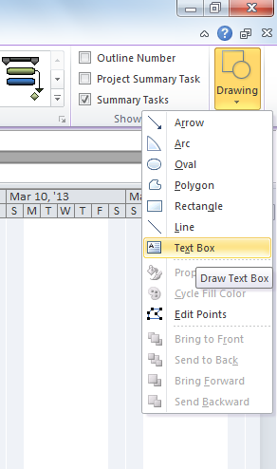
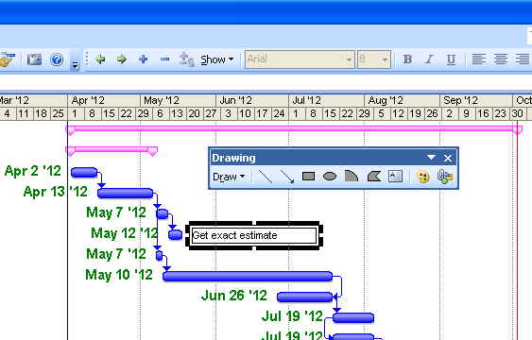
Entering Text on Timeline

Slide 9
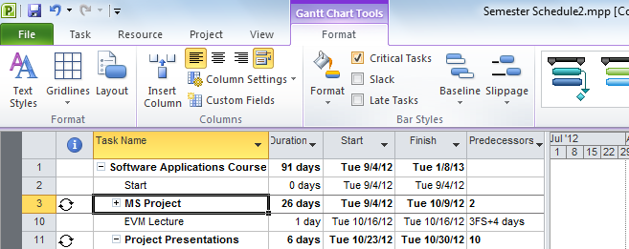
Critical path on bars

Slide 10
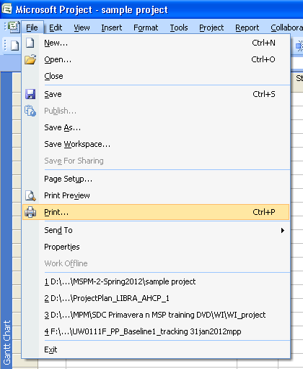
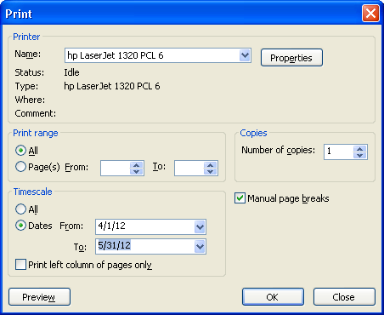
Printing: To zoom Gantt chart for specific duration

Slide 11
Thank You

