Slide 1
Project Management Software Application
PRM 705
Lecture 12

Slide 2
Recap
Task linking
Changing links
Adding Lag and Lead

Slide 3
Today’s Outline
Changing Date format
Changing bar format
Putting data near bar
Identifying critical activities
Changing timescale

Slide 4
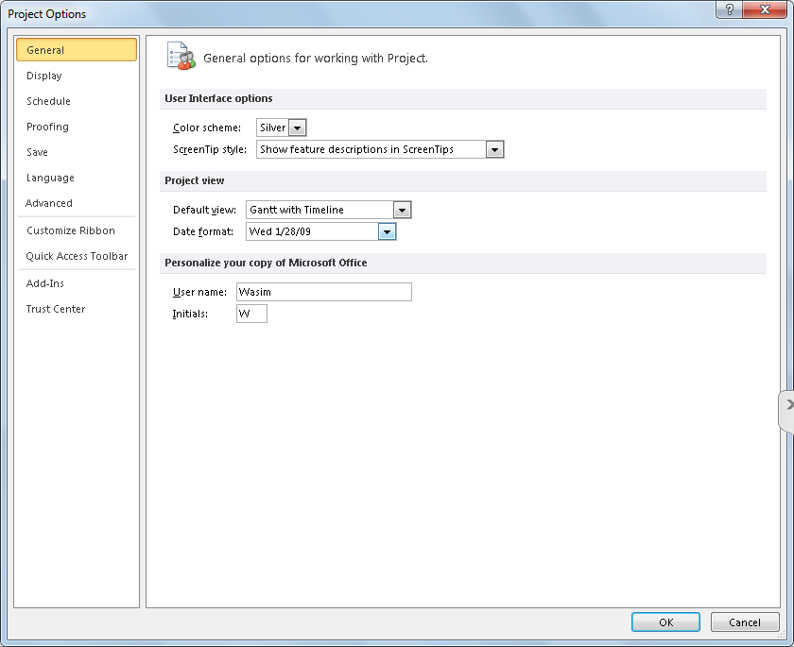
Change date format to small
Precious space - so save it
File > Options > date format

Slide 5
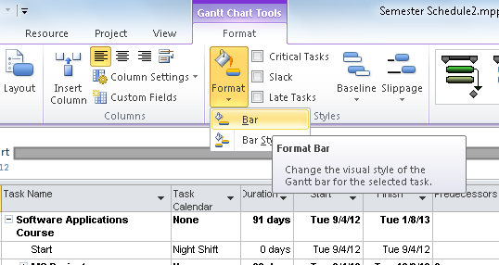
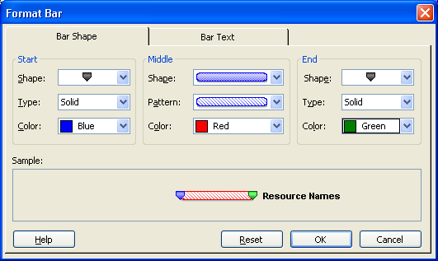
Changing Bar Format in Gantt

Slide 6
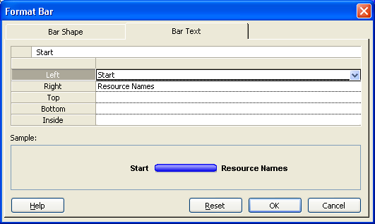
To place date or any other information near bar
Select Activity > Format > Bar Format> Bar > Bar text

Slide 7
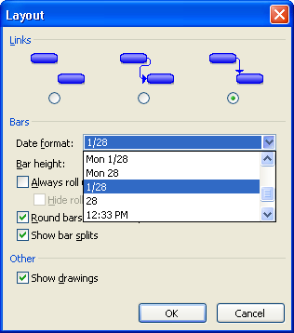
To Change Date Format on Bar
Format > Layout > Date format

Slide 8
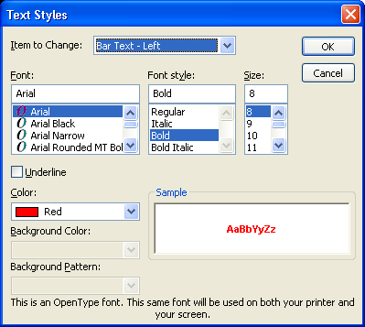
To Change The Color Of Start & Finish Date on Bar
Format > Text Styles
You can do all type of text formatting from here

Slide 9
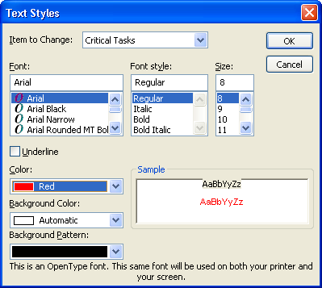
Identify Critical Activities (1)
Format > Text Styles

Slide 10
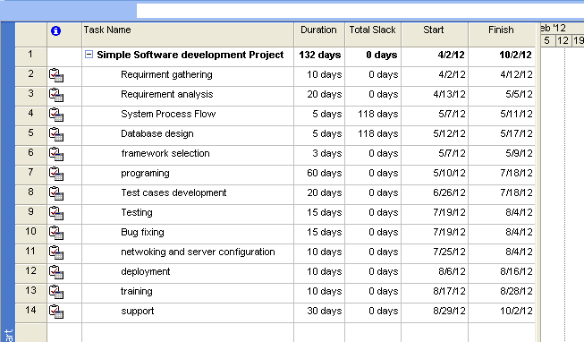
Identify Critical Activities (2)
Using slack
  Insert a column > Total slack
  * Total Slack = 0 means critical activity

Slide 11
How to remove relationship lines
Format > Layout

Slide 12
Thank You

