Slide 1
Project Management Software Application
PRM 705
Lecture 11

Slide 2
Recap
Adding new column
Linking tasks
Assigning calendar to multiple activities
Checking project total time
Entering durations

Slide 3
Today’s Outline
Task linking
Changing links
Adding Lag and Lead

Slide 4
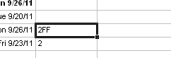
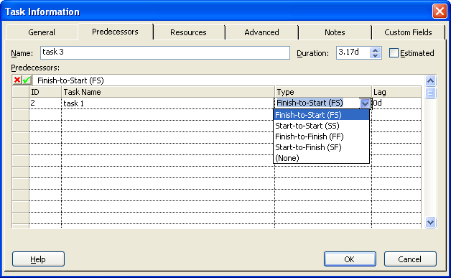
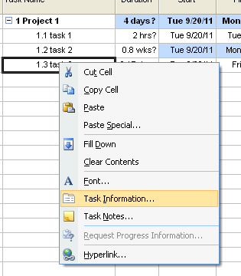
Task Linking
To link tasks in a start-to-start, finish-to-finish, or a start-to-finish dependency
  Click Task Information.
  Click the Predecessors tab.
  In the ID field, type the ID number of the predecessor task.
  In the Type field for the row, select the link type you want.

Slide 5
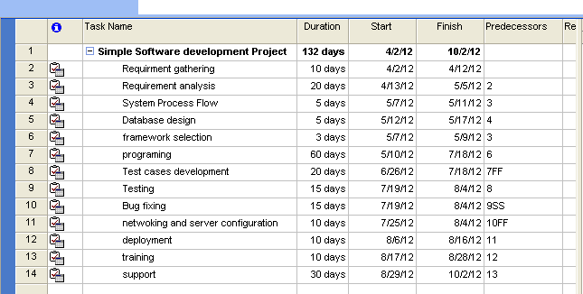
Link Your Tasks Now

Slide 6
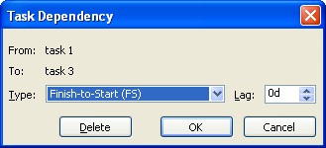
Change or remove task link
To change a task link
  Go to Gantt Chart View.
  Double-click the link line you want to change.
  The Task Dependency dialog box appears.
  In the Type box, click the task link you want.
To remove a task link
  Go to Gantt Chart View.
  Double-click the link line you want to remove.
  In the Task Dependency dialog box, click Delete.
Same thing is applicable on Network Diagram View

Slide 7
Lag and Lead time
Click the Predecessors tab.
In the Lag field for the predecessor, type the lead time or lag time you want, as a duration or as a percentage of the predecessor task duration.
  Type lead time as a negative number or as a negative percentage, and type lag time as a positive number or as a positive percentage.

Slide 8
Thank You

