Slide 1
Project Management Software Application
PRM 705
Lecture 10

Slide 2
Recap
Working times
Calendars

Slide 3
Today’s Outline
Adding new column
Linking tasks
Assigning calendar to multiple activities
Checking project total time
Entering durations

Slide 4
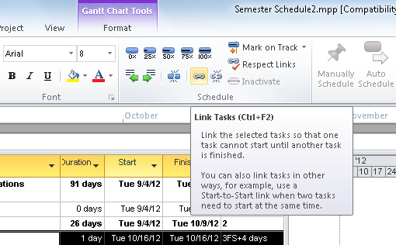
Linking Tasks
Select All tasks and click “Link tasks”

Slide 5
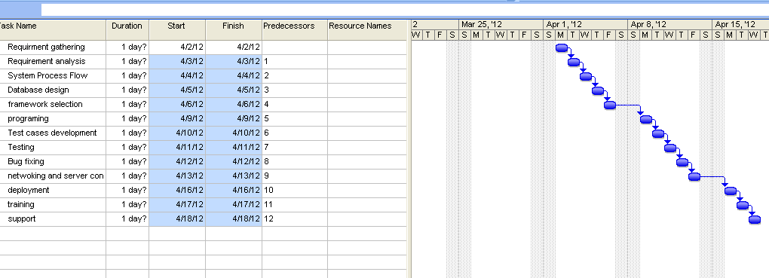
Linking Tasks

Slide 6
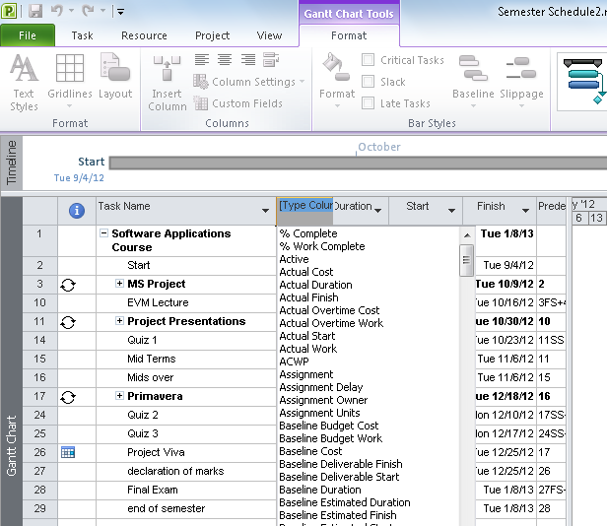
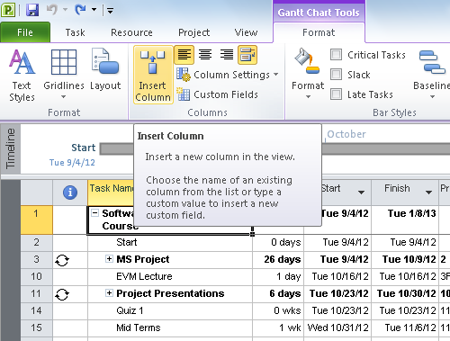
Add new column

Slide 7
Assigning Calendar To all Task
Lecture Progress
Insert column “Task Calendar”
Copy calendar for first task
Select all tasks

Slide 8
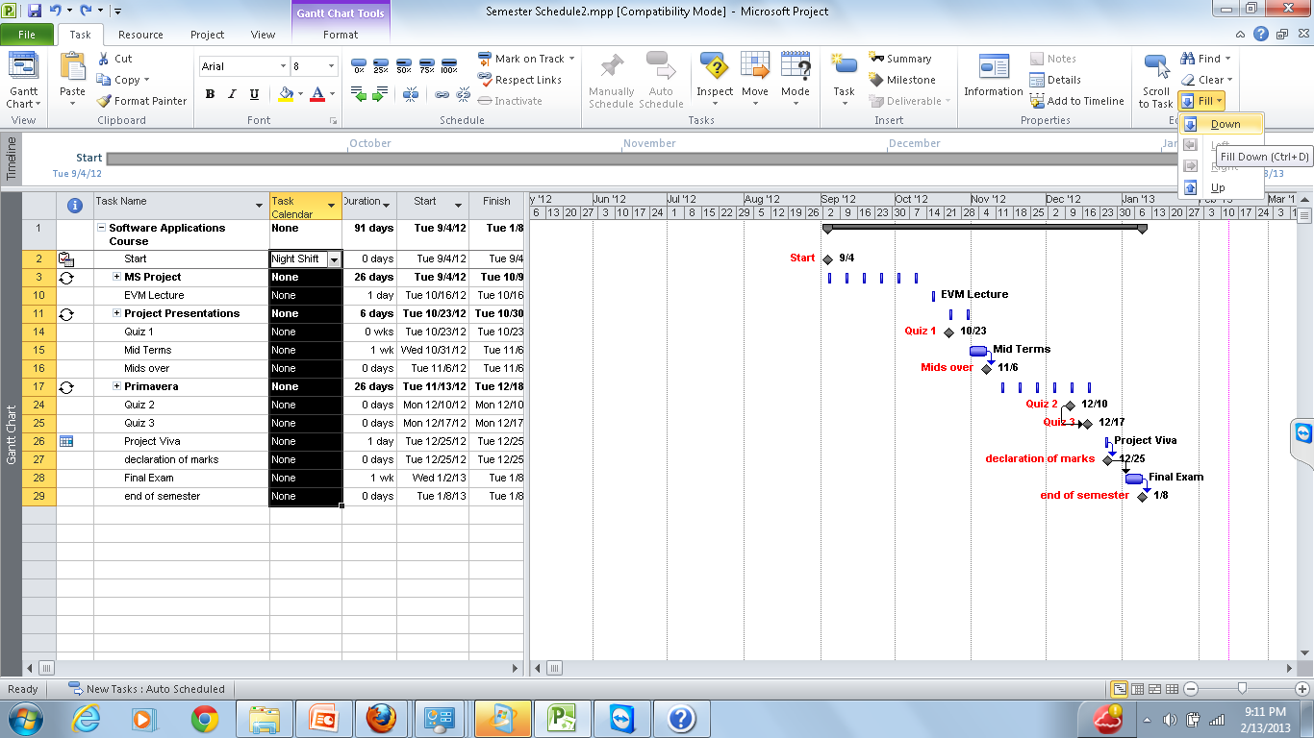
Assigning Calendar To all Task

Slide 9
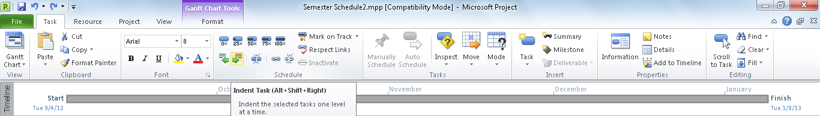
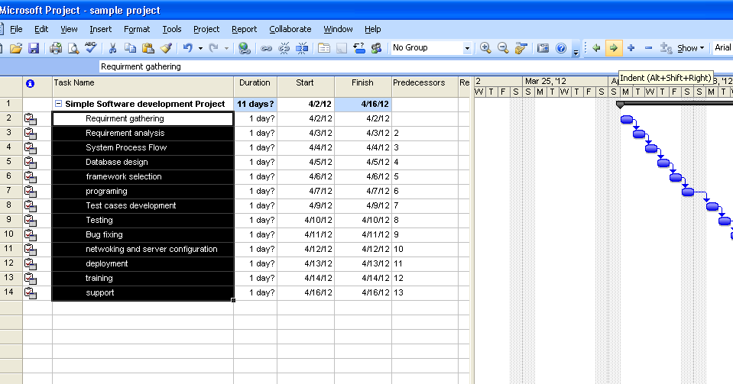
Checking Total Time Of Project
Indent

Slide 10
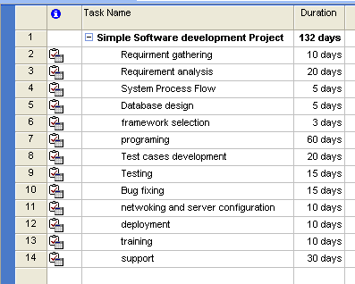
Entering Duration of Tasks

Slide 11
Thank You

